Slide 1
BCSE418L · EXPLAINABLE AI · AGRICULTURE
Explainable Crop Disease Detection
Grad-CAM, SHAP and LIME on two CNNs, and a test of whether the three kinds of explanation can be linked
Notes:
Introduce the team here. One line: we classify crop leaf diseases, explain the predictions three ways, and tested whether the explanations can be linked.

Slide 2
Problem and objectives
The problem
Objectives
A CNN that labels a leaf as diseased gives no reason for its answer. Explanation methods give a reason, but each one answers in a different form: a heat map, a value per pixel, a weight per superpixel. It is not clear how far they agree.
Classify crop leaf diseases with two CNNs: MobileNetV2 and ResNet50
Explain each prediction with Grad-CAM, SHAP and LIME
Check that the explanations hold up: a sanity check and image changes
Link the three kinds of explanation to each other (the instructor's request)
Notes:
The last objective came from the instructor: the explanations from SHAP, LIME and Grad-CAM need to be correlated. We suggested a Siamese / SupCon approach.

Slide 3
Dataset: PlantVillage, Kaggle copy
Pepper, Potato and Tomato leaves, lab photos on plain backgrounds
20,638
images in 15 classes
21 times
largest class (3,208) vs smallest (152)
Split 70 / 15 / 15: 14,447 train, 3,097 validation, 3,094 test
Notes:
We first assumed the 38-class, 54,000-image version. This Kaggle copy has 15 classes and 20,638 images. Docs 02 and RUN_LOG record the correction.

Slide 4
Approach
One CNN prediction, three explanations, one common form
Grad-CAM
smooth heat map
Leaf image
CNN
64 × 64 map
224 × 224
→
MobileNetV2 or ResNet50
frozen backbone
→
SHAP
→
evidence for the predicted class, one per method
value per pixel
LIME
weight per superpixel
Then two ways to compare the maps: Pearson correlation, and a trained Siamese encoder (SupCon loss).
Notes:
All three maps are for the class the CNN predicted, and all three keep only evidence for that class, so they mean the same thing.

Slide 5
The two classifiers
ImageNet weights, backbone frozen, only the last layer trained, 3 epochs
Model | Best validation accuracy | Test accuracy | Test macro-F1
MobileNetV2 | 0.917 | 0.918 | 0.902
ResNet50 | 0.893 | 0.889 | 0.883
These are baselines, not tuned models. ResNet50 was still improving: validation 0.808, 0.869, 0.893
No clear link between class size and recall: Spearman -0.19 (MobileNetV2) and -0.20 (ResNet50), 15 classes
Lowest recall for both: Tomato early blight (0.74 and 0.62)
Notes:
Sources: outputs/eval classification reports and outputs/checkpoints histories. Per-class check computed from the two classification reports.

Slide 6
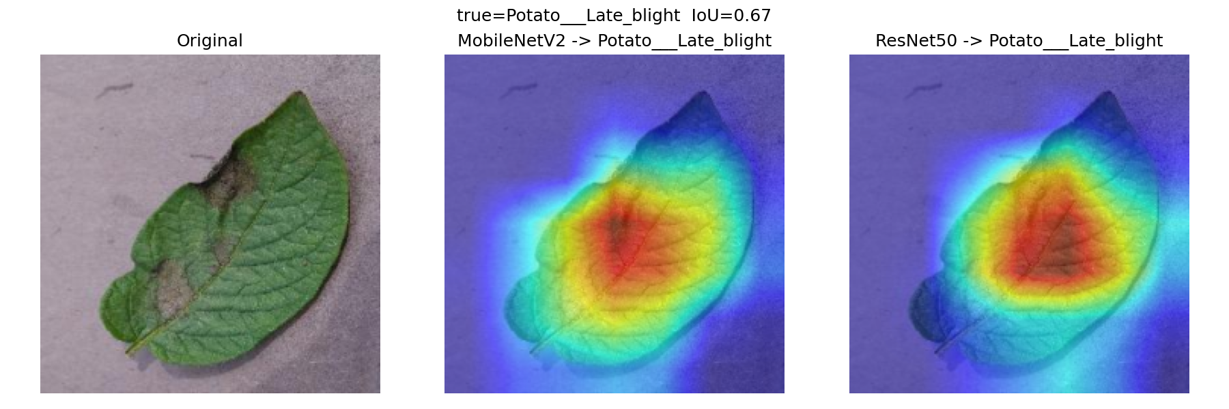
Grad-CAM on both models
Same leaf, same prediction (Potato late blight), overlap of the two heat maps: IoU 0.67
0.435
mean IoU, 75 test images (median 0.452)
Both models correct (67 images): mean IoU 0.456
At least one model wrong (8 images): mean IoU 0.259. Only 8 images, so a hint, not a result
SHAP and LIME maps were built for MobileNetV2 only
Notes:
IoU is the overlap of the top 25% of each heat map. Source: outputs/comparison/iou_raw.csv.

Slide 7
Do the explanations hold up?
Four image changes at the mildest strength, 20 test images per model
Grad-CAM overlap with the unchanged image drops to about 0.5 at these mildest strengths, and to 0.07–0.25 at the strongest
Sanity check (1 image, MobileNetV2): the map already differs from the trained one after randomizing the last 20% of layers, as it should
With 20 images, rates move in steps of 0.05
Notes:
Sources: outputs/robustness/*_perturbation_summary.csv, sanity_checks output. The explanation changes before the prediction does.

Slide 8
Linking the three explanations
The instructor's request, and how we read it
Take the three explanations of one prediction and tie them to each other, so that what one method shows can be carried over to the others.
Way 1: plain correlation
Way 2: a learned shared space
Pearson correlation of two 64 × 64 maps. No training. This is the baseline.
A small Siamese encoder (31,840 parameters). The same weights process maps from all three methods. SupCon loss pulls maps of the same predicted class together.
How it was tested: on images the encoder never saw, 5-fold cross-validation over 60 images, against an untrained encoder, plain correlation and chance. Measure: for a map from one method, is the closest map from another method the same image?
Notes:
Be upfront that this is our reading of the request. The spec is docs/13, the results docs/12.

Slide 9
Result 1: the methods agree a little
Pearson correlation of the maps, all 60 images, no training
Grad-CAM and LIME point at the same places: 0.23 against 0.09
Grad-CAM and SHAP agree weakly: 0.14 against 0.11
SHAP and LIME barely agree: 0.04 against 0.03. SHAP is noisy pixel by pixel
Even the best pair is a weak link: the closest map is the right image 8% of the time (chance 1.7%)
Notes:
Source: outputs/correlate/analysis/mobilenet_v2_summary.json, raw_all_images. MobileNetV2 only.

Slide 10
Result 2: the encoder did not beat correlation
Top-1 same image on held-out images, mean over 5 folds (chance 0.083)
Six trained settings, all reported. None beats the untrained encoder by more than the spread between folds (about 0.03)
All are well below plain correlation (0.192)
Result: a learned link is not shown at this data size
Notes:
Source: outputs/correlate/analysis/mobilenet_v2_cross_validation.json. Class label is the SupCon setup; image label is the usual Siamese setup. Standard deviations are in docs/12.

Slide 11
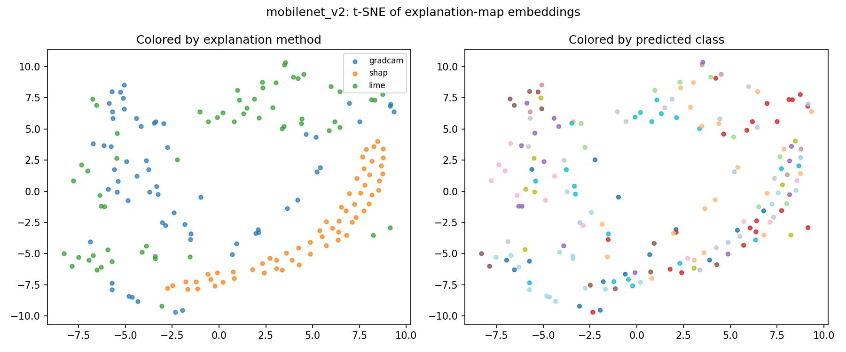
Why the encoder did not link the methods
Embeddings group by method, not by class
It learned to tell the methods apart, the opposite of the goal
Likely causes, not tested: 48 training images per fold; noisy SHAP maps; blocky LIME and smooth Grad-CAM are easy to tell apart
To test properly: a few hundred images (about 18 min per 60 on this laptop) and a less noisy SHAP
A bug that mattered. The first encoder run also looked like pure chance. Looking at the maps showed my SHAP code returned horizontal stripes with the installed shap version. After the fix the whole grid was run again. These are the results shown.
Notes:
Source: docs/figures/correlation_tsne_mobilenet_v2.png and docs/RUN_LOG.md (problems found).

Slide 12
Demo: the web app
FastAPI backend serving a one-page frontend
Explain: upload a leaf, get the top-3 classes and Grad-CAM at once
About 17 seconds later: SHAP and LIME maps, and how well the three match, next to typical values for the same image and for different images
Compare models: Grad-CAM from both CNNs and their overlap
Results: accuracy, robustness charts, and the linking tables from this talk
FORCE_CPU=1 uvicorn
src.api.main:app --port 8000
open localhost:8000
Notes:
Run one warm-up image before the audience arrives so the models are loaded. Demo with MobileNetV2: the reference values and nearest-map lists exist for it only.

Slide 13
Conclusions and limits
Two CNNs classify 15 leaf diseases: 0.918 and 0.889 test accuracy
Grad-CAM, SHAP and LIME maps agree a little. Grad-CAM and LIME most (0.23 vs 0.09), SHAP least
A trained Siamese / SupCon encoder did not improve on plain correlation, tested on unseen images
Explanations change before predictions do when the image is altered
Limits: 60 images for the linking work, 20 for robustness, 1 for the sanity check; MobileNetV2 only for linking; 3-epoch baselines; lab photos only
Code, docs and numbers: github.com/Shashh-wat/xaiproject
Notes:
Next steps if time: more images and a less noisy SHAP, then ResNet50.

