Slide 1
Gainesboro
Group #6
Jack Bell, Sadam Hashi, Andrew Trias, & Jackson Stewart

Slide 2
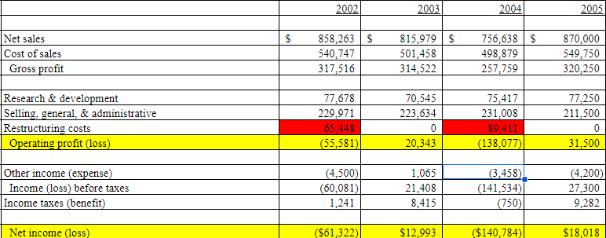
Overview
Financial Position:
Recent years have seen a net loss
Increased competition
Specialized industry entrants
Cash outflows for restructuring
Management is optimistic:
15% growth from 2005-11
Potential to be considered a growth stock
Goals:
Penetrate international markets
Expand on computer-aided manufacturing
Minimize debt obligations
Maintain 40% or less D/E ratio

Slide 3
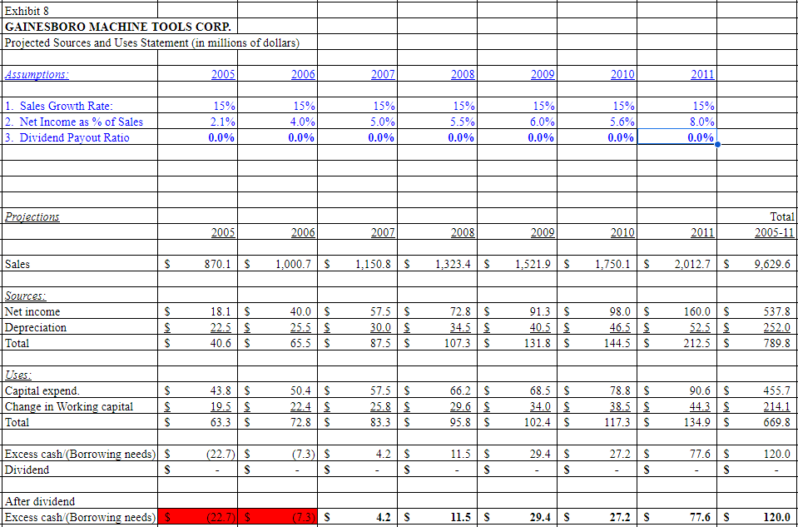
Zero-dividend Payout Policy

Slide 4
Zero-Dividend Payout Policy - Pros and Cons
Pros
Cons
A study found percentage of firms paying cash dividends dropped from 66.5% to 20.8% from 1978-1999
The company achieves a positive cashflow by 2007
Not overly exceed the company’s debt capacity, and hit lower than the minimum requirement of debt-to-equity ratio by 2011
Use retained earnings to rebranding the company or begin(invest) new projects that yield high NPVs
Board shows no commitment to shareholders
Board had assured that a dividend would be paid out sometime in 2005
Analysts can raise concerns on the company’s commitment to shareholders returns
Lack of dividends will hinder the company’s ability to attract future investors and funding
Institutional and individual investors such as value-oriented and long term(retirement) need dividend payments

Slide 5
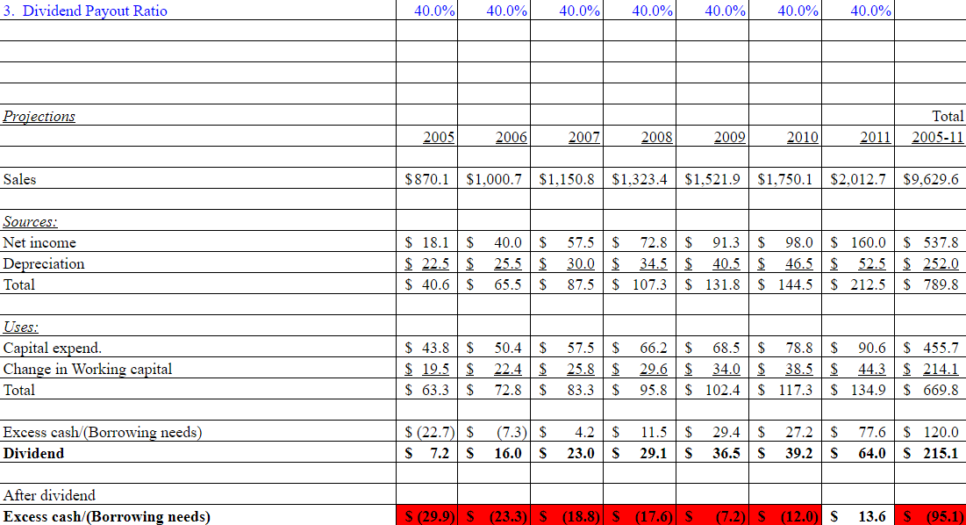
40% Dividend Payout Policy

Slide 6
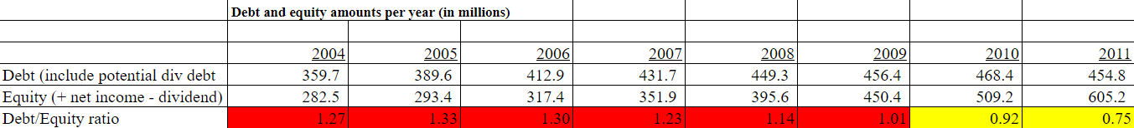
40% Dividend Payout Policy - Pros and Cons
Pro:
Shows potential growth and confidence to shareholders
Would be above industry average for dividend payouts (36% electrical, 26% machine-tool)
Older managers believe company with growth rate of 10-20% should have a dividend payout of 30-50%
Would be highest dividend payout for company since 2001
Potential growth in stock price
Con:
Company would be borrowing cash until 2011
Would not be able to rebrand, pursue new projects, and explore international markets

Slide 7
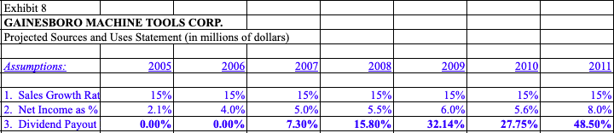
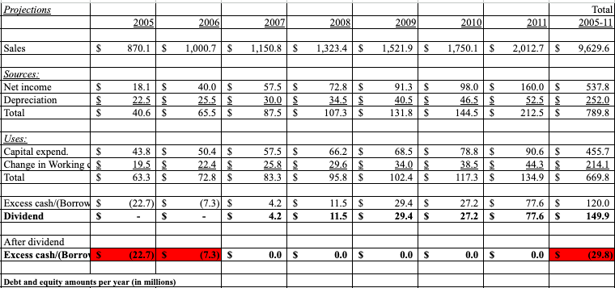
Residual Dividend Payout Policy

Slide 8
Residual Dividend Payout Policy - Pros and Cons
Pro:
In a growing firm (which Gainsboro management hopes to be) this policy is irrelevant. Earlier lack of dividends is made up by dilution at some future point. (dividends rise over time and rarely fall)
Company needs are prioritized
Could build trust with investors with funded projects to increase value of firm
Debt/Equity ratio consistently improving
Con:
Ashley Swenson (CFO) -”main disadvantage is dividend payout is unpredictable”
In later years (with international growth) the dividend becomes a ridiculous payment based on outstanding shares and stock price.
Conflict of Interest
Misinterpretation to shareholders
Does not account for unpredictable market risk (Ex: Hurricane Katrina)
In years with no payments, share price could suffer

Slide 9
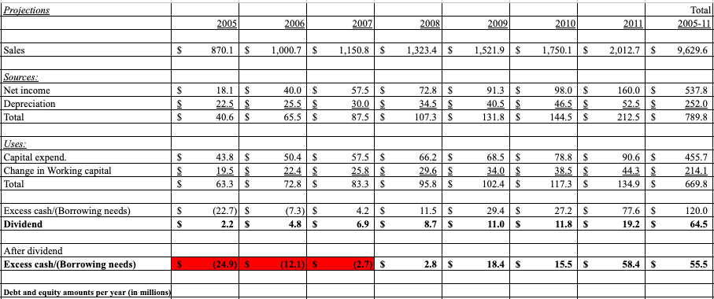
Recommendation - 12% Dividend Payout Policy - Pros and Cons
Pro:
Excess cash available starting in 2008 with 2011 seeing $58.4 million
12% dividend payout above CAD/CAM industry average
Debt/Equity ratio meets goal of 40% by 2011
Option for rebrand and expansion starting in 2009
Con:
Will borrow cash from 2005-2007

