Slide 1
Du Pont
Group #6
Jack Bell, Sadam Hashi, Andrew Trias, & Jackson Stewart

Slide 2
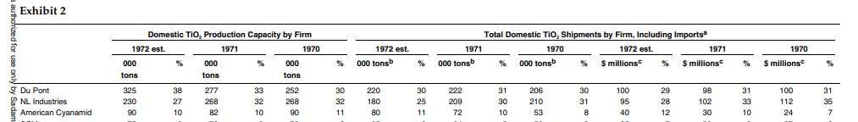
How Du Pont could achieve almost a 65% market share
Increase their capacity level each year
Increase production capacity while diminishing competitors outputs
Build new ilmenite chloride plants
Reaping the benefits of economies of scale to establish competitive advantage
Utilize technological advancements for cost reduction and operational efficiency
Reduce energy consumption, waste generation, and large volumes of material usage to lower production costs
Helps following with government regulations
Acquiring industry competitors
E.g. American Cyanamid which holds 10% of the market share

Slide 3
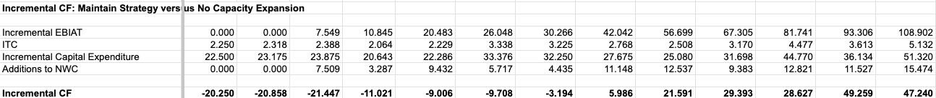
Challenges to Du Pont’s growth strategy
Competitors currently have different production processes
Rutile ore & Sulfate
Replication of Ilmenite process by other companies
Less solo market control in near future
High early capital expenditures for Du Pont
Vulnerable to competition
Industry leaders could follow Du Pont
Expand and attempt to perfect Ilmenite
Possibility to have even more investment into plants
Large assumption that the expenditures and future growth will be consistent
Any disruption lengthens vulnerability

Slide 4
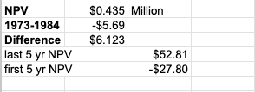
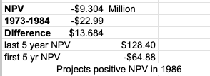
NPV Calculations
Maintain Strategy
NPV amounts to $430,000 from 1973-1985
NPV value in recent years has been steadily improving, making up for loses in incremental cash flows from 1973-1977
Growth Strategy
NPV amounts to -$9.3 million from 1973-1985
Experienced loses in incremental cash flows from 1973-1979, lowering NPV value

Slide 5
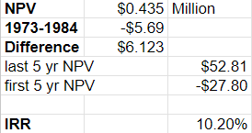
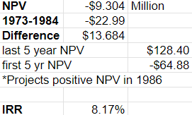
IRR Calculations
Maintain Strategy
IRR generated from 1973-1985 is 10.20%
IRR (10.20%) is greater than the cost of capital (10%) because of the positive NPV ($0.435 million) found for the maintain project
Growth Strategy
IRR generated from 1973-1985 is 8.17%
IRR (8.17%) is smaller than the cost of capital (10%) because of the negative NPV ($-9.304 million) found for the growth project

Slide 6
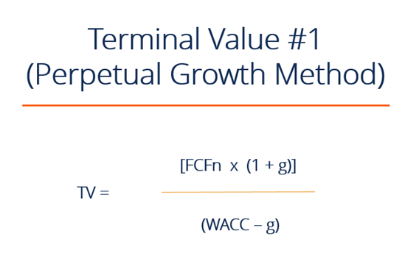
Terminal Value Calculations
Terminal value of the maintain strategy in 1985
(21.13836*(1+0.03))/((0.10-0.03)((1+.1)^13)) = 90.096
estimated present value of all future cash flows beyond the forecast period discounted properly is lower than the terminal value of the growth strategy
Has better NPV and IRR(greater the cost of capital)
Terminal value of the growth strategy in 1985
(47.239928*(1+0.03))/((0.10-0.03)(1+.1)^13)) = 201.346
Terminal value of growth strategy discounted to present value is higher than the maintain strategy’s terminal value
Indicates greater potential growth

Slide 7
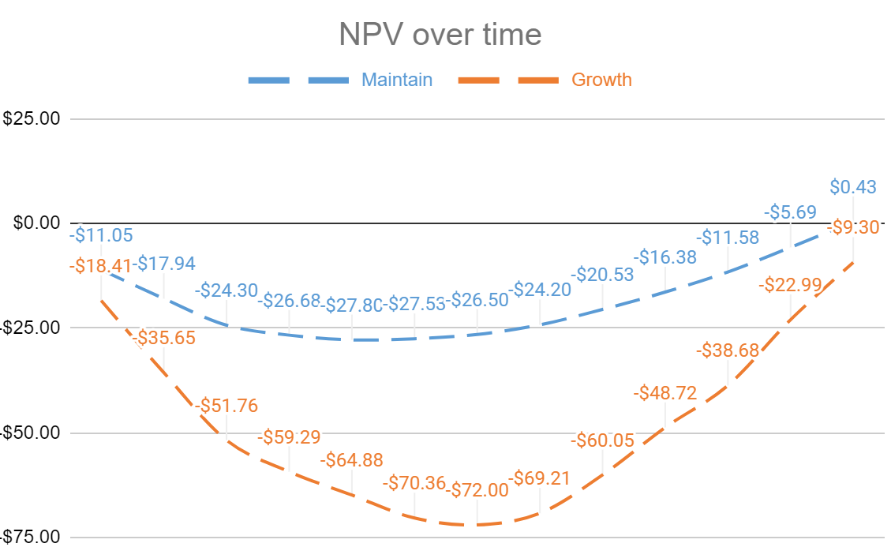
Which strategy is riskier for Du Pont?
Maintain:
Consistent investment and returns
-$27.80 million NPV first 5 years
Less of a hole in case of cash needs
Able to react to change in external environment
Gives time for competitors to adjust processes
Not using Ilmenite superiority
Growth:
Higher initial Investment
-$64.88 million NPV first 5 years
Vulnerable to competitors penetration
No resources to compete or innovate
Do not recoup investment until 1986

Slide 8

Which strategy is best for Du Pont?
Growth strategy is best for Du Pont. The growth strategy requires large capital expenditures for Du Pont in early years, but significantly higher forecasted NPV and IRR growth after 1986, compared to maintain strategy
Projected IRR becomes 10.66% (greater than cost of capital) and NPV becomes $3.862 Million (NPV finally turns positive) for the growth strategy in 1986
Projected IRR and NPV skyrocket after 1986 for growth strategy. Due to a much higher terminal value ($201.346 Million) for growth compared to maintain ($90.096 Million)

