Slide 1


URL Shorteners: Making the Web More Manageable
This presentation explores the world of URL shorteners. We will discuss their purpose, benefits, and best practices. Discover how these tools enhance web manageability.
by S GOWDA

Slide 2
The Problem: Long URLs and Their Drawbacks
Character Limits
Aesthetic Clutter
Typo Risks
Long URLs consume valuable space. This limits sharing on platforms like Twitter.
They look messy and unprofessional. This can deter users from clicking.
Complex URLs are prone to errors. Manual typing leads to broken links.

Slide 3
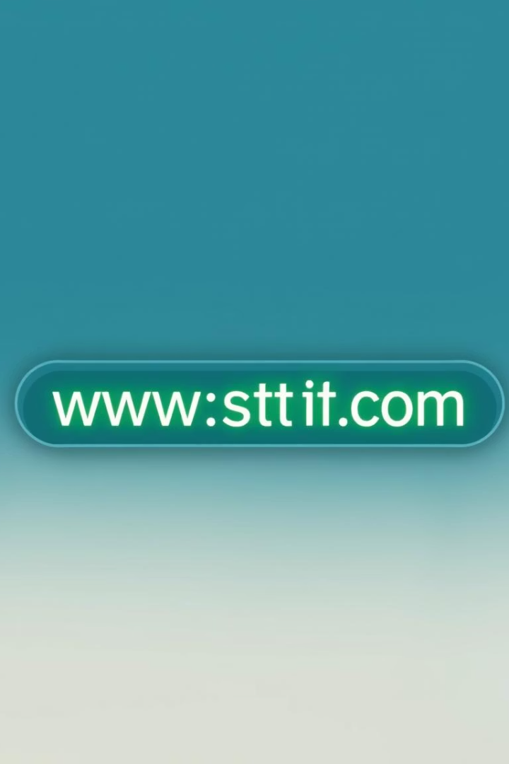




What is a URL Shortener and How Does it Work?
Input Long URL
User pastes the original, lengthy web address.
Generate Short Code
Service creates a unique, short alphanumeric string.
Map and Store
It maps the short code to the original URL in a database.
Redirect Traffic
Clicking the short link redirects users to the original destination.

Slide 4
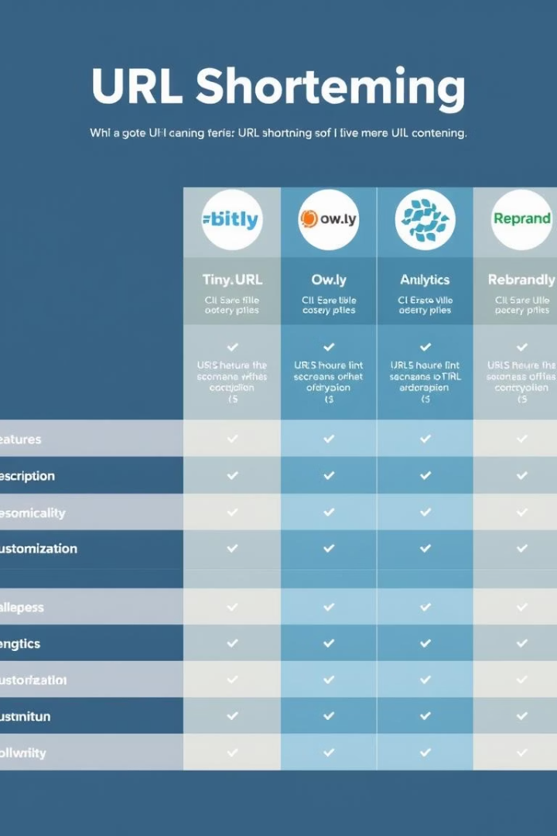
Popular URL Shortening Services Compared
Bitly
Yes
Advanced
Free/Paid
TinyURL
Limited
Basic
Free
Rebrandly
Extensive
Advanced
Paid

Slide 5
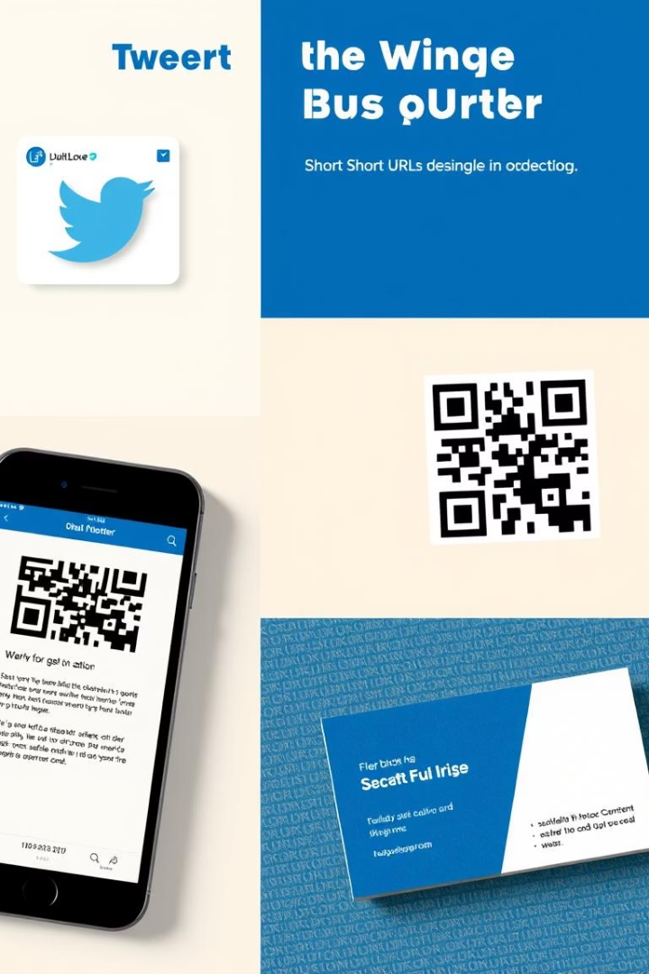
Use Cases: Where Are Short URLs Most Effective?
Social Media
Print Media
Maximizing character limits on Twitter. Enhancing post aesthetics on Instagram.
Easy-to-type links on business cards and flyers. Generating scannable QR codes.
Email Marketing
Clean and professional email campaigns. Improved click-through rates.

Slide 6
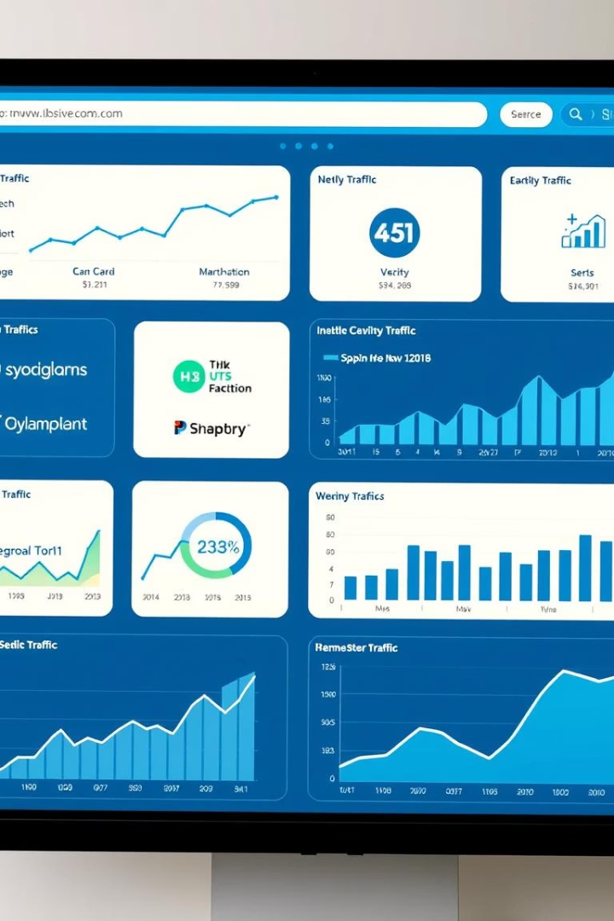



Benefits: Tracking, Branding, and Analytics
Performance Tracking
Custom Branding
A/B Testing
Test different links to optimize campaigns. Gather data for strategic decisions.
Monitor clicks, geographic data, and referral sources. Understand audience engagement.
Use custom domains to build brand recognition. Increase trust and memorability.

Slide 7




Potential Issues: Security and Trust
Malware and Phishing
Link Rot and Trust
Services can shut down, breaking links. Use reputable shorteners to maintain trust.
Shortened links can hide malicious destinations. Exercise caution with unknown links.
Loss of Context
Users cannot see the original URL. This can lead to distrust.

Slide 8
The Future of URL Shortening and Best Practices
Embrace Custom Domains
1
Reinforce branding and increase user trust.
Prioritize Analytics
2
Leverage data for informed marketing decisions.
Educate Users
3
Promote safe clicking habits and awareness.
The future of URL shortening involves deeper integration with analytics and AI. This will provide richer insights and automated optimization. Users and businesses should continue prioritizing trust and transparency. Adhere to best practices for secure and effective link management.

