Slide 1
EFFECT OF NATURAL DISASTERS ON THE STOCK OF INSURANCE COMPANIES
Shashikiran Peddireddy
Avinash Bobbala
Chanthrika Palaniswamy
Aparna Akula
Siri Devarapalli

Slide 2
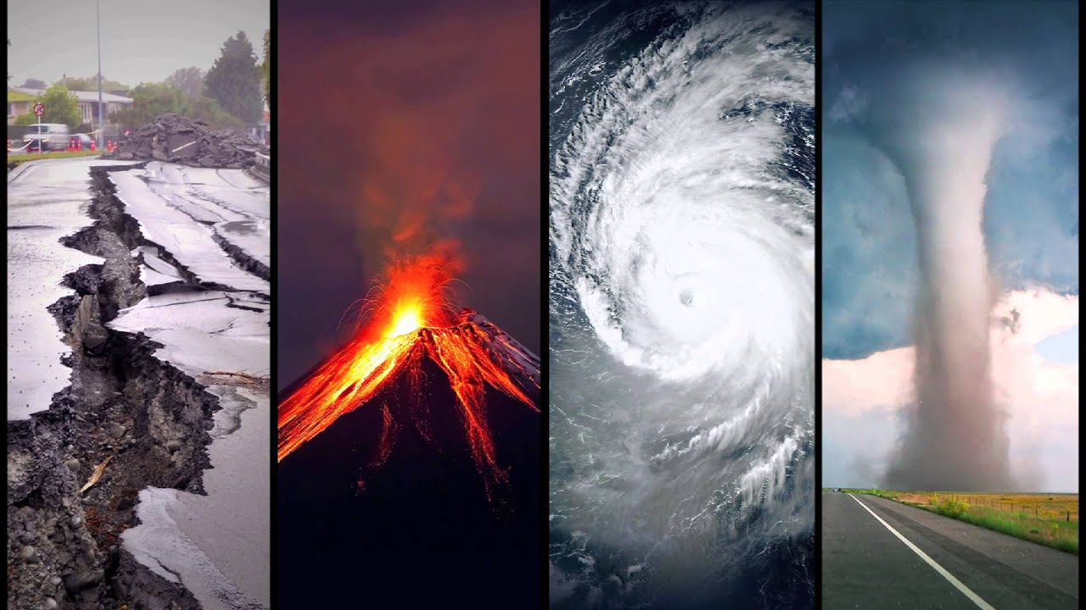

How do natural disasters affect the stock of insurance companies?

Slide 3
Question of interest
Main aim => capture how financial markets especially in the insurance sector are reacting to a major disaster.
Capture the movement of the stock of the insurance company on the day of the disaster
Finally calculate the cumulative movement of the stock on different disaster begin dates.

Slide 4
Import data
In total we used 4 different datasets for our project. Along with the natural disaster dataset, we used stock market data of 3 insurance companies.
Sources:
FEMA
Federal Emergency Management Agency is a federal agency that coordinates disaster response. It has collated data on Disasters all the way back since 1953 to today.
Yahoo Finance
This is a media property that is part of Yahoo! network.It provides financial news, data and commentary including stock quotes, press releases, financial reports, and original content.

Slide 5
Companies considered
Allstate
Progressive
Travellers

Slide 6
Disaster data
FEMA - disaster_data
Interested Variables
incidentBeginDate
State
incidentType
designatedArea
fyDeclared
Stock data of insurance companies :
All state -allstate_data
Progressive - progressive_data
Travellers - travellers_data
Interested Variables
Date
Open
Close
High
Low

Slide 7
Cleaning
Remove unnecessary columns
Rename column names
Distinct disasters- Fire, Flood, Snow, Hurricane, Storms, Biological, Severe ice storm.
Data After 2000
Removed NA values

Slide 8
Preprocessing
Timestamps → date
Join tibbles - date

Slide 9
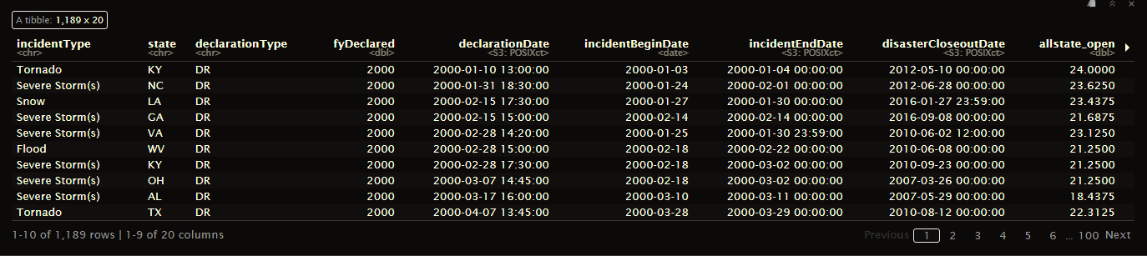
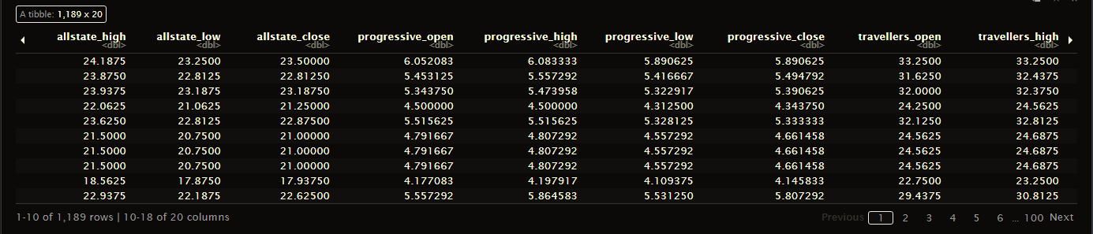
Dataset after preprocessing

Slide 10
Visualisations

Slide 11
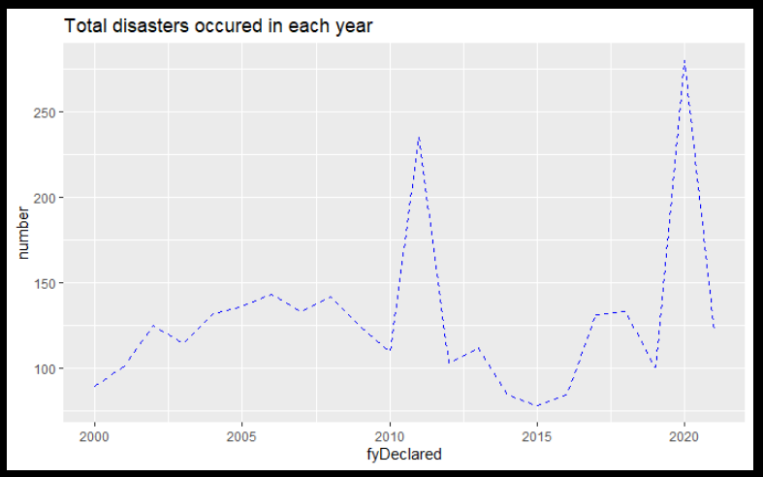
How many disaster occur each year?
Notes:
Before arriving at any conclusion we thought of visualizing the data we have collected. So we tried plotting a line graph to understand the increase or decreases in the number of natural disasters occured every year. To arrive at this line graph we grouped all the disasters that occurred in accordance with the year. In which we could obviously see that the peak is in the year 2020 which is a drastic raise and continuingly a sudden fall.

Slide 12
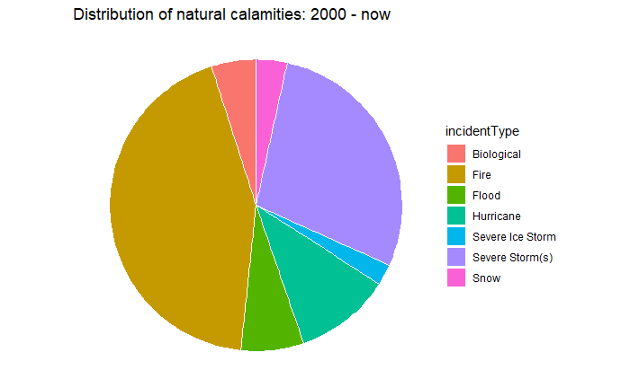
What are the most frequent natural disasters that occur in US?
Notes:
And here is a pie chart for understanding the percentage or the share of each disaster (here we have filter the data so that the listed disaster has occurred more than 50 times in the two decade which gives us the top 7 disasters as listed in the chart. In this we can clearly see that fire is covers major part of the pie chart which is approximately 40% and storm is the second most frequently occurred disaster in US. If take a close look at this pie chart we could spot that severe ice storm is the least most occurred disaster. I have heard colorado experiences most of it.

Slide 13
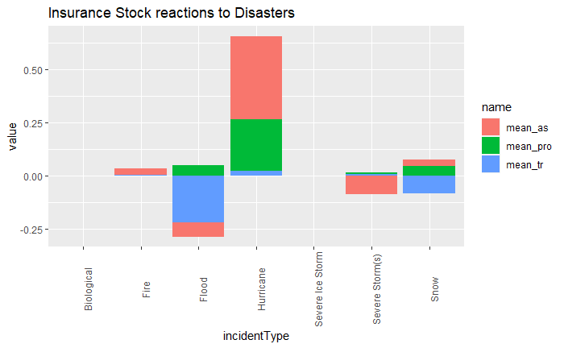
So how do insurance companies stock react to each natural disaster?
Notes:
In the graph the blue, green and orange coloured portions represent the dip taken by each insurance company when that particular natural calamity occurred. We defined dip to be closing price - opening price on the day the natural calamity occurred. A negative dip would indicate that the company lost money on that day. Similarly a positive dip would indicate that the company gained money on that day. The plot was surprising as we expected all of the companies to react to each natural calamity the same way. But we would love to explore this disparity in the future. Most frequent natural calamities hardly affected the companies - they were prepared.

Slide 14
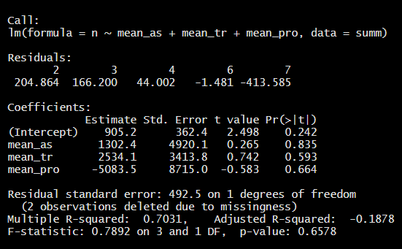
Model the data

Slide 15
Conclusion
During Fire and Hurricane insurance companies gain profit.
When floods, severe storms and snow occurred stocks of progresive increased.
Allstate was affected the most by natural calamities.
Insurance companies took better measures against fire and severe storms.

Slide 16
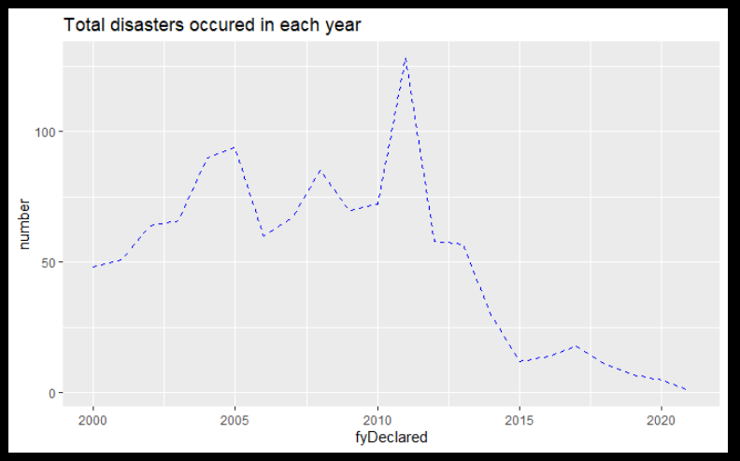
Possible sources of bias
We considered the disasters that occurred more than 50 times. What about the other natural calamities ?
Weekends are not considered as the stock markets are closed on weekends.
National holidays are also not considered.
A lot of data was lost during cleaning.

Slide 17
Questions raised ?
Can we deduce why some natural calamities affected particular companies differently?
Flood - progressive
Severe storm(s) - all state
Snow - travellers
Can we find out the best insurance company based on geographic data.

Slide 18
Thank you!
Github: https://github.com/ShashiKiran07/daf_proj

