Slide 1
User Defined Batch Job Generator and Executer
K Shashi Sekhar 16BCE1286
Ayushi 16BCE1230

Slide 2
Problem Statement
To avoid unnecessary monotonous commands to be executed sequentially for a certain job.
Such tasks can be automated and can be taken care of by the computer.
All the tasks can be executed by execution of a single python script generated by the generator script
These scripts if needed could be given Custom keybinds.

Slide 3
Implementation
The above task has been accomplished by using ‘pyautogui’ module.
The generator script is run once and the necessary inputs are given.
Once generated it can be used as many as times as needed.
The UI is made simple by helping the user input required information by entering basic numbers
As the script is Dynamically Generated by the user and can pretty much control any application all the applications can be automated as long as the data is static to a certain extent.

Slide 4
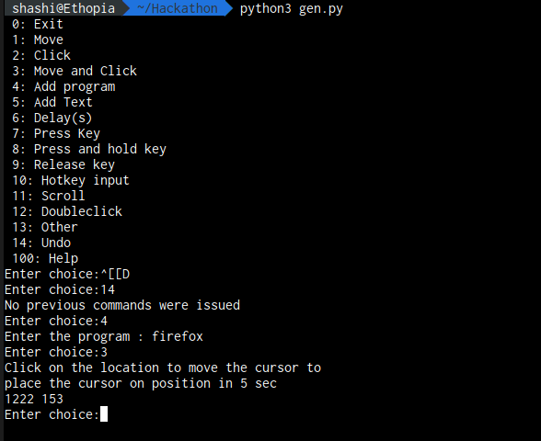
Illustrations
The generator script when taking commands from the user, while generating a script in the background.

Slide 5
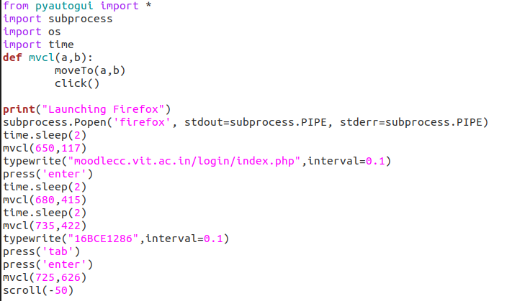
Illustrations
Sample code generated by the script

Slide 6
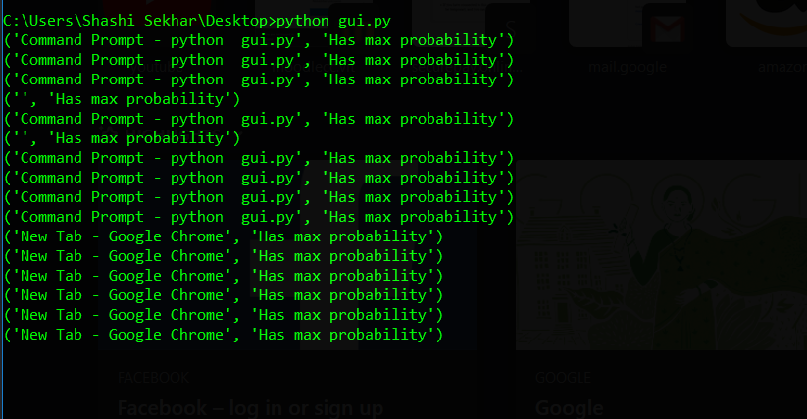
Scopes for Extension
The project can be extended to monitor the usage of the user and thereby through Machine Learning predict the apps the user might want to use.
In the figure the program finds out max probability of opening a window based on previous usage.

