Slide 1
ANGULAR

Slide 2
Overview
Angular 7 is an open source JavaScript framework for building web applications and apps in JavaScript, html, and Typescript which is a superset of JavaScript.
Angular provides built-in features for animation, http service, and materials which in turn have features such as auto-complete, navigation, toolbar, menus, etc.
The code is written in Typescript, which compiles to JavaScript and displays the same in the browser.
Modelview- viewModel Method.
Owned by Google.

Slide 3
Applications
Google Supported Community
Multi-platform support.
Companies that use Angular : Microsoft, Autodesk, MacDonald’s, UPS, Cisco Solution Partner Program, AT&T, Apple, Adobe, GoPro, ProtonMail, Clarity Design System, Upwork, Freelancer, Udemy, YouTube, Paypal, Nike, Google, Telegram, Weather, iStockphoto, AWS, Crunchbase.
https://www.madewithangular.com/

Slide 4
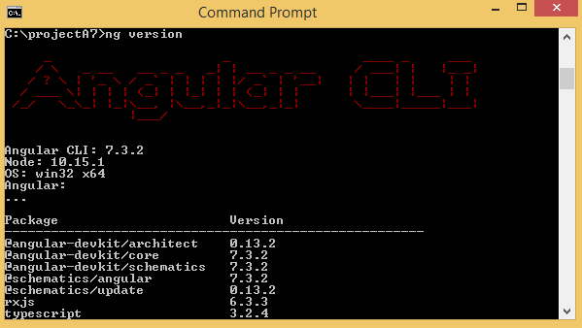
Environment Setup and Project Setup
Node and Npm
Angular Cli
npm install –g @angular/cli.
Ng version
Project Setup
ng new my-dream-app
cd my-dream-app
ng serve or ng serve -o

Slide 5
The my-dream-app/ folder structure : -
e2e/ − end to end test folder. Mainly e2e is used for integration testing and helps ensure the application works fine.
node_modules/ − The npm package installed is node_modules. You can open the folder and see the packages available.
src/ − This folder is where we will work on the project using Angular 7.Inside src/ you will app/ folder created during the project setup and holds all the required files required for the project.
angular.json − It basically holds the project name, version of cli, etc.
.editorconfig − This is the config file for the editor.
.gitignore − A .gitignore file should be committed into the repository, in order to share the ignore rules with any other users that clone the repository.
package.json − The package.json file tells which libraries will be installed into node_modules when you run npm install.

Slide 6
Components and Modules
Major part of the development with Angular 7 is done in the components. Components are basically classes that interact with the .html file of the component, which gets displayed on the browser.
Ng g component new-cmp.
new-cmp.component.css − css file.
new-cmp.component.html − html file.
new-cmp.component.spec.ts − for unit testing.
new-cmp.component.ts − here, we can define the methods, properties, etc.

Slide 7
Data Binding and Event Handling
Data Binding :
Data synchronization between model and view.
curly braces is used for data binding.
Event Handling :
interaction with an application in the form of a keyboard movement.
Ex: on click event, on change event.

Slide 8
Pipes
Pipes were earlier called filters in Angular1 and called pipes from Angular2 onwards.
The | character is used to transform data.
Syntax : {{ Welcome to Angular 7 | lowercase}}

Slide 9
Routing and Services and Http Services
Routing :
Routing basically means navigating between pages.
Routes, RouterModule is used for Routing.
Services :
data connection that needs to be shared across components is done in Services.
ng g service service-name.
Ex : dateservice,userservice.
Http Services :
HttpClient will help us fetch external data.
We need to import the http module to make use of the http service.

