Slide 1
Let's play PUBG
https://www.kaggle.com/competitions/pubg-version-3
Team Members:
Shashidhar Basavaraj Nagaral (MT2022108)
Jayaa Shree Laxmi Kishoore (MT2022053)

Slide 2
Overview: We are given a large number of PUBG game stats and each row of the dataset contains a player's post game stats with data being from all match types. Also, a given match can have any no. of players (<= 100) and a group can have any number of players.
Goal:
We have to create a model that can predict a player's finishing placement based on their post game stats scaling 0 to 1.
Features:
MatchId, GroupId, MatchType, DBNOs, assists, boosts, damageDealt, kills, walkDistance, rideDistance, swimDistance, revives, rideDistance, boosts and heals taken...

Slide 3
Basic Preprocessing
Categorical type features: Id, groupId, matchId, matchType
Row where the output feature 'winPlacePerc' has a null value was removed.
Players who have won the match but with zero walk distance and zero kills are inconsistent with real game scenarios, so their data has been removed.
Removed the outlier of walk distance > 25000, as this could add bias to the model.

Slide 4
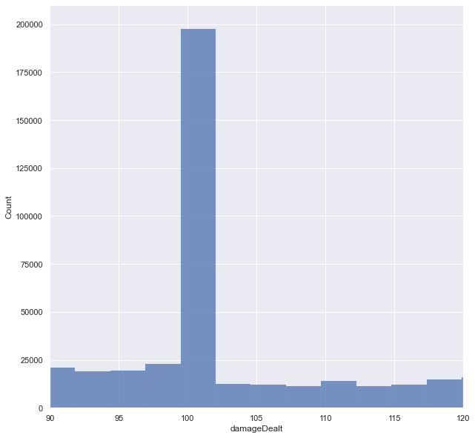
Basic Data Analysis
Out of 31 lakh players 16.5 lakh players have winPlacePerc < 0.5 and 15 lakh players have winPlacePerc > 0.5 therefore we can say that we have a almost balanced output feature.
We also noticed that our dataset is imbalanced I.e for many features majority of the data takes a particular range of values. For example:

Slide 5
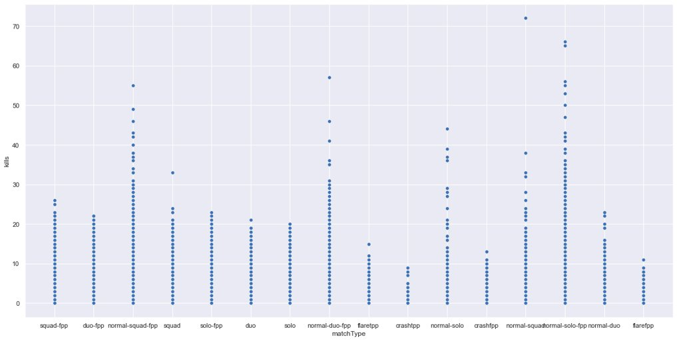
MatchType vs Kills :
From the above scatter plot, we can say that the games of type (normal-duo-fpp, normal-squad-fpp,normal-solo-fpp,normal-duo, normal-squad,normal-solo) have a high kill range than the games of type (solo-fpp, duo, squad, squad-fpp, duo-fpp, solo), which is much lower in games of type (crashfpp, flarefpp,flaretpp,crashtpp)

Slide 6
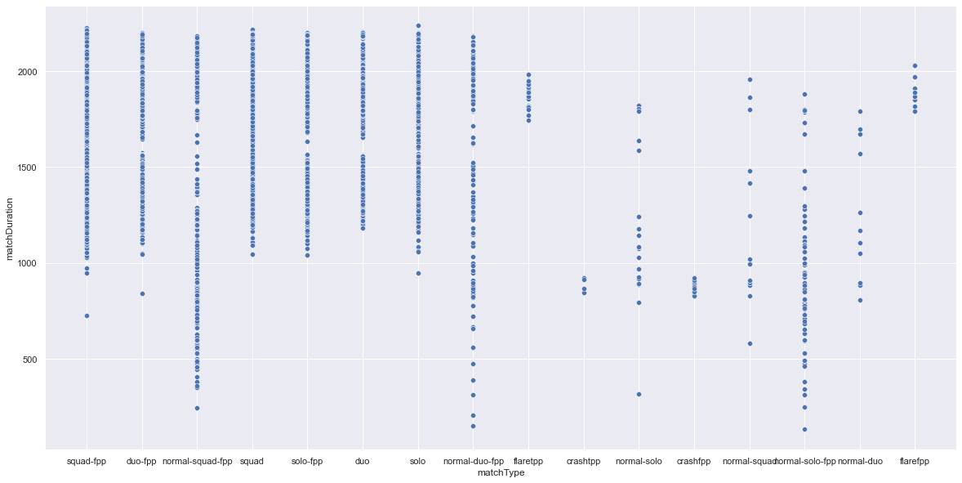
MatchType vs MatchDuration:
From the above scatter plot we can say that, the games of type (solo-fpp, duo, squad, squad-fpp, duo-fpp, solo) have a minimum threshold for matchduration but there is no such indication for the other types of games.

Slide 7
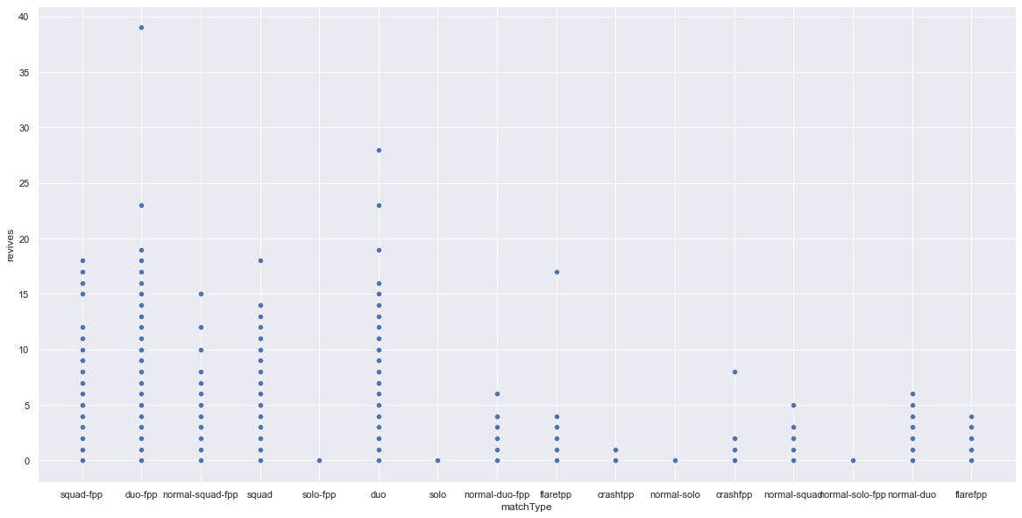
MatchType vs Revives:
From the above scatter plot we can say that, the games of type (duo, squad, squad-fpp, duo-fpp) , have a higher number of revives made than games of type (normal-duo-fpp, normal-squad-fpp,fpp,normal-duo, normal-squad) which is much lower in games of type (crashfpp, flarefpp,flaretpp,crashtpp)

Slide 8
Hypothesis 1/Naive Approach:
Here we are going to analyze data, apply feature engineering and feature selection and test our model on the whole dataset. This is to understand how our other hypothesis are performing compared to the naive approach.
Hypothesis 2:
From the earlier data analysis of feature 'matchtype' we are segregating the data w.r.t match mode type:
standard_mode = ['solo-fpp', 'duo', 'squad', 'squad-fpp', 'duo-fpp', 'solo']
arcade_mode = ['normal-duo-fpp', 'normal-squad-fpp','normal-solo-fpp','normal-duo', 'normal-squad','normal-solo']
other = ['crashfpp', 'flarefpp','flaretpp','crashtpp']
Hypothesis 3:
From the general understanding of the game PUBG we know that there are different game types like squad, duo, solo and other so we are dividing our dataset as follows:
solo = ['solo-fpp','solo','normal-solo', 'normal-solo-fpp']
duo = ['normal-duo-fpp','normal-duo','duo-fpp','duo']
squad = ['squad-fpp', 'normal-squad-fpp','squad', 'normal-squad']
other = ['crashfpp', 'flarefpp','flaretpp','crashtpp']

Slide 9
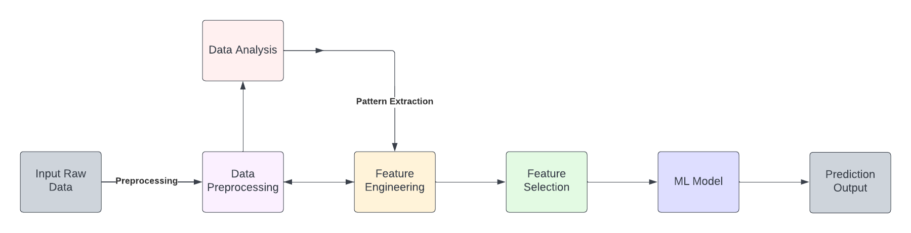
Project Layout:

Slide 10
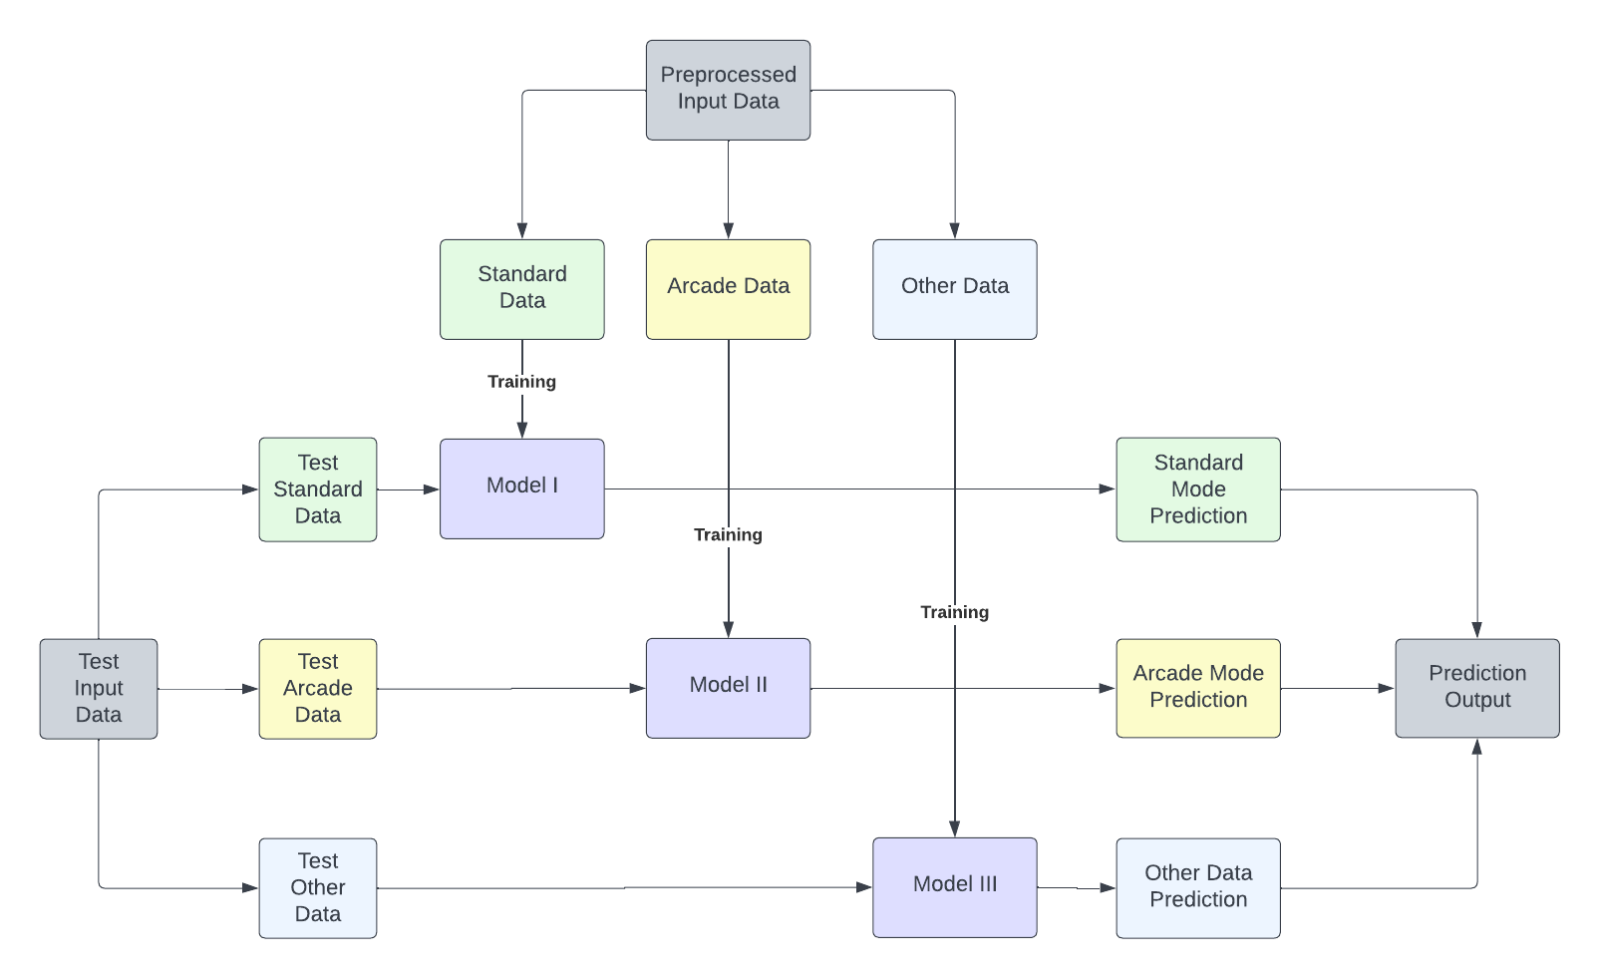
Hypothesis II: Dividing the given data based on the mode of the match

Slide 11
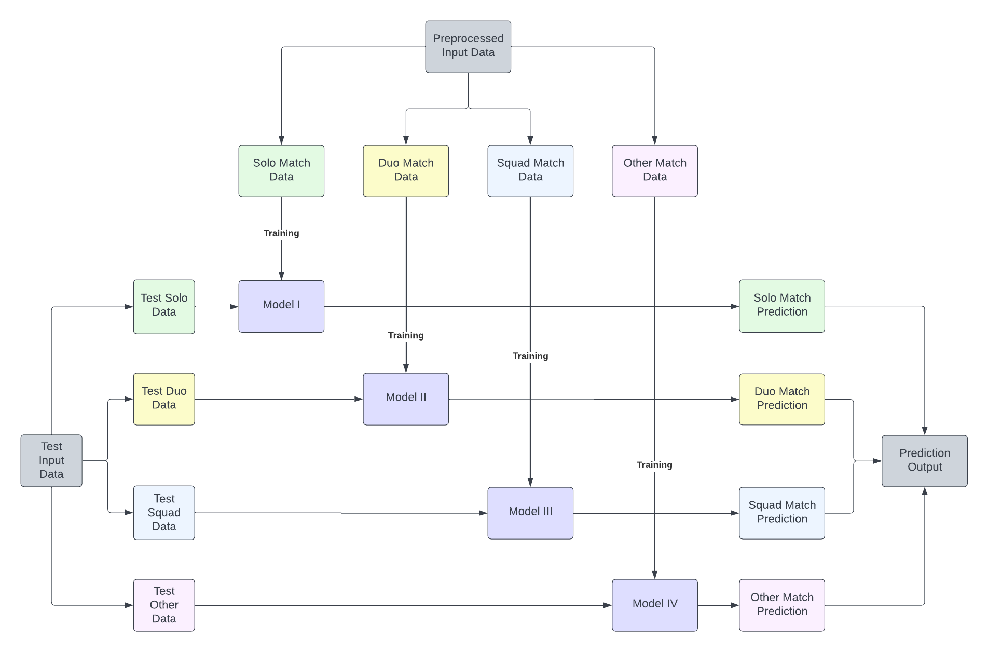
Hypothesis III: Dividing the given data based on the game type of the match:

Slide 12
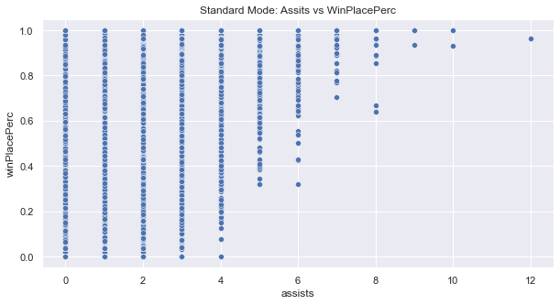
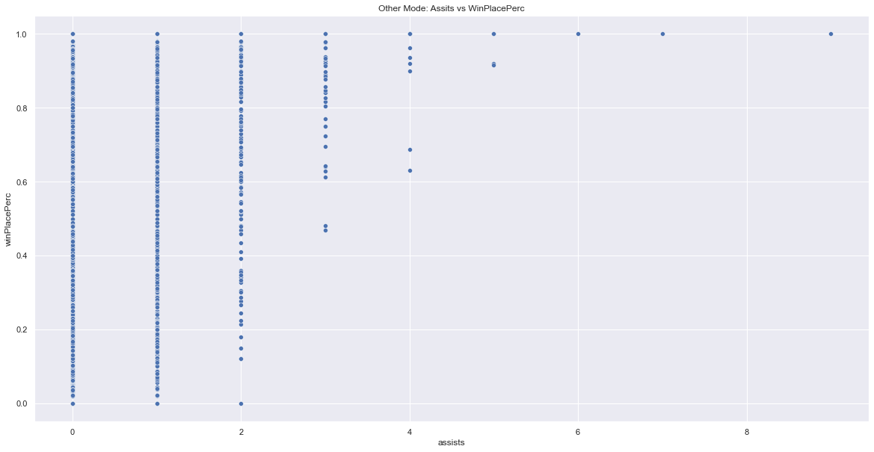
EDA on original data and on data separated based on mode type on few features :
Assists:
Standard Mode Data: We can say that players with assists >= 5 are having win place percentage of atleast 0.37
Other Mode Data: We can say that players with assists >= 5 are having win place percentage of atleast 0.4

Slide 13
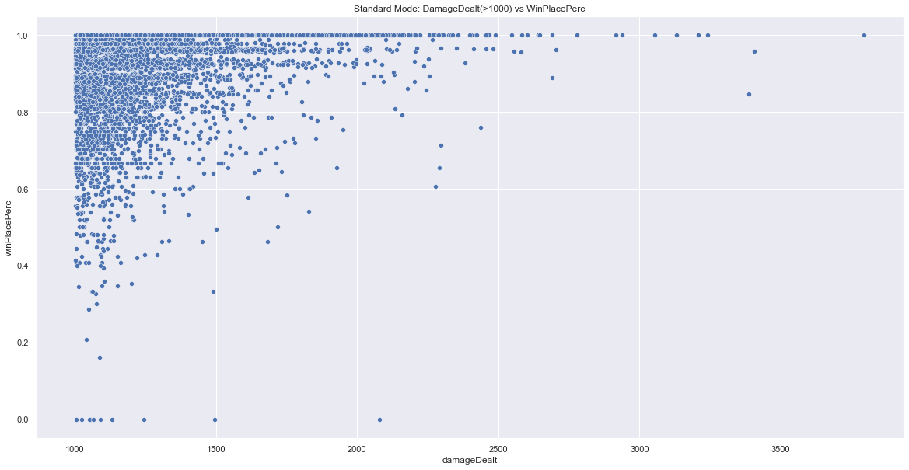
Damage Dealt:​
Standard Mode Data: Around 28% of data have players with damageDealt = 0​
​
Standard Mode Data: We can see that for plot (damage dealt > 1000 vs winPlacePerc), the scatterplot is showing towards upper side ​i.e towards higher winPlacePerc.

Slide 14
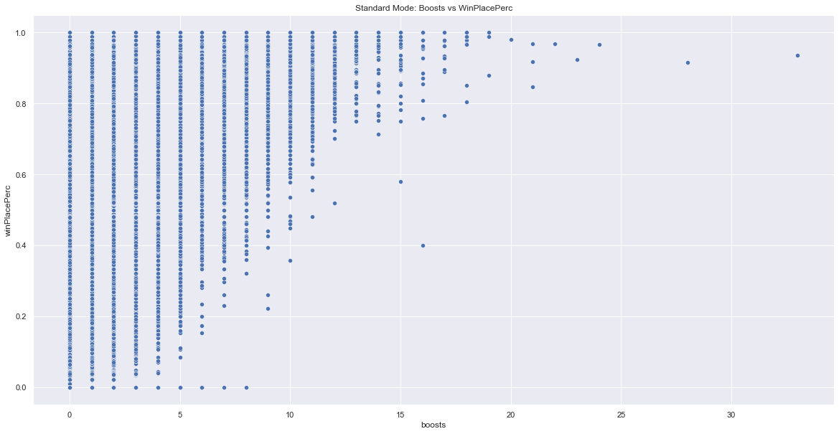
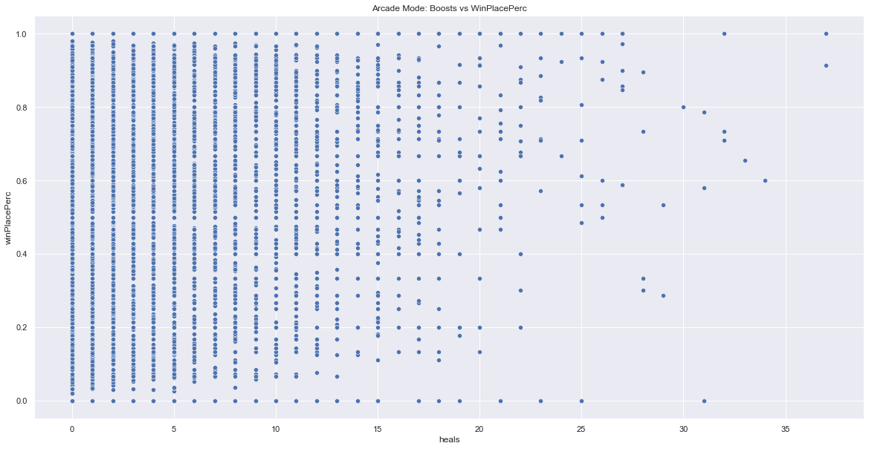
Boosts:
Original Data: WinPlacePerc increases with no of boosts taken after a threshold of 7.
Standard Mode data: we can see that boosts is corelated well with winPlacePerc.
Arcade Mode data: boosts is not that corelated with winPlacePerc
Other Mode data: boosts is slightly corelated with winPlacePerc
DBNOs:
Original Data: About 84% of players have DBNOs less than or equal to 1.

Slide 15
Models Used :
Linear Regression:
Split the train_up.csv into train and test and applied Multivariate Linear Regression, taking all the features into consideration after basic preprocessing on original data. Mean Square Error achieved – 0.01654
Ridge Regression on whole data:
Applied Ridge Regression, taking all the features into consideration after basic preprocessing on original data. Mean Square Error achieved – 0.01528
Ridge Regression on Mode split data:
Split the original data into different mode types and applied Ridge Regression, taking all the features into consideration after basic preprocessing. Mean Square Error achieved – 0.01493
Random Forest on whole data:
Applied RF on the original preprocessed data without hyperparameter tuning to train our model. Mean Square Error achieved – 0.00699
Random Forest on Mode split data:
Split the original data into different mode types and applied RF on the original preprocessed data without hyperparameter tuning to train our model. Mean Square Error achieved – 0.00691

Slide 16
Future Steps
We are going to:
Further analyze our data in depth based on mode types and game types.
Build models based on Hypothesis III i.e based on different group types and try to come up with more hypothesis.
Apply feature engineering and try to add few features that are a combination of other features. For example: heal items as boosts plus heals, Total Distance as linear combination of walk, swim and ride distance.
Apply hyperparameter tuning on Random Forest using Grid Search CV.
Explore more regression algorithms and ensemble techniques as we are unable to increase our score further.

Slide 17
Thank you

