Slide 1
CSE7101- Capstone Project Review -3
Interactive Software Tool for Primary School Students (PSCS_662)
Batch Number: CSE -05
Roll Number | Student Name
20221CSE0364 | SHASHIDHAR REDDY D
20221CSE0108 | AKSHAYA SR
20221CSE0311 | AMOG S
Under Supervision of,
Dr. Pamela Vinitha , Eric professor
Name of the Program: B.TECH(CSE)
Name of the HoD: Dr. Asif Mohammed , Dr. Blessed Prince
Name of the Program Project Coordinator: Dr. Jayavadivel Ravi , Mr. Muniraja V Name of the School Project Coordinators: Dr. Sampath A K , Dr. Geetha A

Slide 2
Problem Statement:
Category (Software)
Primary school students face difficulties managing their academic schedules, assessments, and accessing recorded classes in a streamlined manner. Teachers and admins lack a centralized tool to efficiently manage these resources and deadlines.

Slide 3
Objectives
Develop an interactive tool for primary school students to access timetables, assessments, recorded classes, and provide feedback.
Enable admin/teachers to manage schedules, assessments, and student interactions.
Provide two login types: Admin and Student, with role-based access.
Implement a feedback system for students to communicate with teachers.
Plan for future expansion with enhanced features.

Slide 4
Background and Related Work
Existing educational platforms focus on either administration or student engagement but rarely combine both
effectively for primary students.
Some systems lack feedback mechanisms or role-based access control.
Your tool aims to integrate all key features in a user-friendly way, tailored for primary school needs.

Slide 5
Technology Stack Components
Frontend: HTML, CSS, JavaScript, React.js , TypeScript , Vite.
Backend: XML , Supabase.
Authentication: Role-based login for Admins and Students (based on their roll numbers).
Services: Timetable, Assessments with deadlines, Video lectures , Parental Report , Duel mode AI Chatbot.

Slide 6
Github Link
https://github.com/ShashidharReddyD/4th_Year_Major_Project

Slide 7
Analysis of Problem Statement
Students need a simple and centralized interface to manage academic activities.
Admins require robust management features with oversight.
Timely notifications and deadlines ensure students keep track of assessments.
Feedback system improves communication and learning experience.

Slide 8
Proposed Methodology
Use React for dynamic and responsive UI.
PHP backend to handle database interactions and authentication.
Database to store student and admin data, schedules, assessments, feedback.
Role-based access control implemented to segregate functionalities.
Timetable and assessments updated and managed by admin.
Students access information and submit feedback only.

Slide 9
Innovation or Novel Contributions
Dual login system with distinct roles tailored for primary education.
Integrated system combining schedules, assessments, recorded lessons, and feedback.
User-friendly design targeted at young students.
Real-time updates and deadline tracking.
Future plans to add features such as live classes, AI-based learning paths, and parent dashboards.

Slide 10
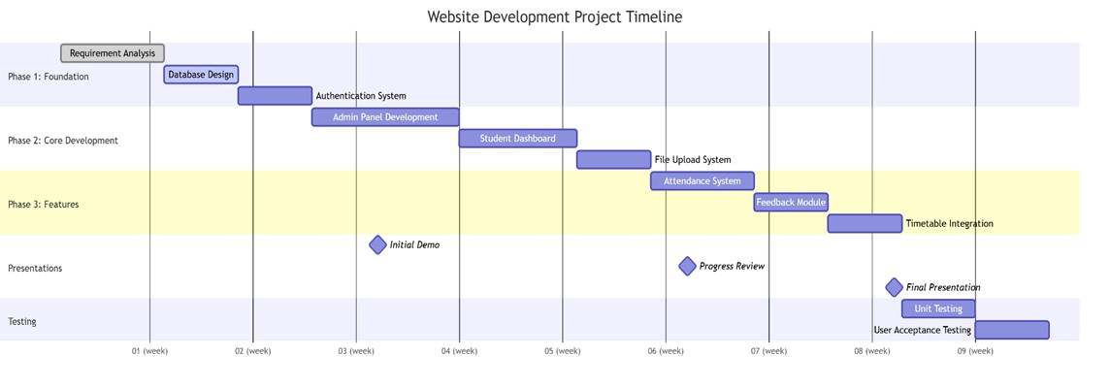
Timeline of the Project (Gantt Chart)

Slide 11
Future Plans
Add live video classes and interactive sessions.
Implement AI-based personalized learning recommendations.
Introduce parental access for monitoring progress.
Mobile app development for better accessibility.
Expand assessment analytics and reporting features.

Slide 12
References (IEEE Paper format)
M. Resnick, Lifelong Kindergarten: Cultivating Creativity through Projects, Passion, Peers, and Play. Cambridge, MA, USA: MIT Press, 2017.
(Key focus: How interactive tools foster creativity in kids—directly supports your project’s goals.)
Scratch Team, "Creative Computing Curriculum Guide," MIT Media Lab, 2021. [Online]. Available: https://scratch.mit.edu/educators
(Practical resource: Official guide for designing child-friendly interactive software using Scratch.)
Kahoot!, "Gamification in Education: Research & Best Practices," 2022. [Online]. Available: https://kahoot.com/blog/ (Evidence-based: Proves how gamification boosts engagement in primary education—critical for your tool’s design.)

Slide 13


