Slide 1
Introduction to Big Data Analytics
What is Big Data? (is it a technology?)
What makes data, “Big” Data?
What is Analytics?
What is Big Data Analytics?
Data --> Information
Information -- > Insight

Slide 2
What is Analytics?
Analytics is the scientific process of discovering and communicating the meaningful patterns which can be found in data.
What is Big Data Analytics?
Big Data Analytics helps you to understand your organization better. With the use of Big data analytics, one can make the informed decisions without blindly relying on guesses.
And it can help answer the following types of questions:
What actually happened?
How or why did it happen?
What’s happening now?
What is likely to happen next?

Slide 3
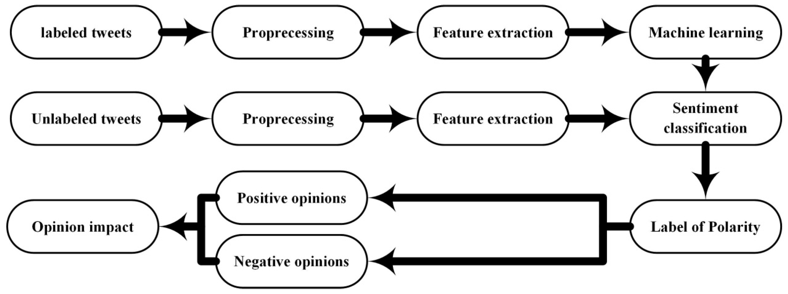
What is Analytics?

Slide 4
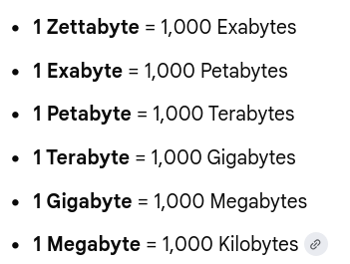
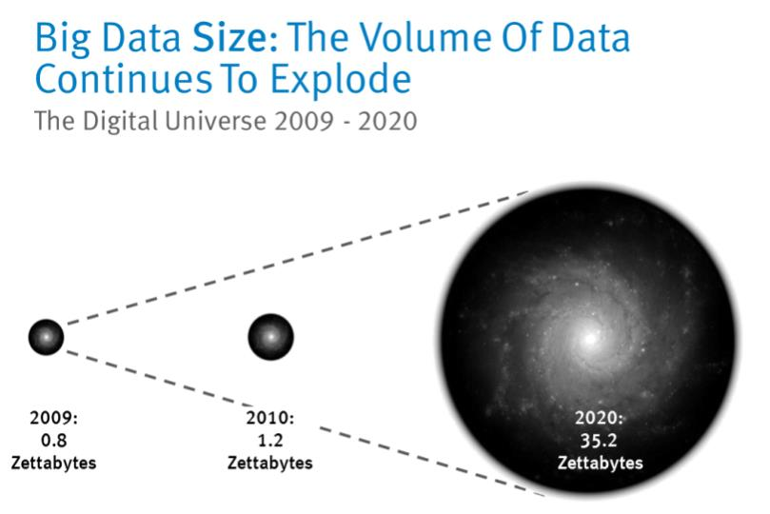
Limitations of RDBMS to support “big data”

Slide 5
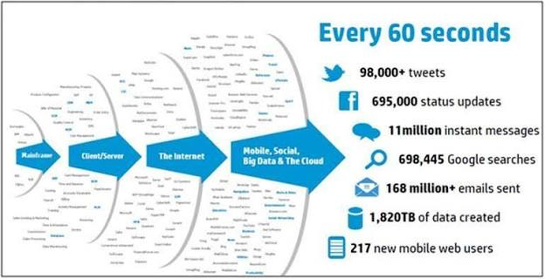

Slide 6
1) The data size has increased tremendously to the range of petabytes—one petabyte = 1,024 terabytes. RDBMS finds it challenging to handle such huge data volumes. To address this, RDBMS added more central processing units (or CPUs) or more memory to the database management system to scale up vertically.
2) the majority of the data comes in a semi-structured or unstructured format from social media, audio, video, texts, and emails. However, the second problem related to unstructured data is outside the purview of RDBMS because relational databases just can’t categorize unstructured data. They’re designed and structured to accommodate structured data such as weblog sensor and financial data.
3) Also, “big data” is generated at a very high velocity. RDBMS lacks in high velocity because it’s designed for steady data retention rather than rapid growth. Even if RDBMS is used to handle and store “big data,” it will turn out to be very expensive.
As a result, the inability of relational databases to handle “big data” led to the emergence of new technologies.
( 80 % of data is unstructured)

Slide 7
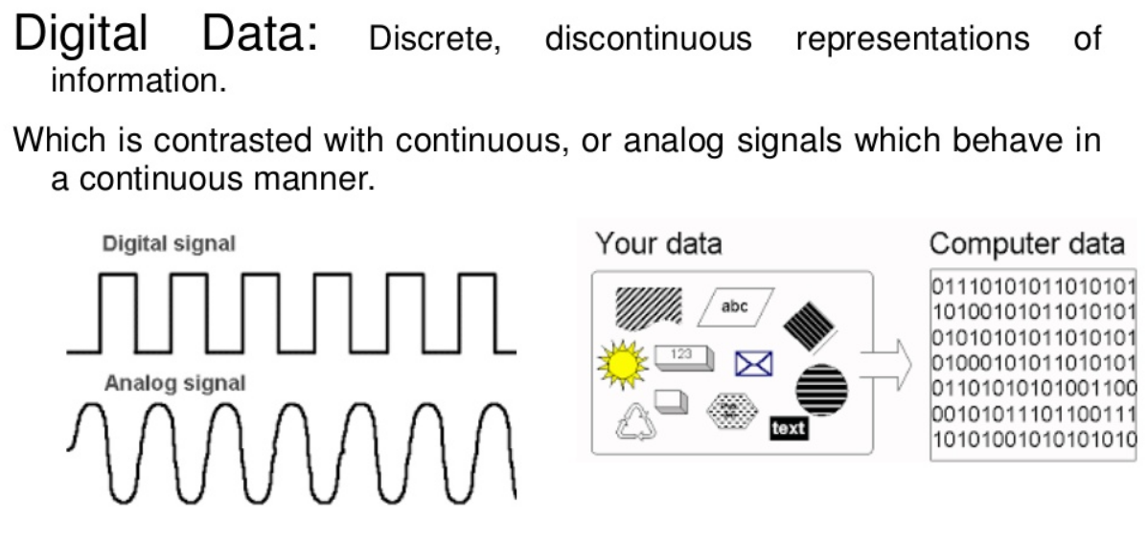

Slide 8
Creating digital data
Each time you use a computer or mobile device, you create data.
You can easily see some of this data, such as, for instance, when you create a new Word document, post something on social media, or take a picture on your mobile phone.

Slide 9
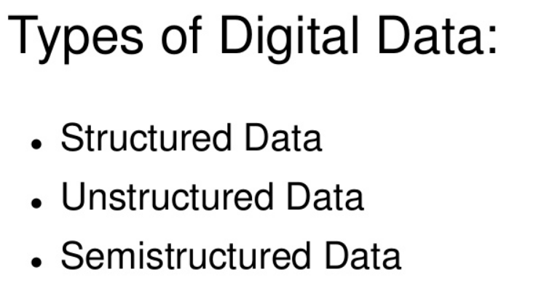

Slide 10
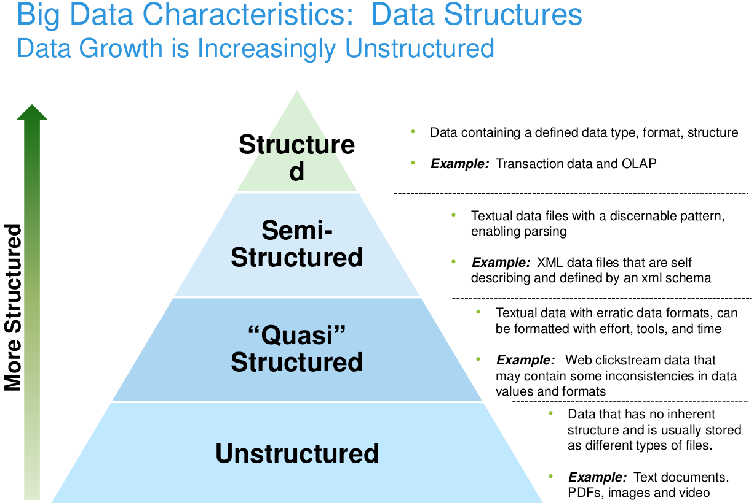
“Big Data is not about the size of the data, it's about the value within the data.”

Slide 11
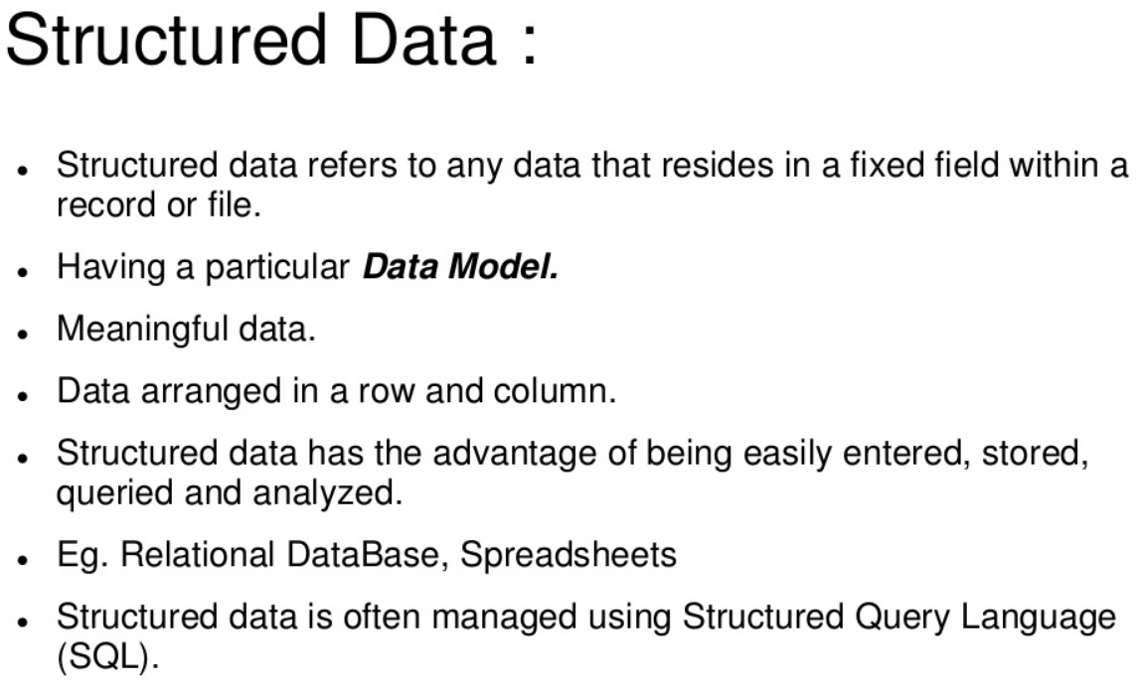

Slide 12
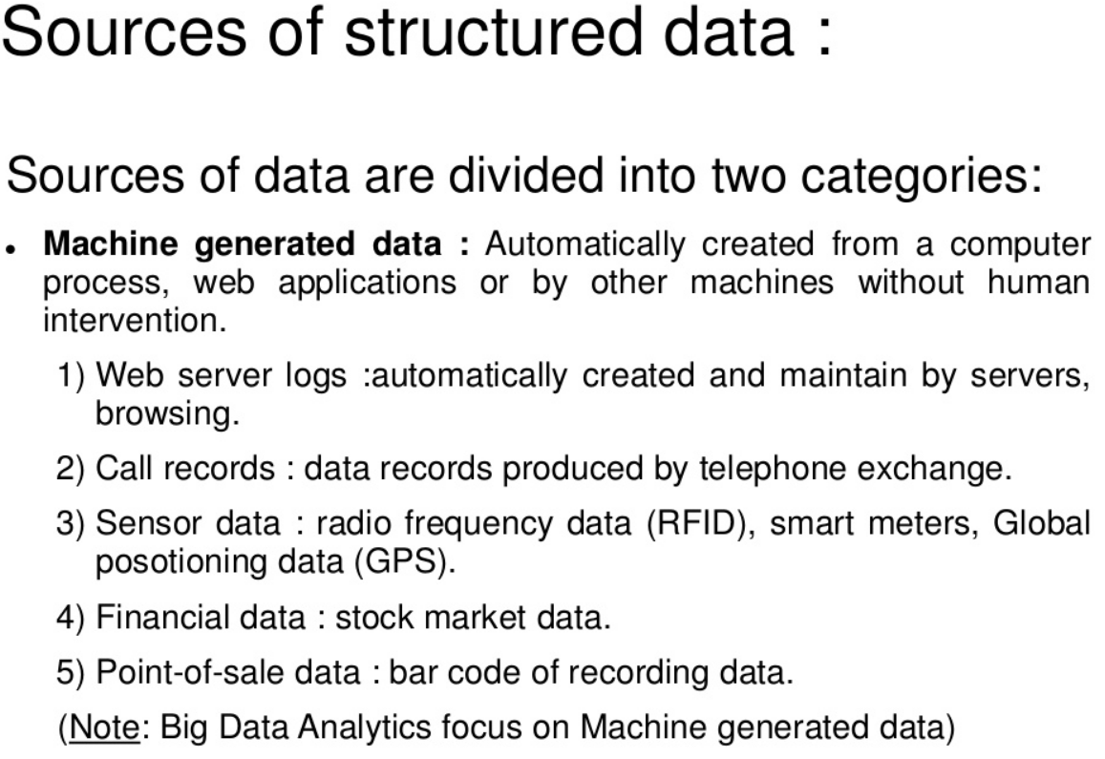

Slide 13
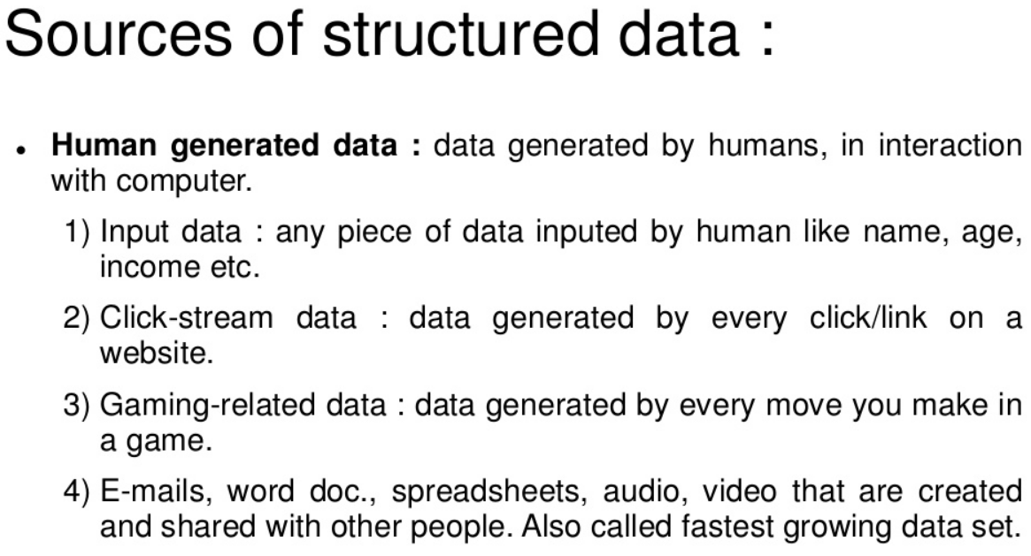

Slide 14
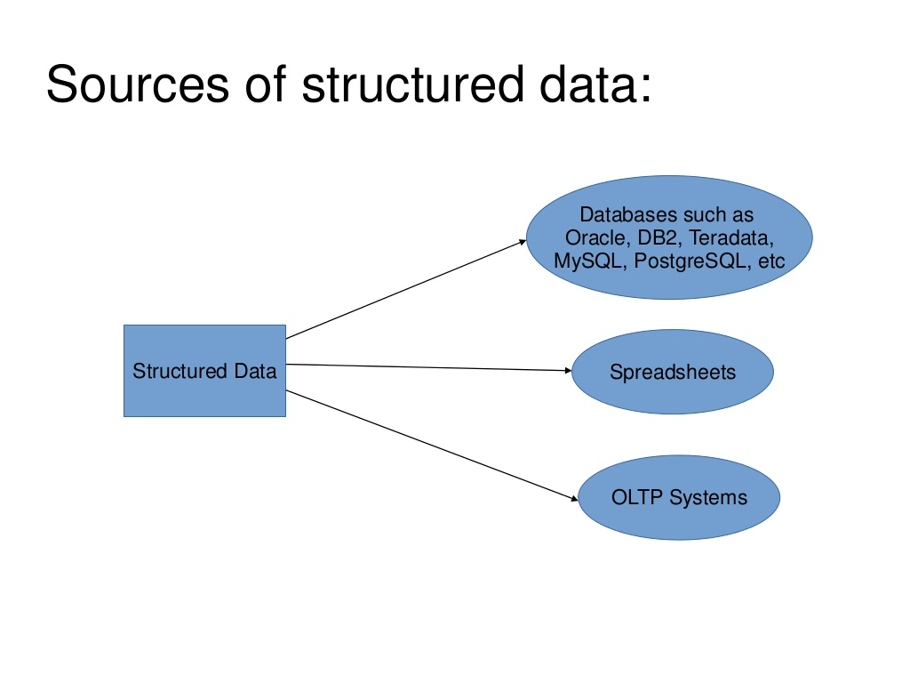

Slide 15
Ease of Working with Structured Data :
Input/Update/Delete: supports DML(Data Manupulation Language).
Security: only authorized individuals can view sensitive information.
Indexing: seed up data retrival operations.
Scalability: traditional RDBMS can easily scaled up by increasing database capacity.
Transaction processing: supports ACID properties
Atomicity: Atomic transaction “all or nothing”.

