Slide 1
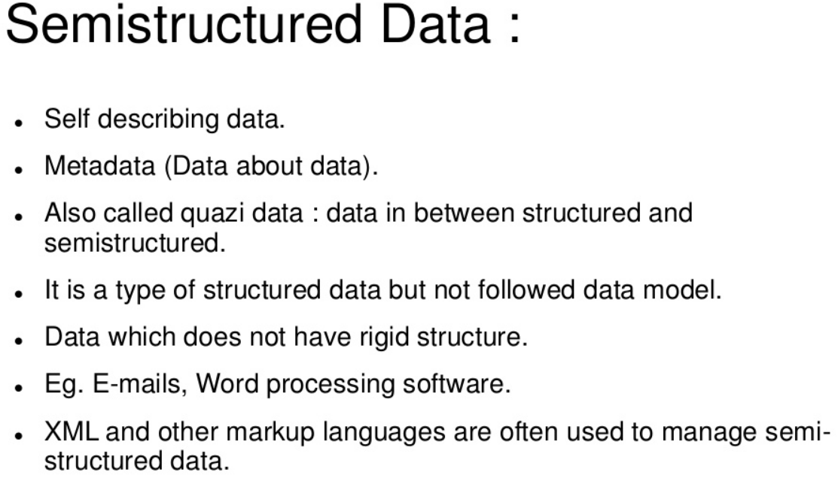

Slide 2
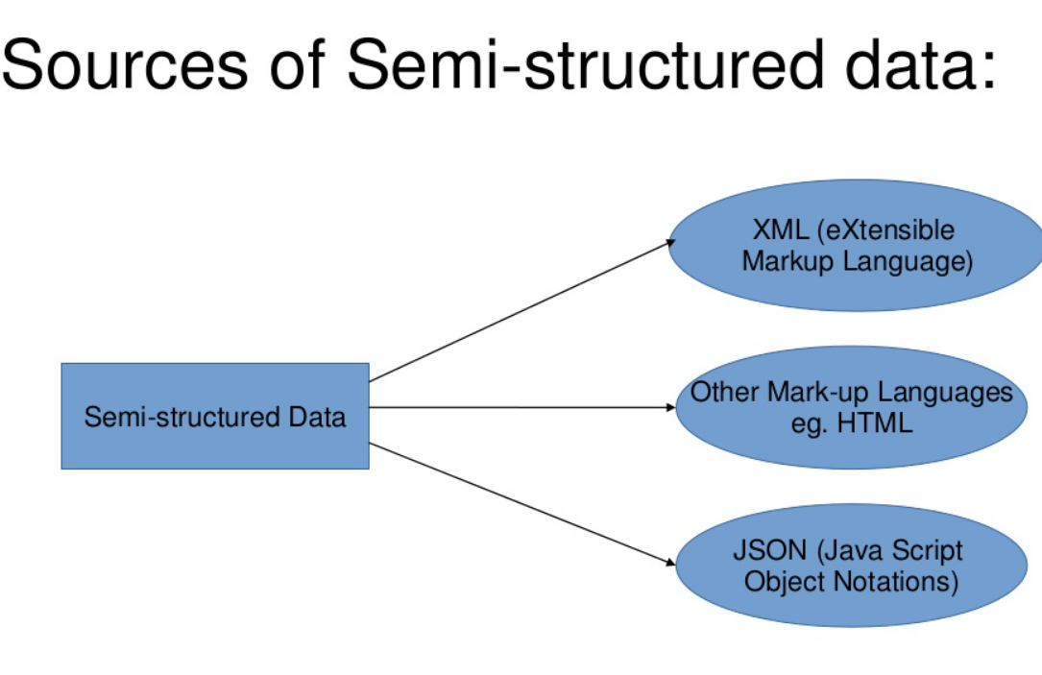

Slide 3
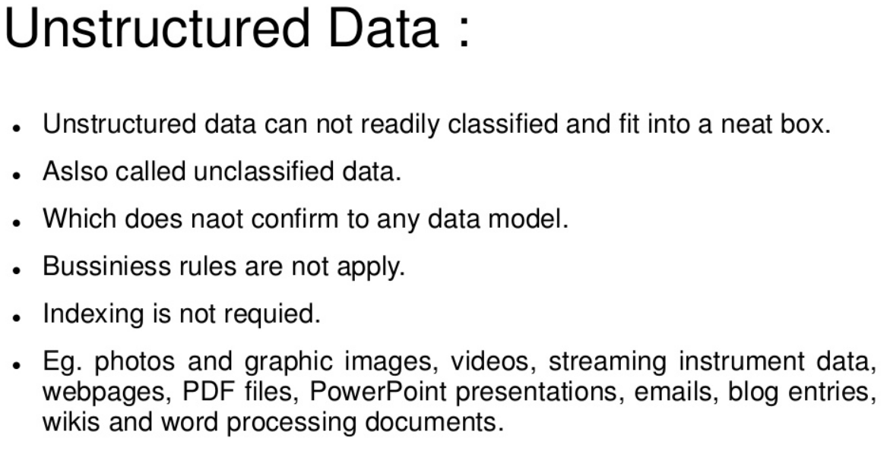

Slide 4
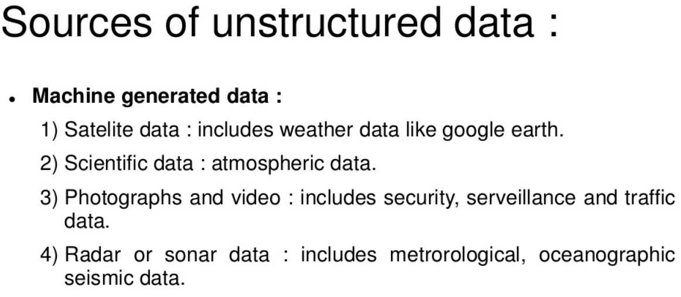

Slide 5
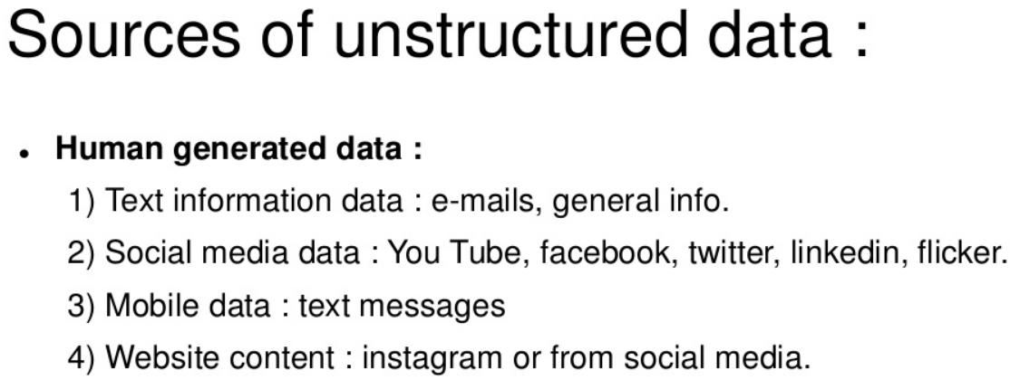

Slide 6
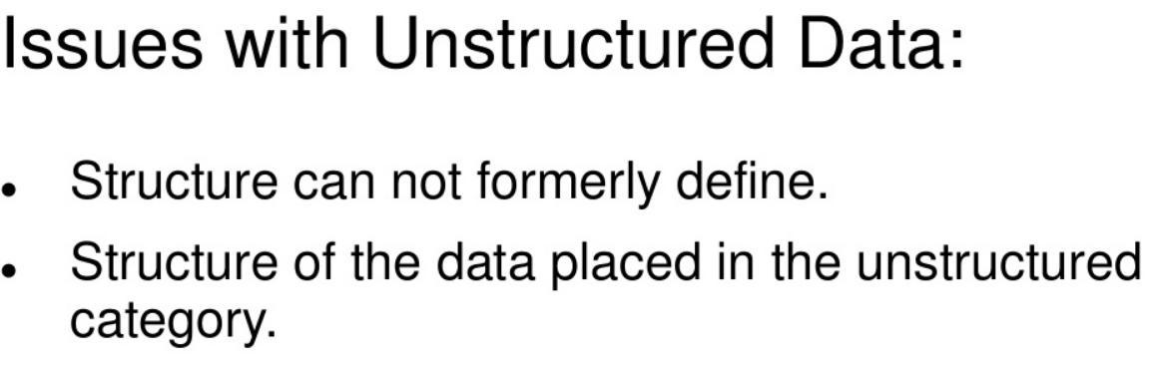

Slide 7
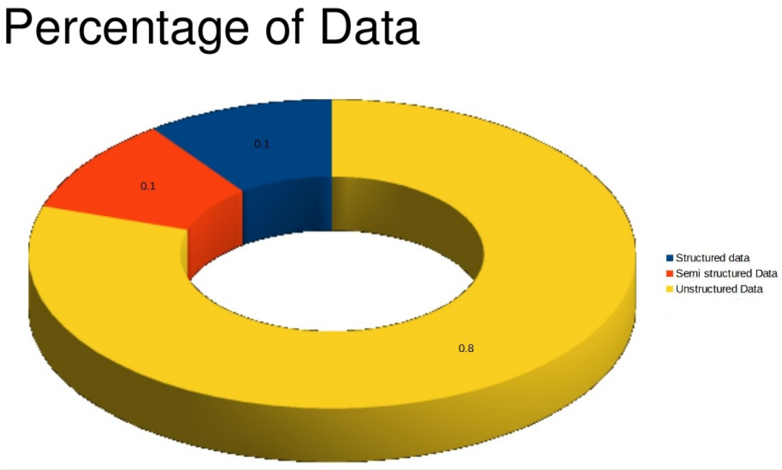

Slide 8
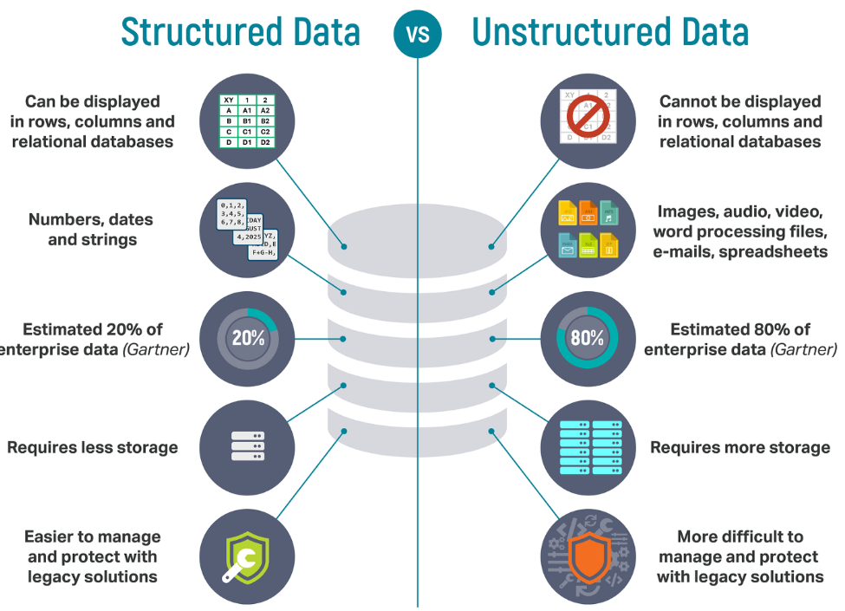

Slide 9
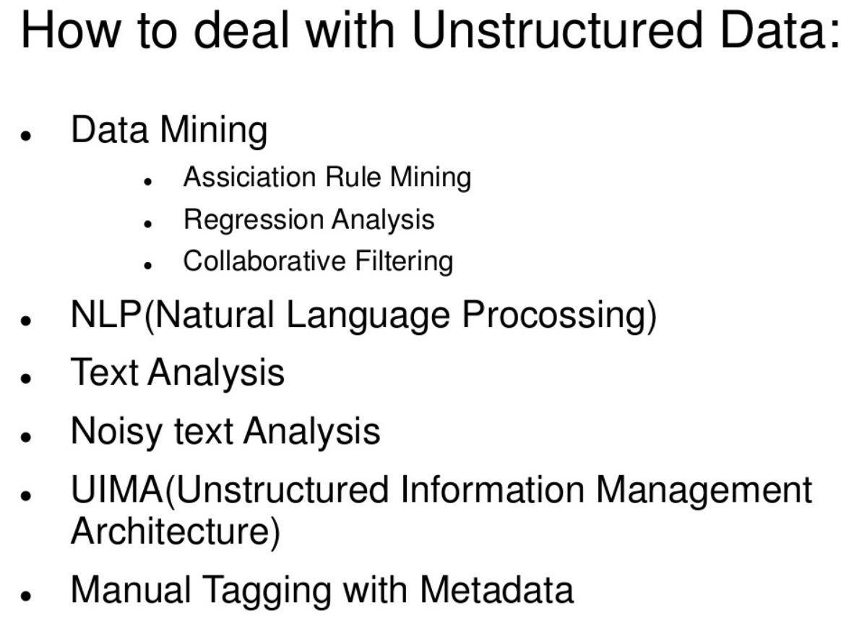

Slide 10
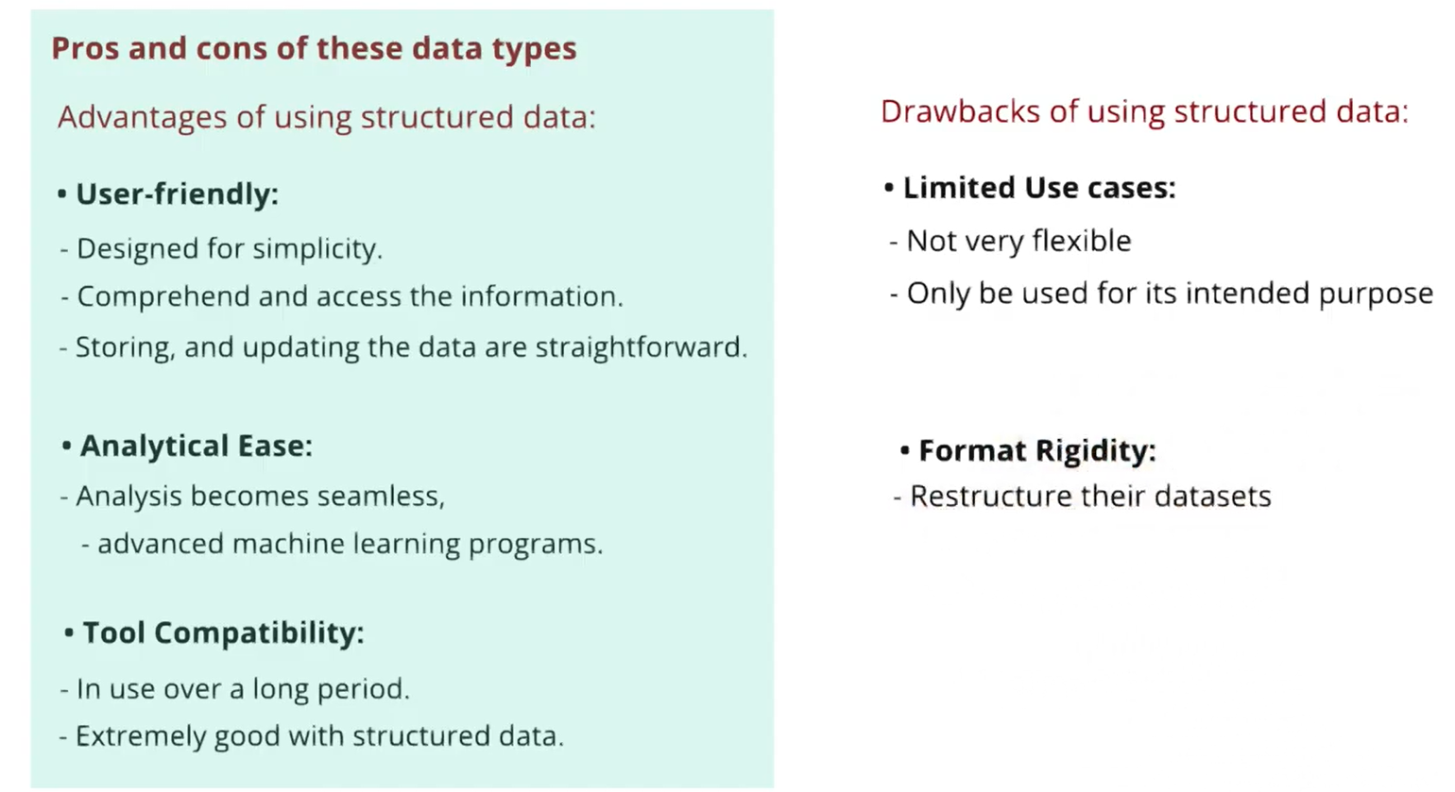

Slide 11
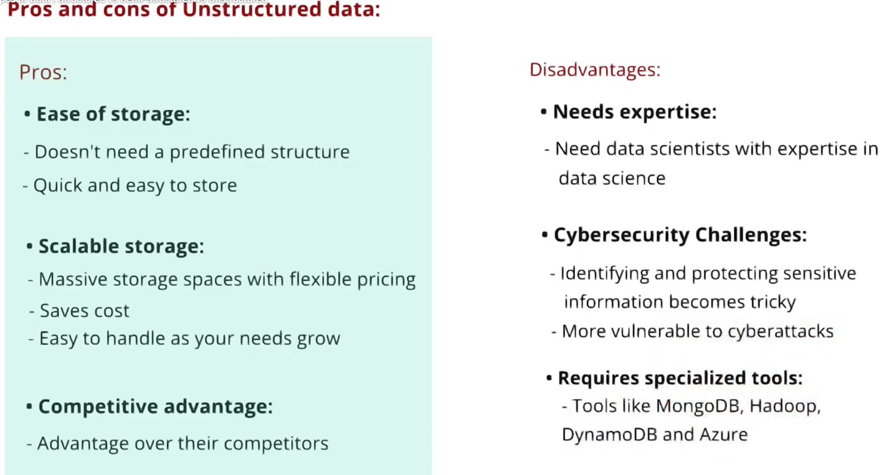

Slide 12
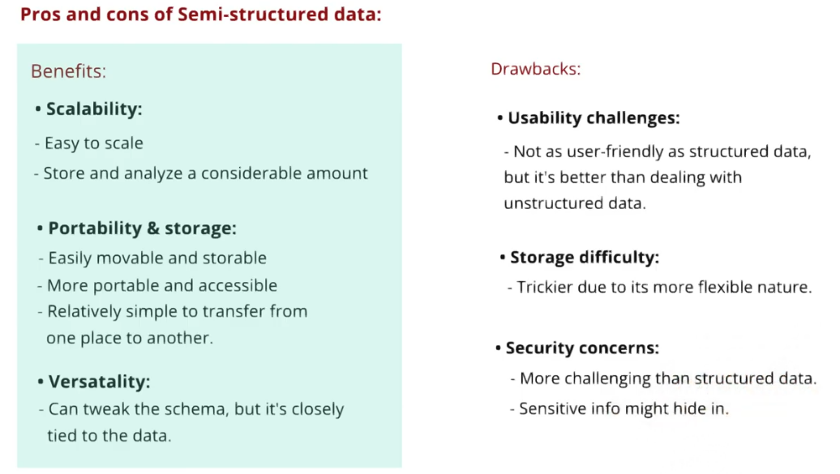

Slide 13
Data mining is the process of discovering patterns in large data sets involving methods at the intersection of machine learning, statistics, and database systems.
Goal is to extract information (with intelligent method) from a data set and transform the information into a comprehensible structure for further use.
or
Data mining is the process of sorting through large data sets to identify patterns and establish relationships to solve problems through data analysis.

Slide 14
Algorithms
1. Association Rule Mining
Also called as “ Market Basket analysis”
Used to determine “What goes with what ?”
2. Regression Analysis
Helps to predict relationship between 2 variables( dependent and independent variables)
3. Collaborative filtering (social filtering)
Filters information by using the recomendations of other people
4. Text analytics Or Text mining
Is a process of deriving high quality of information from text

Slide 15
5. Natural Language Processing: about enabling computers to understand human or natural language input
6. Noisy Text analysis: process of extracting structured or semi structured information from noisy unstructured data
7. Part of Speech tagging: reading text and categorizing into noun, verb, objectives etc
8. Manual tagging with meta data
9. Unstructured Info management Architecture (UIMA): open source platform from IBM to process text and other unstructured data for real time content analytics

