Slide 1
Big Data Analysis of Enterprise
Understand their customer
Provide targeted promotions
Optimize the workforce and save cost and time
Forecast market trends
Take efficient decisions
Boost customer acquisition and retention
Innovate and revamp their products

Slide 2
Chracteristics of Data
● Composition: Deals with the structure of data. i.e.
sources of data, types of data, nature of data.
Granularity (Quality of data)
Types & nature of data (Static or Real Time)
● Condition: Deals with state of data i.e.
Can one use this data as it is for analysis
(or) does it require cleaning for further enhancemment and enrichment

Slide 3
● Context: deals with generation of data, sensitivity of data. i.e
Where has this data been generated?
Why was this data generated?
How sensitive is this data?
What are the events associated with this data ? And so on...

Slide 4
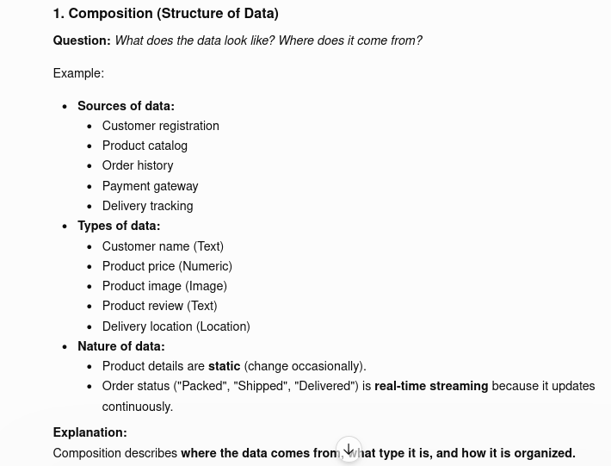

Slide 5
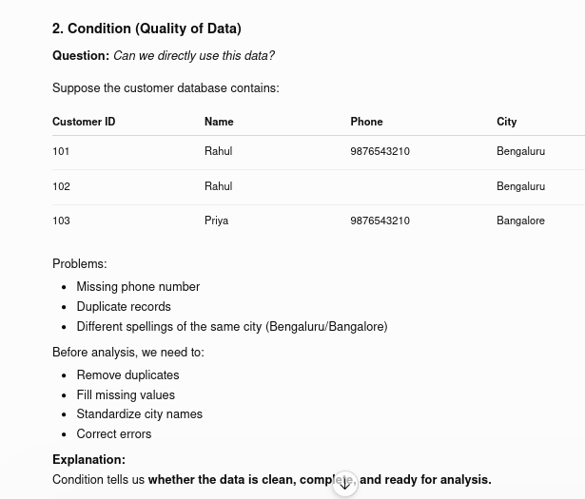

Slide 6
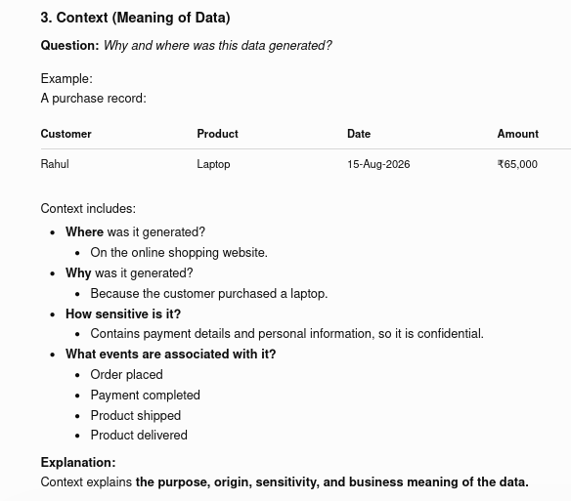

Slide 7
Small Data Vs Big Data
Small data( data existed prior to big data revolution) is about Certainty Is about fairly known data sources Is about no major changes to composition and context of data | Big data is about Complexity Interms of multiple and unknown data sets Interms of exploding volume Interms of speed at which the data is being generated Interms of speed at which the data needs to be processed Interms of variety of data (internal or external, behavioural or social) that is being generated

Slide 8
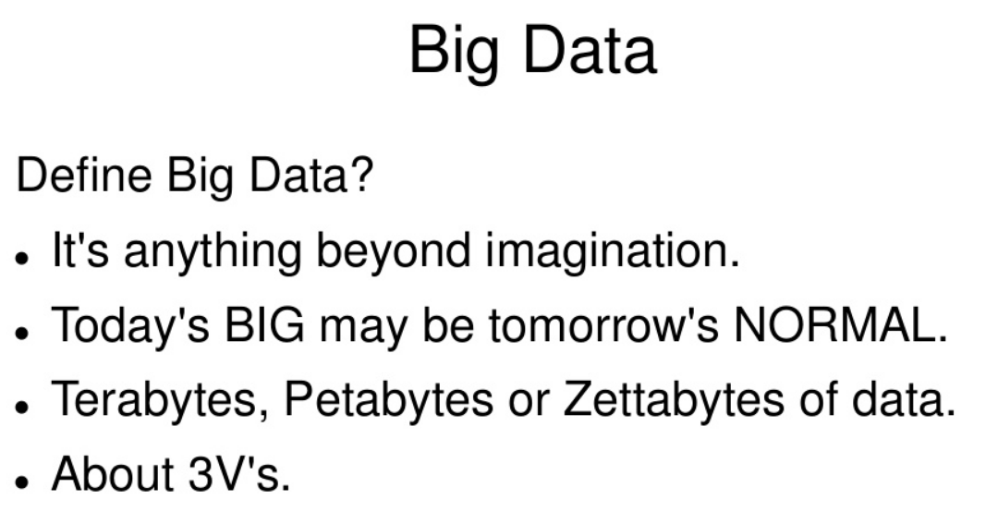

Slide 9
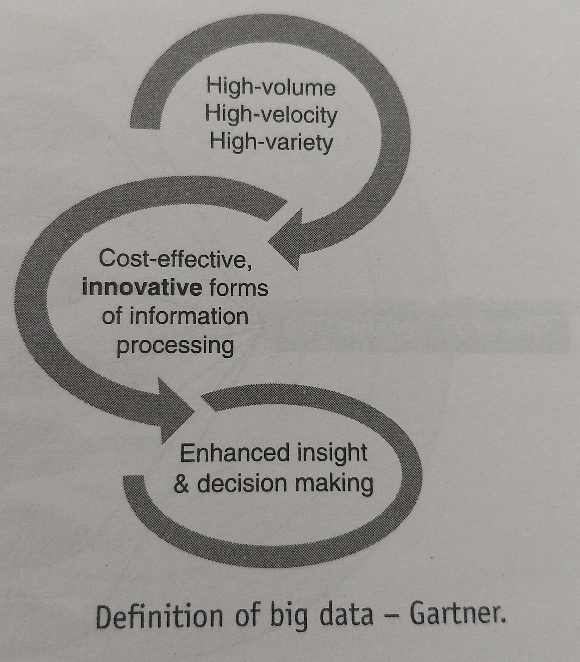

Slide 10
High-Volume: Massive amounts of data generated from transactions, smart devices, and logs.
High-Velocity: Data streaming and arriving at unprecedented speeds requiring real-time or near-real-time handling.
High-Variety: Diverse data types spanning structured database records, unstructured text, audio, and video.
Innovative Forms of Processing: Demands new technical architecture and distributed systems instead of traditional relational databases.
Enhanced Insight: Shifts focus toward optimized decision-making, pattern recognition, and process automation.

Slide 11
Gartner defines big data as high-volume, high-velocity, and high-variety information assets that demand cost-effective, innovative forms of information processing for enhanced insight and decision making.

Slide 12
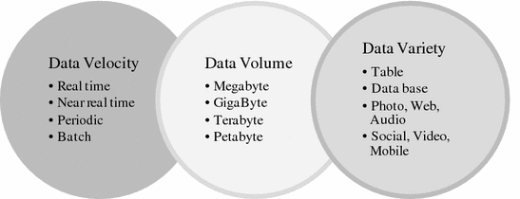
Gartner's view has evolved original 3Vs framework

Slide 13
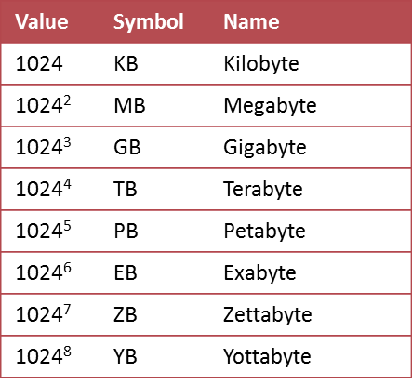
Growth of Data

Slide 14
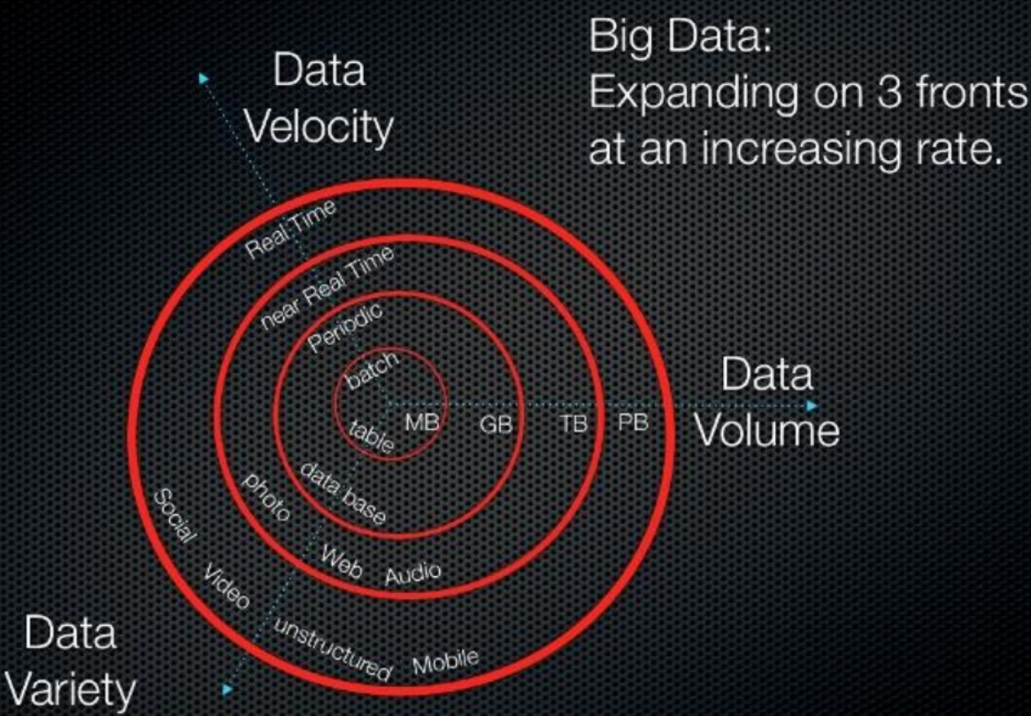

Slide 15
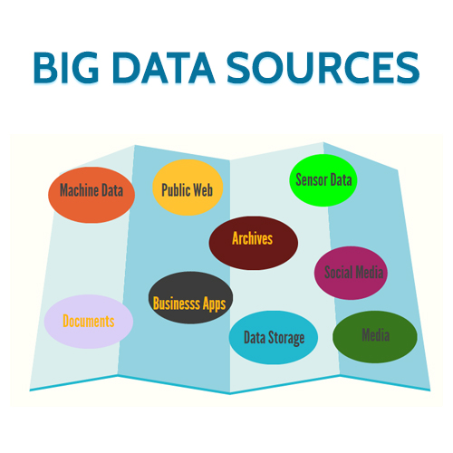
(internal or external or (internal+external)) to the organization

Slide 16
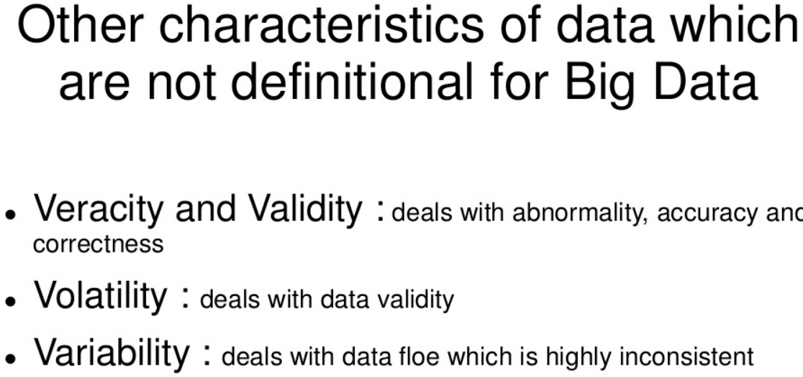
w

Slide 17
Varacity
It refers to inconsistencies and uncertainty in data, that is data which is available can sometimes get messy and quality and accuracy are difficult to control. Big Data is also variable because of the multitude of data dimensions resulting from multiple disparate data types and sources.
Validity (Usefulness):Checks if data matches the goal.Ensures data follows the right rules.Tests if the data answers the question.

Slide 18
Volatility in Big DataShelf life: Refers to how long data remains useful before it becomes obsolete or useless.Storage strategy: Forces systems to decide when to delete, archive, or move data to cold storage.Real-time decay: Common in financial ticks or social trends that expire in seconds or hours

Slide 19
Variability in Big Data
Context shifts: The meaning or formatting of data changes unpredictably over time.
Inconsistent flow: Data load speeds fluctuate randomly rather than streaming at a steady pace.
Distinction from Variety: Variety is about different types of data (text, video), while variability is how those types change shape, tone, or structure midstream

Slide 20
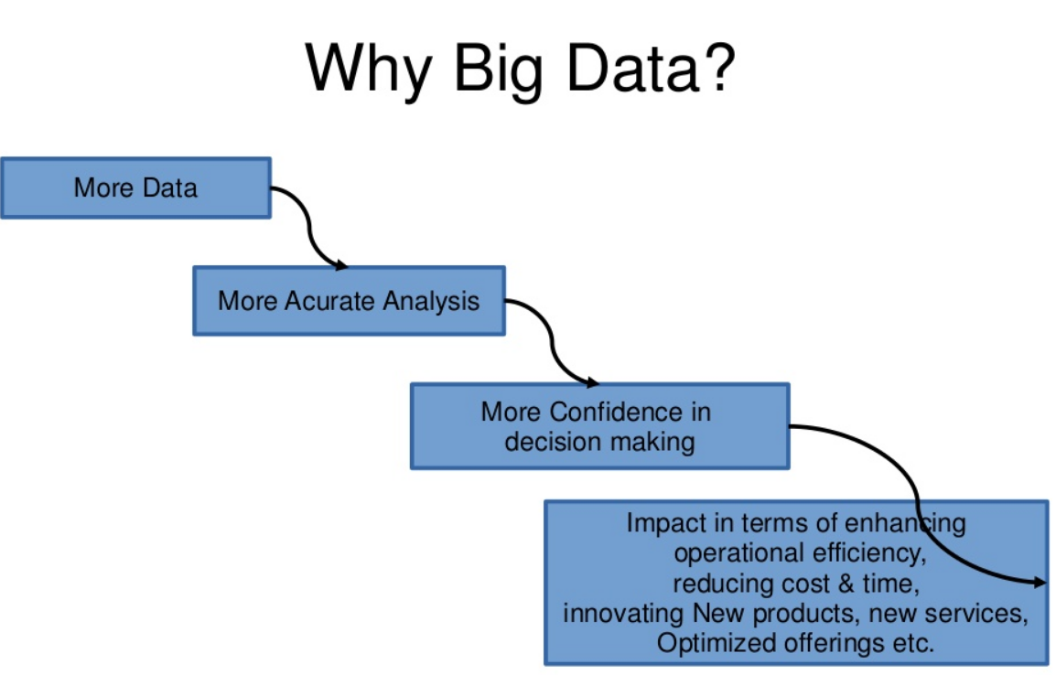
Data in bulk could create confusion whereas less amount of data could convey half or Incomplete Information.

Slide 21
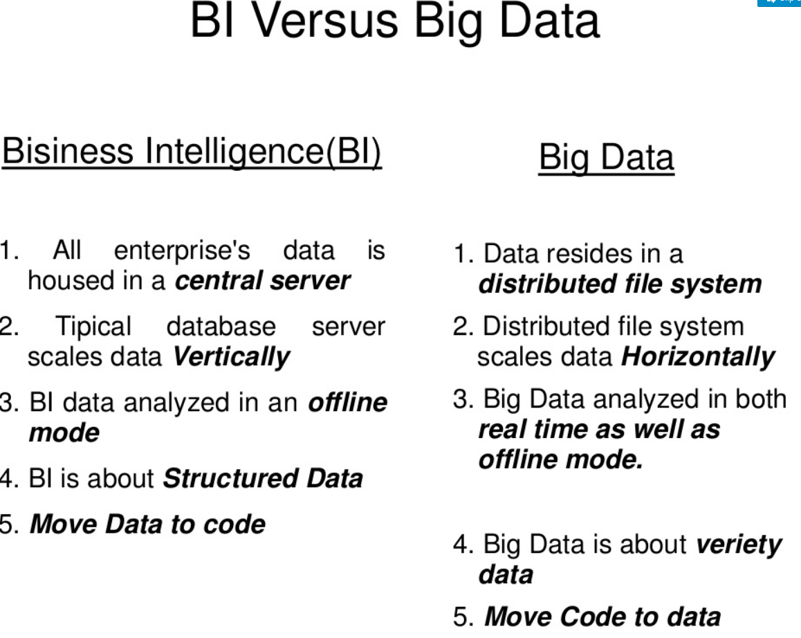

Slide 22
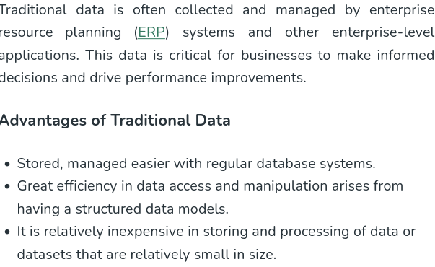

Slide 23
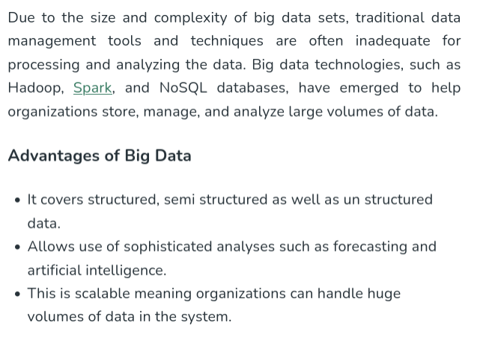
NoSQL databases (AKA "not only SQL") store data differently than relational tables. The main types are document, key-value, wide-column, and graph.

Slide 24
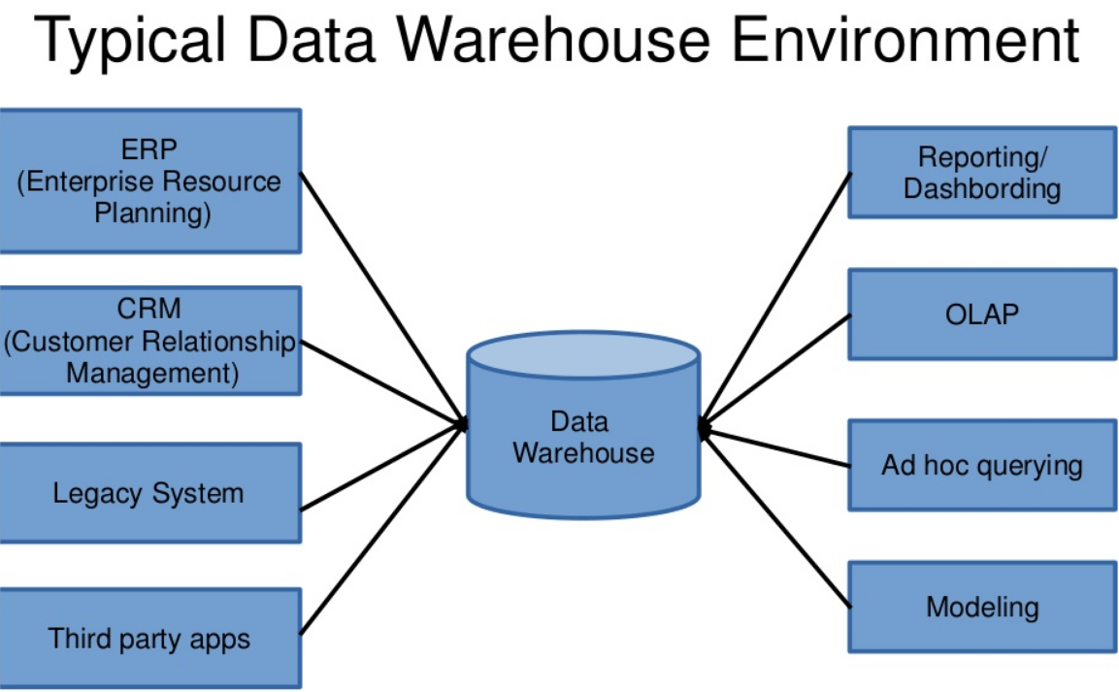
ETL(extract transform and load)
Online Analytical Processing(OLAP)

Slide 25
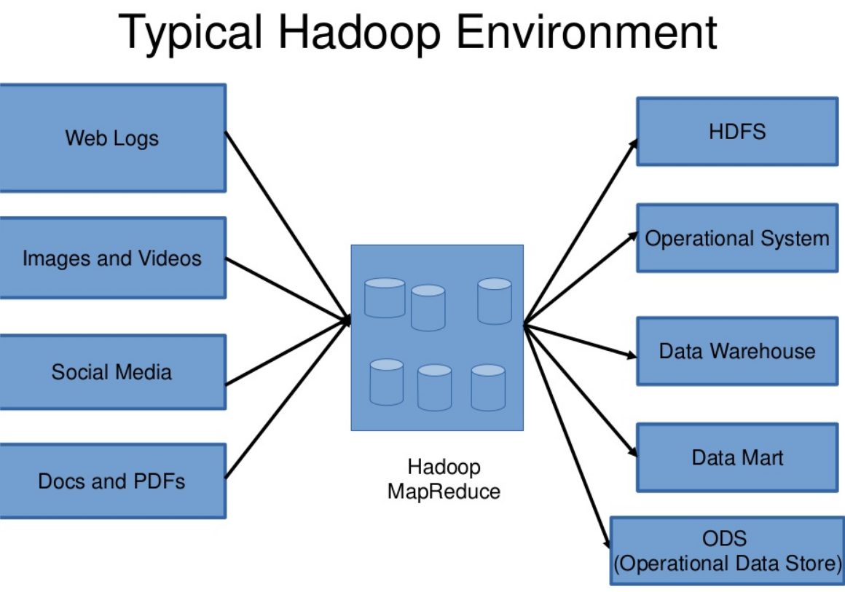
A Hadoop Environment refers to an open-source framework designed for the storage and processing of big data.

Slide 26
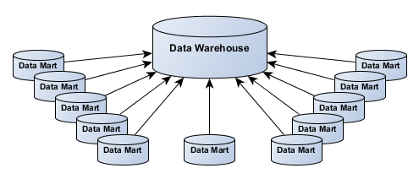
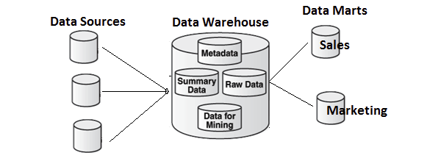
Data Mart
Generally, a data mart can be thought of as a subset of a data warehouse. The data mart is a storehouse of data that is meant to serve a specific community and is designed to meet the needs of a specific group of users.
Data marts are usually controlled by a single department of an organization like sales, finance, etc.

Slide 27
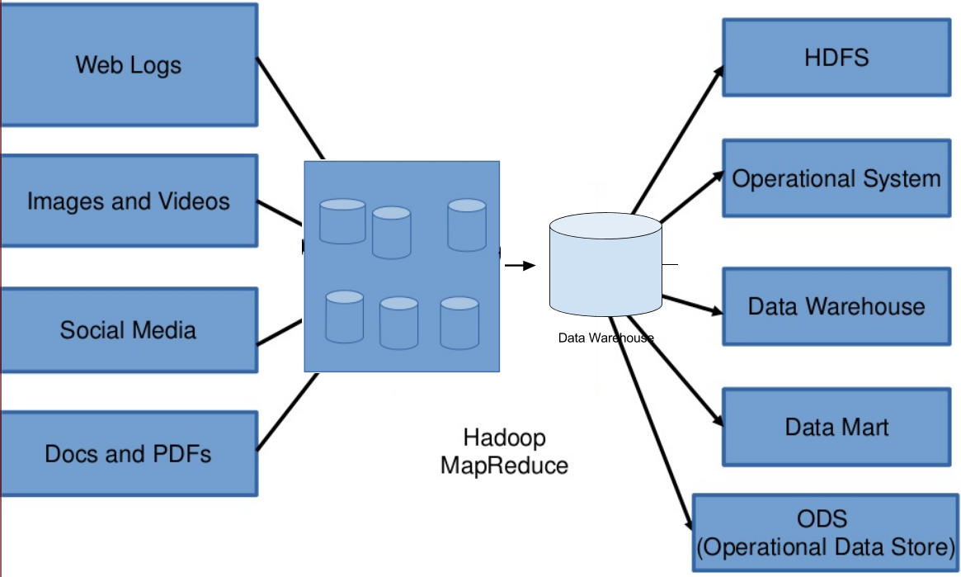
Big Data and Data Warehouse Coexistence

Slide 28
