Slide 1
Big Data Analytics
Big data analytics is the process of examining large and varied data sets --
i.e., big data -- to uncover hidden patterns, unknown correlations, market trends, customer preferences and other useful information that can help organizations make more-informed business decisions.
Analytical finding can lead to more effective marketting, better customer service & satisfaction, newer products & services, improved operational efficiency, reduced expenditure etc.. (ex: Amazon recommendations)

Slide 2
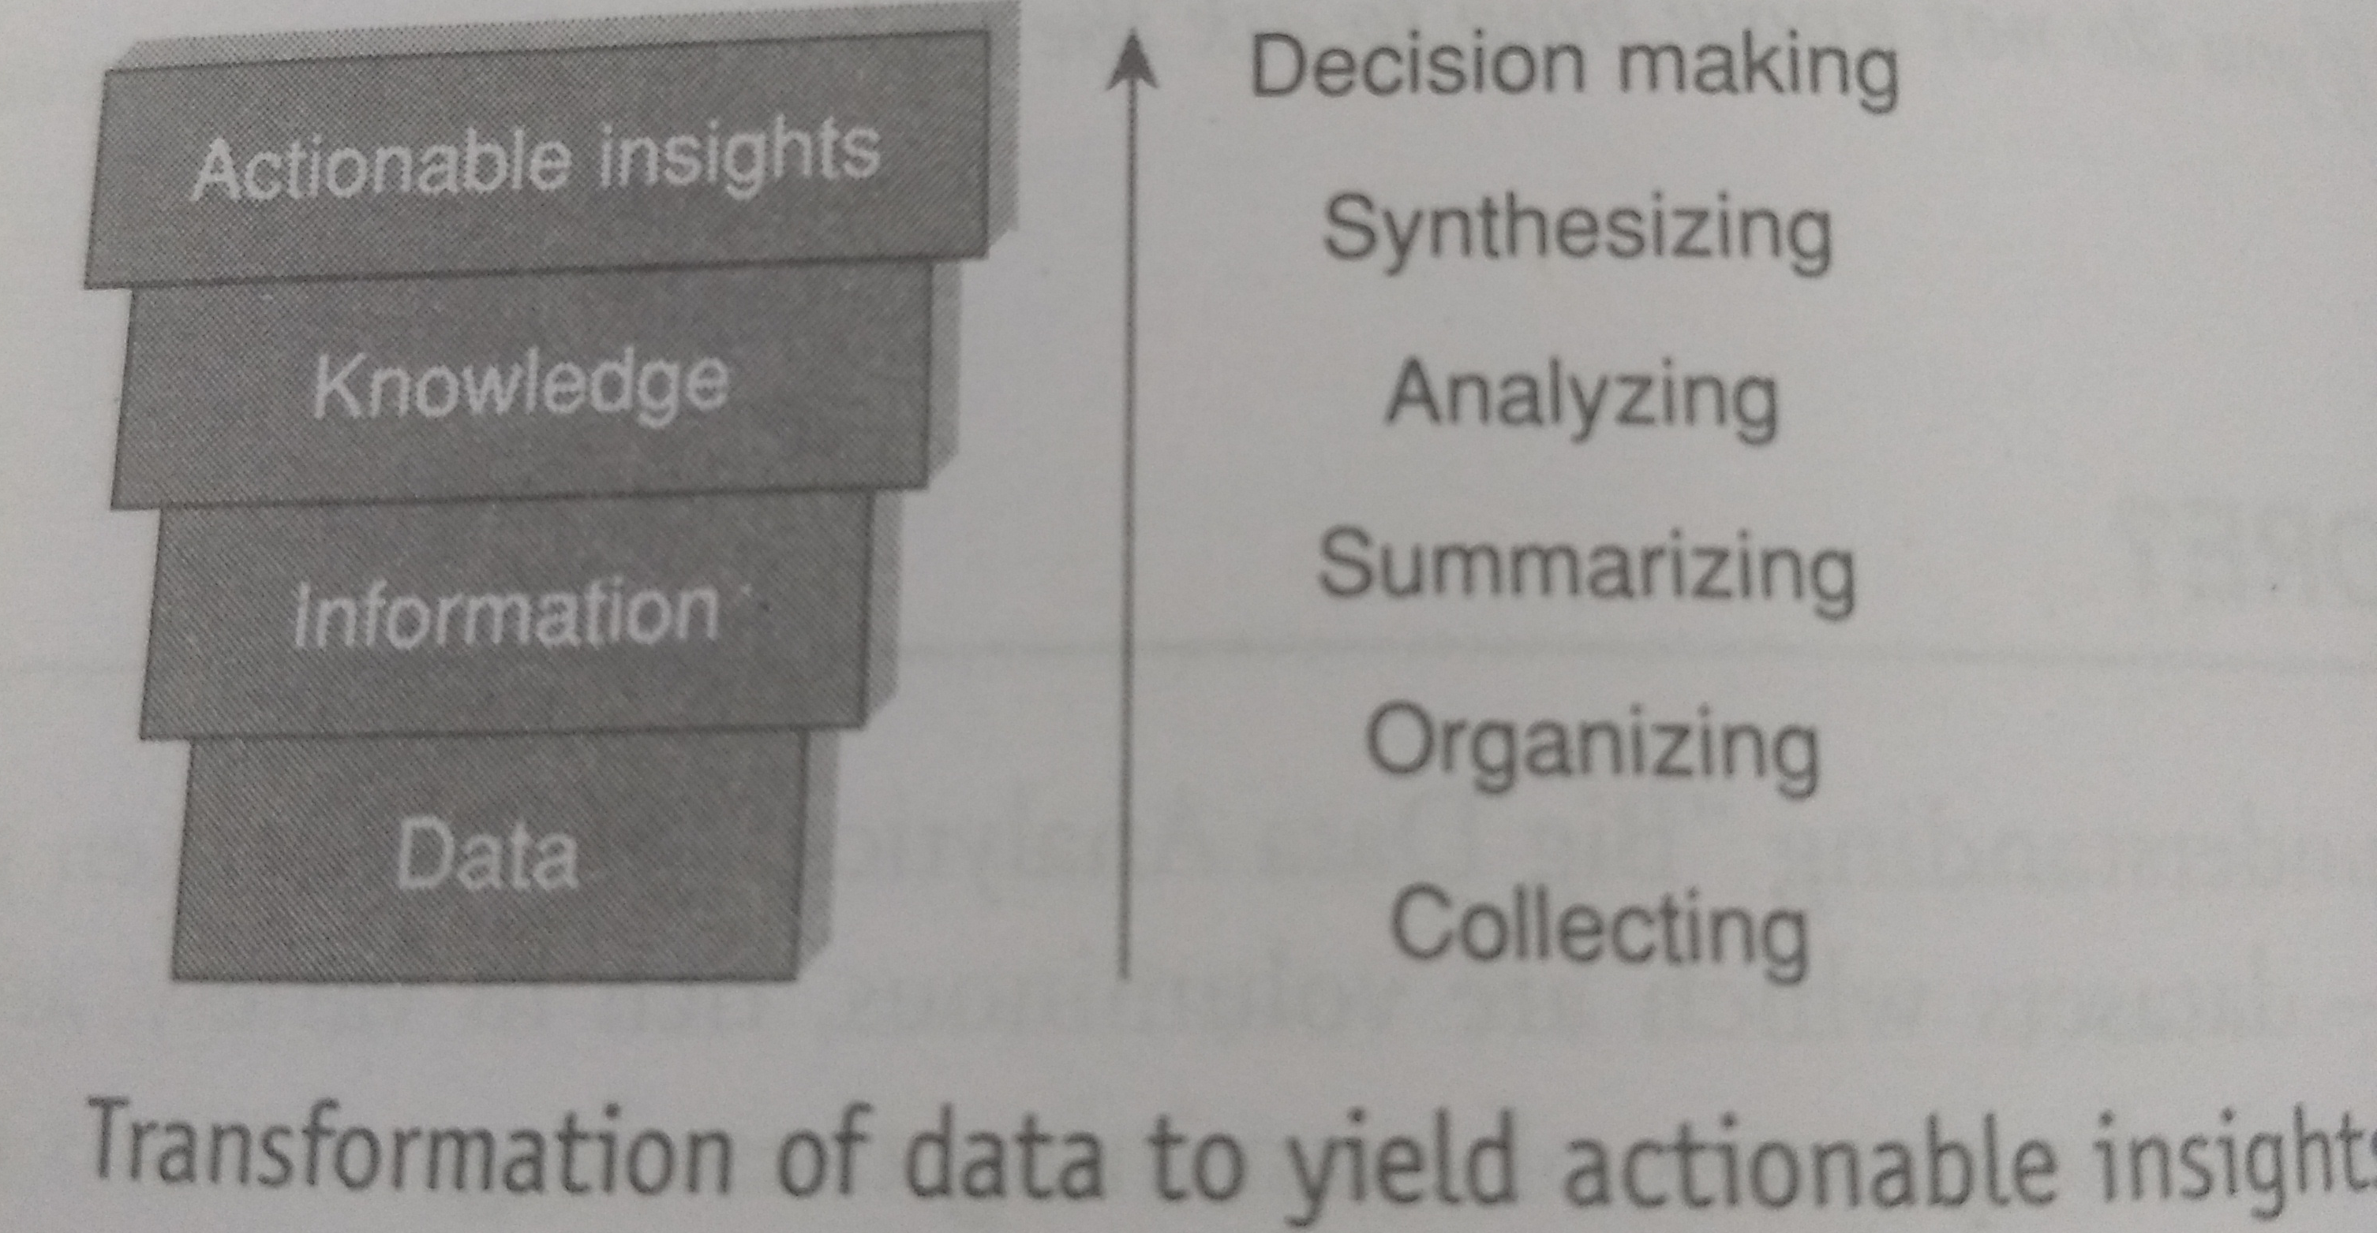
Where Do We Begin ?

Slide 3
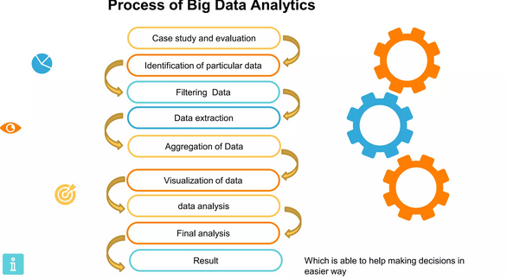

Slide 4
What is Big Data Analytics?
Better, faster
decisions in real
time
Move code to data for
Greater speed
And efficiency
Richer, deeper insights
Into customers, partners
And business
Big Data Analytics
Working with datasets
Whose volume and variety
Is beyond the storage and
Processing capability of a
Typical database software
Competetive
advantage
Technology
Enabled
Analytics
(R, SAS, IBM,Weka)
IT's collaboration with
Business users and
Data scientists
Time sensitive decions
Made in near real time
By processing a steady
Stream of real-time data

Slide 5
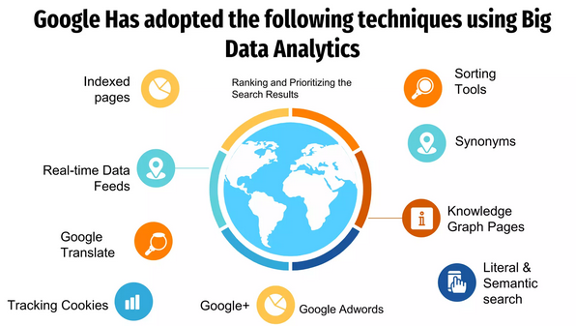

Slide 6
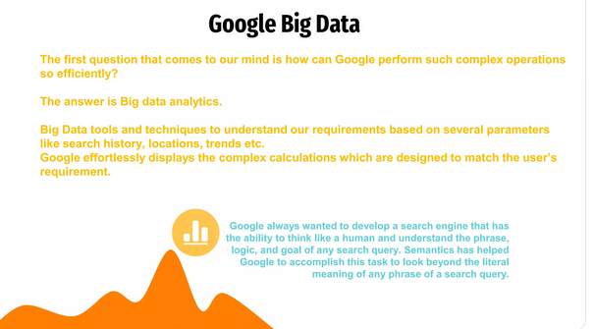

Slide 7
What is Big Data Analytics isn't?
Only About Volume
“One Size-Fit All”
RDBMS built on
shared disk and memory
Just about Technology
Big Data Analytics
Isn't
Only used by huge
online companies
Like Google or Amazon
Meant to replace
RDBMs
Meant to replace
Datawarehouse

Slide 8
Why sudden hipe around BDA ?
Data growing at 40% compound rate, reaching nearly 50 ZB by 2020
Cost per GB of storage has hugely dropped
There is a shortage of user friendly analytical tools available in the market today

