Slide 1
Classification of Analytics
Analytics 1.0 | Analytics 2.0 | Analytics 3.0
Era: mid 1950's to 2009 | Era:2005 to 2012 | Era:2012 To Present
Descriptive Staistics ( report on events, occurences etc of the past) | Descriptive+Predictive Statistics (use data from the past to made predictions for the future) | Descriptive+Predictive + Prescritive Statistics (use data from the past to made predictions for the future at the same time make recommendations to leverage the situation to one's advantage)
Key Questions asked: What happed? Why did it happen ? | Key Questions asked: What will happen? Why will it happen? | Key Questions asked: What will happen? Why will it happen? When will it happen What should be the action taken to take advantage of what will happen?
Data from legacy systems, ERP,CRM and 3rd party applications | Big Data | A blend of big data and data from legacy systems, ERP,CRM and 3rd party applications
ERP* enterprise resource planning
CRM* customer relationship management.

Slide 2
Analytics 1.0 | Analytics 2.0 | Analytics 3.0
Small and structured data sources. Data stored in enterprise data warehouse or data marts | Big data is being taken up seriously. Data is mainly unstructured, arriving at a much higher pace. | A blend of big data and traditional analytics to yield insights and offerings with speed and impact
Data was internally sourced | Data was often externally sourced | Data is both being internally and externally sourced
Relational Databases | Database appliances, Hadoop clusters, SQL to Hadoop environments etc | In memory analytics, in database processing, agile analytical methods, machine learning techniques etc

Slide 3
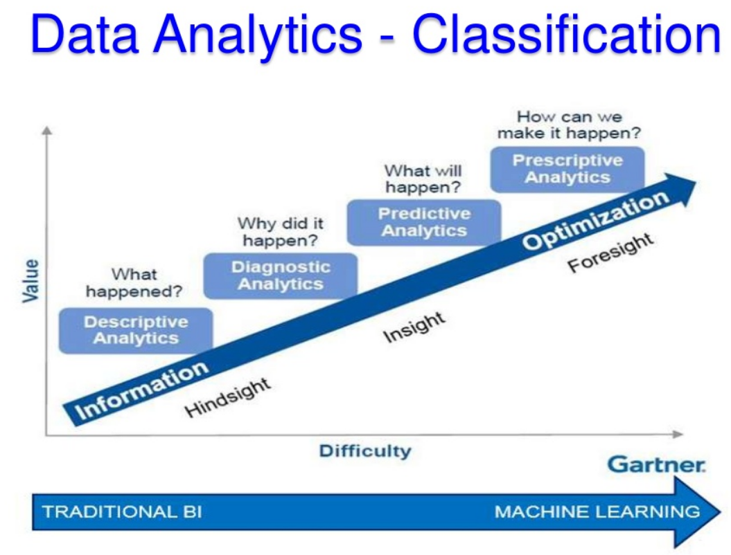

Slide 4
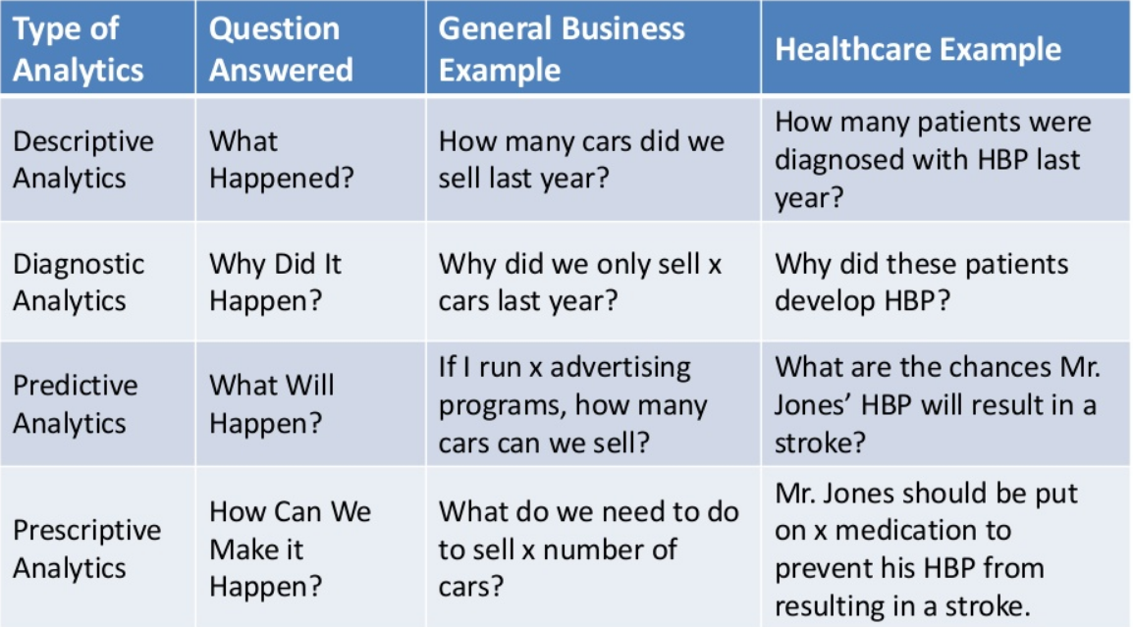

Slide 5
