Slide 1
Greatest challenges that prevent business from capitalizing on big data
Obtaining executive sponserships for investments in big data and its related activities( such as training etc)
Getting the business units to share information across organizations
Finding the right skills (business analysts and data scientists)

Slide 2
Greatest challenges that prevent business from capitalizing on big data
Determining the approach to scale rapidly and elastically
Unpredictable Cloud Costs: Auto-scaling often triggers runaway expenses if workloads are not optimized.
Data Bottlenecks: Real-in-time ingestion lags when storage and compute layers fail to scale at matching speeds.
Architecture Limitations: Old on-premise systems break down under sudden multi-tenant spikes.
State Management: Keeping data consistent across distributed, auto-expanding nodes creates complex sync failures.

Slide 3
Greatest challenges that prevent business from capitalizing on big data
Deciding whether to use structured or unstructured, internal or external data to make business decisions
Choosing the optimal way to report findings and analysis of big data for the prsentations to make more sense
Determining what to do with the insights created from big data

Slide 4
Top challenges facing Big data
Scale: Should you scale vertically or horizontally ?
Security: Most of big data platforms have poor security mechanisms
Schema: Rigid schemas have no place. The need of the hour is dynamic schema
Continuous Availability: How to provide 24/7 support
Consistency: Should one opt for consistency or eventual consistency?
Partition tolerant: How to build partition tolerant systems that can take care of both hardware and software failures?
Data quality: how to maintain accuracy, completeness, timeliness etc

Slide 5
Termnologies used in Bid Data Environments
1. In-Memory Analytics:
In-memory analytics is a business intelligence (BI) methodology used to solve complex and time-sensitive business scenarios.
It works by increasing the speed, performance and reliability when querying data.
Business Intelligence deployments are typically disk-based, meaning the application queries data stored on physical disks. In contrast, with in-memory analytics, the queries and data reside in the server's random access memory (RAM)
In-memory analytics helps improve the overall speed of a BI system and provides business-intelligence users with faster answers compared to traditional disk-based business intelligence, especially for queries that take a long time to process in a large database.

Slide 6
2. In-database processing:
In-database processing, sometimes referred to as in-database analytics, refers to the integration of data analytics into data warehousing functionality.
In-database analytics is a technology that allows data processing to be conducted within the database by building analytic logic into the database itself.
Doing so eliminates the time and effort required to transform data and move it back and forth between a database and a separate analytics application.
Many large databases, such as those used for credit card fraud detection and investment bank risk management, use this technology because it provides significant performance improvements over traditional methods.

Slide 7
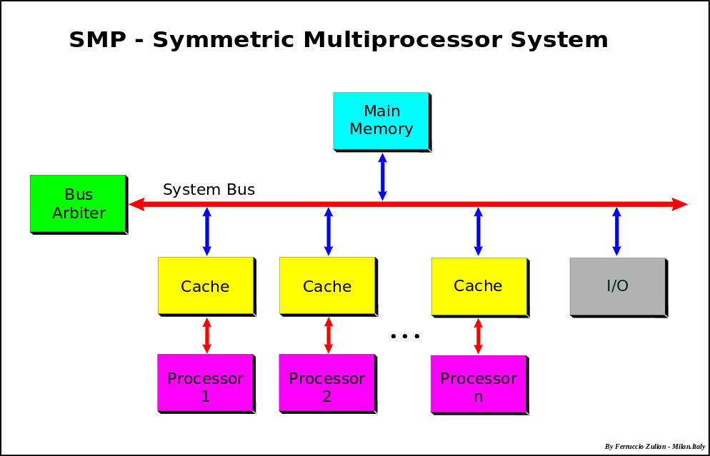
3. Symmetric Multiprocessor System (SMP):

Slide 8
Symmetric multiprocessing (SMP) involves a multiprocessor computer hardware and software architecture where two or more identical processors are connected to a single, shared main memory, have full access to all input and output devices, and are controlled by a single operating system instance that treats all processors equally, reserving none for special purposes. Most multiprocessor systems today use an SMP architecture.
In the case of multi-core processors, the SMP architecture applies to the cores, treating them as separate processors.
SMP systems are tightly coupled multiprocessor systems with a pool of homogeneous processors running independently of each other.
Each processor, executing different programs and working on different sets of data, has the capability of sharing common resources (memory, I/O device, interrupt system and so on) that are connected using a system bus or a crossbar.

Slide 9
4. Massively Parallel Processing (MPP):
MPP (massively parallel processing) is the coordinated processing of a program by multiple processor s that work on different parts of the program, with each processor using its own operating system and memory .
A messaging interface is required to allow the different processors involved in the MPP to arrange thread handling.
An MPP system is also known as a "loosely coupled" or "shared nothing" system.
An MPP system is considered better than a symmetrically parallel system ( SMP ) for applications that allow a number of databases to be searched in parallel.
These include decision support system and data warehouse applications.

Slide 10
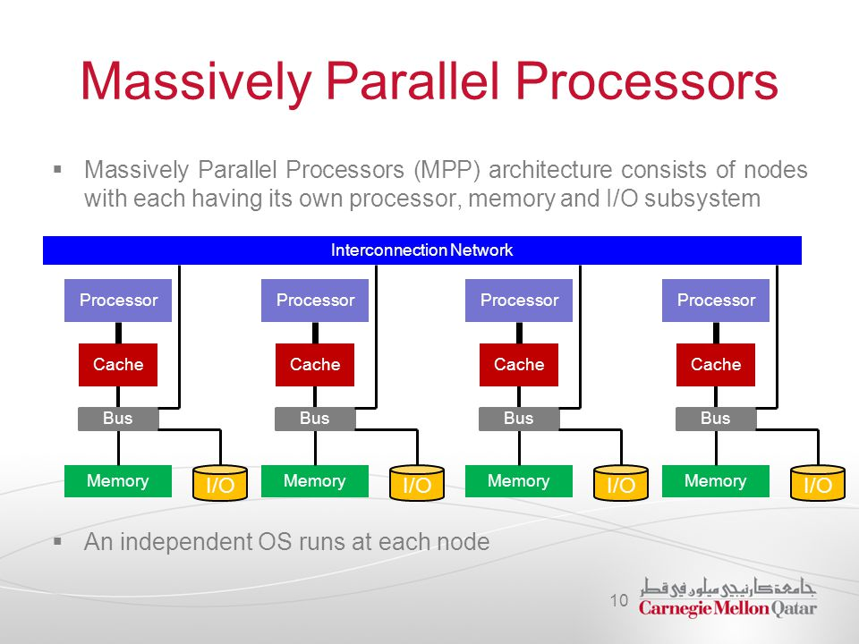

Slide 11
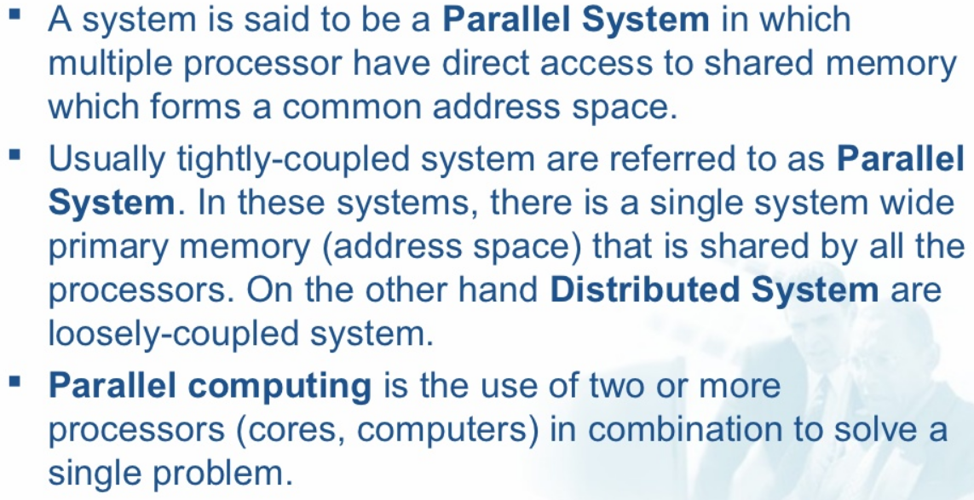
5. Difference between Parellel and Distributed systems
Parallel system:

Slide 12
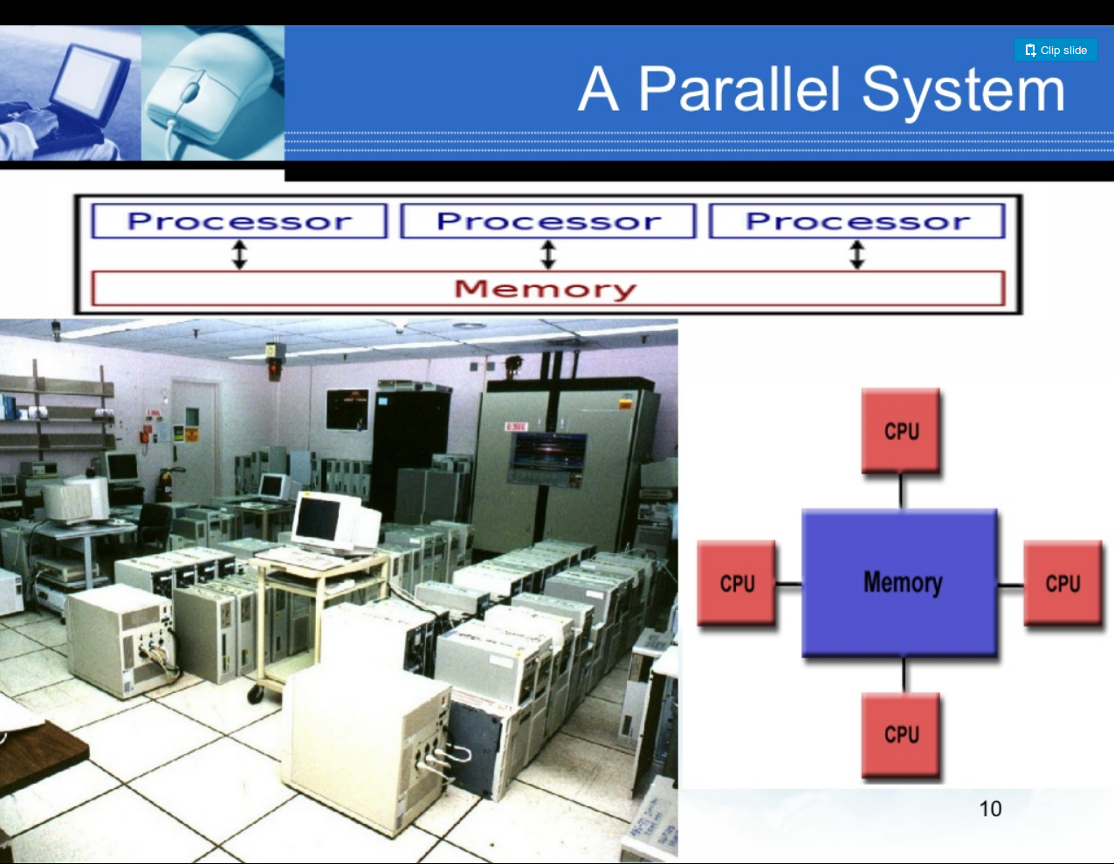

Slide 13
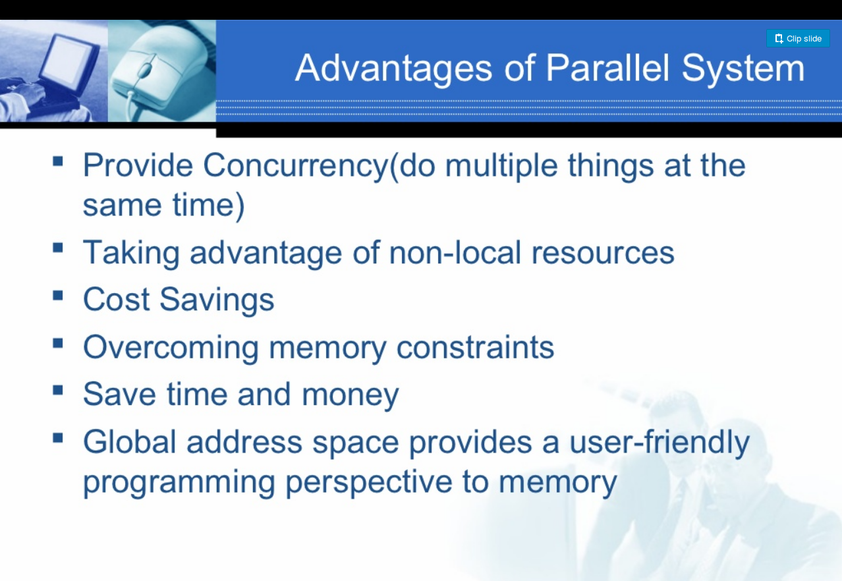

Slide 14
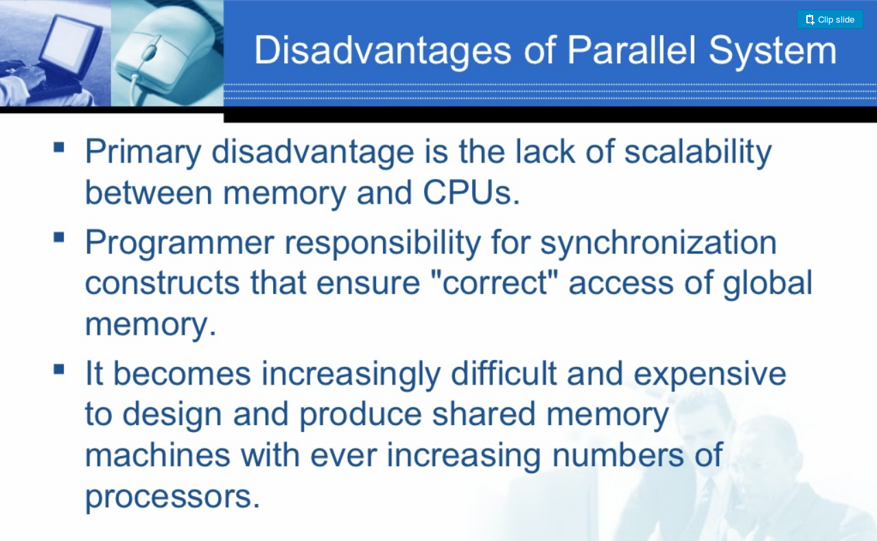

Slide 15
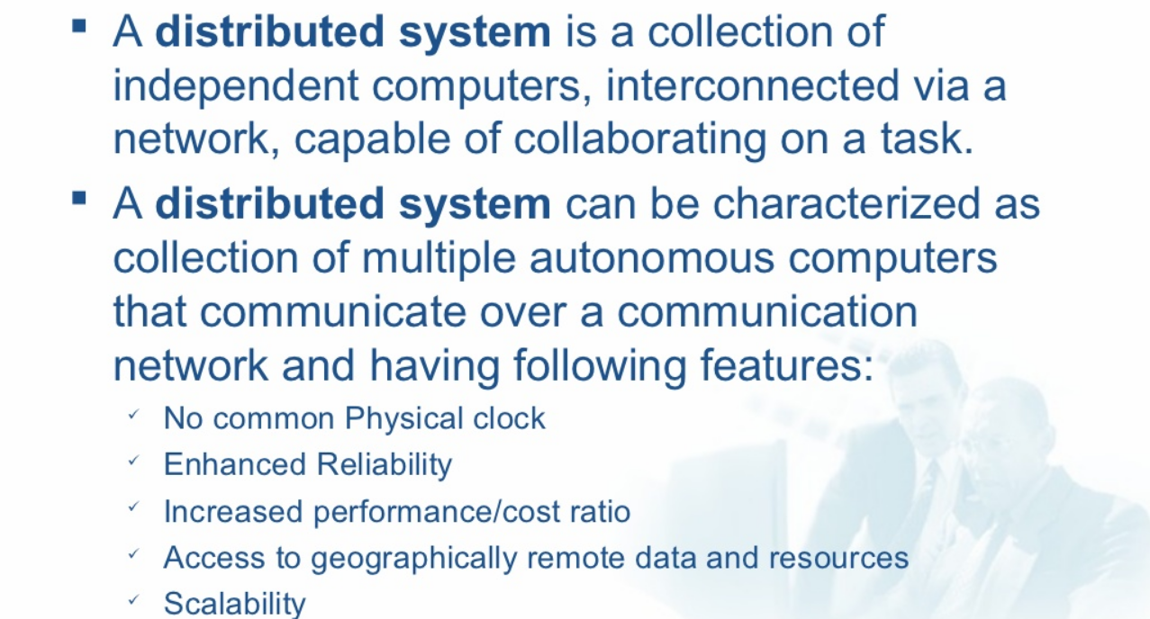
Distributed System:

Slide 16
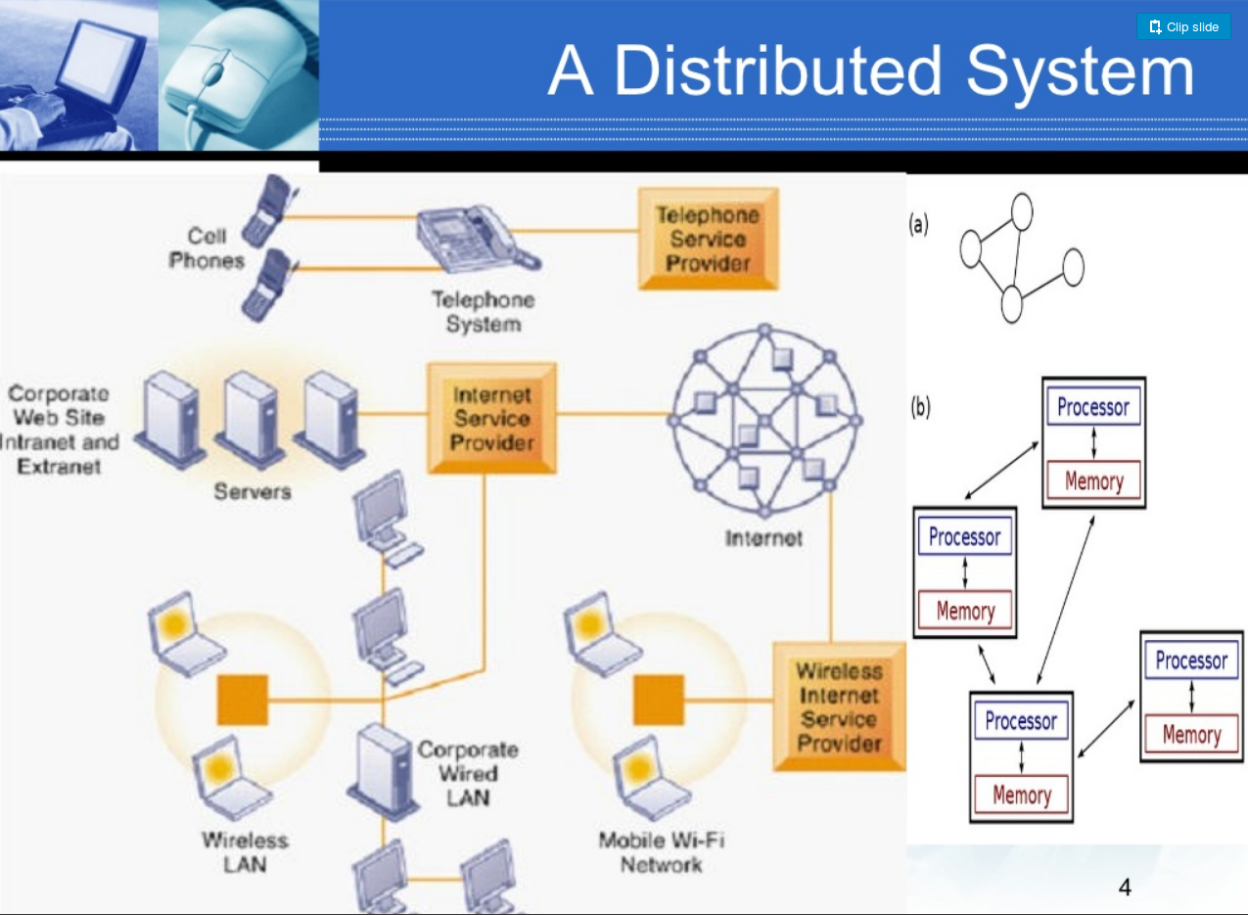

Slide 17
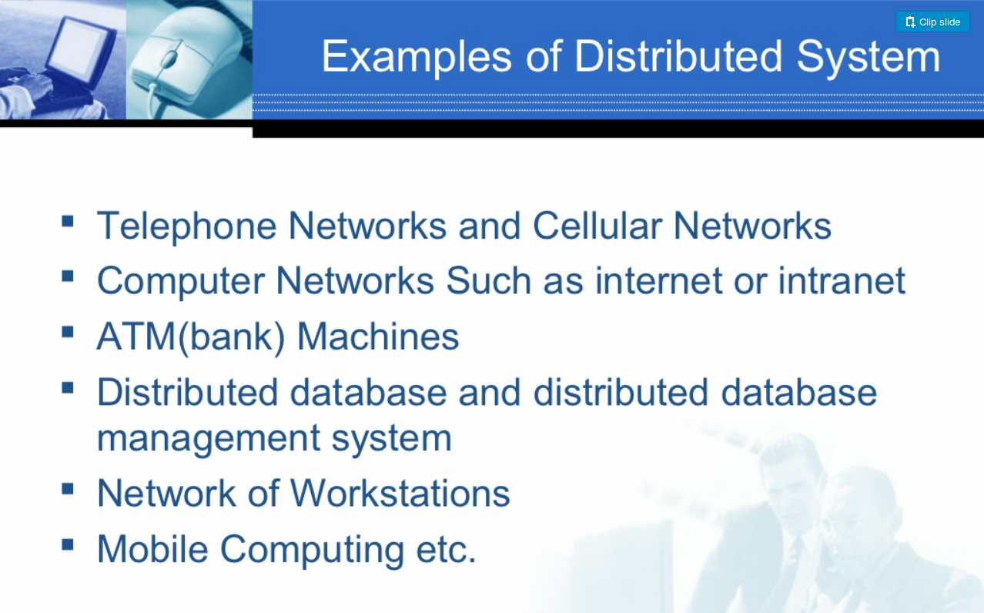

Slide 18
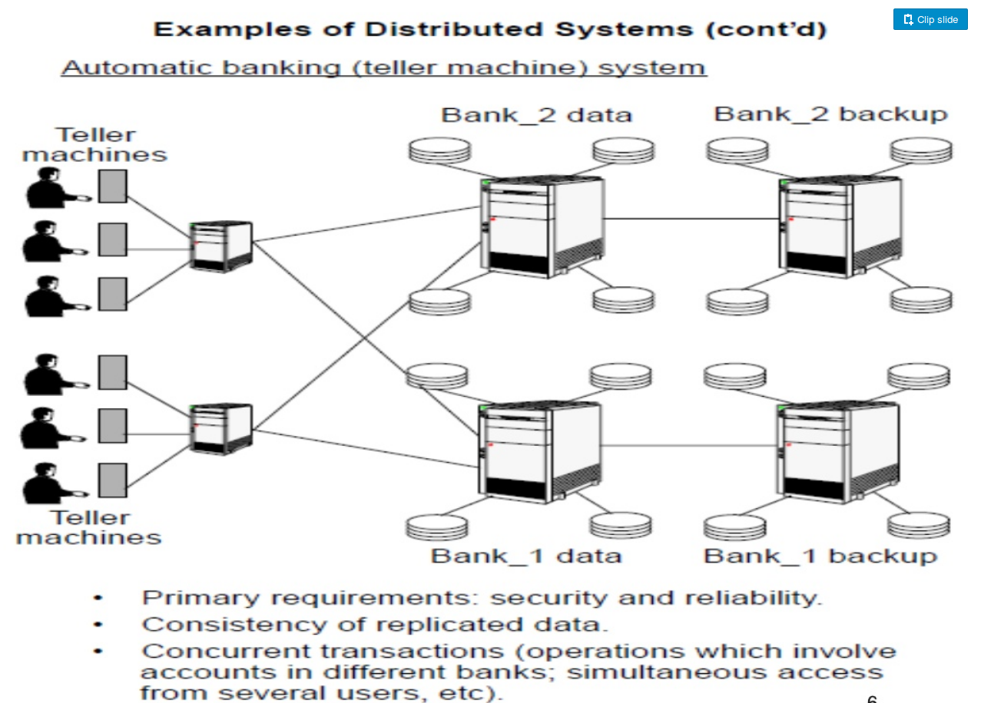

Slide 19
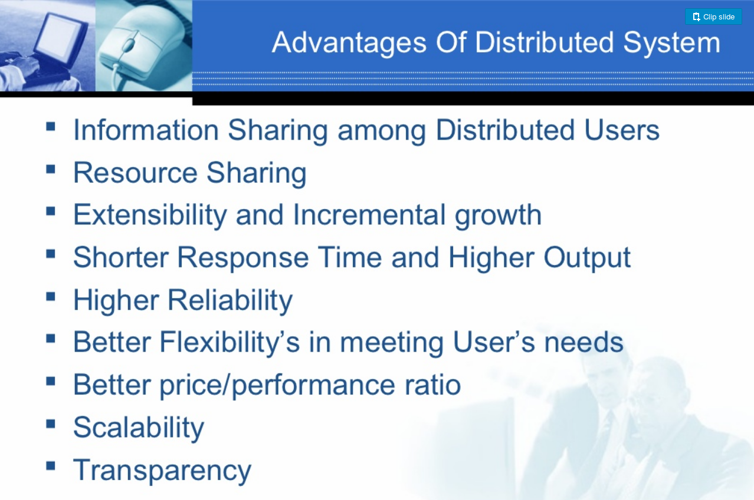

Slide 20
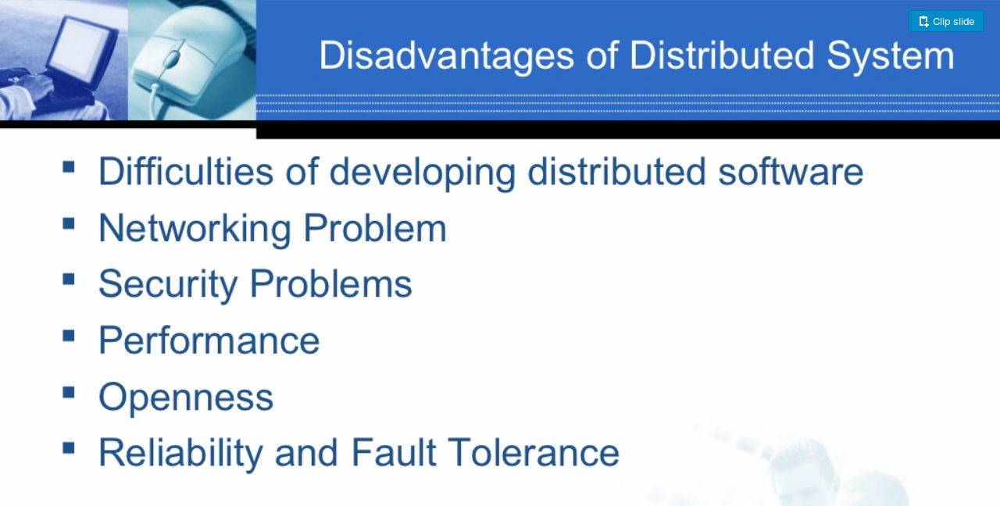

Slide 21
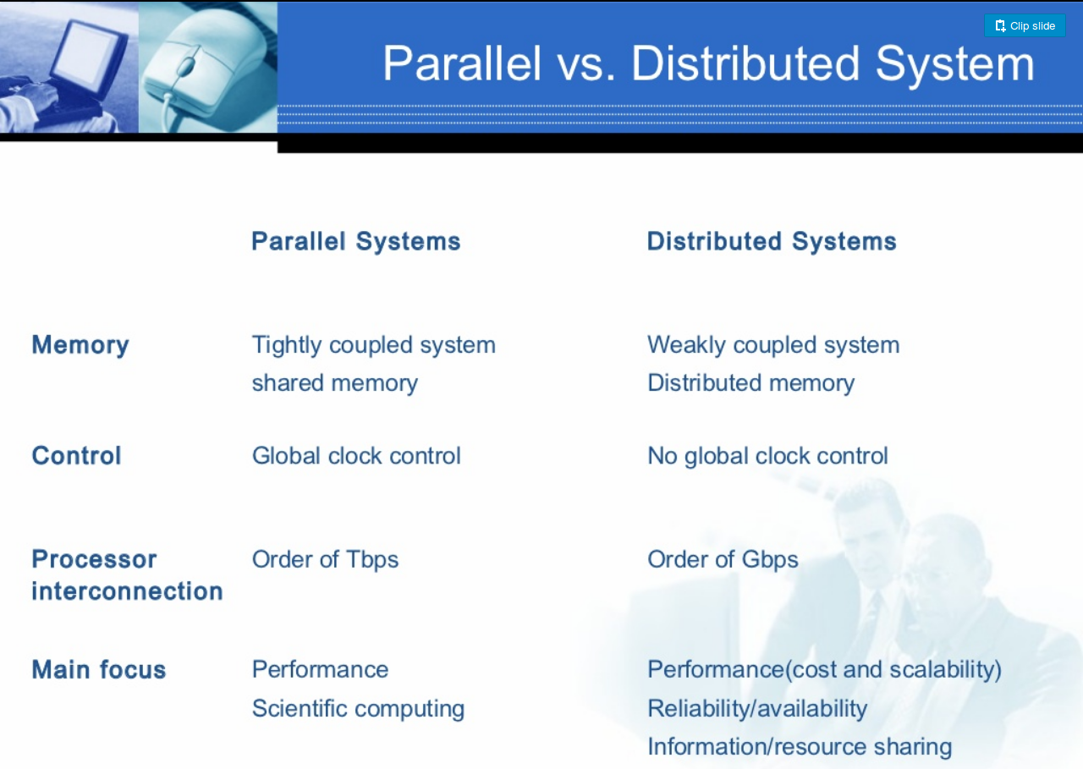

Slide 22
6. Shared Nothing architecture
Three most common types of architecture for multiprocessor high transaction rate systems are:
a. Shared Memory (SM)
--- A common central memory is shared my multiple processors.
b. Shared Disk (SD)
--- Multiple processors have a common collection of disks having their own private memory.
c. Shared Nothing (SN)
--- Neither memory, nor disk is shared among the multiple processors.

Slide 23
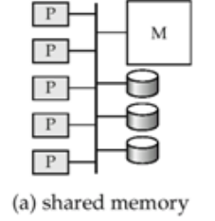
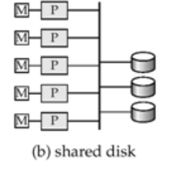
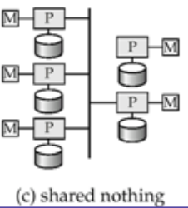

Slide 24
6. Shared Nothing architecture
The "Shared Nothing" concept that makes these systems possible was proposed by Michael Stonebraker in 1986 - when mainframes ruled and the internet barely existed!
Historical Context
In 1986, the computing landscape was totally different:
Mainframes were king
Minicomputers were just getting decent
Networking was in its infancy

Slide 25
What Made It Revolutionary?
Each node should have its own: CPU Memory Disk
No shared resources between nodes (hence "Shared Nothing")
Nodes would communicate only through the network - exactly how our modern distributed systems work!
4. Why It's Still Relevant
The principles Stonebraker outlined everywhere in modern tech:
Horizontal Scaling: Just add more nodes
Fault Tolerance: Node goes down? No problem, the system keeps running
Cost-Effectiveness: Use cheap commodity hardware(low-cost, standardized, off-the-shelf ) instead of expensive specialized equipment

Slide 26
6. Shared Nothing architecture
--A shared-nothing architecture is a distributed computing design where each node in a cluster operates completely independently with its own dedicated CPU, memory, and storage.
New nodes can be added easily, and failures in one node do not directly affect others.
Example: A large e-commerce platform distributes customer data and transactions across multiple servers. If one server fails, the remaining servers continue operating, ensuring high availability and performance.

Slide 27
Advantages and Disadvantages of SN Architecture
Advantages
Elimination of SPOF (single point of failure) – if a part of a system fails, it won’t stop the entire system from working
Non-disruptive upgrades – database updates will not interrupt access to database data
No need for reboots – SN does not require system as a whole to be rebooted when the update process completes.
Self-healing capabilities – allows a database to be repaired while still processing transactions
Disadvantages
Hard to program
Addition of new nodes requires reorganizing

Slide 28
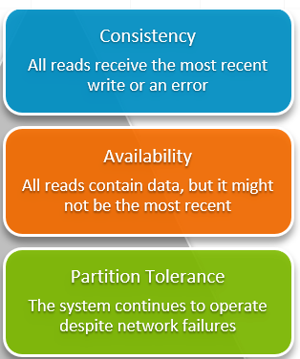
7. CAP Theorem: In the world of distributed systems, where data needs to be stored and accessed across multiple servers or nodes, ensuring the system’s reliability, performance, and consistency can be quite challenging. To address these challenges, computer scientist Eric Brewer introduced the CAP theorem,

Slide 29
7. CAP Theorem
It is also called as Brewer's Theorem or two out of three theorem.
“ It states that in a distributed computing environment, it is impossible to provide the following guanrantees. At the best you can have two of the following three – one must be sacrified.”
1. Consistency
2. Availability
3. Partition Tolerance
Example: Updating a status in a Facebook.
We do not want any type of consistency and also we do not want that our whole servers are available because it may be happens that it is available to some people and later on it may be show to other people also.

Slide 30
Consistency –
This means that the data in the database remains consistent after the execution of an operation. For example after an update operation all clients see the same data.
Availability – This means that the system is always on (service guarantee availability), no downtime.
Partition Tolerance – This means that the system continues to function even the communication among the servers is unreliable, i.e. the servers may be partitioned into multiple groups that cannot communicate with one another.
Theoretically it is impossible to fulfill all 3 requirements.
CAP provides the basic requirements for a distributed system to follow 2 of the 3 requirements.
Therefore all the current NoSQL database follow the different combinations of the C, A, P from the CAP theorem.

Slide 31
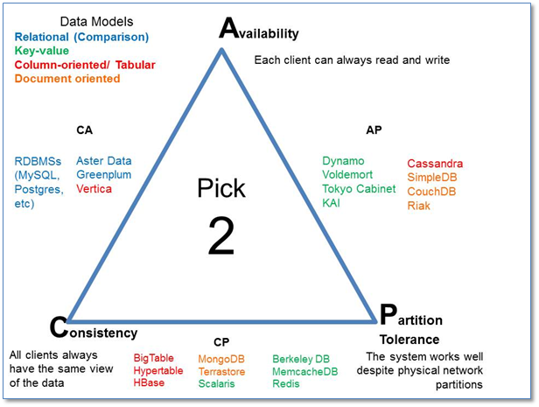
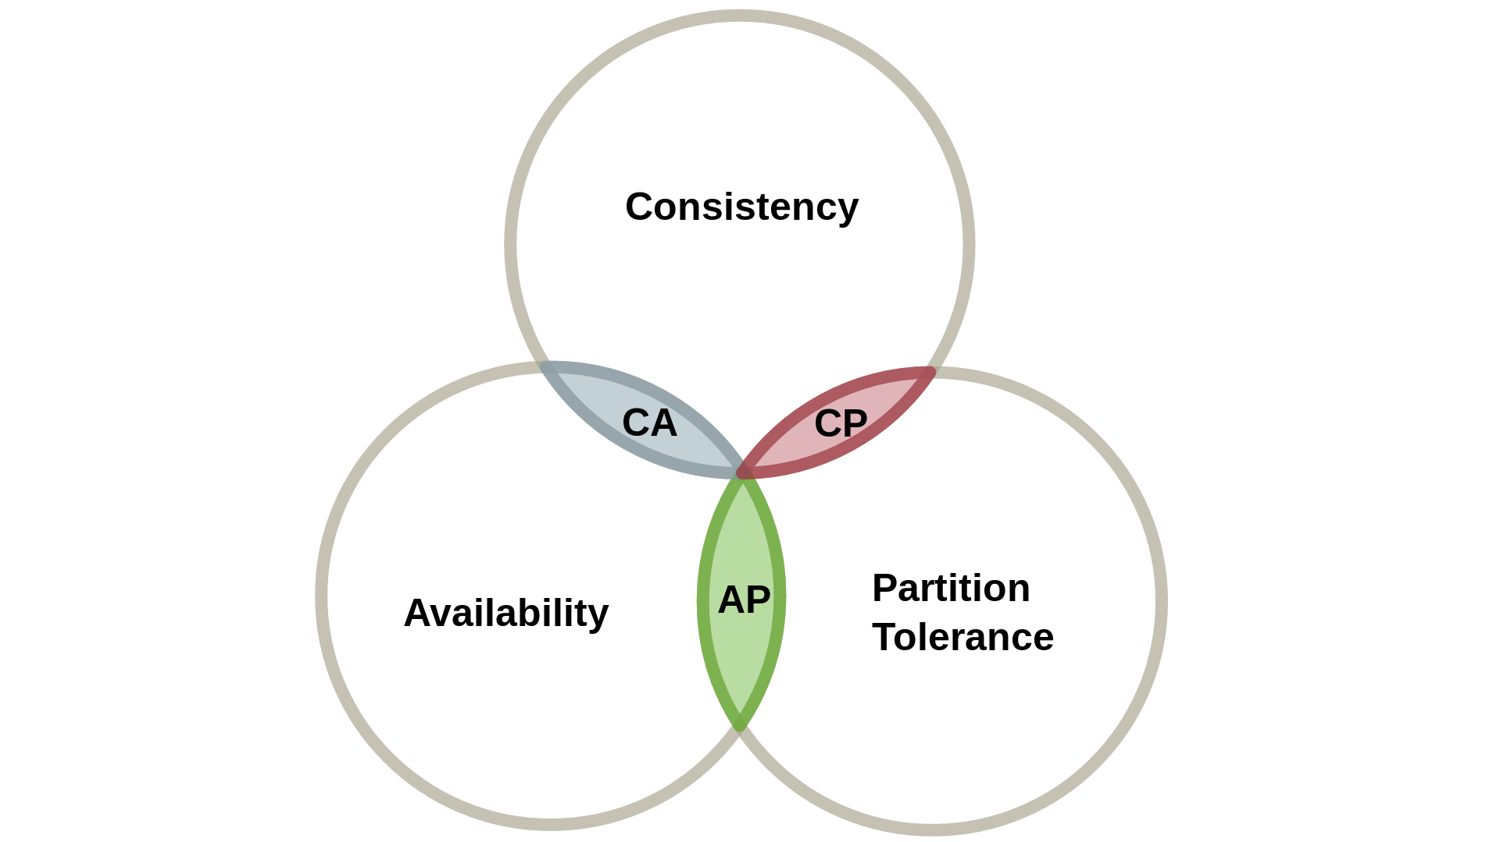
Here is the brief description of three combinations CA, CP, AP :
CA – Single site cluster, therefore all nodes are always in contact. When a partition occurs, the system blocks.
CP – Some data may not be accessible, but the rest is still consistent/accurate.
AP – System is still available under partitioning, but some of the data returned may be inaccurate.

Slide 32
Summary of CAP Theorem with Case study
One can atmost go with two of the three.
1. Consistency:
The instructors or training coordinator, once they have updated information with you, will always get the updated information when they call subsequently.
2. Availability
The instructors or the training coordinators will always get the schedule if any or both of the office administrators have reported to work.
3. Partition Tolerance
Work will go on as usual even if there is communication loss between the office administrators owing to a spat (past) or a tiff(quarrel)

Slide 33
Summary of CAP Theorem with Case study
Whether you’re building a social media app or a globally distributed database, understanding this trade-off is not optional. It’s essential.

Slide 34
BASE PROPERTIES
The BASE properties in database management systems are principles that guide the design and operation of modern databases.
In computer science and database design, ACID models prioritize strict data consistency for systems like banking, while BASE models prioritize high availability and speed for large distributed cloud apps
Financial Systems: Banking ledgers and payment gateways where money transfer accuracy is critical.(ACID)
Social Media Feeds: Platforms like Twitter or Facebook where a post taking a few extra seconds to appear globally is acceptable.(BASE)
Modern apps (Twitter, Netflix) use BASE to handle millions of users without crashing – accepting temporary inconsistency for lightning speed.
Example:
In a shopping website like Amazon, product availability might not always be up-to-date. Even if a product is out of stock, users might still see it as available due to delays in synchronization.

Slide 35
BASE PROPERTIES
BASE stands for Basically Available, Soft state and Eventually consistent.
BASE properties works in a manner that it may be eventually consistent having soft state when it is basically available.
Basically Available:
When data is stored at one site, If that site is down, our data is totally unavailable but if our data is distributed to many sites, means some part of our data is at one site and some part of data is at other site. If one or two sites down our whole data is not unavailable.
It may be that some part of data becomes unavailable for some short time.
Our data is now partially available. It leads to partially failure without any totally failure.

Slide 36
Soft State:
BASE allows that our data may be inconsistent.
It allows dynamic designing to application developers.
In other words, soft state indicates that the state of the system may change over time, even without input.
Eventually Consistent:
consistency in the future, not immediately at the end of operation.
Databases guarantees consistency only at some undefined future time.
So eventually consistency means it is consistent after some time even at that time it is not guarantee of the consistency.

Slide 37
In database systems, ACID — Atomicity, Consistency, Isolation, Durability — defines the core principles that ensure reliable transaction processing.
These properties guarantee that even in the face of failures, the database remains accurate, consistent, and recoverable.
Atomicity ensures a transaction is treated as a single unit — it either completes fully or not at all. If any step fails, all changes are rolled back.
Example: In a bank transfer, debiting one account without crediting the other is prevented; both operations succeed or both are undone.

Slide 38
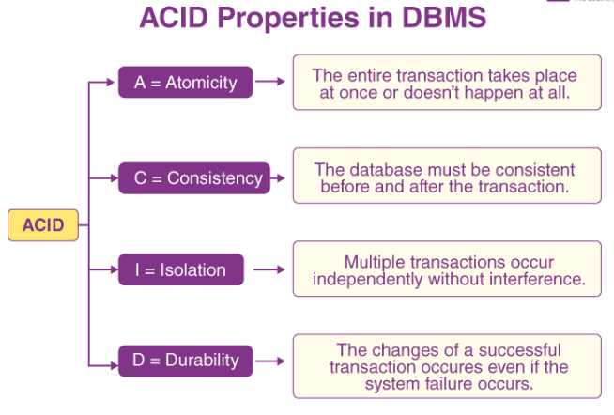

Slide 39
Consistency enforces that a transaction moves the database from one valid state to another.
Example: If total balances in a banking system must remain constant, any transaction that disrupts this rule is rolled back .
Isolation guarantees that concurrent transactions do not interfere with each other. Intermediate states of a transaction are invisible to others until committed.
Example: Two simultaneous transfers won’t see each other’s uncommitted changes, ensuring results match serial execution .
Durability ensures that once a transaction is committed its effects are permanent.
Example: After a successful transfer, the updated balances remain intact even after a power failure .

Slide 40
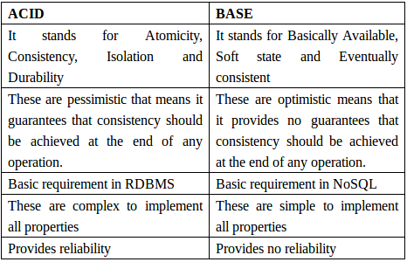
ACID vs BASE PROPERTIES

Slide 41
When to choose consistency over availability and vice-versa....
1. Choose Availability over consistency when your business requirements allow some flexibility around when the data in the system synchronizes.
2. Choose Consistency over Availability when your business requirements demand atomic reads and writes.

Slide 42
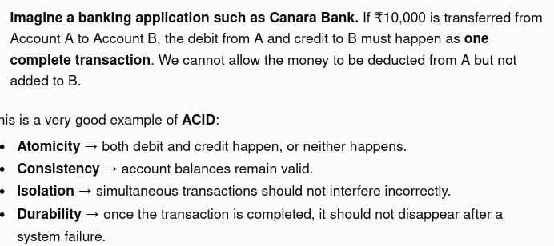

Slide 43
