Slide 1
Statistical inference for Data Science
Course Instructor
Ms. Harshitha G M
Assistant Professor Gd.II,
Dept. of MCA, NMAMIT, Nitte.

Slide 2
Learning Outcomes
On successful completion of this section, learners will be able to:
Understand the fundamental concepts of Data Science, and its distinction from Data Analytics and Business Intelligence.
Classify and differentiate various types of data such as structured, unstructured, natural language, machine-generated, graph-based, and multimedia data, along with quantitative and categorical data.

Slide 3
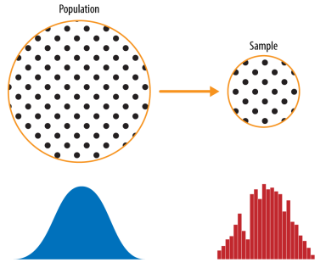
Population vs Sample
Population:
Entire dataset
Unknown distribution
Sample:
Subset of population
Observed data
Sampling bridges the two
Credit: Practical Statistics for Data Scientists, by Peter Bruce, Andrew Bruce, O'Reilly Media, Inc.,May 2017

Slide 4
Data and Sampling Distribution
Big data is often seen as replacing traditional sampling
Common belief: “More data = no need for sampling”
Reality: Sampling is still essential
Helps improve efficiency and reduce bias
Assumption: Entire datasets can always be used
Belief: Large data eliminates uncertainty
Issue: Data may be noisy, incomplete, or irrelevant
Conclusion: Big data increases—not reduces—the need for sampling

Slide 5
When we use the entire population instead of sampling, several practical and statistical problems arise:
1. Cost & Time
Collecting data from every member of a population is often prohibitively expensive and time-consuming. For example, surveying every citizen of a country for a product study would take years and millions of dollars.
2. Infeasibility / Impossibility
In many cases, accessing the entire population is simply not possible.
3. Data Quality Degrades at Scale
Ironically, larger data collection efforts often introduce more errors — more interviewers, more data entry points, more inconsistencies. A well-controlled sample can be more accurate than a sloppy census.

Slide 6
When we use the entire population instead of sampling, several practical and statistical problems arise:
4. Computational Overload
Even if data can be collected, processing a massive dataset requires enormous computational resources, memory, and time — often without a meaningful gain in insight.
5. No Benchmark for Accuracy
Sampling allows us to estimate and verify results using statistical theory (confidence intervals, margins of error). A census gives you one result with no way to cross-validate or measure uncertainty.
6. Redundancy — The Law of Diminishing Returns
Beyond a certain sample size, additional data adds very little new information. A well-drawn sample of 1,000 from a population of 1,000,000 can yield nearly the same insights as using all 1,000,000 records.

Slide 7
Sampling in Big Data Projects
Used in:
Model development
Pilot testing
Validation processes
Example:
Predictive models built on sample datasets
Advantage:
Faster iteration and testing

Slide 8
Why Sampling is Still Important
Handles large-scale data efficiently
Reduces computational cost
Improves data quality analysis
Minimizes bias in datasets
Enables faster experimentation

Slide 9
Random Sampling and Sample Bias
A sample is a subset of data from a larger data set; statisticians call this larger data set the population.
Random sampling is a process in which each available member of the population being sampled has an equal chance of being chosen for the sample at each draw. The sample that results is called a simple random sample.
Sampling can be done with replacement, in which observations are put back in the population after each draw for possible future reselection. Or it can be done without replacement, in which case observations, once selected, are unavailable for future draws.

Slide 10
Keyterms
Sample (n): A subset from a larger data set.
Population (N) : The larger data set or idea of a data set.
Random sampling: Drawing elements into a sample at random.
Stratified sampling: Dividing the population into strata and randomly sampling from each strata.
Stratum (pl., strata): A homogeneous subgroup of a population with common characteristics.
Simple random sample: The sample that results from random sampling without stratifying the population.
Bias: Systematic error.
Sample bias: A sample that misrepresents the population.

Slide 11
Bias
Statistical bias refers to measurement or sampling errors that are systematic and produced by the measurement or sampling process.
An important distinction should be made between errors due to random chance and errors due to bias.

Slide 12
Identify the following as: Bias or Sample Bias
Scenario 1: The School Canteen Survey
The school principal wants to know if students are happy with the canteen food. She asks the first 20 students who arrive at the canteen on Monday morning.
Questions to analyze:
Who are the first students to arrive at the canteen? (Probably those who like the food)
Are late arrivals or students who avoid the canteen represented?
What type of bias is this?
Answer: Sample bias

Slide 13
Identify the following as: Bias or Sample Bias
Scenario 2: The Movie Rating App
A movie app shows an average rating of 4.8/5 for a new film. The rating is based on users who opened the app and chose to rate the movie.
Questions to analyze:
Who is most likely to voluntarily rate a movie?
Would someone who hated the movie bother rating it?
Does 4.8 truly reflect all viewers?
Answer: Sample bias

Slide 14
Identify the following as: Bias or Sample Bias
Scenario 3: The Broken Thermometer
A weather station records daily temperatures using a thermometer that is placed directly above a concrete surface, which absorbs heat. All readings are consistently 3°C higher than the actual air temperature.
Questions to analyze:
Will collecting more data fix this problem?
Is the error random or consistent?
What kind of bias is this?
Answer: Systematic Bias — a consistent, repeatable error that affects all measurements in the same direction due to a flaw in the measurement process itself.

Slide 15
Identify the following as: Bias or Sample Bias
Scenario 4: The Successful Entrepreneur Study
A business magazine publishes an article titled: "The Secret to Success: All Successful Entrepreneurs Dropped Out of College."
The article studied 50 famous successful entrepreneurs who dropped out of college — like Bill Gates, Steve Jobs, and Mark Zuckerberg — and concluded that:
"College is unnecessary. Dropping out increases your chances of becoming a successful entrepreneur."

Slide 16
Random Selection
Random sampling is not always easy. Proper definition of an accessible population is key.
Ex: Create a representative profile of customers using a survey
Step 1: Define “Who is a Customer?”
People who bought something (purchase > 0)
But questions arise:
Include old customers or only recent ones?
Include people who returned/refunded items?
Include test or fake purchases?
Include resellers or only end users?

Slide 17
Step 2: Select a Sample
We cannot survey everyone (too much work)
So we pick a small group
Example: “Select 100 customers randomly”
Step 3: Why Sampling Matters
The sample should represent all types of customers
If not:
Results may be biased or misleading
Imagine a shopping app:
Total customers = 10,000
You randomly pick 100 customers to survey
If chosen properly:
Their responses can reflect overall customer behavior

Slide 18
Stratified Sampling
A method of sampling where:
Population is divided into groups (strata)
Then samples are taken from each group
👉 Each group should be similar within but different between groups
Ensures fair representation of all groups, Gives accurate results than random sampling, Useful for different categories
Population: 100 students of 60 boys and 40 girls
Divide into 2 groups:
Boys (60)
Girls (40)
Select proportionally:
6 boys + 4 girls → sample of 10

Slide 19
Size Versus Quality: When Does Size of the data Matter?
In the era of big data, it is sometimes surprising that smaller is better.
Time and effort spent on random sampling not only reduces bias but also allows greater attention to data exploration and data quality.
For example, missing data and outliers may contain useful information.
It might be prohibitively expensive to track down missing values or evaluate outliers in millions of records, but doing so in a sample of several thousand records may be feasible. Data plotting and manual inspection bog down if there is too much data.

Slide 20

Sample Mean Versus Population Mean
Population Mean (μ):
Average of entire population
Poplulation Mean is given by
Where:
X = all values
N = total number of values

Slide 21

Sample Mean Versus Population Mean
Sample Mean (x̄):
Average of a subset of data
Sample Mean is given by
Where:
x = sample values
n = number of sample values

Slide 22
Sample Mean Versus Population Mean
Example Calculation
Population Data: 70, 80, 90, 60, 100
μ=(70+80+90+60+100)/5=80
Sample Data: 70, 90, 100
xˉ=(70+90+100)/3=86.7
Sample mean is close to, but not exactly equal to, population mean

Slide 23
Selection Bias
Selection bias refers to the practice of selectively choosing data—consciously or
unconsciously—in a way that leads to a conclusion that is misleading or ephemeral.
Key Terms for Selection Bias
Selection bias: Bias resulting from the way in which observations are selected.
Data snooping: Extensive hunting through data in search of something interesting.
Vast search effect
Bias or nonreproducibility resulting from repeated data modeling, or modeling data with large numbers of predictor variables.

Slide 24
Data Snooping
Data Snooping (p-hacking) is a statistical issue that occurs when the same dataset is repeatedly analyzed or searched until a pattern or result appears significant—even if it’s actually due to chance.
Simple Explanation
If you keep testing many hypotheses on the same data, you’re likely to find something that looks meaningful purely by accident.
📊 Example
You have a dataset of student scores.
You test 20 different hypotheses (e.g., gender vs marks, study hours vs marks, sleep vs marks, etc.).
One of them shows a “significant” result.
👉 That result might just be random, not a true relationship.

Slide 25
Data Snooping
Why It’s a Problem
How to Avoid Data Snooping
Leads to false conclusions
Results may not generalize to new data
Common in:
Data science
Machine learning
Financial modeling
Research studies
Use train/test split
Apply cross-validation
Predefine hypotheses before testing
Use a separate validation dataset

Slide 26
Regression to the Mean
Regression to the mean refers to a phenomenon involving successive measurements on a given variable: extreme observations tend to be followed by more central ones.
The phenomenon was first identified by Francis Galton in 1886 [Galton-1886], who wrote of it in connection with genetic tendencies; for example, the children of extremely tall men tend not to be as tall as their father.
Regression to the Mean is a statistical concept that explains why extreme observations tend to move closer to the average (mean) when measured again.
🔍 Simple Explanation
If something is unusually high or low in one measurement, the next measurement will likely be closer to the average, purely due to chance.

Slide 27
Example
A student scores 95% (much higher than their usual performance).
In the next test, they score 80%.
This drop doesn’t necessarily mean they performed worse intentionally—it’s often because the first score was unusually high, and performance naturally returns closer to the average.
🧠 Key Idea
Regression to the mean happens because:
Random variation (luck, noise, temporary factors) affects extreme values.
These random effects are unlikely to repeat in the same way.

Slide 28
Some more examples
Sports A cricket player scores an exceptionally high number of runs in one match → likely to score closer to their average in the next match.
Medicine Patients with extremely high blood pressure readings often show improvement on the next check—even without treatment.
Stock Market Stocks with extreme gains or losses tend to stabilize over time.

Slide 29
The Bootstrap
One easy and effective way to estimate the sampling distribution of a statistic, or of
model parameters, is to draw additional samples, with replacement, from the sample
itself and recalculate the statistic or model for each resample.
This procedure is called the bootstrap, and it does not necessarily involve any assumptions about the data or the sample statistic being normally distributed.
Key Terms
Bootstrap sample: A sample taken with replacement from an observed data set.
Resampling: The process of taking repeated samples from observed data; includes both bootstrap and permutation (shuffling) procedures.

Slide 30
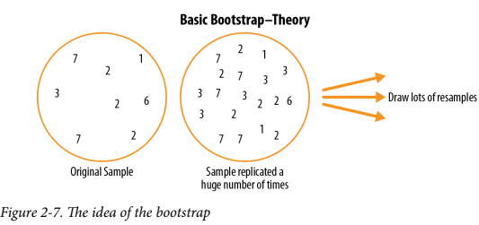
The Bootstrap
Practical Statistics for Data Scientists, by Peter Bruce, Andrew Bruce, O'Reilly Media, Inc.,May 2017

Slide 31
The algorithm for a bootstrap resampling of the mean, for a sample of size n, is as follows:
1. Draw a sample value, record it, and then replace it.
2. Repeat n times.
3. Record the mean of the n resampled values.
4. Repeat steps 1–3 R times.
5. Use the R results to:
a. Calculate their standard deviation (this estimates sample mean standard error).
b. Produce a histogram or boxplot.
c. Find a confidence interval.
R, the number of iterations of the bootstrap, is set somewhat arbitrarily. The more iterations you do, the more accurate the estimate of the standard error, or the confidence interval. The result from this procedure is a bootstrap set of sample statistics or estimated model parameters, which you can then examine to see how variable they are.

Slide 32
Resampling Versus Bootstrapping
Sometimes the term resampling is used synonymously with the term bootstrapping.
More often, the term resampling also includes permutation procedures, where multiple samples are combined and the sampling may be done without replacement.
In any case, the term bootstrap always implies sampling with replacement from an observed data set.

Slide 33
Significance Testing
Design of experiments is a cornerstone of the practice of statistics, with applications in virtually all areas of research.
The goal is to design an experiment in order to confirm or reject a hypothesis. Data scientists often need to conduct continual experiments, particularly regarding user interface and product marketing.

Slide 34
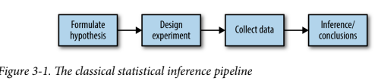
Significance Testing
This process starts with a hypothesis (“drug A is better than the existing standard drug,” or “price A is more profitable than the existing price B”).
An experiment (it might be an A/B test) is designed to test the hypothesis—designed in such a way that it hopefully will deliver conclusive results.
The data is collected and analyzed, and then a conclusion is drawn. The term inference reflects the intention to apply the experiment results, which involve a limited set of data, to a larger process or population.
Practical Statistics for Data Scientists, by Peter Bruce, Andrew Bruce, O'Reilly Media, Inc.,May 2017

Slide 35
A/B Testing
An A/B test is an experiment with two groups to establish which of two treatments, products, procedures, or the like is superior.
Often one of the two treatments is the standard existing treatment, or no treatment. If a standard (or no) treatment is used, it is called the control.
A typical hypothesis is that a new treatment is better than the control.

Slide 36
Key Terms for A/B Testing
Treatment: Something (drug, price, web headline) to which a subject is exposed.
Treatment group: A group of subjects exposed to a specific treatment.
Control group: A group of subjects exposed to no (or standard) treatment.
Randomization: The process of randomly assigning subjects to treatments.
Subjects: The items (web visitors, patients, etc.) that are exposed to treatments.
Test statistic: The metric used to measure the effect of the treatment.

Slide 37
Some examples of A/B testing include:
• Testing two soil treatments to determine which produces better seed germination
• Testing two therapies to determine which suppresses cancer more effectively
• Testing two prices to determine which yields more net profit
• Testing two web headlines to determine which produces more clicks
• Testing two web ads to determine which generates more conversions

Slide 38
Hypothesis Tests
Hypothesis tests, also called significance tests, are ubiquitous in the traditional statistical analysis of published research. Their purpose is to help you learn whether random chance might be responsible for an observed effect.
Key Terms for Hypothesis Tests
Null hypothesis: The hypothesis that chance is to blame.
Alternative hypothesis: Counterpoint to the null (what you hope to prove).
One-way test: Hypothesis test that counts chance results only in one direction.
Two-way test: Hypothesis test that counts chance results in two directions.

Slide 39
In simple terms
•Helps determine whether observed results are due to real effect or random chance.
•Used in A/B testing, medicine, research.
Example:
•A student uses a new study method and scores higher.
•Is it due to the method or just luck?

Slide 40
Hypothesis Tests
Null Hypothesis:
•Assumes no real effect.
•Any observed difference is due to chance.
•Default assumption
Alternative Hypothesis:
•Assumes there is a real effect.
•Represents what we want to prove.
.

Slide 41
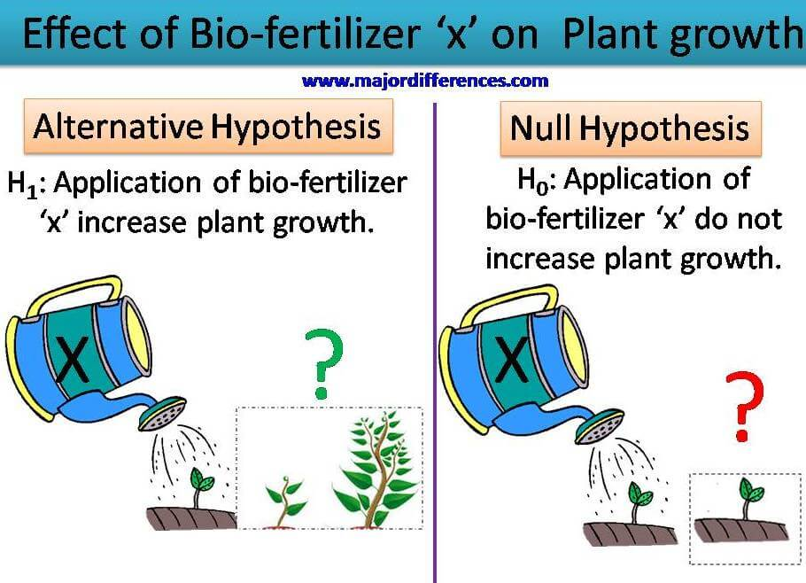

Slide 42
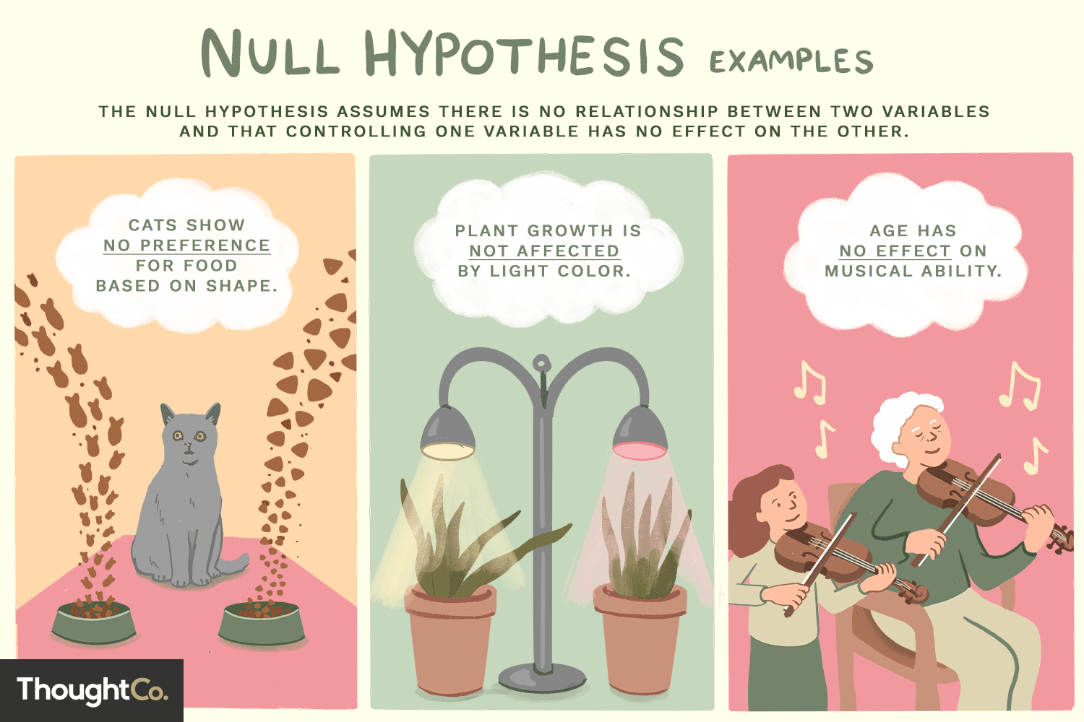

Slide 43
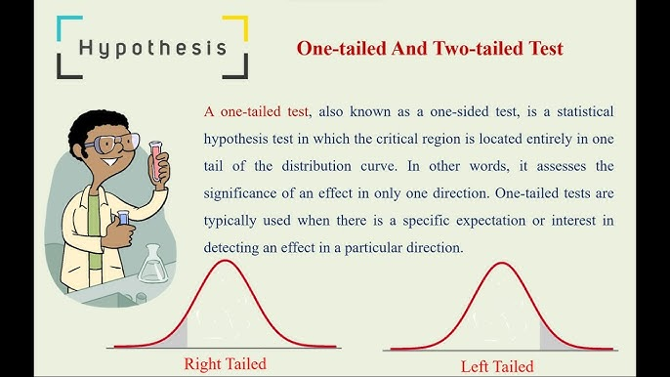

Slide 44
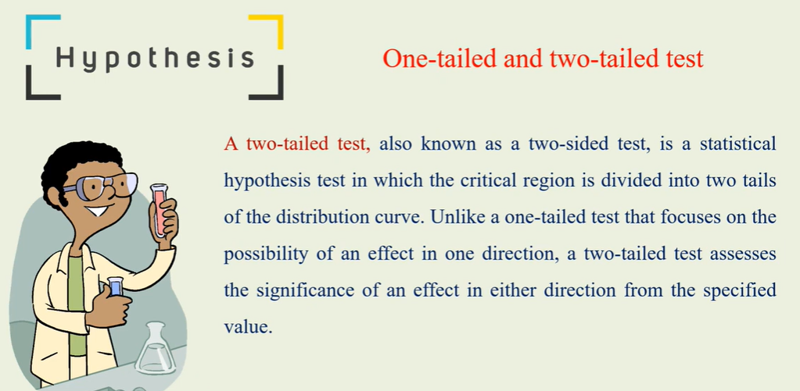

Slide 45
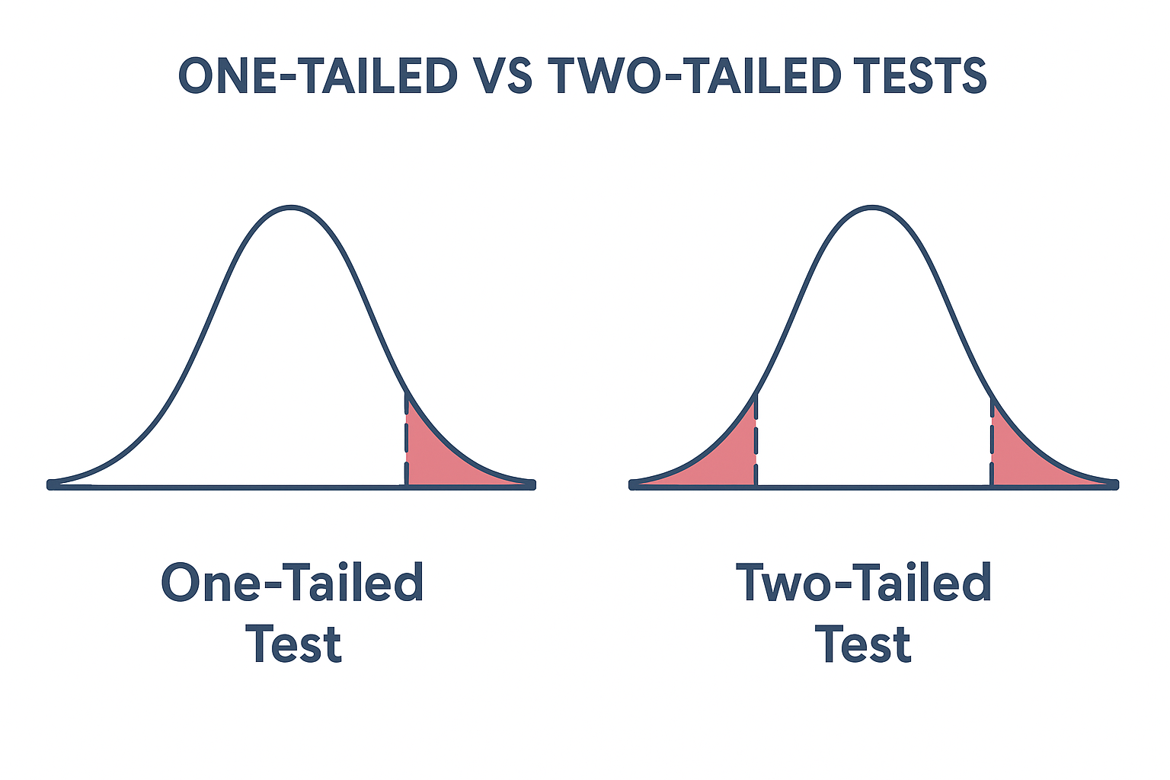

Slide 46
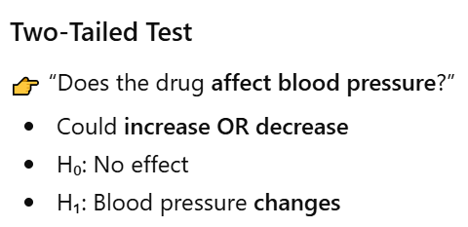
Example: A new drug is tested.
One-Tailed Test
👉 “Does the drug reduce blood pressure?”
Only checking reduction
H₀: No reduction
H₁: Blood pressure decreases

Slide 47
Example: Website A/B Testing
Company tests a new webpage design.
One-Tailed Test
👉 “Does the new design increase conversion rate?”
Only improvement matters
Two-Tailed Test
👉 “Does the new design change conversion rate?”
Could increase OR decrease

Slide 48
Example: Product Weight Check
A factory produces packets labeled 500g
One-Tailed Test
👉 “Are packets underweight?”
Only checking if weight is less than 500g
Two-Tailed Test
👉 “Are packets different from 500g?”
Could be underweight OR overweight

Slide 49
Iris Dataset
The Iris dataset contains measurements of iris flowers from three different species.
It was introduced by the statistician Ronald A. Fisher in 1936.
3 species:
Iris setosa
Iris versicolor
Iris virginica

Slide 50
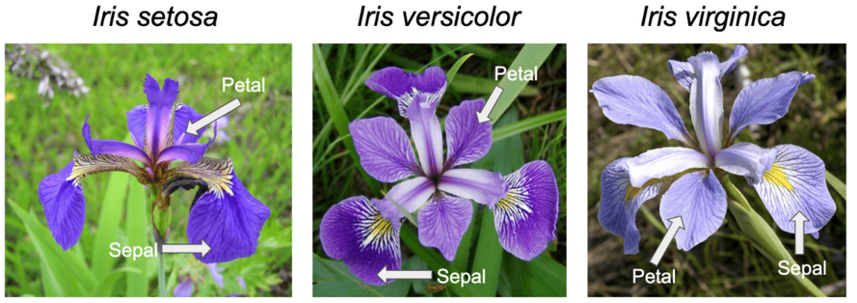
Three species of Iris Flower

Slide 51
Iris Dataset
Iris Data set contains information about 3 different species of Iris plant, with 50 instances for each of the species. It is a multivariate dataset normally used for the classification tasks using input numeric features and multiclass output.
This dataset is readily available, and contains 4 input attributes for each instance. We will use these continuous attributes to develop a classification model for 3 species of Iris plant.
📊 Features (Measurements)
Sepal Length
Sepal Width
Petal Length
Petal Width
In order to classify three IRIS flowers, common features such as petal length, petal width, sepal length, and sepal width are used.

Slide 52
contd…
This data-set contains
Training data set (IRISTraining.csv) used to train a neural network
Test data set (IRISTest.csv) to test/evaluate the obtained trained neural network.
The data structure contains
4 input features (Feature 1 to Feature 4)
3 output classes that are corresponding to three IRIS flower types.

Slide 53
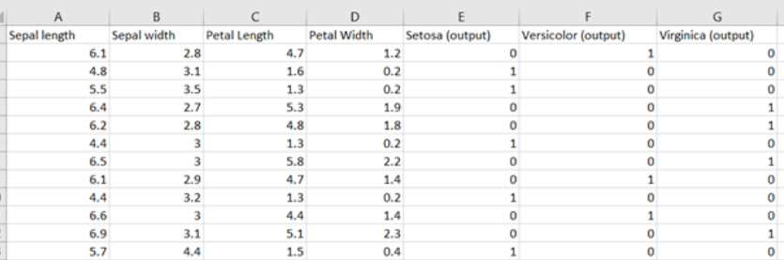
contd…

Slide 54
contd…
Since 3 types of IRIS flowers are classified, the outputs will be decoded into binary.
For example:
[1,0,0] for Setosa
[0,1,0] for Versicolor
[0,0,1] for Virginica.
The IRIS dataset will be separated into a training set (70%) and a test set (30%).

Slide 55

Titanic dataset
The Titanic dataset is one of the most widely used datasets in data science, especially for classification, statistics, and hypothesis testing. It is based on real data from the tragic sinking of Titanic.
Overview:
Contains information about passengers aboard the Titanic
Goal: Predict or analyze survival (who lived and who didn’t)

Slide 56
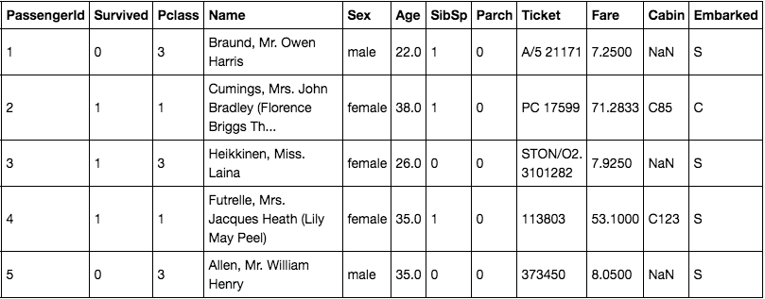

Slide 57
1. Survival (Target Variable)
survived
0 = Did not survive
1 = Survived
2. Passenger Information
pclass → Passenger class
1 = First class (rich)
2 = Second class
3 = Third class (lower income)
sex → Male / Female
age → Age of passenger
3. Family Details
sibsp → Number of siblings/spouses aboard
parch → Number of parents/children aboard
Helps analyze family influence on survival

Slide 58
4. Ticket & Fare
fare → Ticket price
ticket → Ticket number
5. Cabin & Embarkation
cabin → Cabin number (many missing values)
embarked → Port of boarding:
C = Cherbourg
Q = Queenstown
S = Southampton
The dataset is typically used to answer: “What factors influenced survival?”

Slide 59
Thank You

