Slide 1
Data Modelling & Data Ethics
Course Instructor
Ms. Harshitha G M
Assistant Professor Gd.II,
Dept. of MCA, NMAMIT, Nitte.

Slide 2
Introduction to Machine Learning
“Machine learning is a field of study that gives computers the ability to learn without being explicitly programmed.”
—Arthur Samuel, 1959
“Machine learning is the process by which a computer can work more accurately as it collects and learns from the data it is given.”
—Mike Roberts

Slide 3
Introduction to Machine Learning
To achieve machine learning, experts develop general-purpose algorithms that can be used on large classes of learning problems.
When you want to solve a specific task you only need to feed the algorithm more specific data. In a way, you’re programming by example.
In most cases a computer will use data as its source of information and compare its output to a desired output and then correct for it.
The more data or “experience” the computer gets, the better it becomes at its designated job, like a human does.
For example, as a user writes more text messages on a phone, the phone learns more about the messages’ common vocabulary and can predict (autocomplete) their words faster and more accurately.

Slide 4
Applications for machine learning in data science
Regression and classification are of primary importance to a data scientist. To achieve these goals, one of the main tools a data scientist uses is machine learning.
■ Finding oil fields, gold mines, or archeological sites based on existing sites (classification and regression)
■ Finding place names or persons in text (classification)
■ Identifying people based on pictures or voice recordings (classification)
■ Recognizing birds based on their whistle (classification)
■ Proactively identifying car parts that are likely to fail (regression)
■ Identifying tumors and diseases (classification)
■ Predicting the amount of money a person will spend on product X (regression)
■ Predicting the number of eruptions of a volcano in a period (regression)
■ Predicting your company’s yearly revenue (regression)
■ Identifying profitable customers (regression and classification)

Slide 5
Applications for machine learning in data science
Occasionally data scientists build a model (an abstraction of reality) that provides insight to the underlying processes of a phenomenon.
When the goal of a model isn’t prediction but interpretation, it’s called root cause analysis.
Here are a few examples:
■ Understanding and optimizing a business process, such as determining which products add value to a product line
■ Discovering what causes diabetes
■ Determining the causes of traffic jams

Slide 6
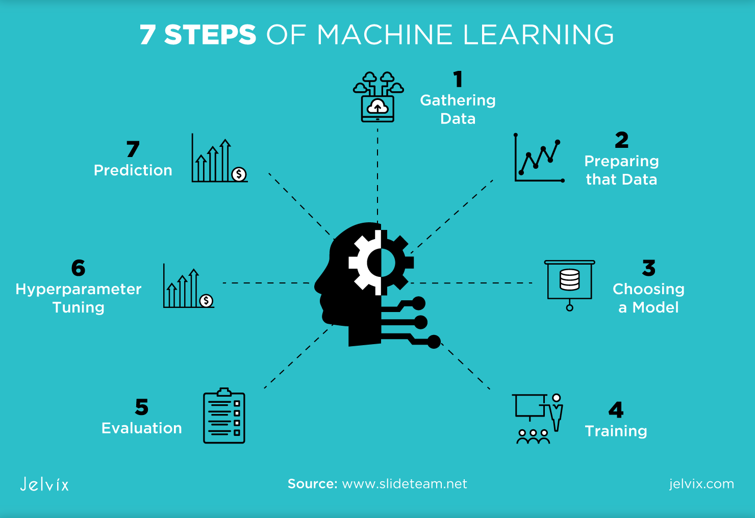

Slide 7
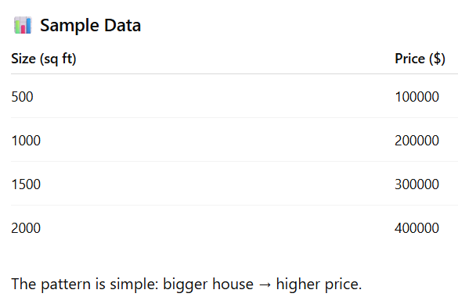
We want a computer to learn the relationship between:
Input (features): size of a house (in sq ft)
Output (label): price of the house
Instead of hardcoding rules, we let a model learn from data.

Slide 8
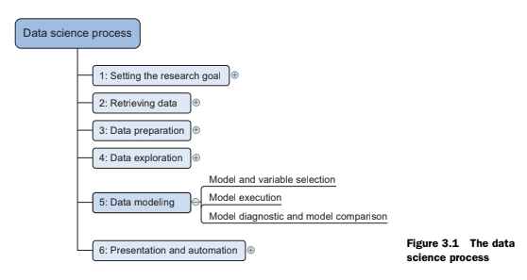
Where machine learning is used in the data science process

Slide 9
Where machine learning is used in the data science process
The data modeling phase can’t start until you have qualitative raw data you can understand. But prior to that, the data preparation phase can benefit from the use of machine learning.
An example would be cleansing a list of text strings; machine learning can group similar strings together so it becomes easier to correct spelling errors.
Machine learning is also useful when exploring data. Algorithms can root out underlying patterns in the data where they’d be difficult to find with only charts.
Given that machine learning is useful throughout the data science process, it shouldn’t come as a surprise that a considerable number of Python libraries were developed to make your life a bit easier.

Slide 10
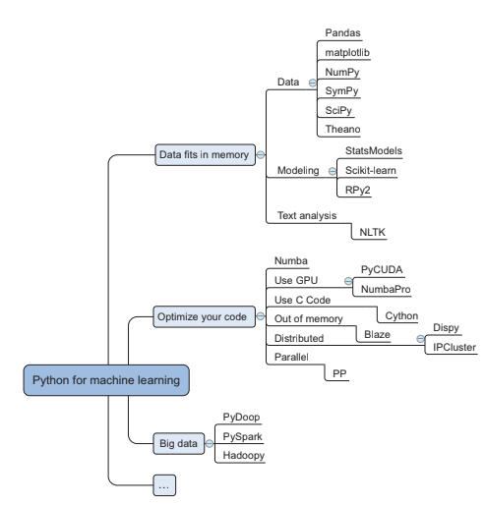

Slide 11
The following packages can get you started by providing advanced functionalities with a few lines of code:
■ SciPy is a library that integrates fundamental packages often used in scientific computing such as NumPy, matplotlib, Pandas, and SymPy.
■ NumPy gives you access to powerful array functions and linear algebra functions.
■ Matplotlib is a popular 2D plotting package with some 3D functionality.
■ Pandas is a high-performance, but easy-to-use, data-wrangling package. It introduces dataframes to Python, a type of in-memory data table. It’s a concept that should sound familiar to regular users of R.
■ SymPy is a package used for symbolic mathematics and computer algebra.
■ StatsModels is a package for statistical methods and algorithms.
■ Scikit-learn is a library filled with machine learning algorithms.
■ RPy2 allows you to call R functions from within Python. R is a popular open source statistics program.
■ NLTK (Natural Language Toolkit) is a Python toolkit with a focus on text analytics.

Slide 12
Numba and NumbaPro—These use just-in-time compilation to speed up applications written directly in Python and a few annotations. NumbaPro also allows you to use the power of your graphics processor unit (GPU).
PyCUDA—This allows you to write code that will be executed on the GPU instead of your CPU and is therefore ideal for calculation-heavy applications.
It works best with problems that lend themselves to being parallelized and need little input compared to the number of required computing cycles.
An example is studying the robustness of your predictions by calculating thousands of different outcomes based on a single start state.
Cython, or C for Python—This brings the C programming language to Python. C is
a lower-level language, so the code is closer to what the computer eventually uses
(bytecode). The closer code is to bits and bytes, the faster it executes.

Slide 13
■ Blaze—Blaze gives you data structures that can be bigger than your computer’s main memory, enabling you to work with large data sets.
■ Dispy and IPCluster—These packages allow you to write code that can be distributed over a cluster of computers.
■ PP—Python is executed as a single process by default. With the help of PP you can parallelize computations on a single machine or over clusters.
■ Pydoop and Hadoopy—These connect Python to Hadoop, a common big data Framework.
■ PySpark—This connects Python and Spark, an in-memory big data framework.

Slide 14
The modeling process
The modeling phase consists of four steps:
1 Feature engineering and model selection
2 Training the model
3 Model validation and selection
4 Applying the trained model to unseen data
Before you find a good model, you’ll probably iterate among the first three steps.
The last step isn’t always present because sometimes the goal isn’t prediction but explanation (root cause analysis).
For instance, you might want to find out the causes of species’ extinctions but not necessarily predict which one is next in line to leave our planet.

Slide 15
The modeling process- Feature engineering and model selection
It’s possible to chain or combine multiple techniques. When you chain multiple models, the output of the first model becomes an input for the second model. When you combine multiple models, you train them independently and combine their results. This last technique is also known as ensemble learning.
A model consists of constructs of information called features or predictors and a target or response variable.
Your model’s goal is to predict the target variable, for example, tomorrow’s high temperature.
The variables that help you do this and are (usually) known to you are the features or predictor variables such as today’s temperature, cloud movements, current wind speed, and so on.
The best models are those that accurately represent reality, preferably while staying concise and interpretable. To achieve this, feature engineering is the most important and arguably most interesting part of modeling.

Slide 16
The modeling process- Training your model
With the right predictors in place and a modeling technique in mind, you can progress to model training. In this phase you present to your model data from which it can learn.
The most common modeling techniques have industry-ready implementations in almost every programming language, including Python. These enable you to train your models by executing a few lines of code.
Once a model is trained, it’s time to test whether it can be extrapolated to reality: model validation.

Slide 17
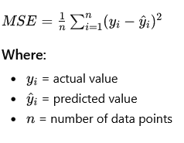
The modeling process - Validating a model
Model Selection in Data Science
Choosing the right model is important.
A good model:
- Has high predictive power
- Generalizes well to new data
Error Measures
Used to check how wrong a model is.
- Classification Error Rate
- Percentage of wrong predictions
- Lower is better
- Used for classification problems
- Mean Squared Error (MSE)
- Measures average squared error
- Big errors are penalized more
- Errors do not cancel each other

Slide 18
The modeling process - Validating a model
Validation Strategies - Leave-One-Out
Ways to test model performance: - Special case of k-fold
- Train-Test Split - Train on all except one data point
- Split data into training and testing sets -Used for small datasets
- Train on one part
- Test on unseen data
- K-Fold Cross Validation
- Divide data into k parts
- Use each part as test once
- Uses all data efficiently

Slide 19
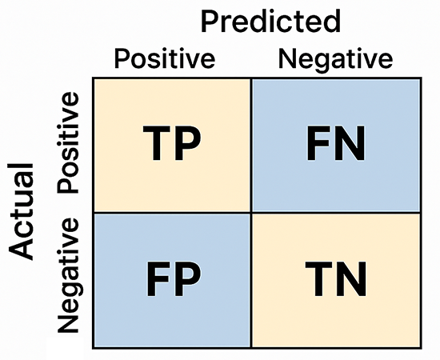
The modeling process - Validating a model
Regularization Confusion Matrix
- Prevents overfitting Used for classification models
- Penalizes complex models Shows correct and incorrect predictions
- Keeps model simple
Types of Regularization
- L1: Reduces number of features
- L2: Balances feature importance
Importance of Validation
- Ensures model works in real life
- Must test on unseen data
- Poor validation leads to wrong results

Slide 20
The modeling process - Predicting new observations
The process of applying your model to new data is called model scoring.
Model scoring involves two steps:
First, you prepare a data set that has features exactly as defined by your model. This boils down to repeating the data preparation you did in step one of the modeling process but for a new data set.
Then you apply the model on this new data set, and this results in a prediction.

Slide 21
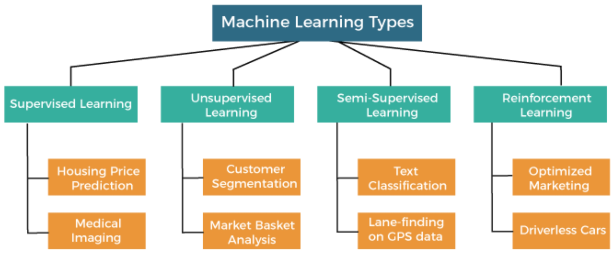

Slide 22
Types of ML
Supervised learning techniques attempt to discern results and learn by trying to find patterns in a labeled data set. Human interaction is required to label the data.
Unsupervised learning techniques don’t rely on labeled data and attempt to find patterns in a data set without human interaction.
Semi-supervised learning techniques need labeled data, and therefore human interaction, to find patterns in the data set, but they can still progress toward a result and learn even if passed unlabeled data as well.
Reinforcement Learning (RL) is a machine learning technique where an autonomous agent learns to make optimal decisions by interacting with an environment, using a trial-and-error approach to maximize cumulative rewards.

Slide 23
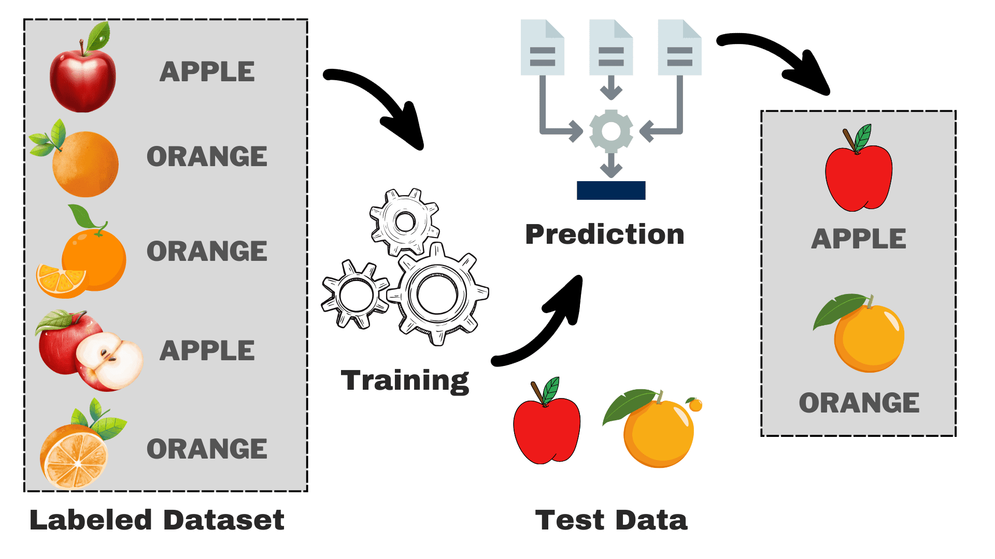
Supervised learning
Supervised learning is a learning technique that can only be applied on labeled data.

Slide 24
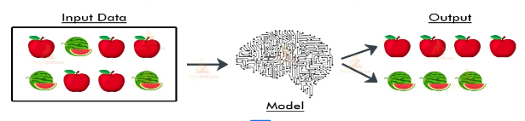
Unsupervised learning
Unsupervised learning techniques don’t rely on labeled data and attempt to find
patterns in a data set without human interaction.

Slide 25
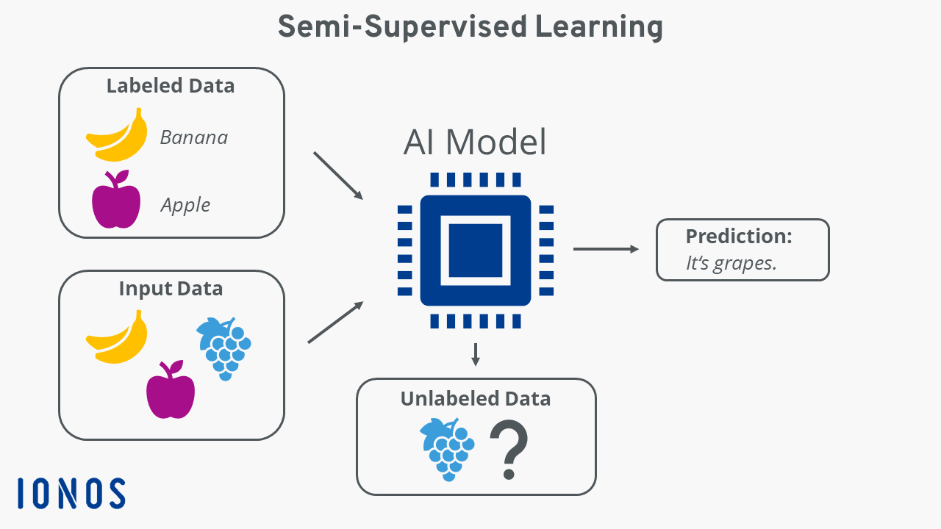
Semi- supervised learning
Semi-supervised learning techniques need labeled data, and therefore human interaction, to find patterns in the data set, but they can still progress toward a result and learn even if passed unlabeled data as well.

Slide 26
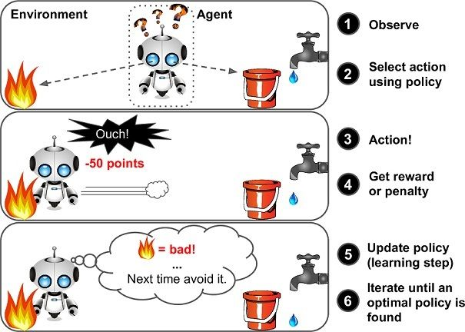
Reinforcement Learning

Slide 27
A model in ML
It’s simply a specification of a mathematical (or probabilistic) relationship that exists between different variables.
The business model is probably based on simple mathematical relationships: profit is
revenue minus expenses, revenue is units sold times average price, and so on.
Input: Patient data (symptoms, test results, scans)
Output: Disease or No Disease

Slide 28
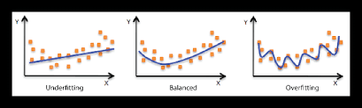
Overfitting and Underfitting
A common danger in machine learning is overfitting—producing a model that performs well on the data you train it on but that generalizes poorly to any new data.
This could involve learning noise in the data. Or it could involve learning to identify specific inputs rather than whatever factors are actually predictive for the desired output.
The other side of this is underfitting, producing a model that doesn’t perform well even on the training data, although typically when this happens you decide your model isn’t good enough and keep looking for a better one.

Slide 29
Underfit
Model is too simple
Cannot capture important patterns in data
Performs poorly on training data and test data
Makes many errors everywhere
📌 Example: A straight line trying to fit curved data
✔ Characteristics:
High bias
Low variance
Poor accuracy
➡️ Conclusion: Model has not learned enough

Slide 30
Balanced
Model is just right
Learns important patterns
Performs well on both training and test data
Generalizes to new/unseen data
Example:A curve that follows the overall trend (not every point)
✔ Characteristics:
Optimal bias and variance
Good accuracy
Stable predictions
➡️ Conclusion: Model has learned correctly

Slide 31
Overfit
Model is too complex
Memorizes training data (including noise)
Performs very well on training data
Performs poorly on test data
Example: A highly complex curve passing through every data point
✔ Characteristics:
Low bias
High variance
Poor generalization
➡️ Conclusion: Model has learned too much (including noise)

Slide 32
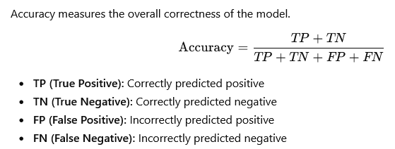
Model evaluation metrics
Model evaluation metrics help you understand how well a machine learning model is performing—especially for classification problems.
The three most commonly used metrics are:

Slide 33
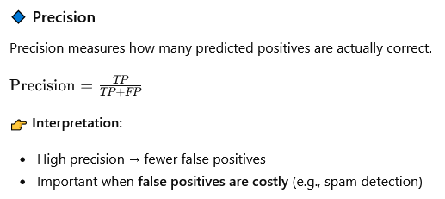
Model evaluation metrics

Slide 34
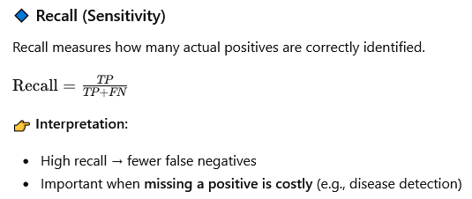
Model evaluation metrics

Slide 35
The Bias-Variance Trade-off.
When you train a model on different datasets (from the same population), two things can go wrong:
1. Bias (Error due to simplicity)
Happens when the model is too simple
It misses patterns in the data
Performs poorly even on training data
👉 Example: A straight line trying to fit curved data → It won’t fit well no matter what data you use
✔ High Bias = Underfitting

Slide 36
The Bias-Variance Trade-off.
2. Variance (Error due to sensitivity)
Happens when the model is too complex
It memorizes training data
Changes a lot with different datasets
👉 Example: A very complex curve that fits every point exactly → But changes wildly if data changes
✔ High Variance = Overfitting

Slide 37
The Bias-Variance Trade-off.
Trade-off (The Balance)
You cannot minimize both at the same time easily:
Simple model → High Bias, Low Variance
Complex model → Low Bias, High Variance
Goal: Find a balance where both are reasonably low

Slide 38
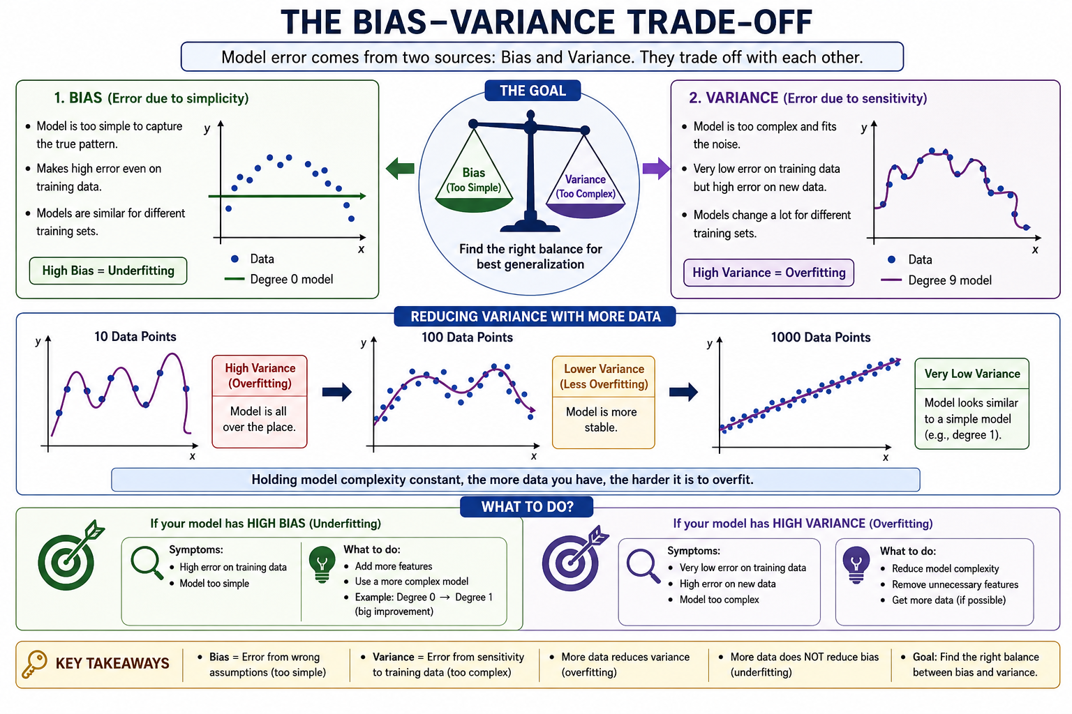

Slide 39
Real-Time Example: Exam Preparation
🔹 Case 1: High Bias (Underfitting)
A student studies only 1–2 basic questions from each topic.
In the exam, questions are slightly different
Student cannot answer properly
Performs poorly even on simple questions
👉 This is like a simple model ✔ Doesn’t learn enough patterns ❌ Makes mistakes everywhere
➡️ High Bias = Underfitting

Slide 40
Real-Time Example: Exam Preparation
Case 2: High Variance (Overfitting)
A student memorizes exact answers from previous question papers.
If the same questions come → scores very high
If questions change slightly → gets confused
👉 This is like a complex model ✔ Perfect on training data (past papers) ❌ Fails on new/unseen questions
➡️ High Variance = Overfitting

Slide 41
What is Data Ethics
Ethics = a framework for thinking about "right" and "wrong" behavior.
Data Ethics = Data ethics means deciding what is right or wrong when collecting, using, or sharing data.
Think of it like this:
Just because technology can do something,
does not mean it should do it.

Slide 42
What is Data Ethics
Suppose a company collects your browsing history.
They can:
use it to improve recommendations,
or sell it to advertisers without clearly informing you.
Data ethics asks:
“Is this fair to users?”

Slide 43
What is Data Ethics
Two Ways to Think About Ethics
Type Meaning
Prescriptive Follow fixed rules or commandments
Reflective Think carefully about consequences before acting
Example: Instead of blindly following:
“Never use customer data”
You think:
Why are we using it?
Will it help users?
Can it harm someone?

Slide 44
Why Should You Care About Data Ethics?
Technology affects millions of people at once.
A small mistake in software can create a huge real-world problem.
Example: YouTube Recommendation System
If YouTube changes its algorithm:
millions of people may suddenly see misleading videos,
political content,
or conspiracy theories.
One line of code can influence society.
So: Bigger impact = Bigger ethical responsibility

Slide 45
Building bad data products
Sometimes companies create harmful systems without bad intentions.
The problem is:
poor testing,
poor planning,
ignoring misuse possibilities.

Slide 46
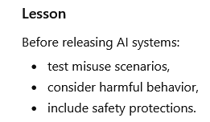
Building bad data products
Example 1: Microsoft's Tay Chatbot
Microsoft created a chatbot named Tay.
The bot learned from Twitter users.
People intentionally taught it offensive language.
Soon, the bot started posting racist tweets.
What went wrong?
Microsoft failed to think:
“What if users misuse the system?”

Slide 47
Building bad data products
Example 2: Google Photos Misclassification
Google Photos' image recognition classified photos of Black people as "gorillas"
This likely happened because:
training data lacked diversity,
testing was insufficient,
the model learned biased patterns.
Ethical Issue: Even accidental mistakes can deeply hurt people.
Google's fix: Simply stopped the model from ever predicting "gorilla" (a band-aid, not a real fix)
Lesson: Train and test your model on diverse, representative data. You can never be 100% sure some input won't produce an offensive result — but you must try.

Slide 48
Accuracy vs Fairness
This is one of the biggest challenges in machine learning.
Sometimes:
a highly accurate model
may still be unfair to certain groups.

Slide 49
Real-Time Example: Bank Loan Approval
Suppose a bank creates an AI model to approve loans.
The model predicts:
Group Approved More Often
Group A 80%
Group B 20%
The model may still be statistically accurate.
But ethical questions arise:
Is the data biased?
Were past loan decisions discriminatory?
Is the model unfairly disadvantaging one group?

Slide 50
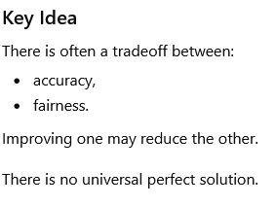
Contd…
Some people think:
Equal outcomes = fairness
Others think:
Equal accuracy = fairness
Others focus on:
reducing false accusations,
reducing missed opportunities.

Slide 51
Recommendations
When you use apps like YouTube, Netflix, Instagram, or Amazon, the platform suggests videos, movies, posts, or products that you may like. These suggestions are called recommendations.
The computer uses a set of rules called an algorithm to decide what to show you. This is known as algorithmic influence because the algorithm can influence what people watch, buy, think, or believe.

Slide 52
Recommendations are personalized suggestions given by a system based on:
Your past activity
Your likes/dislikes
Your searches
What similar users enjoy
Example
If you watch many cooking videos on YouTube, the system may recommend:
Recipe videos
Restaurant reviews
Baking tutorials
The algorithm thinks:
“This user likes cooking content, so show more similar content.”

Slide 53
Benefits
Saves Time: Users quickly find useful content.
Personalized Experience: Different users see different recommendations.
Better Business: Companies keep users active and increase sales.
Discover New Things: Users may find new music, movies, or products.

Slide 54
Algorithmic Influence
Algorithmic influence means:
Algorithms affect human decisions and behavior.
The recommendations can influence:
What news people read
Which products they buy
Which videos they watch
Even political opinions

Slide 55
Problems with Algorithmic Influence
a) Filter Bubble: The algorithm keeps showing similar content only. This limits different viewpoints.
b) Addiction / Overuse Platforms may recommend highly engaging content continuously. Users may spend too much time online.
c) Bias: Algorithms may treat some groups unfairly if trained on biased data.
d) Spread of Misinformation: If fake or sensational content gets more clicks, algorithms may promote it.

Slide 56
Biased Data
The data used to train a machine learning model is unfair, unbalanced, or does not represent all people equally.
Since machine learning models learn from data, if the data contains bias, the model also becomes biased.
Machine learning models learn patterns from real-world data.
But the real world already contains:
discrimination
stereotypes
unfair treatment
unequal representation
So the model learns these unfair patterns automatically.
If biased data goes into the model, biased decisions come out.

Slide 57
Data Protection
Scenario
An online shopping company like Amazon collects user data such as:
Purchase history
Search history
Location
Payment details
Products viewed
Time spent browsing

Slide 58
Data Protection
Different Stakeholders Want Different Uses
Stakeholder Want
Marketing Team Send personalized ads
Data Analysts Study customer behavior
Third-Party Sellers Access customer preferences
Government Agencies Request user transaction records
Ethical Questions
Even if users accepted the terms and conditions:
Should all personal data be shared?
Are users fully aware of how their data is used?
Could this harm user privacy?

Slide 59
Ethical Concerns
Personalized Advertising
Too much tracking of user behavior
Users may feel constantly monitored
Sharing with Third Parties
Customer information may be misused
Risk of data leaks
Government Requests
Innocent users’ activities may be monitored
Privacy concerns increase
Data Breaches
Hackers may steal payment information
Financial fraud can occur

Slide 60
Key Lesson : Collecting user data creates responsibility.
Companies must:
Protect user privacy
Use data responsibly
Avoid misuse of personal information
Maintain user trust
Conclusion
Data protection is about safely and ethically handling users’ personal information, not just storing it securely.

