Slide 1
Ruby on Rails

Slide 2
Ruby on Rails, commonly called Rails, is an open-source web application framework written in the Ruby programming language. It is mainly used to develop server-side web applications quickly and efficiently.
Rails was created by David Heinemeier Hansson and released in 2004. It became popular because it helps developers build web applications with less code, less effort, and less time.

Slide 3
Ruby on Rails Framework
Ruby on Rails is a full-stack framework, meaning it provides everything needed to build a web application, such as:
Database handling
Routing
Controllers
Views
Security features

Slide 4
Rails follows the MVC (Model–View–Controller) architecture, which separates:
Data (Model)
User Interface (View)
Application Logic (Controller)

Slide 5
Key Features of Ruby on Rails
1. Convention over Configuration (CoC)
Rails assumes sensible defaults, so developers don’t need to write extra configuration files.
2. Don’t Repeat Yourself (DRY)
Avoids writing the same code again and again, making applications cleaner and easier to maintain.
3. Active Record (ORM)
Rails uses Active Record to interact with databases using Ruby objects instead of SQL queries.

Slide 6
4. RESTful Architecture
Rails supports REST principles, making web applications structured and scalable.
5. Built-in Security
Provides protection against:
SQL Injection
Cross-Site Scripting (XSS)
Cross-Site Request Forgery (CSRF)

Slide 7
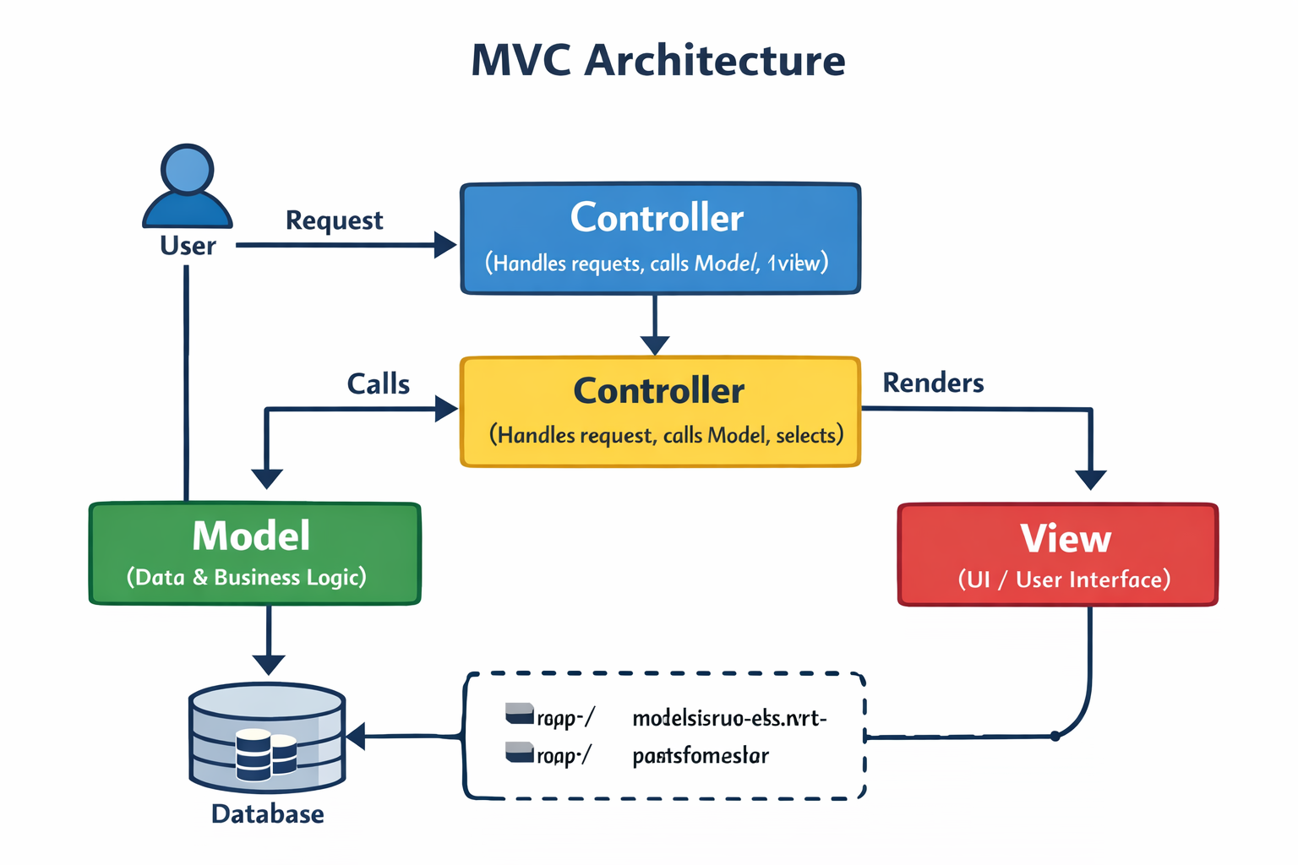
Rails MVC Architecture
Model -> Data & business logic
View ->User interface
Controller ->Request handling & coordination

Slide 8
Real-Time Scenario: Student Management System
Assume we are building a Student Management System where:
Admin can add students
Users can view student details

Slide 9
What is Model?
The Model represents the data and rules of the application.
Real-Time Role
Stores student information (name, roll number, department)
Applies validations
Talks to the database

Slide 10
What is View?
The View displays information to the user.
Real-Time Role
Shows student details on a webpage
Displays forms and tables
Does not contain database logic

Slide 11
What is Controller?
The Controller handles user requests and decides what to do next.
Real-Time Role
Receives request to view a student
Fetches student data from Model
Sends data to View

Slide 12
Complete MVC Request Flow
User enters URL: (http://localhost:3000/students/1)
Router sends request to StudentsController
Controller asks the Model for student data
Model fetches data from the database
Controller sends data to the View
View displays student details to the user

