Slide 1
Introduction to Hadoop
Challenges with Big volume, variety and velocity of data :
How to store terabytes of mouting data
“ I need data in varied sources- I have data that is rich in veriety- Structured, Semi-structured and Unstructured” .
        How to work with data that is so very different ?
“I need this data to be processed quickly. My decision is pending.”
        How to access the information quickly?
        “To Process, analyze and make sense of these different kinds of data , we need a system that scales and addresses the above challenges.”

Slide 2
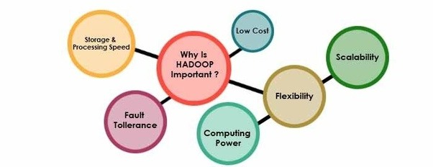
Why Hadoop
Key Consideration :
“ Its capability to handle massive amounts of data , different categories of data – fairly quickly.”
Other Considerations:

Slide 3
Low Cost:
Hadoop is an open source framework and uses commodity(Off-the-shelf hardware, is a computer device or IT component that is relatively inexpensive, ) software to store enormous quantities of data
Computing Power:
Hadoop is based on distributed computing model which processes large volume of data very quickly and fairly
The more number of computing nodes, the more power
Scalability:
Can easily add nodes as the system grows and requires much less adinistration
Storage flexibility:
One can store unstructured data like images, videos and free-form text
Inherent data protection:
Protects data against hardware failure

Slide 4
How Data is Managed with Hadoop?
Distributes the data duplicates chunk of each data file across several nodes.
Locally available computer resource is used to process each chunk of data in parallel.
Hadoop framework handles failover smartly and automatically.
Scale Out
25-30
36-40
31-35
41-45
46-50
31-35
25-30
46-50
36-40
41-45
36-40
41-45
25-30
46-50
31-35

Slide 5
How Data is Managed with Hadoop?
Hadoop does not store a very large file on just one computer. Instead, it divides the file into smaller blocks and distributes those blocks across different computers, called nodes.”
For example, suppose we have a 1 GB file.
Hadoop may divide it into blocks:
1 GB File → Block 1 + Block 2 + Block 3 + Block 4
These blocks are stored on different machines in the Hadoop cluster.

Slide 6
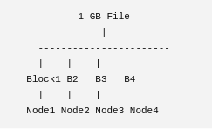
Distributes the data and duplicates chunks of each data file across several nodes”
This means Hadoop splits the data into blocks and stores copies of those blocks on different computers.
For example:

Slide 7
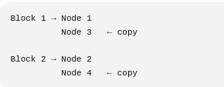
Hadoop also keeps replicas (copies) of the blocks.
For example:
The purpose of duplication is fault tolerance.
If Node 1 fails, Hadoop can get Block 1 from Node 3.
Important: In Hadoop terminology, the data is divided into blocks, and those blocks are replicated across nodes.

Slide 8
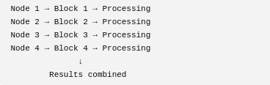
2. “Locally available computer resource is used to process each chunk of data in parallel”
This is one of the most important ideas in Hadoop.
Instead of moving all the data to one computer, Hadoop tries to process the data where it is stored.
For example:

Slide 9

All four nodes can work at the same time.
This is called parallel processing.
So, instead of:
One computer → processes 1 GB sequentially
Hadoop does:
Multiple computers → process different blocks simultaneously.
This is why Hadoop can handle very large datasets.
3. “Hadoop framework handles failover smartly and automatically”
Failover means what happens when one computer or node fails.
Suppose:

Slide 10
Now suppose Node 2 fails.
Hadoop automatically uses the available replica.
Therefore, failure of one machine does not necessarily stop the entire Hadoop job.

Slide 11
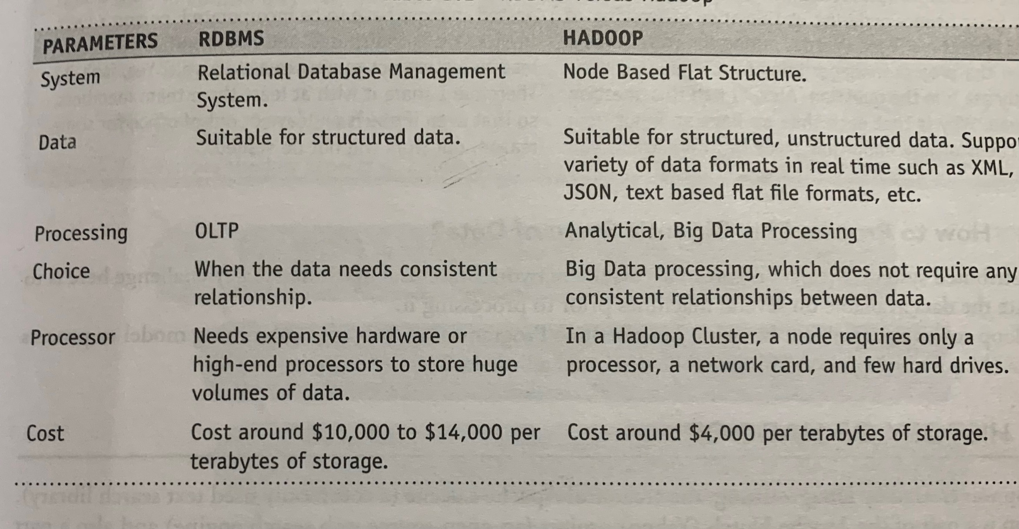

Slide 12
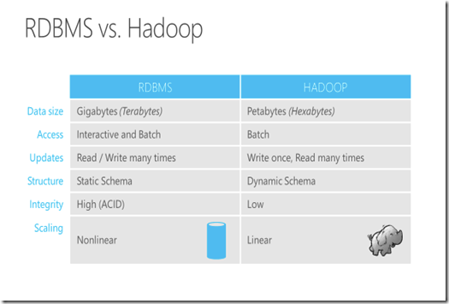

Slide 13
Distributed Computing Challenges
Hardware Failure
In a distributed system, several servers are networked together
There may be a possibility of failure
Solution: This problem can be solved using Replication Factor(RF)
Replication Factor connects the number of data copies of a given data item/ data block stored across tyhe network.
2. How to Process the large amount of Data ?
In a distributed system, the data is spread across the network on several machines. A key challenge is to integrate the data available on several machines prior to processing it .
Solution: Hadoop solves this problem by using MapReduce Programming

Slide 14
Hadoop Overview
Hadoop is a open source framework to store and process massive amount of data in a distributed fashion on large clusters of commodity hardware.
Hadoop accomplishes two tasks:
1. Massive Data Storage
2. Faster Data Processing
Key aspects of Hadoop are:
Open source Software: Free to download, use and contribute to
Framework: Programs, tools etc for apllication developement are provided
Distributed: Divides and stores data across multiple computers
Massive Storage: Stores large amount of data across nodes of low cost commodity hardware
Faster Processing: Data is processed in parallel, yielding quick response

Slide 15
Distributed computing is a broad concept or
field of study, while Hadoop is a specific
framework used to implement that concept.
Think of distributed computing as the concept
of "motor transportation," and Hadoop as a
specific brand of truck.

Slide 16
Features of Hadoop
1. Hadoop Brings Flexibility In Data Processing:
Hadoop manages data whether structured or unstructured, encoded or formatted, or any other type of data.
2. Hadoop Is Easily Scalable
Hadoop is extremely scalable platform where new nodes can be easily added in the system as and data volume of processing needs grow without altering anything in the existing systems or programs.
3.
Hadoop Is Fault Tolerant
In Hadoop, the data is stored in HDFS where data automatically gets replicated at two other locations.
So, even if one or two of the systems collapse, the file is still available on the third system at least.
This brings a high level of fault tolerance.

Slide 17
4. Hadoop Is Great at Faster Data Processing
Hadoop is extremely good at high-volume batch processing because of its ability to do parallel processing.
Hadoop can perform batch processes 10 times faster than on a single thread server or on the mainframe.
5. Hadoop Ecosystem Is Robust:
Hadoop has a very robust ecosystem that is well suited to meet the analytical needs of developers and small to large organizations.
Hadoop Ecosystem comes with a suite of tools and technologies making it a very much suitable to deliver to a variety of data processing needs.
6. Hadoop Is Very Cost Effective
Hadoop generates cost benefits by bringing massively parallel computing to commodity servers, resulting in a substantial reduction in the cost per terabyte of storage, which in turn makes it reasonable to model all your data.

Slide 18
Advantages of Hadoop
Stores data in its native format (schema-less)
It can store and distribute very large data sets across hundreds of inexpensive servers that operate in parallel (Scalable)
It has much reduced cost/terabyte of storage and processing (cost-effective)
It is fault-tolerant(Resilient to failure)
It can work with all kinds of data.(Flexibility)
The processing is extremely fast bcoz of 'move code to data' paradigm(Fast)

Slide 19
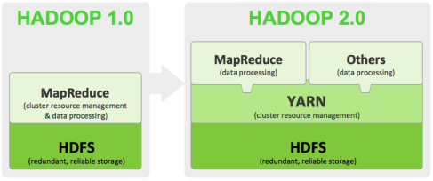
Versions of Hadoop
Apache Hadoop is structured into three major generations (Hadoop 1.x, 2.x, and 3.x), with version 3.5.0 being the latest stable release.

Slide 20
Hadoop 1.0
It has two main parts
1. Data Storage framework:
It is HDFS and is schema-less.
It stores data files and these data files can be in any format.
2. Data Processing framework:
It is a functional programming model and uses two functions to process the data.
The MAP and the REDUCE
The mappers take in a set of key-value pairs and generate intermediate data .
The Reducers then act on this input to produce output data.
These two funtions work in isolation from one another , thus enabling the processing to be highly distributed in a highly-parallel, fault-tolerant and scalable way.

Slide 21
Limitaions of Hadoop 1.0
1. The requiremnt for MapReduce Programming expertise along with proficiency required in other programming languages (notably java)
2. It supported only Batch processing (Batch Processing system is an efficient way of processing large volumes of data. where a group of transactions is collected over a period of time. Data is collected, entered, processed and then the batch results are produced. )
3. It is tightly , computationally coupled with MapReduce Programming which means users are left with two options
Either rewrite their functionality in MapReduce so that so that it could be executed in Hadoop
(or) Extract the data from HDFS and process it outside the Hadoop

Slide 22
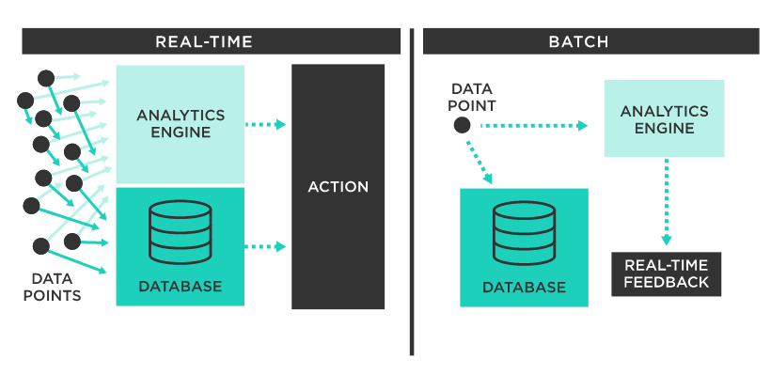

Slide 23
Hadoop 2.0
In Hadoop 2.0 , HDFS is the data storage framewok.
However a new separate resouce management framework called YARN(Yet Another Resource Negotiator) has been added.
Any application capable of dividing itself into parallel task is supported by YARN.
Here MapReduce programming expertise is no longer needed.
It supports both batch processing and real time processing.

Slide 24
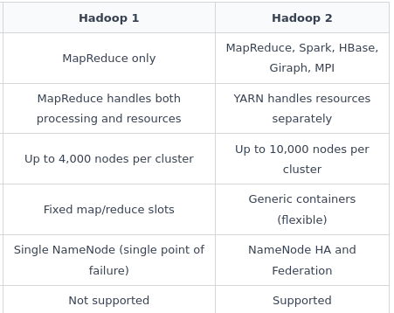

Slide 25
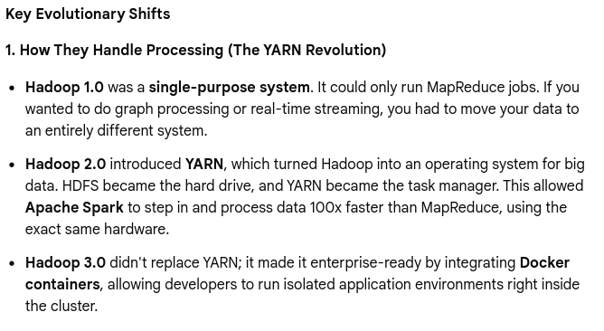
Hadoop 3.0 Advantages

Slide 26
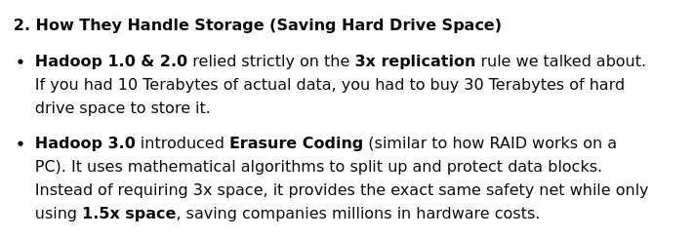

Slide 27
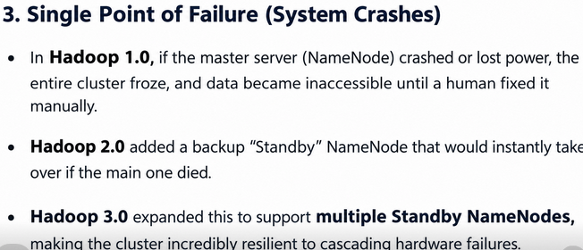

Slide 28
Hadoop Components
HaDOOP Core Components:
1. HDFS (Hadoop distributed file system)
a. Storage component
b. Distributes data across several nodes
c. Natively redundant
2. Map Reduce
a. Computational framework
b. Splits a task across multiple nodes
c. Processes data in parallel
3. Hadoop ecosystem
Hadoop ecostsem are support projects to enhance the functionality of Hadoop core components.

Slide 29
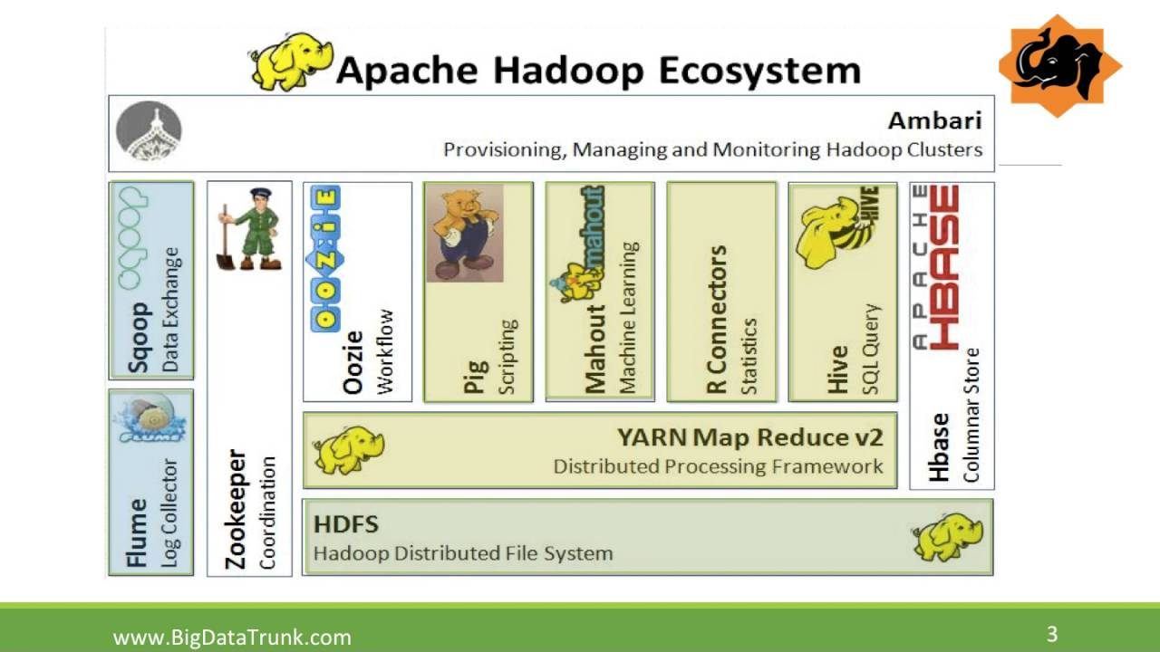

Slide 30
Hadoop Distributed File System (HDFS) -
The default big data storage layer for Apache Hadoop is HDFS.
HDFS is the “Secret Sauce” of Apache Hadoop components as users can dump huge datasets into HDFS and the data will sit there nicely until the user wants to leverage it for analysis.
HDFS component creates several replicas of the data block to be distributed across different clusters for reliable and quick data access.
HDFS comprises of 3 important components-NameNode, DataNode and Secondary NameNode.
HDFS operates on a Master-Slave architecture model where the NameNode acts as the master node for keeping a track of the storage cluster and the DataNode acts as a slave node summing up to the various systems within a Hadoop cluster.

Slide 31
Data Access Components of Hadoop Ecosystem- Pig and Hive
Pig-
​Apache Pig is a convenient tools developed by Yahoo for analysing huge data sets efficiently and easily.
It provides a high level data flow language Pig Latin that is optimized, extensible and easy to use.
The most outstanding feature of Pig programs is that their structure is open to considerable parallelization making it easy for handling large data sets.
Hive-
​ Hive developed by Facebook is a data warehouse built on top of Hadoop and provides a simple language known as HiveQL similar to SQL for querying, data summarization and analysis.
Hive makes querying faster through indexing.

Slide 32
Data Integration Components of Hadoop Ecosystem- Sqoop and Flume
Sqoop
Sqoop component is used for importing data from external sources into related Hadoop components like HDFS, HBase or Hive.
It can also be used for exporting data from Hadoop o other external structured data stores. Sqoop parallelized data transfer, mitigates excessive loads, allows data imports, efficient data analysis and copies data quickly.
Flume
Flume component is used to gather and aggregate large amounts of data.
Apache Flume is used for collecting data from its origin and sending it back to the resting location (HDFS).

Slide 33
Data Storage Component of Hadoop Ecosystem –HBase
HBase –
HBase is a column-oriented database that uses HDFS for underlying storage of data. HBase supports random reads and also batch computations using MapReduce.
With HBase NoSQL database enterprise can create large tables with millions of rows and columns on hardware machine.
The best practice to use HBase is when there is a requirement for random ‘read or write’ access to big datasets.

Slide 34
Monitoring, Management and Orchestration(COORDINATION) Components of Hadoop Ecosystem- Oozie and Zookeeper
Oozie-
Oozie is a workflow scheduler where the workflows are expressed as Directed Acyclic Graphs.
Oozie runs in a Java servlet container makes use of a database to store all the running workflow instances, their states ad variables along with the workflow definitions to manage Hadoop jobs (MapReduce, Sqoop, Pig and Hive).
The workflows in Oozie are executed based on data and time dependencies.
Zookeeper-
Zookeeper is the king of coordination and provides simple, fast, reliable and ordered operational services for a Hadoop cluster.
Zookeeper is responsible for synchronization service, distributed configuration service and for providing a naming registry for distributed systems.

Slide 35
Apache AMBARI or Call it the Elephant Rider
A Hadoop component, Ambari is a RESTful (representational state transfer)API (web based tool) which provides easy to use web user interface for Hadoop management.
Ambari provides step-by-step wizard for installing Hadoop ecosystem services.
It is equipped with central management to start, stop and re-configure Hadoop services and it facilitates the metrics collection, alert framework, which can monitor the health status of the Hadoop cluster.
Apache MAHOUT
Mahout is an important Hadoop component for machine learning, this provides implementation of various machine learning and data mining algorithms.
This Hadoop component helps with considering user behavior in
providing suggestions,
categorizing the items to its respective group,
classifying items based on the categorization and supporting in implementation group mining or itemset mining, to determine items which appear in group.

Slide 36
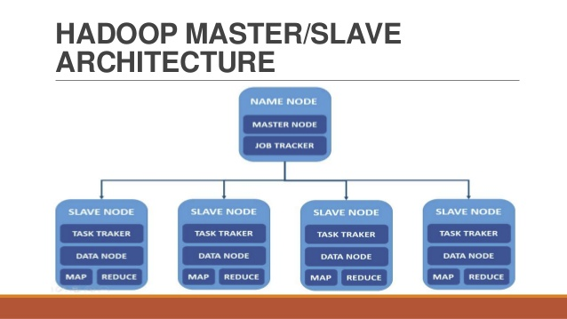

Slide 37
HDFS operates on a Master-Slave architecture model where the NameNode acts as the master node for keeping a track of the storage cluster and the DataNode acts as a slave node summing up to the various systems within a Hadoop cluster.
Components of Master Node are:
1. Master HDFS (Name node):
  Its main responsibility is partitioning the data storage across several nodes
  It also keeps track of locations of data on Data Nodes
  2. Master MapReduce:
  It decides and schedules computation task on slave nodes

Slide 38
Hadoop follows a master slave architecture design for data storage and distributed data processing using HDFS and MapReduce respectively.
The master node for data storage is hadoop HDFS is the NameNode and the master node for parallel processing of data using Hadoop MapReduce is the Job Tracker.
The slave nodes in the hadoop architecture are the other machines in the Hadoop cluster which store data and perform complex computations.
Every slave node has a Task Tracker daemon and a DataNode that synchronizes the processes with the Job Tracker and NameNode respectively. In Hadoop architectural implementation the master or slave systems can be setup in the cloud or on-premise.

Slide 39
Hadoop | SQL
Scale out | Scale up
Key-Value pairs | Relational table
Functioal Programming | Declarative Queries
Off-line batch processing | On-line transaction processing

Slide 40
Key Aspects of HDFS
NameNode
HDFS works in a master-slave/master-worker fashion.
All the metadata related to HDFS including the information about data nodes, files stored on HDFS, and Replication, etc. are stored and maintained on the NameNode.
A NameNode serves as the master and there is only one NameNode per cluster.
DataNode
DataNode is the slave/worker node and holds the user data in the form of Data Blocks. There can be any number of DataNodes in a Hadoop Cluster.

Slide 41
Data Block
A Data Block can be considered as the standard unit of data/files stored on HDFS. Each incoming file is broken into 64 MB by default.
Any file larger than 64 MB is broken down into 64 MB blocks and all the blocks which make up a particular file are of the same size (64 MB) except for the last block which might be less than 64 MB depending upon the size of the file.
Replication
Data blocks are replicated across different nodes in the cluster to ensure a high degree of fault tolerance.
Replication enables the use of low cost commodity hardware for the storage of data. The number of replicas to be made/maintained is configurable at the cluster level as well as for each file.
Based on the Replication Factor, each file (data block which forms each file) is replicated many times across different nodes in the cluster.

Slide 42
Rack Awareness
Data is replicated across different nodes in the cluster to ensure reliability/fault tolerance.
Replication of data blocks is done based on the location of the data node, so as to ensure high degree of fault tolerance.
For instance, one or two copies of data blocks are stored on the same rack, one copy is stored on a different rack within the same data center, one more block on a rack in a different data center, and so on.

Slide 43
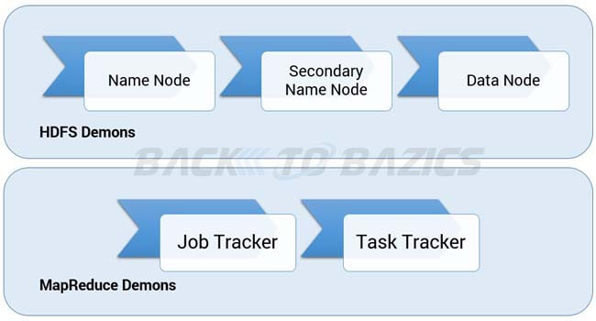
Hadoop 1.x Architecture

Slide 44
HDFS Architecture in Hadoop 1.x mainly has 3 daemons which are Name Node, Secondary Name Node and Data Node.
Name Node
There is only single instance of this process runs on a cluster and that is on a master node
It is responsible for manage metadata about files distributed across the cluster
It manages information like location of file blocks across cluster and it’s permission
This process reads all the metadata from a file named fsimage and keeps it in memory
After this process is started, it updates metadata for newly added or removed files in RAM
It periodically writes the changes in one file called edits as edit logs
This process is a heart of HDFS, if it is down HDFS is not accessible any more

Slide 45
Secondary Name Node (Helper to Namenode)
For this also, only single instance of this process runs on a cluster
This process can run on a master node (for smaller clusters) or can run on a separate node (in larger clusters) depends on the size of the cluster
One misinterpretation from name is “This is a backup Name Node” but IT IS NOT!!!!!
It manages the metadata for the Name Node. In the sense, it reads the information written in edit logs (by Name Node) and creates an updated file of current cluster metadata
Than it transfers that file back to Name Node so that fsimage file can be updated
So, whenever Name Node daemon is restarted it can always find updated information in fsimage file

Slide 46
Data Node
There are many instances of this process running on various slave nodes(referred as Data nodes)
It is responsible for storing the individual file blocks on the slave nodes in Hadoop cluster
Based on the replication factor, a single block is replicated in multiple slave nodes(only if replication factor is > 1) to prevent the data loss
Whenever required, this process handles the access to a data block by communicating with Name Node
This process periodically sends heart bits to Name Node to make Name Node aware that slave process is running

Slide 47
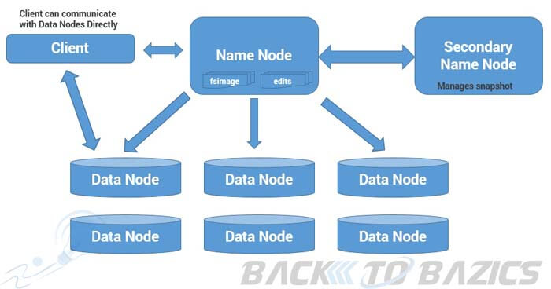

Slide 48
HDFS master-slave/master-worker Working Model:
NameNode servers as the master and each DataNode servers as a worker/slave.
User data is stored on the local file system of DataNodes.
If the NameNode goes down then the data in HDFS is non-usable as only the NameNode knows which blocks belong to which file, where each block located etc.
NameNode can talk to all the live DataNodes and the live DataNodes can talk to each other.

Slide 49
There is also a Secondary NameNode which comes in handy when the Primary NameNode goes down.
Secondary NameNode can be brought up to bring the cluster online.
This process of switching of nodes needs to be done manually and there is no automatic failover mechanism in place.
NameNode receives heartbeat signals and a Block Report periodically from each of the DataNodes.
Heartbeat signals from a DataNode indicates that the corresponding DataNode is alive and is working fine.
If a heartbeat signal is not received from a DataNode then that DataNode is marked as dead and no further I/O requests are sent to that DataNode.
Block Report from each DataNode contains a list of all the blocks that are stored on that DataNode.
Heartbeat signals and Block Reports received from each DataNode help the NameNode to identify any potential loss of Blocks/Data and to replicate the Blocks to other active DataNodes in the event when one or more DataNodes holding the data blocks go down.

Slide 50
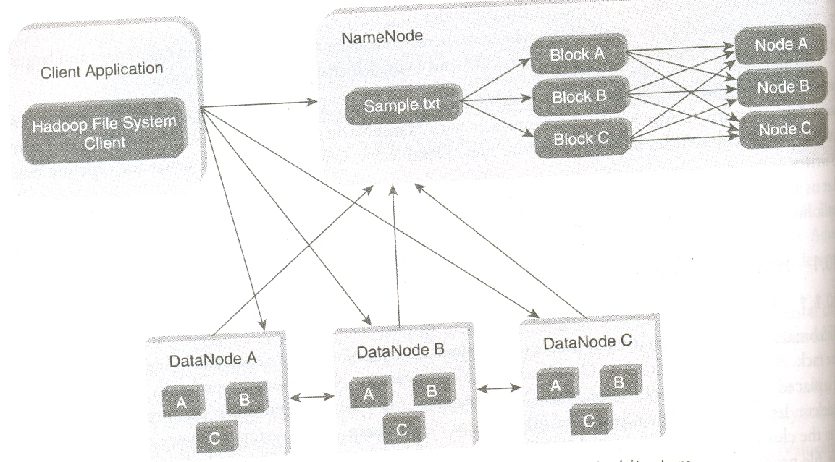

Slide 51
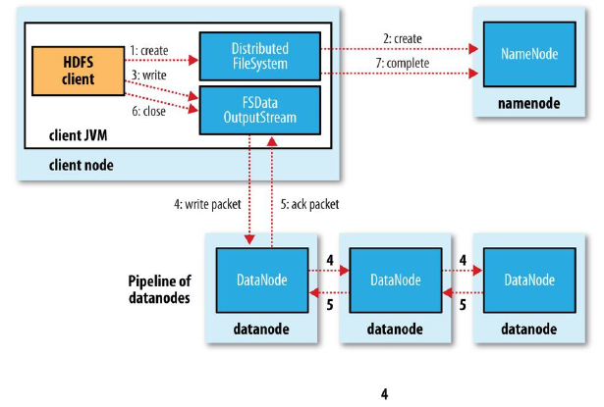
Anatomy of File Write in HDFS

Slide 52
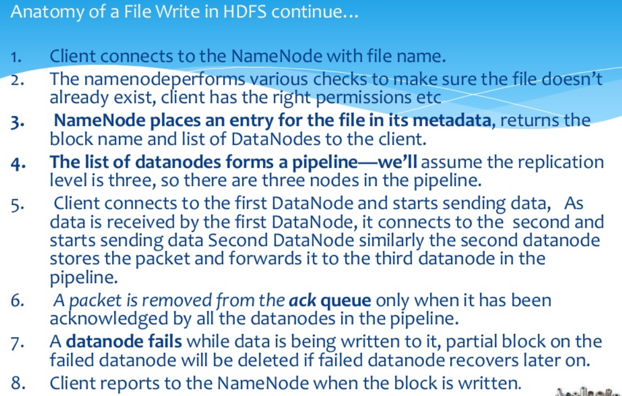

Slide 53
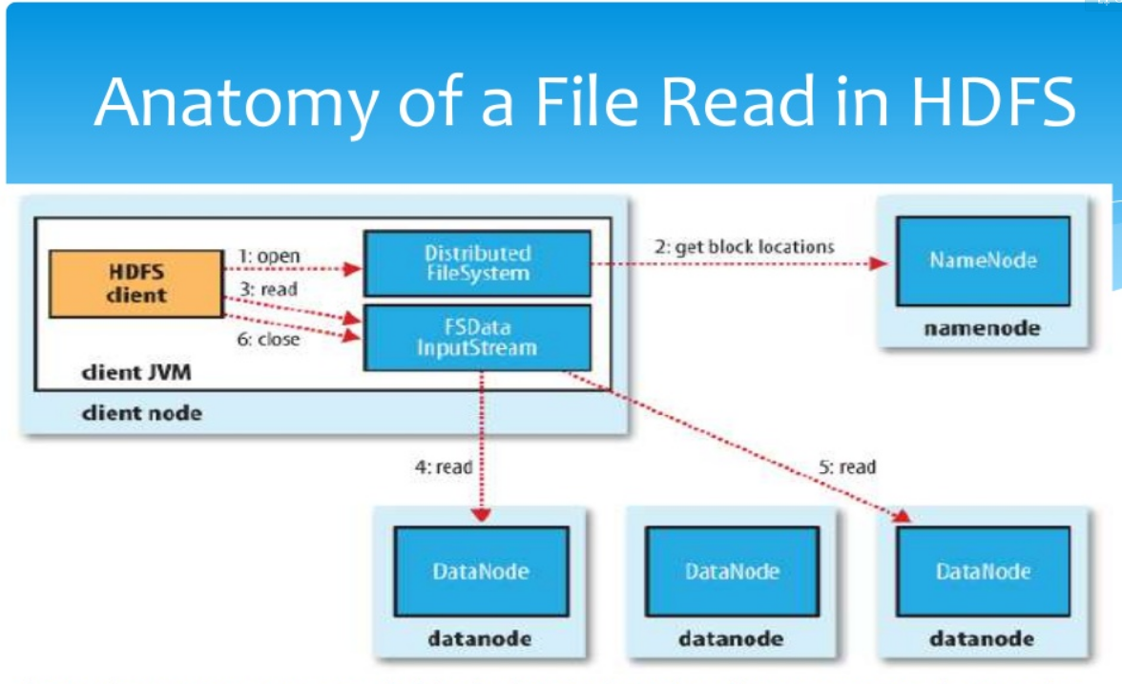

Slide 54
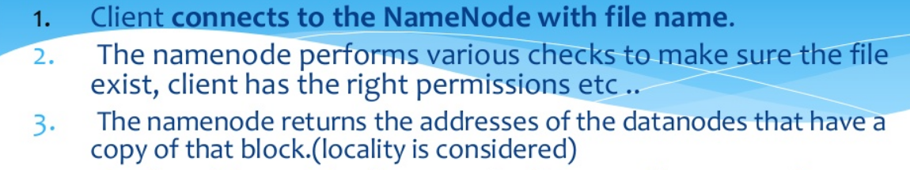
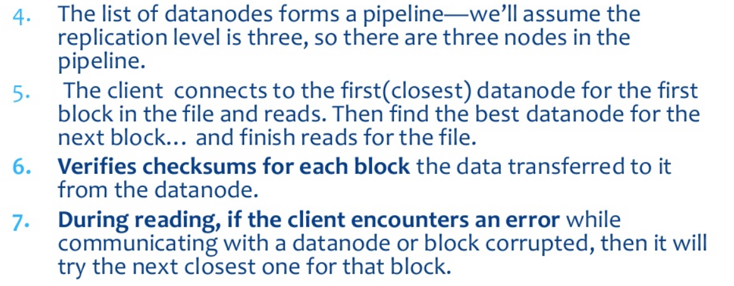

Slide 55
Data processing in Hadoop(MapReduce Phases and Daemons )
Phases are :
1. Map : Converts input into Key-Value pairs
2. Reduce: Combines output of mappers and produces a reduced result set
There are 2 daemons asssociated with MapReduce Programming
1. A single master JobTracker per cluster
Provides connectivity between Hadoop and your application
When you submit the code to the cluster, JobTracker creates the execution plan by deciding which task to assign to which node.
It monitors all the running tasks.
When a task fails, it automatically re-schedules the task to a different node after a predefined number of tries.

Slide 56
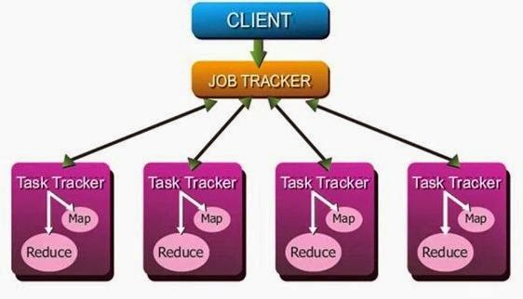
2. One slave TaskTracker per cluster node.
This daemon is responsible for executing individual tasks that is assigned by the JobTracker.
Handles multiple map or reduce tasks in parallel.
TaskTracker continuously sends heartbeat messsage to JobTracker.
When the JobTracker fails to recieve a heartbeat from a TaskTracker, the JobTracker assumes that the TaskTracker has failed and resubmits the task to another available node in the cluster.
Once the client submits a job to the JobTracker, it partitions and assigns diverse MapReduce tasks for each TaskTracker in the cluster.

Slide 57
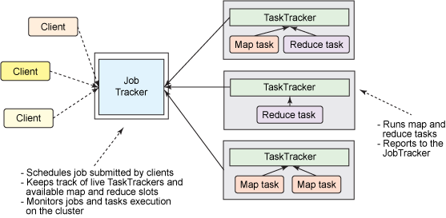
MapReduce Programming Architecture

Slide 58
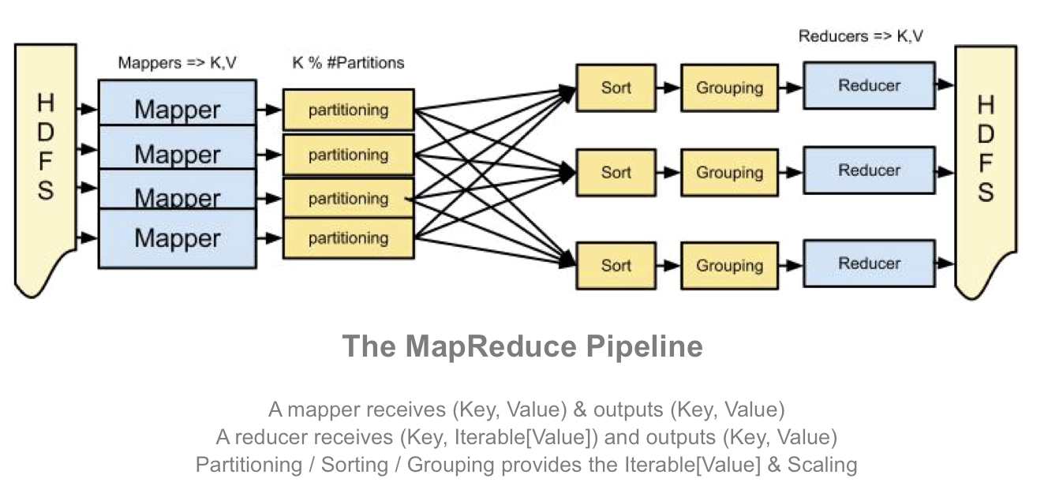

Slide 59
MapReduce performs the following tasks:
The input data set is split into multiple copies of the data
The framework creates a master and several workers processes and executes the worker prosesses remotely
Several map tasks work simultaneously and read pieces of data that were assigned to each map task. The map worker uses the map function to extract only those data and generates key-value pair for extracted data
Map worker uses partitioner function to divide the data into regions. Partitioner decides which reducer should get the output of the specified mapper.
When the map workers complete their work, the master instructs the reduce workers to begin their work. The data thus recieved is shuffled and sorted as per keys.
Then it calls reduce function for every unique key. This function writes the output to the file.
When all the reduce workers complete their work, the master transfers the control to the user program.

Slide 60
MapReduce Example: Word count
The MapReduce Programming requires 3 things
Driver Class: This class specifies Job Configuration Details
Mapper Class: This class overrides the Map Function based on the problem statement
Reducer Class: This class overrides the Reduce Function based on the problem statement

Slide 61
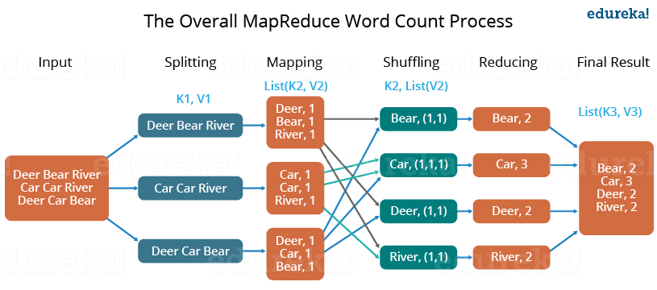

Slide 62
Limitations of Hadoop 1.x Architecture
Major drawback of Hadoop 1.x Architecture is Single Point of Failure as there is no backup Name Node.
Job scheduling, resource management and job monitoring are being done by Job Tracker which is tightly coupled with Hadoop. So Job Tracker is not able to manage resources outside Hadoop.
Job Tracker has to coordinate with all task tracker so in a very big cluster it will be difficult to manage huge number of task trackers altogether.
Due to single Name Node, there is no concept of namespaces in Hadoop 1.x. So everything is being managed under single namespace.
Using Hadoop 1.x architecture, Hadoop Cluster can be scaled upto ~4000 nodes. Scalablity beyond that may cause performance degradation and increasing task failure ratio.

Slide 63
Limitations of Hadoop 1.x Architecture
6. It has a restricted processing model which is suitable for batch oriented MapReduce jobs
7. Hadoop MapReduce is not suitable for interactivbe analysis
8. Hadoop 1.0 is not suitable for machine learning algorithms, graphs and other \
memory intensive algorithms

Slide 64
HDFS 2
Consists of 2 major components
Namespace
Takes care of file related operations such as creating files, modifying files and directories
Blocks storage service
Handles data node cluster management, replication

Slide 65
HDFS 2 Features:
Horizontal Scalability
HDFS2 uses multiple independent namenodes which are independent of each other
Data nodes are common storage for blocks and shared by all Name nodes
All the DataNodes in the cluster registers with each Namenode in the cluster.
High availability
It is obtained with the help of Passive standby NameNode
In Hadoop 2.x, Active-Passive NameNode handles failover automatically

Slide 66
Active NameNode
Passive Namenode
Shared edit logs
Write
Read
All namespace edits are recorded to a shared storage and there is a single witer at any point of time
Passive NameNode reads edits from shared storage and keeps updated metadata information.
In case of Active Namenode failure, Passive Namenode becomes an Active Namenode automatically. Then it starts writing to the shared storage

Slide 67
YARN Architecture and Components
In Hadoop 1.x Architecture,
JobTracker daemon was carrying the responsibility of Job scheduling and Monitoring as well as was managing resource across the cluster.
TaskTracker daemon was executing map reduce tasks on the slave nodes.
YARN has divided the responsibilities of JobTracker to two processes ResourceManager and ApplicationMaster and instead of TaskTracker is using NodeManager daemon for map reduce task execution.
YARN has total three major components
ResourceManager
NodeManager
ApplicationMaster

Slide 68
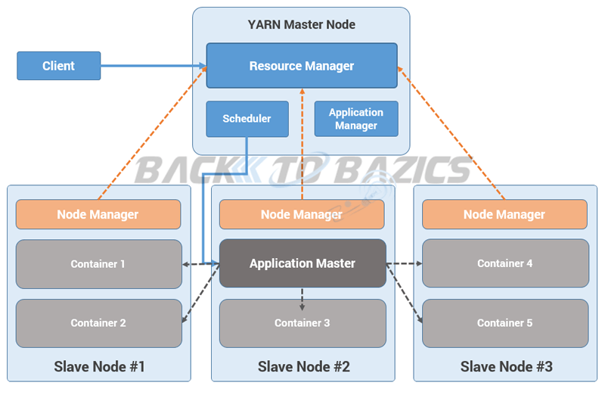

Slide 69
1) ResourceManager
This daemon process resides on the Master Node (not necessarily on NameNode of Hadoop)
Responsible for,
Managing resources scheduling for different compute applications in an optimum way
Coordinating with two process on master node,
                Scheduler and ApplicationManager

Slide 70
a. Scheduler
This daemon process resides on the Master Node (runs along with ResourceManager daemon )
Responsible for,
Scheduling the job execution as per submission request received by ResourceManager
Allocating resources to applications submitted to the cluster
Coordinating with ApplicationManager daemon and keeping track of resources of running applications

Slide 71
b. ApplicationManager
This daemon process resides on the Master Node (runs along with ResourceManager daemon )
Responsible for,
Helping Scheduler daemon to keeps track of running application by coordination
Accepting job submissions from client
Negotiating first container for executing application specific task with suitable ApplicationMaster on slave node

Slide 72
2) NodeManager
This daemon process resides on the slave nodes (runs along with DataNode daemon)
Responsible for,
Managing and executing containers
Monitoring resource usage (i.e. usage of memory, cpu, network etc..) and reporting it back to ResourceManager daemon
Periodically sending heart-bits to ResourceManager for its health status update

Slide 73
3) ApplicationMaster
This daemon process runs on the slave node (along with the NodeManager daemon)
It is per application specific library works with NodeManager to execute the task
The instance of this daemon is per application, which means in case of multiple jobs submitted on cluster, it may have more than one instances of ApplicationMaster on slave nodes
Responsible for,
Negotiating suitable resource containers on slave node from ResourceManager
Working with one or multiple NodeManagers to monitor task execution on slave nodes

Slide 74
What is Container?
It is considered to be a small unit of resources (like cpu, memory, disk) belong to the SlaveNode
Scheduler process running along with ResourceManager daemon allocates the resources as a container
At the beginning of a job execution with YARN, container allows ApplicationMaster process to make a use of some resources on any slave node on the cluster
Then ApplicationMaster manages the application execution across other containers on slave nodes of a YARN cluster

Slide 75
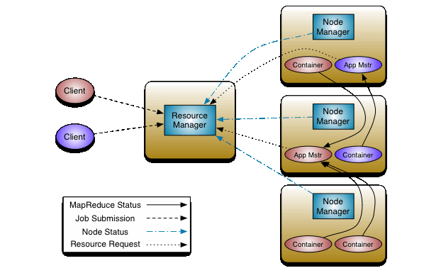

Slide 76
Steps:
Client submits an Application (Say MapReduce job)
Resource Manager allocates a container to start Application Manager
Application Manager registers with Resource Manager
Application Manager asks containers from Resource Manager
Application Manager notifies Node Manager to launch containers
Application code is executed in the container
Client contacts Resource Manager/Application Manager to monitor application’s status
Application Manager unregisters with Resource Manager

Slide 77
Steps in Detail:
Step 1: Job/Application(which can be MapReduce, Java/Scala Application, DAG jobs like Apache Spark etc..) is submitted by the YARN client application to the ResourceManager daemon along with the command to start the ApplicationMaster on any container at NodeManager
Step 2: ApplicationManager process on Master Node validates the job submission request and hand it over to Scheduler process for resource allocation
Step 3: Scheduler process assigns a container for ApplicationMaster on one slave node
Step 4: NodeManager daemon starts the ApplicationMaster service within one of its container using the command mentioned in Step 1, hence ApplicationMaster is considered to be the first container of any application
Step 5: ApplicationMaster negotiates the other containers from ResourceManager by providing the details like location of data on slave nodes, required cpu, memory, cores etc..

Slide 78
Step 6: ReourceManager allocates the best suitable resources on slave nodes and responds to ApplicationMaster with node details and other details
Step 7: Then, ApplicationMaster send requests to NodeManagers on suggested slave nodes to start the containers
Step 8: ApplicationMaster then manages the resources of requested containers while job execution and notifies the ResourceManager when execution is completed
Step 9: NodeManagers periodically notify the ResourceManager with the current status of available resources on the node which information can be used by scheduler to schedule new application on the clusters
Step 10: In case of any failure of slave node ResourceManager will try to allocate new container on other best suitable node so that ApplicationMaster can complete the process using new container

