Slide 1
LOGISTIC REGRESSION

Slide 2
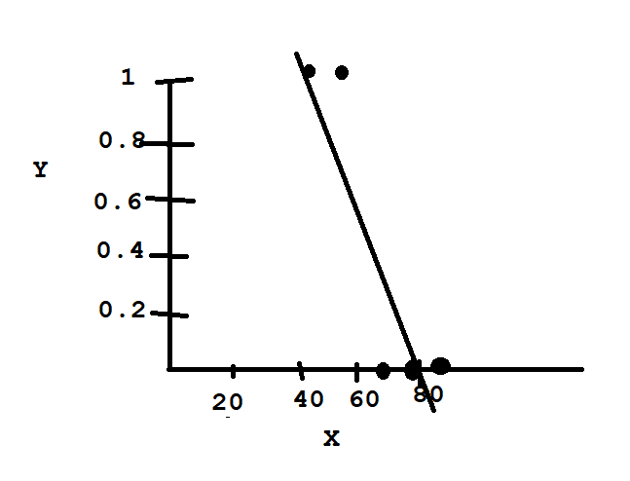
Consider the Data:
In the above we have 2 variables
The independent variable X is the Time spent by user on a web site
The dependent variable Y is whether the user clicked on any Ads
Time | Clicked on Ad
68.95 | No
80.23 | No
69.45 | No
74.15 | No
50 | Yes
55.5 | Yes
80 | No
70.5 | No
Now suppose we apply Linear Regression to the data, the points to be considered are:
There is no continuous numerical data
We have categorical data
Now when we plot the graph, we get

Slide 3
The above provides no use in predicting the dependent variables by using the independent variable.
Using the above, it is not possible for us to predict if a user will click on ads for a given time.
Therefore we cannot use Linear Regression for this scenario.
The main reason is because we have categorical data as dependent variable.
So when we have categorical data inthe dependent variable , it is better not to use Linear regression
Or if you have yes/no or 0/1 or true/false etc, then linear regression will not be of use.

Slide 4
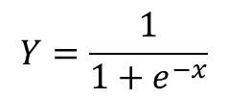
LOGISTIC REGRESSION:
In such a case go for Logistic Regression.
That is, basically Logistic Regression is used for Classification.
Sigmoid Function:
$$Y=\frac{1}{1+e^{−x}}$$
The Sigmoid function is the most important function used in Logistic Regression.
Here x is the independent variable that you want to transform.
E is the Eiuler’s constant which is 2.718
Y is the output or the dependent variable.

Slide 5
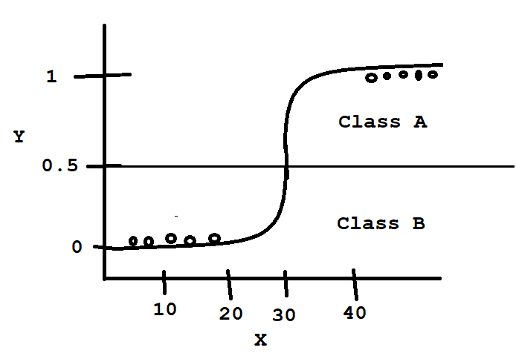
The Sigmoid function tries to convert the independent variable into an expression of probability that ranges between 0 and 1 with respect to the dependent variable.
It will not go below 0 and above 1.
So you can depict the logistic regression as shown below.
As shown abpve, logistic regression works between 0 and 1.
We can consider 0.5 as cut off point.
So there are some points below 0.5 and some points above 0.5.
Therefore the logistic regression acts as a strong binary classifier.
It maps the real values of the independent variable in the interval of 0 and 1
The points above 0.5 will be considered as Class A and the points below 0.5 will be considered as Class B
The points that are plotted are the actual output
So the outputs are classified as belonging to Class A and Class B.

Slide 6
As shown abpve, logistic regression works between 0 and 1.
We can consider 0.5 as cut off point.
So there are some points below 0.5 and some points above 0.5.
Therefore the logistic regression acts as a strong binary classifier.
It maps the real values of the independent variable in the interval of 0 and 1
The points above 0.5 will be considered as Class A and the points below 0.5 will be considered as Class B
The points that are plotted are the actual output
So the outputs are classified as belonging to Class A and Class B.

Slide 7
The Y axis is always between 0 and 1.
All the data points will be between 0 and 1.
0 means no possibility of occurrence
1 means highest possibility of occurrence.
So the data points nearer to 1 belong to one class and their possibility is the highest.
Where as the data points nearer to 0 belong to another class and their probability of occurrence is next to impossible.
If the data points are located at 0.5, then they are unclassifieable. But this is rare.
Applications:
Fraud detection
Disease Diagnosis
Emergency Detection
Spam , no spam

Slide 8
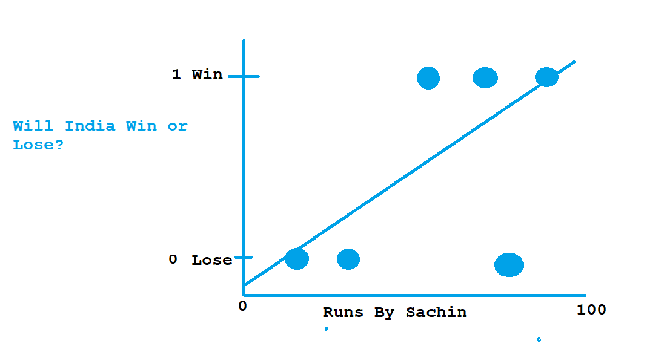
Another example is Scores by Sachin and whether India has won or lost.
If score by Sachin is plotted against X axis an win/lose against Y axis
The below points may represent scores 10, 40 and 80 and the matches were lost
In the above case, the scores might be 60, 80 and 90 and the matches were won.

Slide 9
So if we want to predict if Sachin scores 57, then will the match be won?
For this drawing a regression line will not work or it will not show the relationship between the score and the result of the match.
Because a Linear Regression Line will not show the Y value as 0(lose) or 1(Win).
Because it is a straight line and the line may go above 1 or below 0.
So suppose the score is 140, then the Y value may be 3 or 4.
But we want the Y value to be either 0 or 1 or maybe in between.

Slide 10
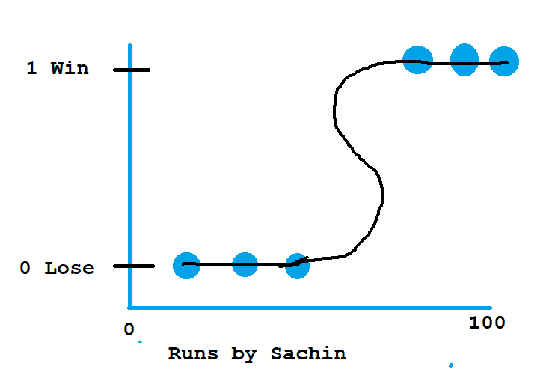
Here we are not predicting a value, but we are classifying, whether India will win or lose the match.
In such cases where we are doing a binary classification, we go for Logistic Regression.
We do not draw a regression line, instead we draw the Regression curve.
This curve we call it the Sigmoid Curve or the S curve.
There can be any number of data points, but the result will be 1 or 0.
So here we have applied logistic regression and created a Sigmoid curve.
The Sigmoid curve will tell you the probability of the result Y based on X value.
That is it will give the winning probability of the match based on the runs scored by Sachin.

Slide 11
Here we see that when the runs scored is 20, 30, 40, the probolity is that the match will be lost.
When the runs scored is 70, 80, 90, the probability is that the match will be won.
So as the runs scored increases, the probability of winning the match is more.
The probability of winning will not go above 1 or below 0.
The dependent variable Y will always be categorical.
So Logistic Regression is used for binary classification.
Another Example is Smoking(Yes/No)-------------------→Cancer(Yes/No)

Slide 12
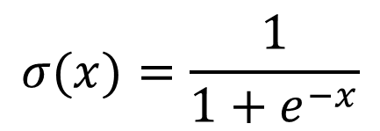
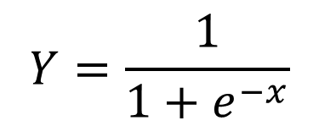



The Formula for the Sigmoid Curve is as follows:
$$Y=\frac{1}{1+e^{−x}}$$
$$σ(x)=\frac{1}{1+e^{−x}}$$
Here x is
$$β^{T}X$$
$$β^{T}X$$
is
$$β_{0}+β_{1}X_{1}+β_{2}X_{2}+…+β_{n}X_{n}$$
Where

