Slide 1
MULTIPLE LINEAR REGRESSION

Slide 2
Predict the value of Y given X1 and X2
SUBJECT | Y | X1 | X2
1 | -3.7 | 3 | 8
2 | 3.5 | 4 | 5
3 | 2.5 | 5 | 7
4 | 11.5 | 6 | 3
5 | 5.7 | 2 | 1
6 | ? | 3 | 2

Slide 3
The Multiple Regression Model
Multiple Regression Model with k Independent Variables
Population slopes
Random Error
Y intercept
$$a=β_{0}+β_{1}X_{1}+β_{2}X_{2}+…+β_{k}X_{k}+ε$$

Slide 4
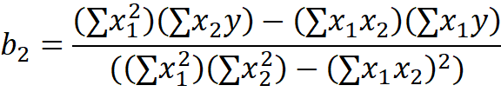
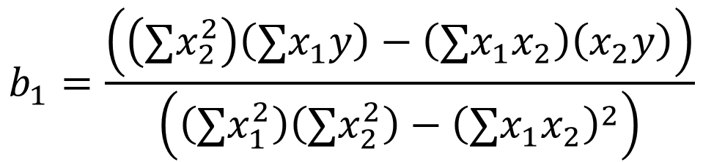

Linear Regression 2 Independent Variable
$$a=\overline{Y}−b_{1}{\overline{X}}_{1}−b_{2}{\overline{X}}_{2}$$
$$b_{1}=\frac{\left(\left(∑x_{2}^{2}\right)\left(∑x_{1}y\right)−\left(∑x_{1}x_{2}\right)\left(x_{2}y\right)\right)}{\left(\left(∑x_{1}^{2}\right)\left(∑x_{2}^{2}\right)−{\left(∑x_{1}x_{2}\right)}^{2}\right)}$$

Slide 5





Linear Regression 2 Independent Variable

Slide 6
Linear Regression 2 Independent Variable
SUBJECT | Y | X₁ | X₂ | X₁ X₁ | X₂ X₂ | X₁ X₂ | X₁ Y | X₂ Y
1 | -3.7 | 3 | 8 | 9 | 64 | 24 | -11.1 | -29.6
2 | 3.5 | 4 | 5 | 16 | 25 | 20 | 14 | 17.5
3 | 2.5 | 5 | 7 | 25 | 49 | 35 | 12.5 | 17.5
4 | 11.5 | 6 | 3 | 36 | 9 | 18 | 69 | 34.5
5 | 5.7 | 2 | 1 | 4 | 1 | 2 | 11.4 | 5.7
∑ | 19.5 | 20 | 24 | 90 | 148 | 99 | 95.8 | 45.6

Slide 7
Linear Regression 2 Independent Variable

Slide 8
Linear Regression 2 Independent Variable
SUBJECT | Y | X₁ | X₂ | X₁ X₁ | X₂ X₂ | X₁ X₂ | X₁ Y | X₂ Y
1 | -3.7 | 3 | 8 | 9 | 64 | 24 | -11.1 | -29.6
2 | 3.5 | 4 | 5 | 16 | 25 | 20 | 14 | 17.5
3 | 2.5 | 5 | 7 | 25 | 49 | 35 | 12.5 | 17.5
4 | 11.5 | 6 | 3 | 36 | 9 | 18 | 69 | 34.5
5 | 5.7 | 2 | 1 | 4 | 1 | 2 | 11.4 | 5.7
∑ | 19.5 | 20 | 24 | 90 | 148 | 99 | 95.8 | 45.6

Slide 9
Linear Regression 2 Independent Variable

Slide 10
Linear Regression 2 Independent Variable
SUBJECT | Y | X₁ | X₂ | X₁ X₁ | X₂ X₂ | X₁ X₂ | X₁ Y | X₂ Y
1 | -3.7 | 3 | 8 | 9 | 64 | 24 | -11.1 | -29.6
2 | 3.5 | 4 | 5 | 16 | 25 | 20 | 14 | 17.5
3 | 2.5 | 5 | 7 | 25 | 49 | 35 | 12.5 | 17.5
4 | 11.5 | 6 | 3 | 36 | 9 | 18 | 69 | 34.5
5 | 5.7 | 2 | 1 | 4 | 1 | 2 | 11.4 | 5.7
∑ | 19.5 | 20 | 24 | 90 | 148 | 99 | 95.8 | 45.6

Slide 11





Linear Regression 2 Independent Variable

Slide 12
Linear Regression 2 Independent Variable

Slide 13
Linear Regression 2 Independent Variable

Slide 14
Linear Regression 2 Independent Variable

Slide 15
Linear Regression 2 Independent Variable
SUBJECT | Y | X₁ | X₂ | X₁ X₁ | X₂ X₂ | X₁ X₂ | X₁ Y | X₂ Y
1 | -3.7 | 3 | 8 | 9 | 64 | 24 | -11.1 | -29.6
2 | 3.5 | 4 | 5 | 16 | 25 | 20 | 14 | 17.5
3 | 2.5 | 5 | 7 | 25 | 49 | 35 | 12.5 | 17.5
4 | 11.5 | 6 | 3 | 36 | 9 | 18 | 69 | 34.5
5 | 5.7 | 2 | 1 | 4 | 1 | 2 | 11.4 | 5.7
∑ | 19.5 | 20 | 24 | 90 | 148 | 99 | 95.8 | 45.6

Slide 16
Linear Regression 2 Independent Variable

Slide 17
Linear Regression 2 Independent Variable
Final Regression equation or Model is:
Now given x₁ =3 and x₂ =2 Y=?
Y = 2.796 + 2.28 * 3 – 1.67 * 2
= 6.296

Slide 18
Linear Regression 2 Independent Variable

Slide 19
Linear Regression 2 Independent Variable
Final Regression equation or Model is:
Now given x₁ =3 and x₂ =2 Y=?
Y = 2.796 + 2.28 * 3 – 1.67 * 2
= 6.296

