Slide 1
K-Means Clustering

Slide 2
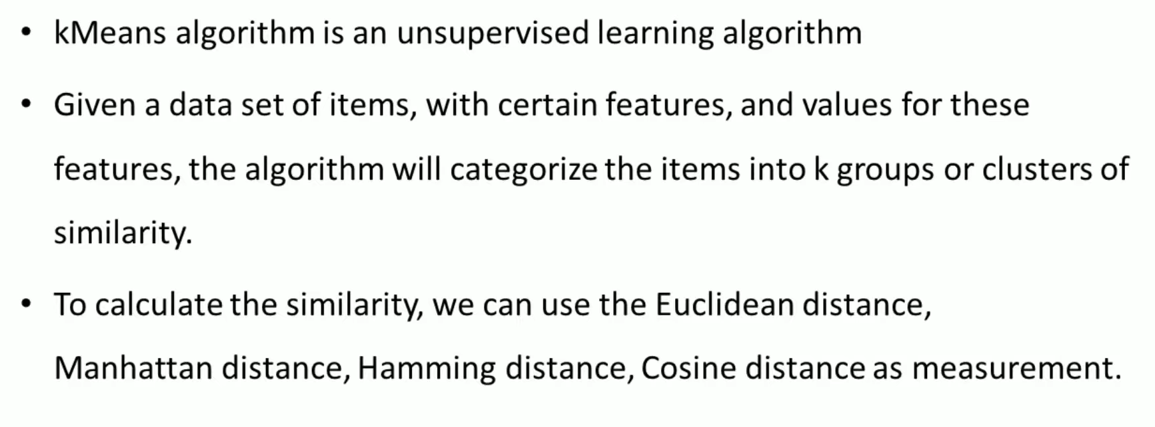

Slide 3
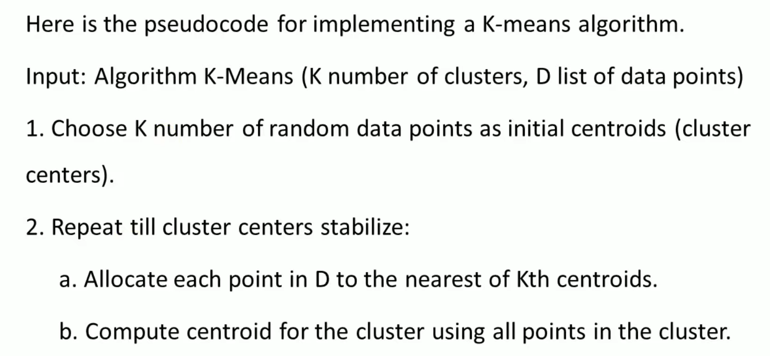
K-Means Clustering Algorithm

Slide 4
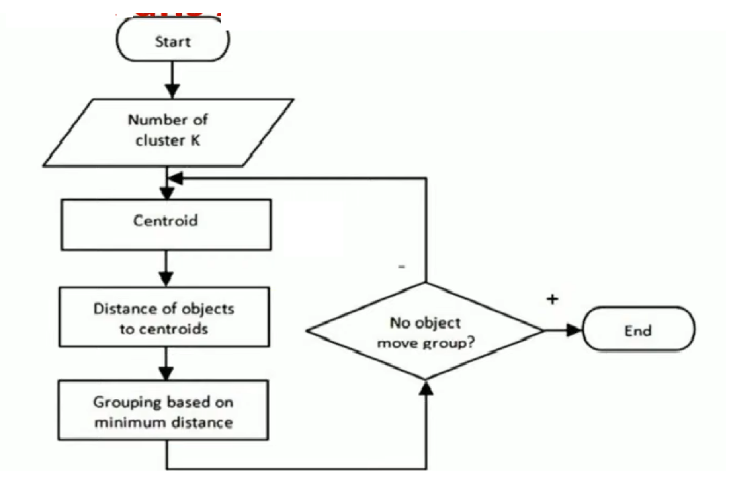

Slide 5
