Slide 1
Ethics In Research & Scientific Writing
Unit 4

Slide 2
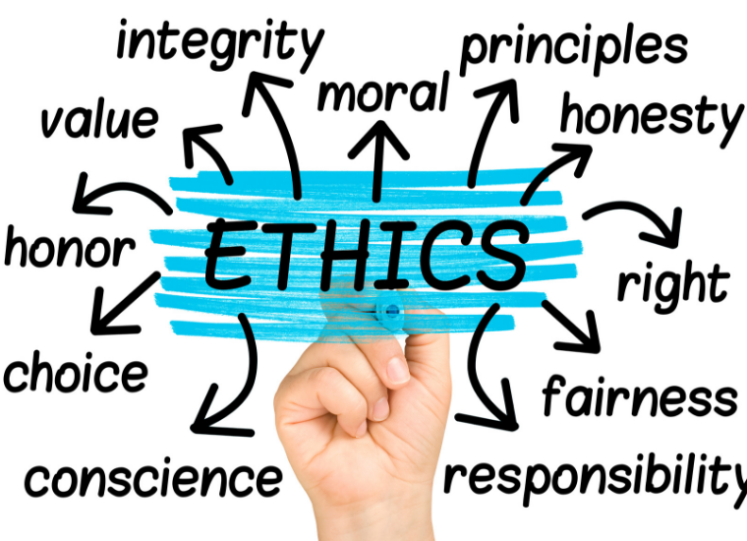
Ethics

Slide 3
Ethics
Ethics or moral philosophy is a branch of philosophy that "involves systematizing, defending, and recommending concepts of right and wrong behavior".

Slide 4
Ethics contd…
Three major areas of study within ethics recognized today are:
Meta-ethics: concerning the theoretical meaning and reference of moral propositions, and how their truth values (if any) can be determined;
Normative ethics: concerning the practical means of determining a moral course of action;
Applied ethics: concerning what a person is obligated (or permitted) to do in a specific situation or a particular domain of action.
Ex: War, Animal rights, Social Justice, Biomedical ethics.

Slide 5
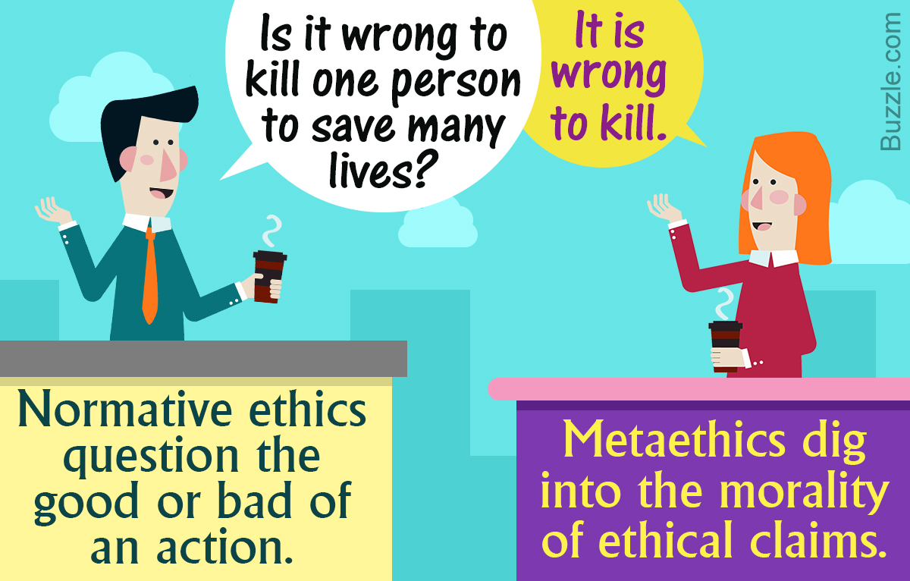

Slide 6
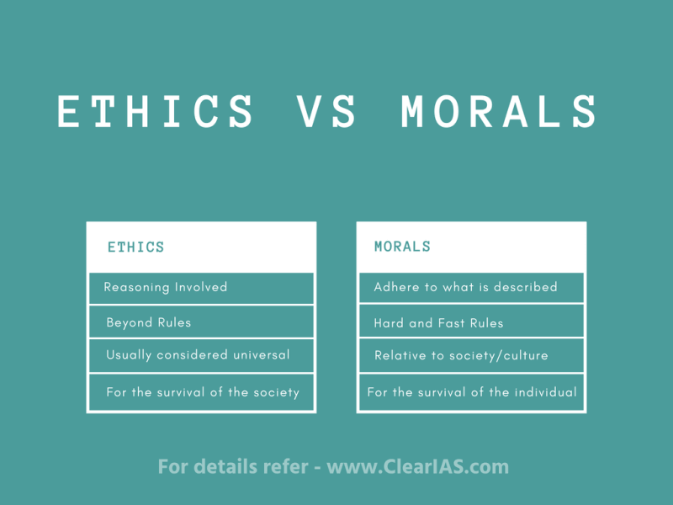

Slide 7
Philosophy
The word philosophy is derived from the Greek words philia (love) and sophia (wisdom) and means the love of wisdom.
Philosophy is the study of general and fundamental problems, such as those connected with existence, knowledge, values, reason, mind, and language.
It is the rational attempt to formulate, understand, and answer fundamental questions.

Slide 8

Moral Philosophy
Moral Philosophy, also known as Ethics, is the branch of philosophy that studies right and wrong, good and bad, and how people ought to behave. It tries to answer questions like:
What makes an action morally right or wrong?
Why should we be moral?
How do we decide what is good for society or individuals?
Ethics helps guide human behaviour in personal life, society, law, medicine, business, and many other areas.

Slide 9
Nature of moral judgments & reactions
A judgement of right and wrong, good and bad is commonly termed as moral judgement.
It is judgement of an individual which he passes to estimate the rightness or wrongness of his action.
The moral judgement is the judgement which deals with the moral value or quality of an action.
It is a judgement of value and it evaluates the rightness or wrongness of our actions.

Slide 10
Nature of moral judgments & reactions
When we analyse a moral judgement then we find that it contains:
a subject which will judge
an object whose action will be judged
a standard in conformity to which the action of the subject will be judged a power of judging the action as required.
Moral judgment is the judgment of moral quality of voluntary habitual actions.

Slide 11
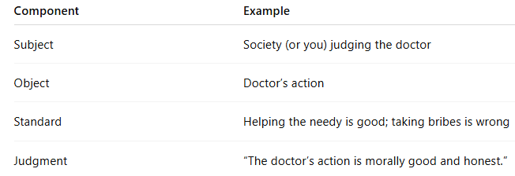
Example
A doctor refuses a bribe and treats a poor patient for free.

Slide 12
Nature of moral judgments
Moral judgment is a judgment of values. It is distinct from the judgment of facts.
A Judgment of value is a judgment of “what ought to be”. But a judgment of fact is a judgment of “what is”.
Judgment of fact is a descriptive judgment, while moral judgment is an appreciative or critical judgment. So, moral judgment is a mental act of pronouncing a particular action to be right or wrong.

Slide 13
Nature of moral judgments
According to Mackenzie, moral judgment is not merely to state the nature of some object, but to compare it with a standard and to pronounce it to be good or evil, right or wrong. So, it is normative.
Muirhead says that moral judgment is concerned with the judgment upon conduct, the judgment that such and such conduct is right and wrong. The judgment upon conduct has a judicial sense and the judgment of fact has logical sense.

Slide 14
Nature of moral judgments
But in the language of Bradley, ordinarily moral judgment is intuitive and immediate. Because, we intuitively brings an action under a moral rule recognized by the community and judge it to be right or wrong.

Slide 15
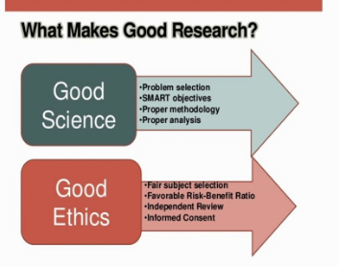
Scientific Conduct Ethics with respect to Science & Research

Slide 16
Scientific Conduct Ethics with respect to Science & Research
There are ten ethical principles common across scientific disciplines. They are;
Duty to society;
beneficence;
conflict of interest;
informed consent;
integrity;
nondiscrimination;
non exploitation;
privacy and confidentiality;
professional competence; and
Professional discipline.

Slide 17
Each ethical principle applies to the scientific inquiry, the conduct and behaviors of researchers, or the ethical treatment of research participants. ·
Only one ethical principle — duty to society — applies to the scientific inquiry by asking whether the research benefits society. ·
Variations in ethical principles across disciplines are usually due to whether the discipline includes human or animal subjects. ·
Variations in ethical principles across countries are usually due to local laws, oversight, and enforcement; cultural norms; and whether research is conducted in the researchers' host country or a foreign country.

Slide 18
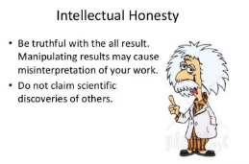
Intellectual honesty and research integrity
Intellectual honesty is an applied method of problem solving characterized by an unbiased, honest attitude which can be demonstrated in a number of different ways including but not limited to: one’s personal beliefs do not interfere with the pursuit of truth; relevant facts and information are not purposefully omitted even when such things may contradict one’s hypothesis.
Facts are always presented in an unbiased manner.

Slide 19
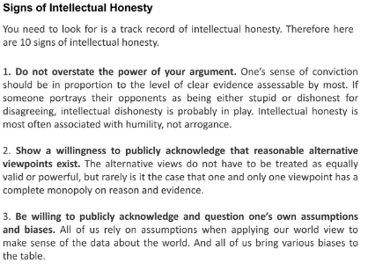

Slide 20
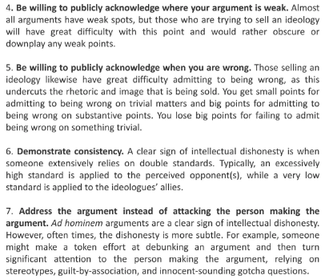

Slide 21
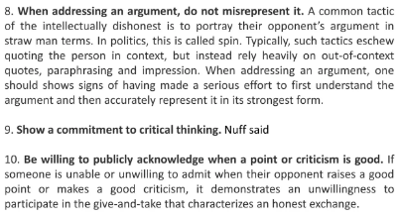

Slide 22
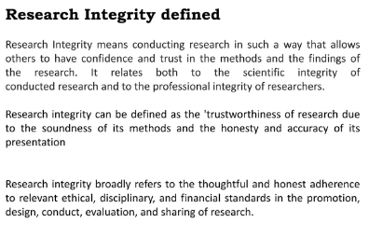
Research Integrity

Slide 23
For the individual scientist, integrity embodies above all a commitment to intellectual honesty and personal responsibility for one's actions and to a range of practices that characterize responsible research conduct.
These practices include:
intellectual honesty in proposing, performing, and reporting research;
accuracy in representing contributions to research proposals and reports;
fairness in peer review;

Slide 24
contd..
collegiality in scientific interactions, including communications and sharing of resources;
transparency in conflicts of interest or potential conflicts of interest;
protection of human subjects in the conduct of research;
humane care of animals in the conduct of research; and
adherence to the mutual responsibilities between investigators and their research teams.

Slide 25


