Slide 1
Installation of Ruby, Rails and PostgreSQL
Ashwini Bhandary

Slide 2
Introduction
Ruby is a dynamic, object-oriented programming language
Ruby on Rails is a web application framework written in Ruby
PostgreSQL is an open-source relational database
These tools are commonly used together for web development

Slide 3
System Requirements
Operating System: Windows / Linux / macOS
Minimum 4 GB RAM recommended
Stable internet connection
Administrator (root) access

Slide 4
Software Prerequisites
Command Prompt / Terminal
Text editor or IDE (VS Code recommended)
Basic command-line knowledge

Slide 5
Ruby Installation – Windows
Ruby Installation – Windows (Detailed)
Go to RubyInstaller official site.
Download the latest stable version (with DevKit recommended).
Run the installer:
Accept license agreement.
Choose installation directory (default is fine).
Select “Add Ruby executables to PATH”.
Complete installation.
Open Command Prompt and type:
ruby –v (to verify installation)

Slide 6
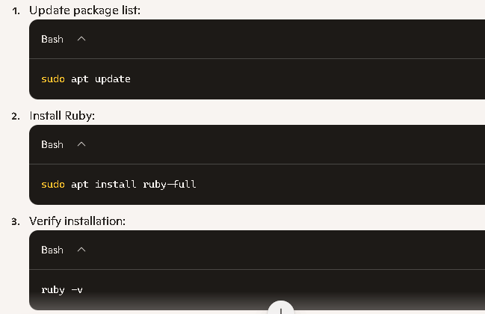
Ruby Installation – Linux / macOS

Slide 7
Ruby Installation – macOS
Install Homebrew if not already installed:
/bin/bash -c "$(curl –fsSL https://raw.githubusercontent.com/Homebrew/install/HEAD/install.sh)"
2. Install Ruby:
brew install ruby
3. Verify installation:
ruby -v

Slide 8
RubyGems
RubyGems is the package manager for Ruby
Used to install Ruby libraries
Rails is installed using RubyGems

Slide 9
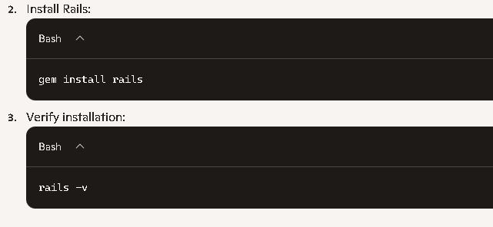
Rails Installation
Ensure RubyGems is installed (comes with Ruby).

Slide 10
PostgreSQL Overview
PostgreSQL is an open-source RDBMS
Supports ACID properties
Widely used with Rails applications

Slide 11
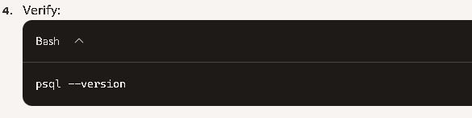
PostgreSQL Installation windows
Download installer from PostgreSQL official site.
Run setup wizard:
Choose installation directory.
Set superuser password (remember this for Rails config).
Default port: 5432.
Complete installation.

Slide 12
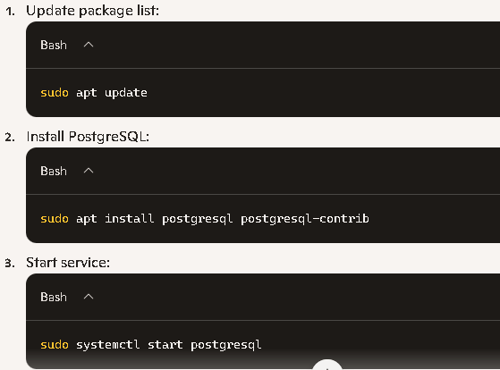
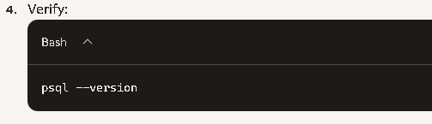
PostgreSQL Installation – Linux

Slide 13
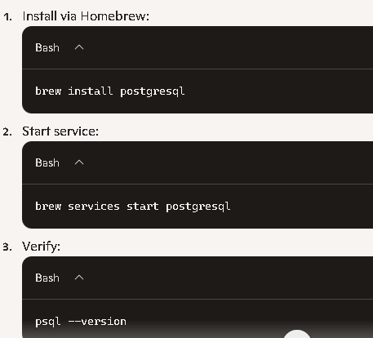
PostgreSQL Installation – macOS

Slide 14
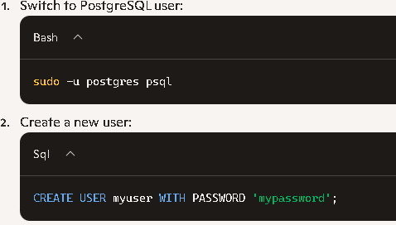
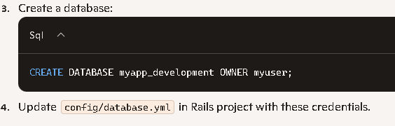
PostgreSQL Configuration for Rails
Notes:
Create database user
Assign username and password
Update credentials in database.yml

Slide 15
Create Rails Application
rails new myapp -d postgresql
cd myapp
rails db:create

Slide 16
Run Rails Server
Run command: rails server
Server runs on port 3000
Open browser: http://localhost:3000

Slide 17
Common Errors
Ruby or Rails command not recognized
PostgreSQL service not running
Database authentication failure

Slide 18
Conclusion
Ruby, Rails, and PostgreSQL installed successfully
System ready for Rails development
Follow correct steps to avoid errors

