Slide 1
Agile Software Development

Slide 2
Rapid software development
Why?
  Need to react to changes more quickly than 2 year long waterfall projects
  2 years and then you got the design wrong anyway! Small deliveries aren't abstract
How?
  Goal - Deliver working software quickly
    Compromise - less functionality in a delivery, not lower quality
    Less documentation
  Focus on the code rather than the design
  Interleave
    Specification, design and implementation are inter-leaved
  Deliver small versions and get user (stakeholder) input

Slide 3
Agile manifesto
Our values:
  Individuals and interactions over processes and tools
  Working software over comprehensive documentation
  Customer collaboration over contract negotiation
  Responding to change over following a plan
That is, while there is value in the items on the right, we value the items on the left more.

Slide 4
Agile Methods
Scrum: Uses short development cycles called sprints, with defined roles (Product Owner, Scrum Master, Team) and regular ceremonies such as daily stand-ups and sprint reviews.
Kanban: Focuses on visualizing work using boards, limiting work in progress, and improving flow continuously.
Extreme Programming (XP): Emphasizes technical excellence through practices like pair programming, test-driven development, and continuous integration.
Lean Software Development: Aims to eliminate waste, optimize processes, and deliver value efficiently.
Crystal: A family of Agile methods tailored to team size and project criticality.

Slide 5

Problems with agile methods
It can be difficult to keep the interest of customers / users who are involved in the process.
Team members may be unsuited to the intense involvement that characterizes agile methods.
Prioritizing changes can be difficult where there are multiple stakeholders.
Maintaining simplicity requires extra work.
Contracts may be a problem as with other approaches to iterative development.
Because of their focus on small, tightly-integrated teams, there are problems in scaling agile methods to large systems.
Less emphasis on documentation - harder to maintain when you get a new team for maintenance

Slide 6
Agile Development Techniques
Iterative and Incremental Development: Building software in small, manageable iterations.
User Stories: Simple descriptions of features from the user’s perspective.
Continuous Integration and Continuous Delivery (CI/CD): Frequent code integration with automated testing and deployment.
Test-Driven Development (TDD): Writing tests before code to ensure reliability.
Pair Programming: Two developers work together to improve code quality and knowledge sharing.
Refactoring: Continuously improving code structure without changing functionality.
Daily Stand-ups and Retrospectives: Regular meetings to track progress and improve team performance.
.

Slide 7
Balance plan driven and agile
Not great for Agile:
  What type of system is being developed?
    Plan-driven approaches may be required for systems that require a lot of analysis before implementation (e.g. real-time system with complex timing requirements).
  What is the expected system lifetime?
    Long-lifetime systems may require more design documentation to communicate the original intentions of the system developers to the support team.
  What technologies are available to support system development?
    Agile methods rely on good tools to keep track of an evolving design
  How is the development team organized?
    Many teams; Outsourcing ---> need design documents to control borders
  Culture or contract needs detailed specification
  Is rapid feedback from users realistic?
  Large scale, not co-located may require more formal communication methods
  Need high level programming skills - refactoring, work with little spec
  Outside regulation documentation requirements

Slide 8
Extreme programming
A popular form of Agile
Extreme Programming (XP) takes an ‘extreme’ approach to iterative development.
  New versions may be built several times per day;
  Increments are delivered to customers every 2 weeks;
  All tests must be run for every build and the build is only accepted if tests run successfully.
Customer involvement means full-time customer engagement with the team. - Specifications through user stories broken into tasks
People not process : pair programming, collective ownership and a process that avoids long working hours.
Regular system releases. - release set of user stories
Maintaining simplicity through constant refactoring of code.

Slide 9
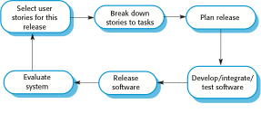
The extreme programming release cycle

Slide 10
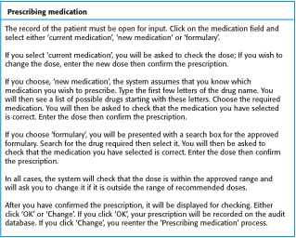
A ‘prescribing medication’ story

Slide 11
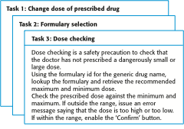
Examples of task cards for prescribing medication

Slide 12
Refactoring
Programming team look for possible software improvements and make these improvements even where there is no immediate need for them.
This improves the understandability of the software and so reduces the need for documentation.
Changes are easier to make because the code is well-structured and clear.
However, some changes requires architecture refactoring and this is much more expensive.
RISK:
  Changes the user does not test
  Changes to working software break it

Slide 13
Examples of refactoring
Re-organization of a class hierarchy to remove duplicate code.
Tidying up and renaming attributes and methods to make them easier to understand.
The replacement of inline code with calls to methods that have been included in a program library.

Slide 14
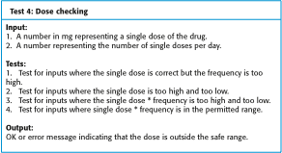
Test case description for dose checking

Slide 15
Test automation
Automate tests (junit)
Run upon checkin
Difficulties:
  Time constraints
  Programmer preferences to not test
  Test coverage

Slide 16
Pair programming
In XP, programmers work in pairs, sitting together to develop code.
Common ownership
Knowledge spread
Informal review
Refactoring
Similar output to two people coding

Slide 17
Scrum
Project Manager's job: - Deliver needed system on time within budget
The Scrum approach - manage the iterations
There are three phases in Scrum.
  outline planning phase - general picture and architecture
  Sprint cycles releasing increments of the system.
  The project closure phase - final delivery, documentation and review of lessons learned.

Slide 18
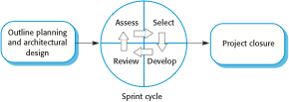
The Scrum process

Slide 19
The Sprint cycle
Every 2–4 weeks (a fixed length).
1) Project team with customer: Look at product backlog - select stories to implement
2) implement with all customer communication through scrum master (protecting pgmr at this point)
  Scrum master has project manager role during sprint
  Daily 15 min meetings
    Stand up often
    Team presents progress and impediments
    Scrum master tasked with removing impediments
3) Review system release with user

Slide 20
Scrum benefits
The product is broken down into a set of manageable and understandable chunks.
Unstable requirements do not hold up progress.
The whole team have visibility of everything and consequently team communication is improved.
Customers see on-time delivery of increments and gain feedback on how the product works.
Trust between customers and developers is established and a positive culture is created in which everyone expects the project to succeed.

