Slide 1
Templates in Django
A template in Django is an HTML file that is used to display data dynamically.
It acts as the presentation layer in Django’s MTV (Model–Template–View) architecture.
Templates combine:
  Static HTML
  Dynamic data from views
Django uses its own Template Language (DTL)
Example:
<h1>Hello {{ name }}</h1>
Template Directory Structure
Django allows two main ways to organize templates:
1. App-Level Template Directory
app_name/
templates/
app_name/
home.html
Avoids naming conflicts between apps
Keeps templates organized per app

Slide 2
Project-Level Template Directory
project_name/
templates/
home.html
Must configure in settings.py:
TEMPLATES = [
{
'DIRS': ['templates'],
'APP_DIRS': True,
},
]
Flow of Template Rendering
User sends request
View processes data
View sends data to template
Template renders HTML
Response sent to browser

Slide 3
Variables
Used to display dynamic data.
  Synatx
  {{ variable_name }}
  Example:
  <p>{{ username }}</p>
Template Inheritance in Django
Template inheritance allows you to reuse a common layout (like header, footer, navbar) across multiple pages.
You create a base template
Other templates (child templates) extend it
Avoids repetition → cleaner code

Slide 4
Base.html
<!DOCTYPE html>
<html>
<head>
<title>{% block title %}My Site{% endblock %}</title>
</head>
<body>
<header>
<h1>My Website</h1>
</header>
{% block content %}
Default content
{% endblock %}
<footer>
<p>Footer Section</p>
</footer>
</body>
</html>

Slide 5
blocks in Django
Defined using:
{% block name %} ... {% endblock %}
Used as placeholders in base template
Child templates can override these blocks
Advantages of Template Inheritance
Reusability of layout
Reduces code duplication
Easy maintenance
Consistent UI across pages
Child.html
{% extends 'base.html' %}
{% block title %}
Home Page
{% endblock %}
{% block content %}
<h2>Welcome to Home Page</h2>
<p>This is dynamic content.</p>
{% endblock %}
Important points
{% extends %} must be the first line in child template
Block names should match between parent & child
You can define multiple blocks

Slide 6
Basic Tags
Tag Name | Syntax | Explanation | Example
if | {% if condition %} ... {% endif %} | Checks a condition and displays content accordingly | {% if user %} Hello {{ user }} {% endif %}
for | {% for item in list %} ... {% endfor %} | Iterates over a list or queryset | {% for i in items %} {{ i }} {% endfor %}
block | {% block name %} ... {% endblock %} | Defines a section that can be overridden in child templates | {% block content %} Main Content {% endblock %}
extends | {% extends 'base.html' %} | Inherits layout from a parent template | {% extends 'base.html' %}
include | {% include 'file.html' %} | Includes another template inside current template | {% include 'header.html' %}
url | {% url 'name' %} | Generates URL dynamically using URL patterns | <a href="{% url 'home' %}">Home</a>
static | {% load static %}{% static 'path' %} | Loads and links static files like CSS, JS, images | {% load static %} <img src="{% static 'images/logo.png' %}">
csrf_token | {% csrf_token %} | Protects forms from CSRF attacks (security) | <form method="post">{% csrf_token %}</form>

Slide 7
Template Control Tag (if)
Syntax:
{% if condition %}
// code
{% elif another_condition%}
// code
{% else %}
// code
{% endif %}
Example:
{% if marks > 50 %}
<p>Pass</p>
{% else %}
<p>Fail</p>
{% endif %}
Example:
{% if name%}
<p>Welcome, {{ name}}</p>
{% else %}
<p>No name</p>
{% endif %}

Slide 8
Loop Template Tag (for)
Syntax:
{% for item in list %}
// code
{% endfor %}
Example:
<ul>
{% for student in students %}
<li>{{ student.name }}</li>
{% endfor %}
</ul>

Slide 9
Examples:
Uppercase:
{{ name | upper }}
Lowercase:
{{ name | lower }}
Title case:
  {{ name | title }}
Length:
{{ students | length }}
Date format:
{{ today | date:"d-m-Y" }}
Default value:
{{ name | default:"Guest" }}
Template Filters
Syntax:
{{ variable | filter_name }}

Slide 10
Context Processor
A context processor is a function that adds variables to all templates automatically.
Syntax:
def function_name(request):
return {
"key": value
}
Example:
1. Create context processor (context_processors.py)
def site_info(request):
return {
"site_name": "My Website",
"year": 2026
}
2. Add in settings.py
TEMPLATES = [
{
'OPTIONS': {
'context_processors': [
'myapp.context_processors.site_info',
],
},
},
]
3. Use in template
<h1>Welcome to {{ site_name }}</h1>
<p>Year: {{ year }}</p>

Slide 11
Step 2: Add in settings.py
STATIC_URL = '/static/'
# Optional (for development)
STATICFILES_DIRS = [
BASE_DIR / "static",
]
Step 3: Load Static in Template
{% load static %}
Working with Static Files
Static files are CSS, JavaScript, and Images used to design the frontend.
Step 1: Create Static Folder
Inside your app:
myapp/
static/
css/
style.css
js/
script.js
images/
logo.png
Step 4: Use Static Files
CSS:
<link rel="stylesheet" href="{% static 'css/style.css' %}">
JavaScript:
<script src="{% static 'js/script.js' %}"></script>
Image:
<img src="{% static 'images/logo.png' %}" alt="Logo">

Slide 12
Introduction to Form in Django
A form in Django is a tool used to collect input from users and process it securely.
Features:
Built-in validation
Easy data handling
Secure (CSRF protection)
Can be rendered in templates
Purpose:
To take user input.
To validate data.
To process and store data.

Slide 13
Django Form (forms.Form)
Used to create forms manually without linking to a model.
template (form.html)
<form method="POST">
{% csrf_token %}
{{ form.as_p }}
<button type="submit">Submit</button> </form>
forms.py
from django import forms
class StudentForm(forms.Form):
name = forms.CharField(max_length=100)
email = forms.EmailField()
age = forms.IntegerField()
views.py
from django.shortcuts import render
from .forms import StudentForm
def student_form(request):
form = StudentForm()
return render(request, "form.html", {"form": form})

Slide 14
request.POST → gets user input
Data is taken directly from form
No validation is performed
Form Handling Without cleaned_data
def example_details(request):
if request.method == 'POST’:
name = request.POST.get('name’)
email = request.POST.get('email’)
age = request.POST.get('age’)
return render(request, "success.html", {
"name": name,
"email": email,
"age": age })
Problems:
Invalid email accepted
Wrong data type accepted
Unsafe data

Slide 15
Slide 2: Form Handling With cleaned_data
Code:
def example_details(request):
if request.method == 'POST’:
form = studentForm(request.POST)
if form.is_valid():
name = form.cleaned_data['name’]
email = form.cleaned_data['email’]
age = form.cleaned_data['age’]
return render(request, "success.html", {
"name": name,
"email": email,
"age": age
})
Advantages:
Valid email only
Correct data type
Secure and clean data
studentForm(request.POST) → binds data
form.is_valid() → validates input
cleaned_data → gives safe data

Slide 16
Django ModelForm (forms.ModelForm)
Automatically creates form fields from a model.
models.py
from django.db import models
class Student(models.Model):
name = models.CharField(max_length=100)
email = models.EmailField()
age = models.IntegerField()
forms.py
from django import forms
from .models import Student
class StudentModelForm(forms.ModelForm):
class Meta:
model = Student
fields = '__all__'

Slide 17
views.py
from django.shortcuts import render
from .forms import StudentModelForm
def student_model_form(request):
form = StudentModelForm()
return render(request, "modelform.html", {"form": form})
Template
<form method="POST">
{% csrf_token %}
{{ form.as_p }}
<button type="submit">Submit</button> </form>

Slide 18
What is Custom Validation?
Custom validation is used to add your own validation rules in a form.
Example:
Age must be ≥ 18
Name should not be "admin"
Why needed?
Built-in validation is limited
Sometimes we need extra conditions

Slide 19
Field-Level Validation (clean_)
Syntax:
def clean_fieldname(self):
Example:
from django import forms
class StudentForm(forms.Form):
name = forms.CharField(max_length=100)
age = forms.IntegerField()
def clean_name(self):
name = self.cleaned_data['name’]
if name.lower() == "admin":
raise forms.ValidationError("Name cannot be admin")
return name
clean_name() → validates only name field
Must return cleaned value

Slide 20
def clean_age(self):
age = self.cleaned_data['age’]
if age < 18:
raise forms.ValidationError("Age must be 18 or above") return age

Slide 21
Form-Level Validation (clean)
Syntax:
def clean(self):
Example:
def clean(self):
cleaned_data = super().clean()
name = cleaned_data.get('name’)
age = cleaned_data.get('age’)
if name == "Rakshitha" and age < 18:
raise forms.ValidationError("Not allowed")
return cleaned_data
Used for multiple field validation
Access all fields together

Slide 22
Manual vs Automatic Form Rendering in Django
Django provides built-in ways to render forms in templates
Two main approaches:
  Automatic Rendering (form.as_p, form.as_table, form.as_ul)
  Manual Rendering (custom HTML)
Choosing the right method improves UI and error handling

Slide 23
Automatic Rendering
Django renders form fields automatically
Common methods:
  form.as_p
  form.as_table
  form.as_ul
Example:
<form method="POST">
{% csrf_token %}
{{ form.as_p }}
<button type="submit">Submit</button>
</form>
Automatically displays:
Labels
Input fields
Field errors
Form-level errors
Limitation
Limited design control
Hard to customize layout
Not suitable for advanced UI (Bootstrap, Tailwind, etc.)

Slide 24
Manual Rendering
Developer writes full HTML for each field
Provides complete control over UI
Example:
<form method="POST">
{% csrf_token %}
{{ form.non_field_errors }}
Name: {{ form.name }}
{{ form.name.errors }}
Age: {{ form.age }}
{{ form.age.errors }}
<button type="submit">Submit</button>
</form>
Features of Manual Rendering
Full control over design and layout
Easy to integrate with CSS frameworks
Better user experience
Custom placement of fields and errors

Slide 25
In Manual Rendering
  Errors are NOT shown automatically
  Must explicitly include:
Field Errors:
{{ form.field_name.errors }}
Form Errors:
{{ form.non_field_errors }}

Slide 26
CSRF Protection in Django
  CSRF = Cross-Site Request Forgery
  A security mechanism to protect user data
  Prevents unauthorized form submissions
Why CSRF is Important
  Protects against malicious requests
  Ensures request is from trusted source
  Important for all POST requests
How Django Handles CSRF
Django provides built-in CSRF protection
Uses a unique token per session
Token is validated on server side

Slide 27
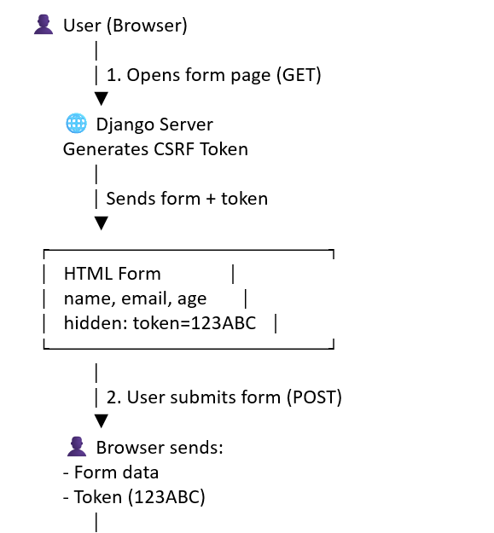
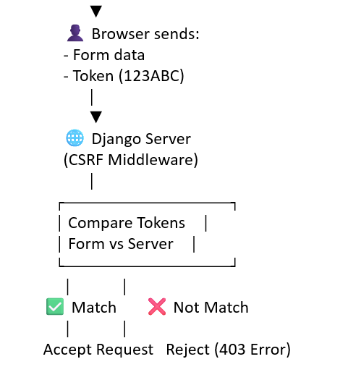

Slide 28
CSRF Token Usage
<form method="POST">
{% csrf_token %}
{{ form.as_p }}
<button type="submit">Submit</button>
</form>
{% csrf_token %} is mandatory for POST forms
Missing token → Request rejected

Slide 29
What is a Form Field?
A form field defines what type of data a form accepts
It is a Python class provided by Django
Used to collect input from users
Why Do We Use Form Fields?
To validate user input automatically
To ensure correct data type (text, number, email, etc.)
To reduce manual validation code
To improve data integrity
What Does a Field Do?
Accepts user input
Converts input into Python data type
Validates data
Stores cleaned data in cleaned_data

Slide 30
Field Name | Syntax | Purpose
CharField | name = forms.CharField(max_length=100) | Used to accept text input
EmailField | email = forms.EmailField() | Validates email format
IntegerField | age = forms.IntegerField() | Accepts whole numbers
FloatField | price = forms.FloatField() | Accepts decimal values
BooleanField | agree = forms.BooleanField() | Used for True/False (checkbox)
DateField | dob = forms.DateField() | Accepts date input
URLField | website = forms.URLField() | Validates website URLs
FileField | file = forms.FileField() | Used to upload files
ChoiceField | gender = forms.ChoiceField(choices=CHOICES) | Creates dropdown selection
MultipleChoiceField | hobbies = forms.MultipleChoiceField(choices=CHOICES) | Allows multiple selections

Slide 31
What is a Form Widget?
A widget controls how a form field is displayed in HTML
It defines the input type (UI part)
Why Use Widgets?
To improve user interface (UI)
To apply CSS styling (Bootstrap)
To customize input fields
To enhance user experience
Syntax
field_name = forms.FieldType(
widget=forms.WidgetType(attrs={...})
)

Slide 32
Field | Widget | Output (HTML) | Purpose
CharField | TextInput | <input type="text"> | Accepts text input (name, city)
EmailField | EmailInput | <input type="email"> | Validates email format
IntegerField | NumberInput | <input type="number"> | Accepts whole numbers
FloatField | NumberInput | <input type="number"> | Accepts decimal values
BooleanField | CheckboxInput | <input type="checkbox"> | Used for True/False (agree)
DateField | DateInput | <input type="date"> | Accepts date input
URLField | URLInput | <input type="url"> | Validates website URL
FileField | ClearableFileInput | <input type="file"> | Upload files
ChoiceField | Select | <select>...</select> | Dropdown selection
MultipleChoiceField | CheckboxSelectMultiple | Multiple checkboxes | Select multiple options

Slide 33
Bootstrap is used in Django templates to style web pages using predefined CSS classes.
Step 1 – Create Django View
Define a view to render template
from django.shortcuts import render
def home(request):
return render(request, 'home.html')
It is a frontend CSS framework
Django just renders HTML templates
Bootstrap is used to style that HTML
Step 2 – Configure URLs
Connect view to URL
from django.urls import path
from .views import home
urlpatterns = [
path('', home),
]
Step 3 – Create Template
Create templates/myapp/home.html
This file will contain Bootstrap code

Slide 34
Step 4 – Add Bootstrap CDN
Add Bootstrap link inside
<head>
<link href="https://cdn.jsdelivr.net/npm/bootstrap@5.3.0/dist/css/bootstrap.min.css" rel="stylesheet”>
</head>
Use Bootstrap Classes
Apply classes to HTML elements
<button class="btn btn-primary">Submit</button>
<button class="btn btn-danger">Delete</button>
Step 6 – Run Server
Start Django server
python manage.py runserver

Slide 35
Bootstrap has a CSS file (like bootstrap.min.css) which contains code like:
.btn {
padding: 10px;
border-radius: 5px;
}
.btn-primary {
background-color: blue;
color: white;
}
Text Classes
<p class="text-primary">Blue Text</p>
<p class="text-danger">Red Text</p>
<p class="text-center">Centered Text</p>
Used to style text color and alignment
Button Classes
<button class="btn btn-primary">Primary</button>
<button class="btn btn-success">Success</button>
<button class="btn btn-danger">Danger</button>
Used to create colored buttons
Form Classes
<input type="text" class="form-control" placeholder="Enter name">
Background Classes
<div class="bg-primary text-white">Background Blue</div>
<div class="bg-warning">Background Yellow</div>
Used for background colors

Slide 36
What is CDN?
CDN (Content Delivery Network) is a system of servers that deliver files (like CSS, JS) through the internet.
In Bootstrap:
  Instead of downloading files
  use a link to access them online
<link href="https://cdn.jsdelivr.net/npm/bootstrap@5.3.0/dist/css/bootstrap.min.css" rel="stylesheet">
How CDN Works
add CDN link in HTML
Browser sends request to internet
Bootstrap file is loaded from CDN server
Styles are applied to the page

Slide 37
Step 1: Create Static Folder
Inside your app:
myapp/
static/
css/
js/
Step 4: Configure Static Settings
In settings.py:
STATIC_URL = '/static/'
Step 5: Load Static in Template
At top of HTML file:
{% load static %}
Step 2: Download Bootstrap
  Go to Bootstrap website
  Download files
  Copy:
bootstrap.min.css
Step6: Link Bootstrap File
<link rel="stylesheet" href="{% static 'css/bootstrap.min.css' %}">
Step 3: Paste that inside:
myapp/static/css/
myproject/
myapp/
static/
css/
bootstrap.min.css
templates/
home.html
Step7: Use Bootstrap Classes
<button class="btn btn-primary">Click Me</button>

Slide 38
Media File Upload in Django
Step 1 – Configure Media Settings
MEDIA_URL = '/media/'
MEDIA_ROOT = os.path.join(BASE_DIR, 'media')
Step 4 – Create Form
from django import forms
from .models import FileUpload
class FileUploadForm(forms.ModelForm):
class Meta:
model = FileUpload
fields = ['file']
Step 2: Create Media Folder
Manually create folder:
mypro/
media/
Step 3: Create Model
from django.db import models
class FileUpload(models.Model):
file = models.FileField(upload_to='uploads/')

Slide 39
Step 5 – Create View
def upload_file(request):
if request.method == 'POST':
form = FileUploadForm(request.POST, request.FILES)
if form.is_valid():
form.save()
return redirect('success')
else:
form = FileUploadForm()
return render(request, 'home.html', {'form': form})
Step 6 – HTML Form
<form method="POST" enctype="multipart/form-data">
{% csrf_token %}
{{ form.as_p }}
<button type="submit">Upload</button>
</form>

Slide 40
Step 7 – Configure URLs
urlpatterns = [
path('home/', upload_file),
] + static(settings.MEDIA_URL, document_root=settings.MEDIA_ROOT)
Step 8 – Run Migrations
python manage.py makemigrations
python manage.py migrate

