Slide 2
Introduction
Django provides a built-in admin interface
Used to manage application data easily
No need to build a separate backend UI
Automatically generated from models
Steps to Activate Admin Site
Create Django project
Add app to project
Enable admin in settings
Run migrations
Create superuser
Start server
What is Django Admin?
A web-based interface for managing database data
Accessible only to admin (authorized users)
Supports CRUD operations:
Create
Read
Update
Delete

Slide 3
Customizing Django Model Admin (list_display, search_fields, readonly_fields)
Django Admin allows customization of model display
Improves usability and data management
Done using ModelAdmin class in admin.py
ModelAdmin?
A class used to customize admin interface
Connected to a model using admin.site.register()
Controls how data is displayed and managed

Slide 4
models.py
from django.db import models
class Student(models.Model):
name = models.CharField(max_length=100)
email = models.EmailField()
age = models.IntegerField()
def __str__(self):
return self.name
Admin.py
from django.contrib import admin
from .models import Student
admin.site.register(Student)

Slide 5
list_display
Used to display fields in admin list view
Appears as columns in admin table
class StudentAdmin(admin.ModelAdmin):
list_display = ('name', 'email', 'age')
readonly_fields Use Cases
Prevent accidental changes
Protect important data
Useful for auto-generated fields
class StudentAdmin(admin.ModelAdmin):
readonly_fields = ('email',)
admin.site.register(Student, StudentAdmin)
search_fields
Adds search box in admin
Allows searching by specified fields
class StudentAdmin(admin.ModelAdmin): search_fields = ('name', 'email')

Slide 6
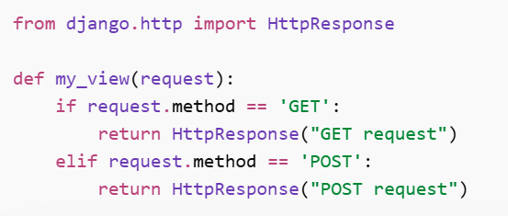
CBV
Class-Based Views are views written using Python classes where different HTTP requests are handled using methods like get(), post(), etc.
User sends request
URL calls as_view()
Django converts class → function
Basic View
from django.views import View
from django.http import HttpResponse
class MyView(View):
def get(self, request):
return HttpResponse("Hello CBV")
def post(self, request): return HttpResponse("POST request")

Slide 7
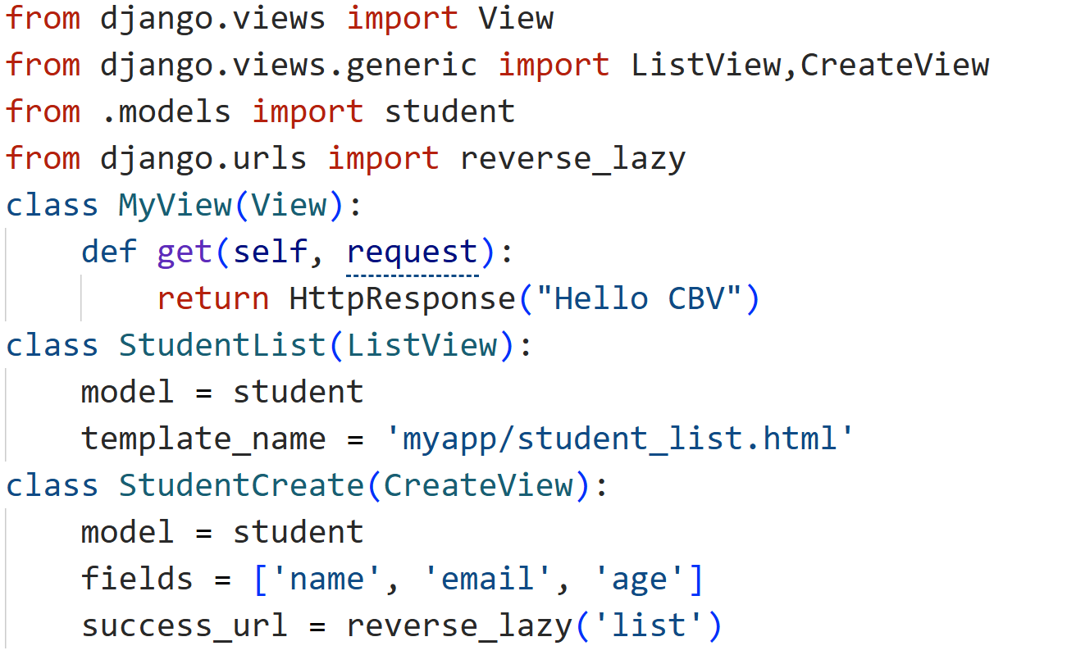

Slide 8
