Slide 1


Git Assignment
Topic - Checkout
Presented By: Shashikant Tanti
Notes:
Note: First “Right Click” on the Gradient background, go to “Order” option and “Send it to Back”, then insert your picture into “Image Placeholder”, “Right Click” on the picture and again go to “Order” option and “Send it to Back” to get the “Gradient” effect.
1

Slide 2

Our Agenda
01
03
Git Introduction
01
02
Works on Git
03
Learn and Discussion
04
Git Command and Snapshots
05
Learn and Discussion on Topic - Checkout

Slide 3

Introduction of Git
Git is an Open Source Distributed Version Control System.
Control System: This basically means that Git is a content tracker. So Git can be used to store content — it is mostly used to store code due to the other features it provides.
Version Control System: The code which is stored in Git keeps changing as more code is added. Also, many developers can add code in parallel. So Version Control System helps in handling this by maintaining a history of what changes have happened. Also, Git provides features like branches and merges, which I will be covering later.
Distributed Version Control System: Git has a remote repository which is stored in a server and a local repository which is stored in the computer of each developer. This means that the code is not just stored in a central server, but the full copy of the code is present in all the developers’ computers. Git is a Distributed Version Control System since the code is present in every developer’s computer.

Slide 4
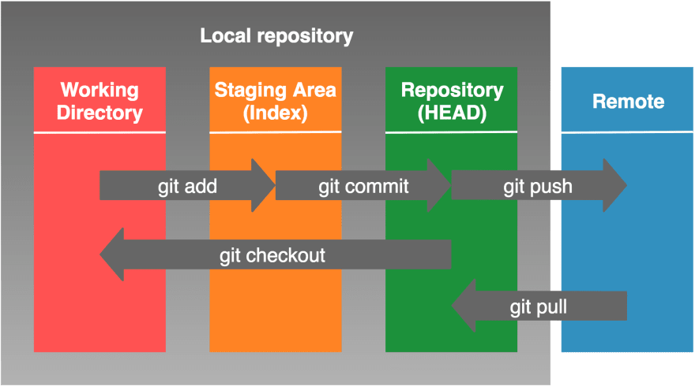
Works on Git
Steps to Follow
Step 1 − We can modify a file from the working directory.
Step 2 − We can add these files to the staging area.
Step 3 − We can perform commit operation that moves the files from the staging area. After push operation, it stores the changes permanently to the Git repository.

Slide 5
Learn and Discussion
Learning and Discussion on Git
Git Life Cycle
Local working directory: The first stage of a Git project life cycle is the local working directory where our project resides, which may or may not be tracked.
Initialization: To initialize a repository, we give the command git init. With this command, we will make Git aware of the project file in our repo.
Staging area: Now that our source code files, data files, and configuration files are being tracked by Git, we will add the files that we want to commit to the staging area by the git add command. This process can also be called indexing. The index consists of files added to the staging area.
Commit: Now, we will commit our files using the git commit -m ‘our message’ command.

Slide 6
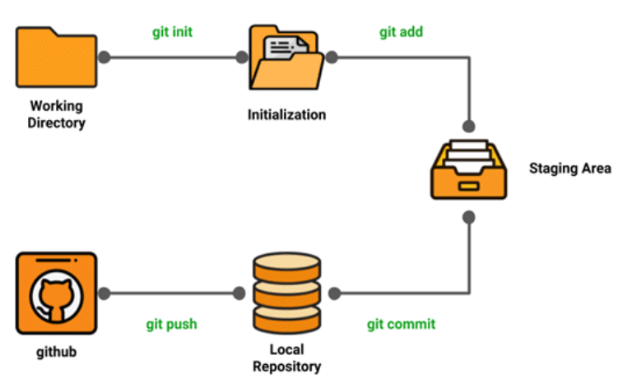
Git Life Cycle

Slide 7
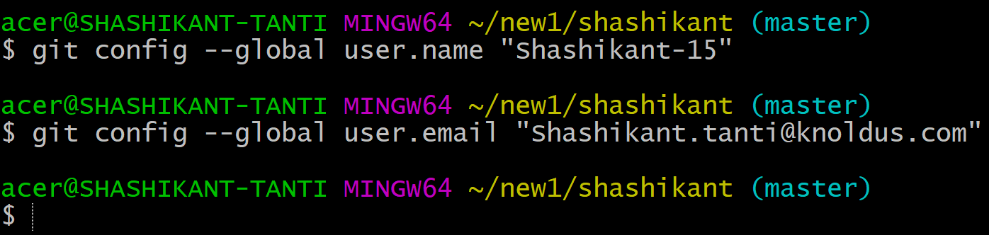
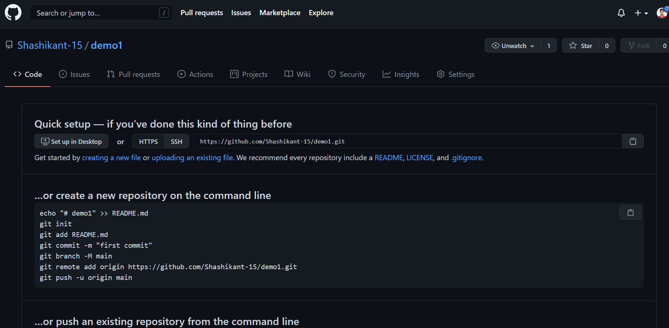
Configuring Git:
To tell Git who we are, run the following two commands:
Creating a local repository: creating and collaborate on a new empty repository on GitHub:

Slide 8
Common Git Commands
We will divide the common Git commands into two primary categories:
Local: git init, git touch, git status, git add, git commit, and git rm
Remote: git remote, git pull, and git push
git init - The git init command creates a new Git repository. It can be used to convert an existing, or a new project to a Git repository or initialize a new, empty repository.
git add - git add is the first command in a chain of operations that directs Git to "save" a snapshot of the current project state, into the commit history.
git status - The git status command displays the state of the working directory and the staging area.
git commit - The git commit command captures a snapshot of the project’s currently staged changes.
git branch - Branches are used to create another line of development. By default, Git has a master branch, which is same as trunk in Subversion. Usually, a branch is created to work on a new feature. Once the feature is completed, it is merged back with the master branch and we delete the branch.
git push - git push is a command used to add all committed files in the local repository to the remote repository. So in the remote repository, all files and changes will be visible to anyone with access to the remote repository.
git merge - merge command used to get the files from the local repository into the working directory.
Notes:
8

Slide 9
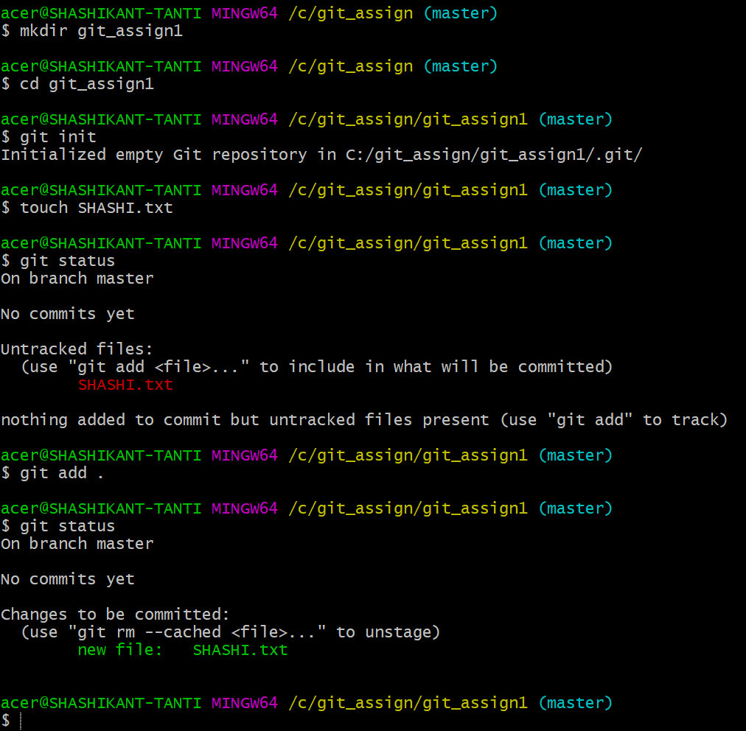
Git Commands and Snapshots
Notes:
9

Slide 10
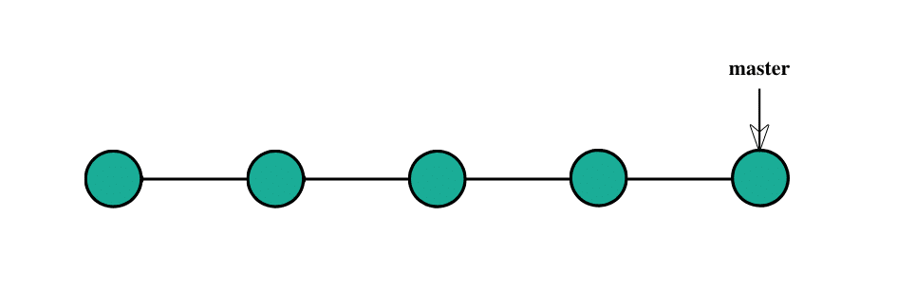
Learn and Discussion on
Topic - Checkout
The git checkout command operates upon three distinct entities: files, commits, and branches. In addition to the definition
of "checkout" the phrase "checking out" is commonly used to imply the act of executing the git checkout command.
$＞ git branch main another_branch new_branch $＞ git checkout new_branch
Notes:
10

Slide 11
New Branches
Git checkout works hand-in-hand with git branch. The git branch command
can be used to create a new branch. When you want to start a new feature,
you create a new branch off main using git branch new_branch. Once created
you can then use git checkout new_branch to switch to that branch.
Additionally, The git checkout command accepts a -b argument that
acts as a convenience method which will create the new branch and
immediately switch to it.
git checkout -b ＜new-branch＞
git checkout-b ＜new-branch＞ ＜existing-branch＞

Slide 12
Git Checkout a Remote Branch
Switching Branches
Switching branches is a straightforward operation. Executing the following will point HEAD to the tip of .
Git tracks a history of checkout operations in the reflog. You can execute git reflog to view the history.
When collaborating with a team it is common to utilize remote repositories. These repositories may be hosted and shared or they may be another colleague's local copy. Each remote repository will contain its own set of branches. In order to checkout a remote branch you have to first fetch the contents of the branch.
git fetch –all
In modern versions of Git, you can then checkout the remote branch like a local branch.
git checkout ＜remotebranch＞
Older versions of Git require the creation of a new branch based on the remote.
git checkout ＜remotebranch＞ origin/＜remotebranch
＞
Additionally you can checkout a new local branch and reset it to the remote branches last commit.
git checkout -b ＜branchname＞
git checkout ＜branchname＞

Slide 13
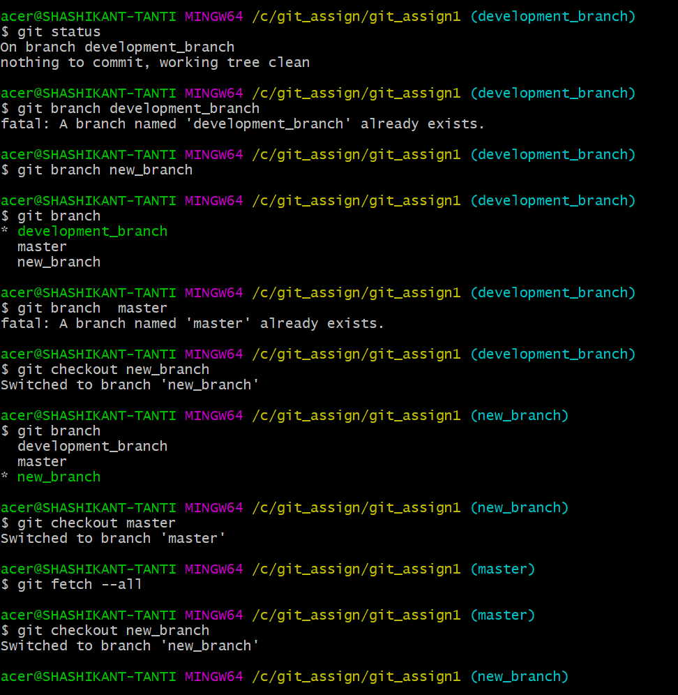
Learn and Discussion on
Topic - Checkout

Slide 14
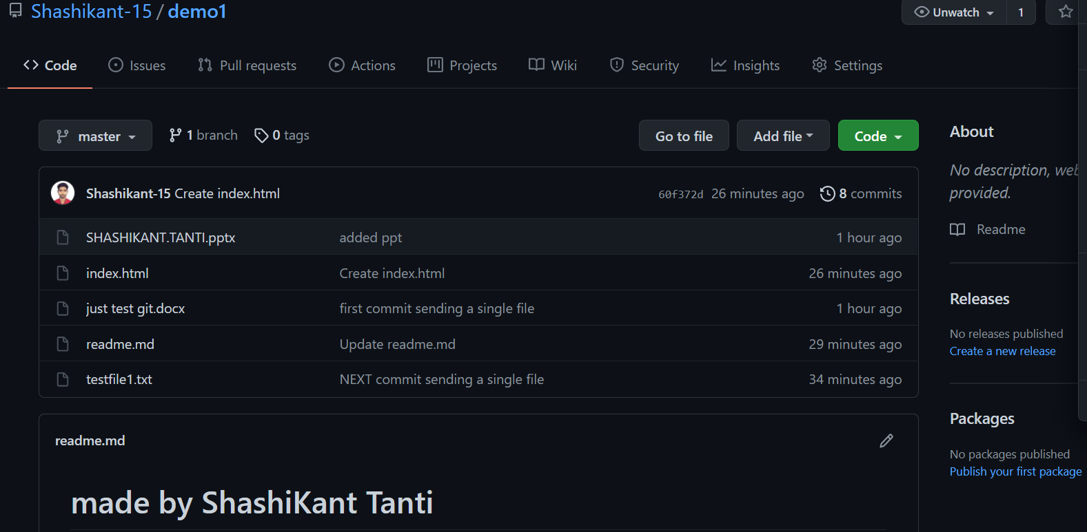
Learn and Discussion on
Topic - Checkout

Slide 15
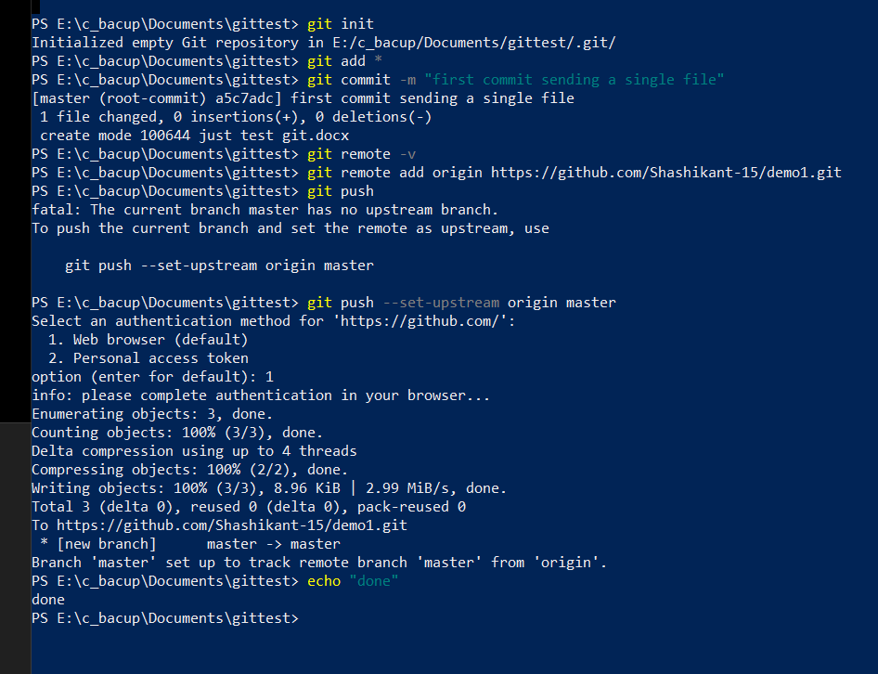
GitHub Repo Snapshot
After pushing the file from the local to the remote repository :-- -
Notes:
15

Slide 16
REFRENCES
https://www.freecodecamp.org/news/what-is-git-and-how-to-use-it-c341b049ae61/
https://www.atlassian.com/git/tutorials/using-branches/git-checkout
Notes:
16

Slide 17
Thank You !
Notes:
17

