Slide 1

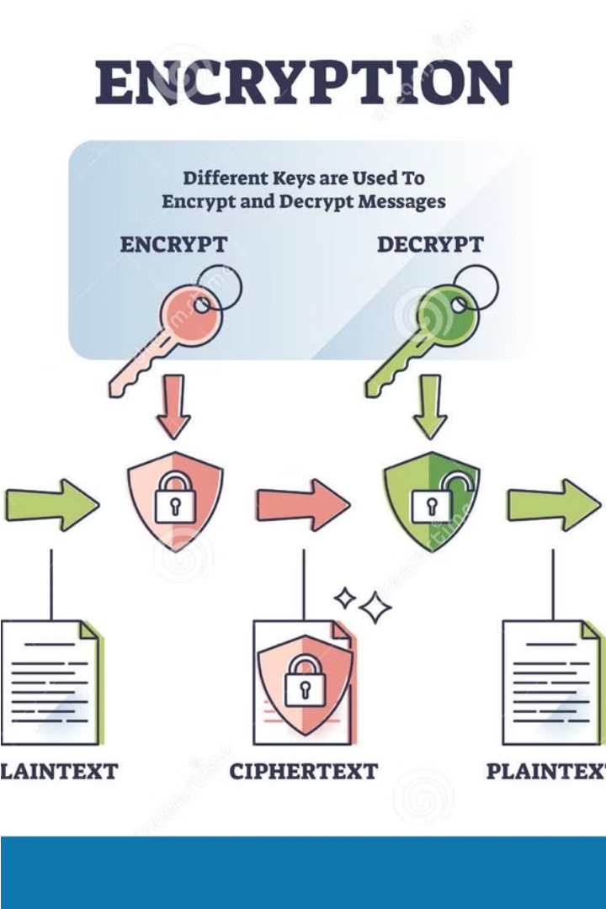
Introduction to Encryption and Decryption
Encryption and decryption are fundamental processes in digital security, enabling the secure transmission of sensitive information. This presentation will explore the principles and practical applications of these powerful tools, equipping you with the knowledge to safeguard your digital assets.
Presented By:-
Shashikant Kesharwani
BCA 6th Sem.
A60204821012

Slide 2

Importance of Data Security
In today's digital landscape, data security is paramount. Sensitive information, such as personal, financial, and confidential business data, must be protected from unauthorized access, theft, or misuse. Effective encryption and decryption tools are essential to safeguard this vital asset and maintain trust in digital systems.
Breaches in data security can lead to devastating consequences, including financial loss, reputational damage, and legal liabilities. Investing in robust encryption solutions is a proactive measure to mitigate these risks and ensure the integrity and privacy of critical data.

Slide 3
Overview of Cryptographic Principles
Confidentiality
Integrity
Cryptography ensures that data can only be accessed by authorized parties, preventing unauthorized disclosure through encryption techniques.
Cryptographic methods verify that data has not been altered or tampered with during transmission or storage, ensuring its trustworthiness.
Authentication
Non-Repudiation
Cryptography allows parties to verify each other's identities, enabling secure communication and transactions between trusted entities.
Cryptographic signatures and timestamps prevent parties from denying their involvement in a particular action or event.

Slide 4



Symmetric Encryption Algorithms
Symmetric Encryption
Secret Key
Encryption Process
Symmetric encryption algorithms use the same secret key for both encryption and decryption. They are fast, efficient, and widely used to secure data in transit and at rest.
The secret key must be securely shared between the sender and recipient. Common symmetric algorithms include AES, DES, and Blowfish, each with their own strengths and use cases.
Symmetric encryption transforms plaintext into ciphertext using the secret key through mathematical operations. The reverse process of decryption uses the same key to recover the original data.

Slide 5
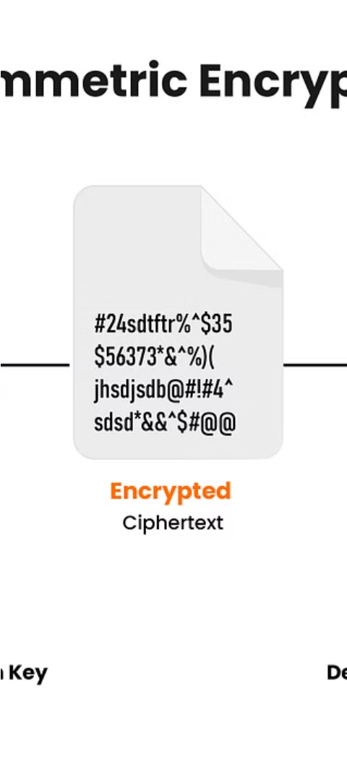
Asymmetric Encryption Algorithms
Public-Key Cryptography
RSA Algorithm
Asymmetric encryption, also known as public-key cryptography, uses a pair of related keys - a public key for encryption and a private key for decryption. This provides an extra layer of security compared to symmetric encryption.
RSA is a widely-used asymmetric algorithm that relies on the difficulty of factoring large prime numbers. It is commonly used for secure data transmission, digital signatures, and key exchange.
Elliptic Curve Cryptography
ECC is an alternative to RSA that offers similar security with smaller key sizes, making it more efficient for devices with limited processing power or storage, such as mobile phones and IoT devices.

Slide 6
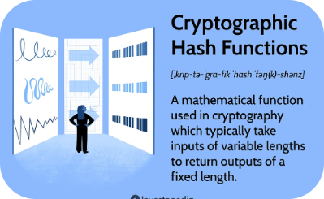

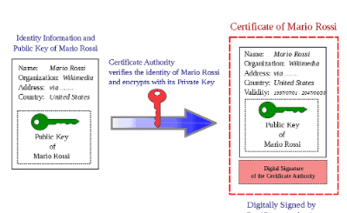
Hashing and Digital Signatures
Cryptographic Hashing
Digital Signatures
Certificate Authorities
Hashing is a mathematical process that converts any digital data into a unique fixed-length string of characters, called a hash value. This allows for secure data verification and integrity checks.
Digital signatures use hashing and asymmetric cryptography to provide a secure way to verify the origin and integrity of digital documents or messages. They ensure non-repudiation and protect against tampering.
Certificate authorities issue digital certificates that bind a public key to an individual or organization, enabling the use of digital signatures. They act as trusted third parties to validate identities.

Slide 7
Python Libraries for Encryption and Decryption
Cryptography
PyCrypto
PyNaCl
M2Crypto
The Cryptography library is a Python package that provides a set of cryptographic primitives and recipes. It supports symmetric encryption algorithms like AES, symmetric hashing functions like SHA256, and asymmetric encryption like RSA.
PyCrypto is a collection of cryptographic modules for Python, supporting a wide variety of cryptographic algorithms and protocols. It includes functions for encryption, hashing, digital signatures, and random number generation.
PyNaCl is a Python binding to the Networking and Cryptography (NaCl) library, providing a set of easy-to-use high-level APIs for symmetric and public-key cryptography, hashing, and randomness.
M2Crypto is a Python wrapper for the OpenSSL library, providing a wide range of cryptographic and X.509 functionality. It supports SSL/TLS connections, RSA, DSA, HMAC, and more.

Slide 8




Implementing Encryption and Decryption in Python
Identify Libraries
Utilize Python's built-in cryptography module or popular third-party libraries like PyCryptodome or PyNaCl to access a wide range of encryption and hashing algorithms.
Encrypt Data
Leverage symmetric encryption algorithms like AES or asymmetric algorithms like RSA to securely encrypt sensitive data, ensuring confidentiality.
Decrypt Data
Implement the corresponding decryption methods to reliably decrypt the encrypted data, allowing authorized parties to access the original information.
Manage Keys
Properly generate, store, and distribute encryption keys to ensure the security of your encryption and decryption processes.

Slide 9
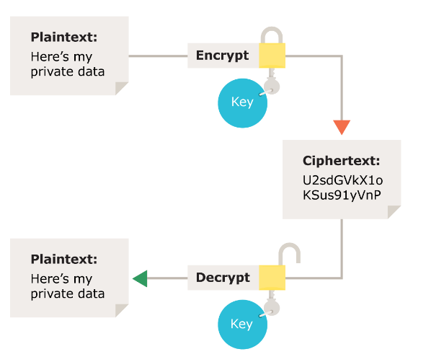
Real-world Use Cases and Applications
Encryption and decryption tools built with Python have a wide range of real-world applications. They are used to secure sensitive data in industries like healthcare, finance, and government. These tools protect communications, files, and databases from unauthorized access and ensure data privacy.
Additionally, Python-based encryption is leveraged in cybersecurity solutions, secure messaging apps, and file transfer protocols. It plays a crucial role in protecting personal and business information in the digital age.

Slide 10

Conclusion and Future Considerations
In conclusion, the encryption and decryption tool built using Python has demonstrated its potent capabilities in safeguarding sensitive data. As we look to the future, continued advancements in cryptographic algorithms and computing power will drive further innovations in this domain.

