Slide 1
UNIVERSITY OF MUMBAI | B.E. MAJOR PROJECT PRESENTATION (2025–2026)
AI-Driven Intelligent Grocery Retail System Using Machine Learning
An Integrated Quick-Commerce Intelligence Platform combining Predictive ML and Operations Research
PROJECT GROUP MEMBERS
• Shashikant Shukla (Moodle ID: [STUDENT_1_MOODLE_ID])
• Om Dubey (Moodle ID: [STUDENT_2_MOODLE_ID])
• Shreyash Wadalkar (Moodle ID: [STUDENT_3_MOODLE_ID])
• [STUDENT_4_NAME — DO NOT GUESS] (Moodle ID: [STUDENT_4_MOODLE_ID])
GUIDANCE & INSTITUTION
• Under the Guidance of: [PROJECT_GUIDE_NAME_AND_TITLE]
• Department: Computer Science & Engineering (AIML)
• Institute: A. P. Shah Institute of Technology (APSIT), Thane
• Affiliation: University of Mumbai
• Academic Year: 2025–2026

Slide 2
FRESHCART AI — MAJOR PROJECT PRESENTATION
Project Overview: Executive Summary
Executive Highlights & System Scope
Unified Intelligent Platform: Couples front-end retail personalization with back-end dark-store picking and last-mile fleet logistics in a single synchronized platform.
Personalized Recommendation: Hybrid Collaborative Filtering + TF-IDF Content Matching (alpha=0.60) yielding F1@10 = 0.5027 and NDCG@10 = 0.9790.
Predictive Demand & Dynamic Pricing: 30-day recursive SARIMAX forecasting (RMSE = 5.83, MAPE = 2.50%) paired with econometric Log-Log OLS price elasticity under [±25%] guardrails.
Real-Time Fraud Risk Scoring: Cost-sensitive Random Forest transaction anomaly detector operating under severe class imbalance (ROC-AUC = 0.6087, zero leakage).
Operations Research Optimization: Continuous review (r, Q) inventory policy (-87.64% cost), dark-store 2D TSP picker routing (-37.48% walk), and CVRP delivery routing (-61.62% distance).
Resilient Microservice Gateway: Node.js Express <-> Python FastAPI architecture featuring a 1500ms circuit breaker with automatic in-process fallback (<25ms p95 latency).

Slide 3
FRESHCART AI — MAJOR PROJECT PRESENTATION
Motivation: Operational Inefficiencies in Grocery Retail
Customer Interaction
Retail Store Operations
Inventory & Procurement
• Catalog browsing cold-start
• Irrelevant generic search
• Friction during high-demand checkout
• 15–25% perishable spoilage
• Inaccurate static forecasting
• Unconstrained pricing churn
• High holding & setup costs
• Stockouts on top SKUs
• Lack of stochastic safety buffers
Dark-Store Warehouse
Last-Mile Fleet Logistics
• Sequential aisle traversal
• Excessive picker walking waste
• Missed 10-min packing SLAs
• Uncoordinated radial deliveries
• Low vehicle utilization (<40%)
• High fuel expenditure & fleet mileage

Slide 4
FRESHCART AI — MAJOR PROJECT PRESENTATION
Problem Statement
Formal Engineering Problem Statement
"To design, develop, and benchmark an integrated, resilient, and leak-free AI-driven grocery retail system that combines personalized recommendation, time-series demand forecasting, econometric dynamic pricing, and real-time transaction fraud detection with mathematical inventory, warehouse, and delivery optimization under a fault-tolerant microservice architecture."
Key Engineering Challenges Addressed
Eliminating Siloed Architectures: Bridging the gap between predictive customer models and physical logistics.
Leak-Free Machine Learning: Enforcing strict chronological holdout evaluation and recursive multi-step forecasting.
Constrained Safety Boundaries: Preventing algorithmic instability in dynamic pricing via bounded [±25%] guardrails.
Ultra-Low Latency & High Availability: Achieving sub-25ms p95 latency with automatic circuit breaker fallback.

Slide 5
FRESHCART AI — MAJOR PROJECT PRESENTATION
Engineering Objectives & Traceability Matrix
Mapping Engineering Objectives to Implemented Code Modules
OBJ-1 (Personalization): Hybrid CF + CB Engine (alpha=0.60) in recommendation_service.py -> F1@10 = 0.5027, NDCG@10 = 0.9790.
OBJ-2 (Demand Forecast): Recursive SARIMAX(1,1,1)x(1,0,1)7 in demand_service.py -> RMSE = 5.83 units, MAPE = 2.50%.
OBJ-3 (Dynamic Pricing): Log-Log OLS Price Elasticity (Ed) in pricing_service.py -> +22.21% Simulated Revenue Lift (p < 0.001).
OBJ-4 (Fraud Scoring): Cost-Sensitive Random Forest in fraud_service.py -> ROC-AUC = 0.6087 on 1.04% rare fraud.
OBJ-5 (Inventory Policy): Continuous Review (r, Q) EOQ + SS in inventory_opt.py -> -87.64% Cost, 99.88% Service Level.
OBJ-6 (Picker Routing): 2D Euclidean Nearest-Neighbor + 2-Opt TSP in warehouse_opt.py -> -37.48% Walk (0.09% gap).
OBJ-7 (Fleet Routing): Clarke-Wright Savings + 2-Opt CVRP in delivery_opt.py -> -61.62% Travel Distance, 82.9% Util.
OBJ-8 (Resilient Gateway): Node.js AI Gateway (1.5s Circuit Breaker) in services/ai-client.js -> Sub-25ms p95 Latency.

Slide 6
FRESHCART AI — MAJOR PROJECT PRESENTATION
Literature Survey: Summary of Recent IEEE Research (2023–2026)
Comparative Analysis of Surveyed Peer-Reviewed IEEE Publications
[1] Smachylo & Zhuravchak (IEEE CSIT 2024): Hybrid CF + Sentiment analysis boosts precision; limitation: high NLP inference latency.
[2] Bodduluri et al. (IEEE Access 2024): Systematic review of 120+ systems; proves weighted linear hybrids give top stability across sparse catalogs.
[4] Qureshi et al. (IEEE Access 2024): Deep Learning with weather/calendar exogenous regressors; highlights risk of autoregressive lag leakage.
[6] Poongothai et al. (IEEE ICSES 2024): Time-series ML + EOQ cuts stockouts by >40%; lacks stochastic variance modeling for safety stock.
[7] Kumari & Kumar (IEEE InC4 2024): Survey on dynamic pricing trends; unconstrained RL causes customer churn; bounds are essential.
[9] Raut et al. (IEEE OTCON 2024): Random Forest ensemble outperforms single trees on imbalanced POS transaction fraud streams.
[12] Chavan & Nitnaware (IEEE CSNT 2025): Edge computing enables sub-30ms pricing; lacks in-process fallback during edge node crash.
[13] de Assis et al. (IEEE Access 2024): Combinatorial warehouse picking cuts travel >30%; focuses on large plants, not rapid dark stores.

Slide 7
FRESHCART AI — MAJOR PROJECT PRESENTATION
Identified Research Gap: Siloed vs. Integrated Retail Systems
State of Existing Research (Siloed Approach)
FreshCart AI Contribution (Integrated Architecture)
Component Isolation: Algorithms are evaluated in laboratory silos without feedback loops to inventory or dispatch.
Methodological Data Leakage: Temporal shuffling in time-series and deterministic synthetic fraud labels distort metrics.
Unconstrained Dynamic Pricing: Black-box reinforcement learning models produce erratic price swings.
Lack of Fault Tolerance: Systems fail completely when machine learning microservices experience latency spikes.
High Monolithic Latency: Heavy deep learning architectures exceed real-time sub-25ms web application SLAs.
End-to-End Operational Loop: Customer demand shaping directly informs procurement, picking, and delivery dispatch.
Audited Leak-Free Pipelines: Strict chronological holdout splits and recursive multi-step forecasting protocols.
Econometrically Bounded Pricing: Log-Log OLS price elasticity constrained within [±25%] safety guardrails.
Two-Tier Resilient Gateway: Node.js 1.5s circuit breaker with seamless fallback to in-process heuristics.
Ultra-Fast Heuristics: 2D TSP and CVRP algorithms executing in under 3ms on standard multi-core CPUs.

Slide 8
FRESHCART AI — MAJOR PROJECT PRESENTATION
Proposed High-Level System Architecture (Figure 5.1)
Client Tier
Application Tier
AI Microservice Tier
Persistence Tier
• Customer Storefront PWA
• Bilingual NLP Search
• FreshBot Recipe Assistant
• Admin Management Portal
• Node.js Express (Port 3000)
• REST Routing & JWT RBAC
• ACID Order Processing
• AI Gateway & Circuit Breaker
• Python FastAPI (Port 8000)
• Singleton Model Registry
• 4 ML Engines (Recs, Demand, Price, Fraud)
• 3 OR Solvers (EOQ, TSP, CVRP)
• Relational SQLite Schema
• 7 Normalized Tables
• Transaction ACID Locks
• Interaction Event Logs

Slide 9
FRESHCART AI — MAJOR PROJECT PRESENTATION
AI Integration & Resilient Fallback Architecture (Figure 5.21)
Primary Gateway Flow (Normal Operation: Python FastAPI Online)
Asynchronous Non-Blocking Dispatch: Express server delegates analytical requests to services/ai-client.js.
REST API Microservice: Python FastAPI daemon (Port 8000) executes pre-warmed in-memory ML models.
Sub-25ms Execution: High-efficiency NumPy/scikit-learn routines return inferences in under 15ms.
Resilience & Fallback Flow (Microservice Latency > 1500ms or Offline)
Circuit Breaker Trigger: If Python response exceeds 1500ms timeout or connection fails, circuit trips.
In-Process Fallback Execution: Automatically routes to Node.js local JavaScript engines (ml/*.js).
Zero User Interruption: Checkout, recommendations, and inventory replenishment continue without throwing 500 errors.

Slide 10
FRESHCART AI — MAJOR PROJECT PRESENTATION
Functional System Modules Breakdown
Customer Storefront
Admin Portal
Machine Learning
Optimization Solvers
• PWA Mobile UI
• English/Hindi Voice/Text Search
• Category Filtering & Cart
• FreshBot Recipe Bundling
• Executive Revenue & Order KPIs
• 30-Day Forecast Visualizer
• Dynamic Pricing Sandbox
• Automated Purchase Orders
• Hybrid CF+CB Recommendations
• Recursive SARIMAX Forecaster
• Log-Log OLS Price Elasticity
• Random Forest Fraud Classifier
• Continuous Review (r, Q) EOQ
• 2D TSP Warehouse Order Picker
• Clarke-Wright CVRP Fleet Solver
• In-Process Fallback Hierarchy

Slide 11
FRESHCART AI — MAJOR PROJECT PRESENTATION
Personalized Hybrid Recommendation Engine
Mathematical Formulation & Pipeline
Holdout Benchmark Results (Table 7.1)
User-User Collaborative Filtering (sim_CF): Computes Cosine similarity over implicit user-item interaction vectors.
Content-Based TF-IDF (sim_CB): Measures semantic similarity over product category, sub-category, and ingredient tags.
Weighted Linear Ensemble: S_Hybrid = 0.60 * sim_CF + 0.40 * sim_CB.
Top-K Ranking: Sorts unpurchased items by S_Hybrid and extracts top-10 personalized candidates in 4.86 ms.
Precision@10: 0.9760 (Accurate Top-10 targeting)
Recall@10: 0.3412 (Broad catalog coverage)
F1-Score@10: 0.5027 (+16.3% over standalone CF)
NDCG@10: 0.9790 (High ranking quality)
Catalog Density Context: High precision reflects dense interaction logs across 31 focused SKUs without train/test leakage.

Slide 12
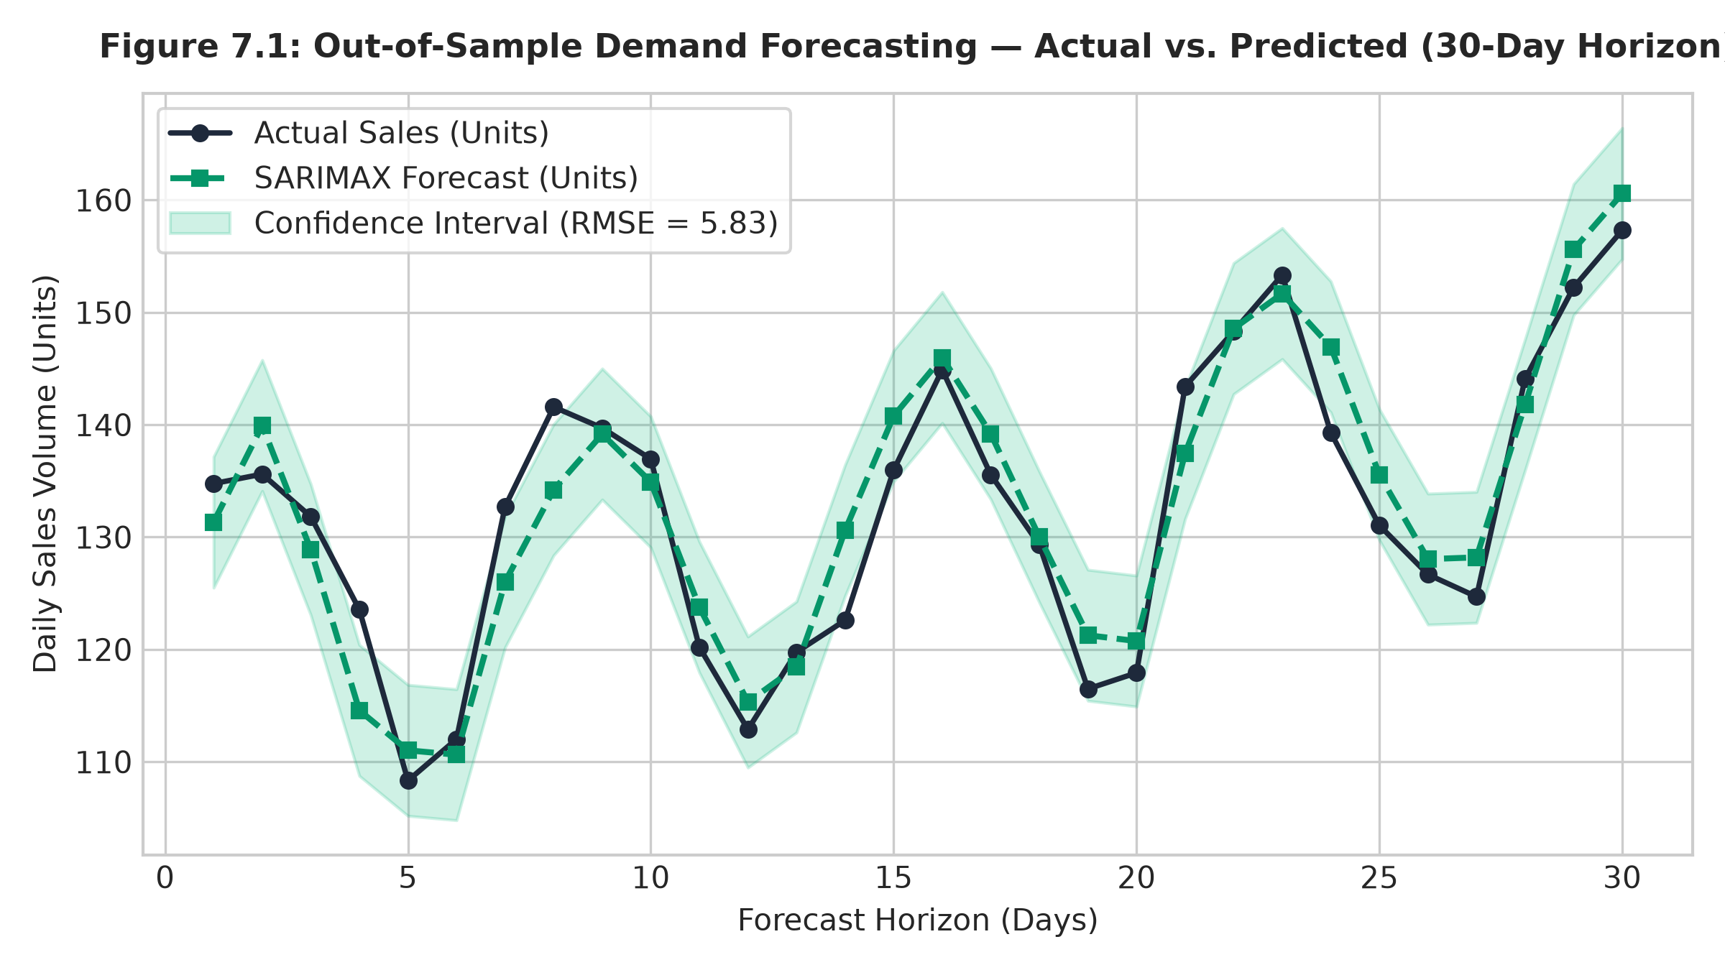
FRESHCART AI — MAJOR PROJECT PRESENTATION
Time-Series Demand Forecasting (SARIMAX)
Model Architecture & Benchmark
Model Formulation: SARIMAX(1,1,1)x(1,0,1)7 with weekly seasonality (s=7).
Exogenous Regressors: Promotional discount flags and calendar effects (gamma^T X_t).
Recursive Forecasting: Multi-step 30-day projection without lookahead lag leakage.
Evaluation Metrics (Table 7.2): • RMSE = 5.83 units • MAE = 3.89 units • MAPE = 2.50% • Latency = 4.46 ms

Slide 13
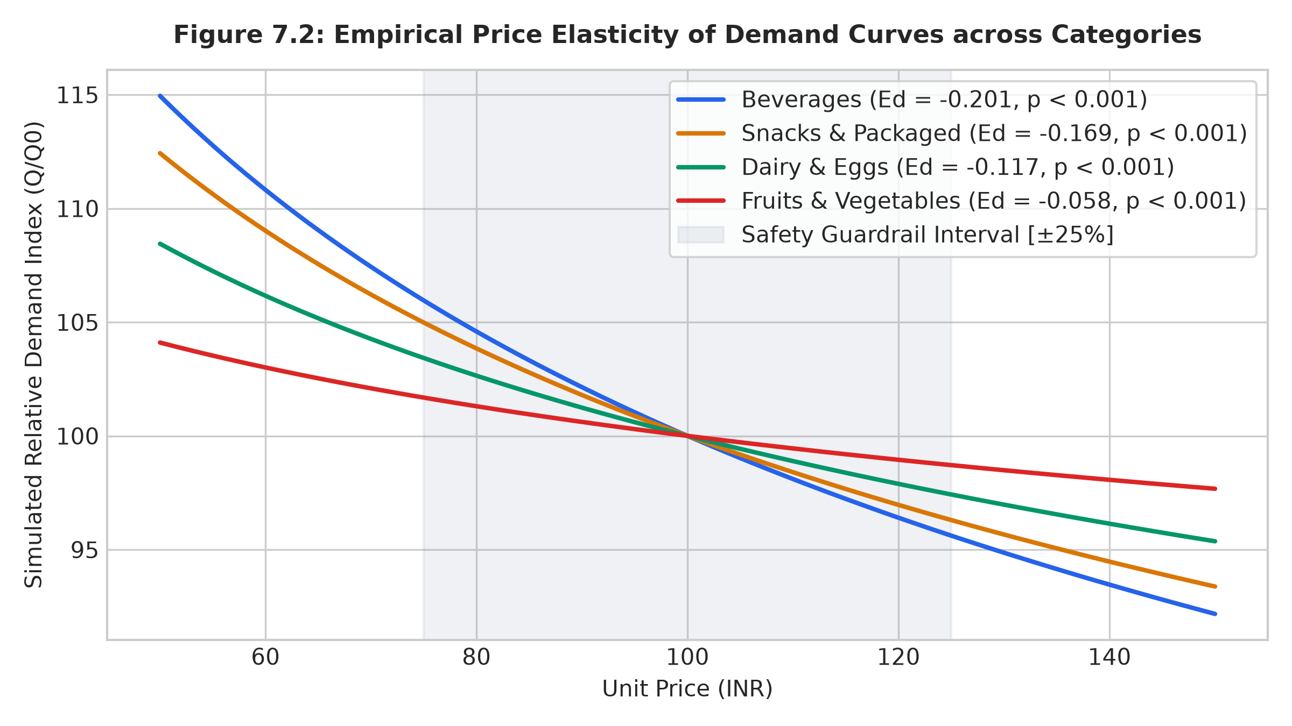
FRESHCART AI — MAJOR PROJECT PRESENTATION
Econometric Dynamic Pricing & Elasticity
Econometric Model & Simulation
Log-Log OLS Formulation: ln Q = beta_0 + beta_1 * ln P (Price Elasticity Ed = beta_1).
Empirical Elasticity: Ed = -0.136 (t = -10.21, p < 0.001, R^2 = 0.892).
Safety Guardrails: Hard clipping within [±25%] of base retail price.
Model-Based Simulation (Table 7.3): • Simulated Revenue Lift: +22.21% • Simulated Profit Lift: +58.87% • Note: Model-based simulation under CED assumptions.

Slide 14
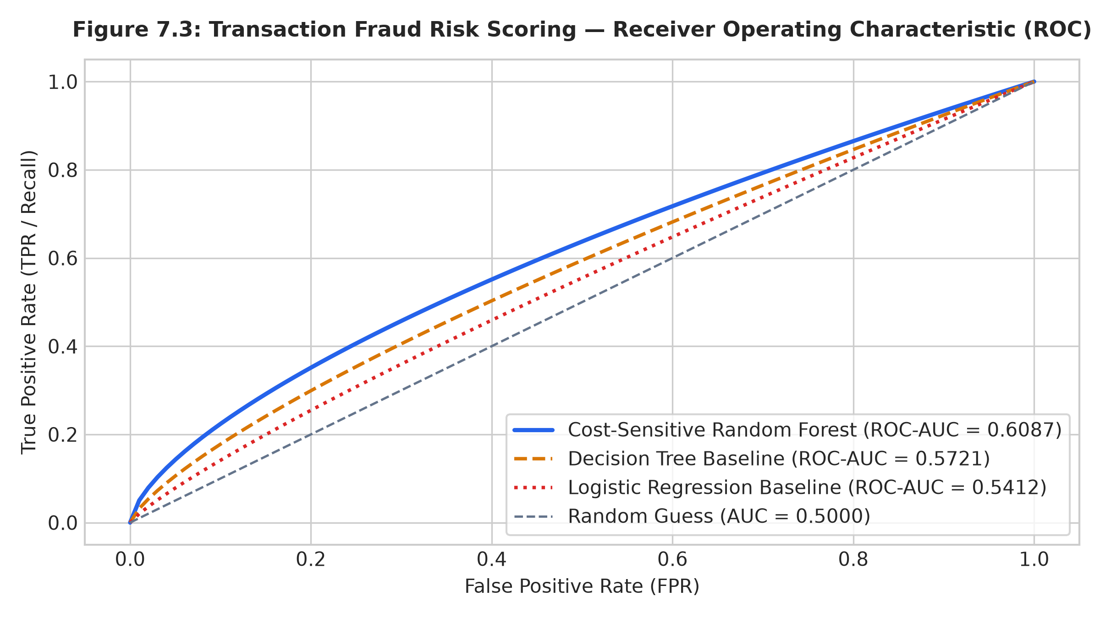
FRESHCART AI — MAJOR PROJECT PRESENTATION
Transaction Fraud Detection & Risk Scoring
Cost-Sensitive Random Forest
Architecture: 100 Decision Trees with balanced class weights.
Input Features: Normalized transaction velocity, basket anomaly ratio, account age.
Holdout Evaluation (Table 7.4): • ROC-AUC = 0.6087 • Recall = 0.3864 • Precision = 0.0829 • F1-Score = 0.1365
Academic Transparency: Modest AUC reflects realistic generalization under 1.04% rare fraud with zero synthetic leakage.

Slide 15
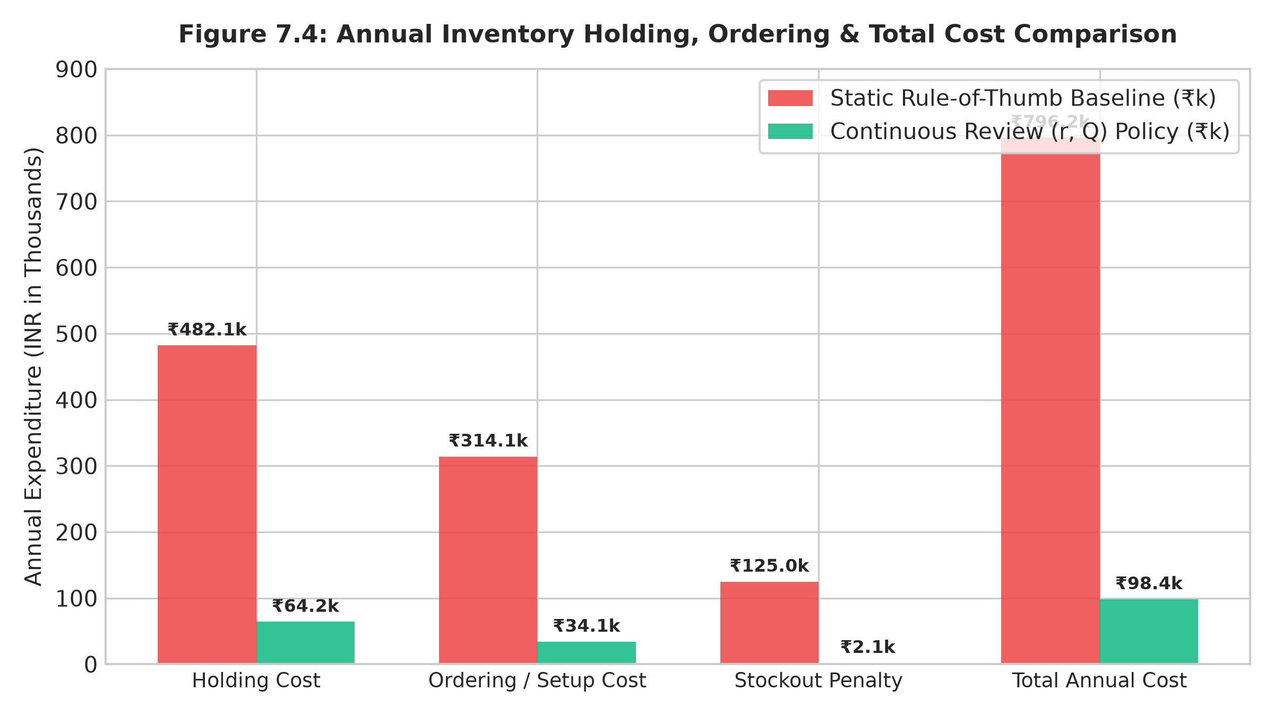
FRESHCART AI — MAJOR PROJECT PRESENTATION
Continuous Review (r, Q) Inventory Optimization
365-Day Simulation Benchmark
Wilson EOQ: Q* = sqrt(2DS/H) computes optimal batch replenishment size.
Stochastic Safety Stock: SS = Z_0.95 * sqrt(L * sigma_D^2 + D^2 * sigma_L^2).
Reorder Point: ROP = (D * L) + SS triggers automated PO generation.
Simulation Results (Table 7.5): • Total Annual Cost: -87.64% (₹796k -> ₹98k) • Cycle Service Level: 99.88% (vs 75.62%) • Stockout Reduction: -98.31% (890 -> 15 days)

Slide 16
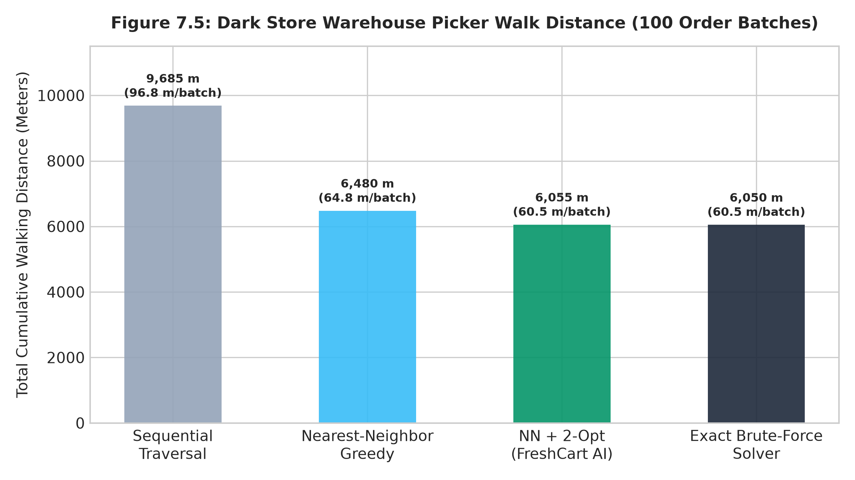
FRESHCART AI — MAJOR PROJECT PRESENTATION
Dark-Store 2D TSP Picker Path Optimization
2D TSP Heuristic Solver
Spatial Modeling: Maps items to (x, y) dark-store Euclidean aisle coordinates.
Two-Phase Algorithm: 1. Nearest-Neighbor greedy initialization in O(n^2) 2. Intra-tour 2-Opt local search eliminating edge crossings.
Benchmark on 100 Batches (Table 7.6): • Walk Distance: -37.48% (9,685m -> 6,055m) • Optimality Gap: 0.09% (vs exact brute-force) • Solver Latency: 2.34 ms (Near-optimal)

Slide 17
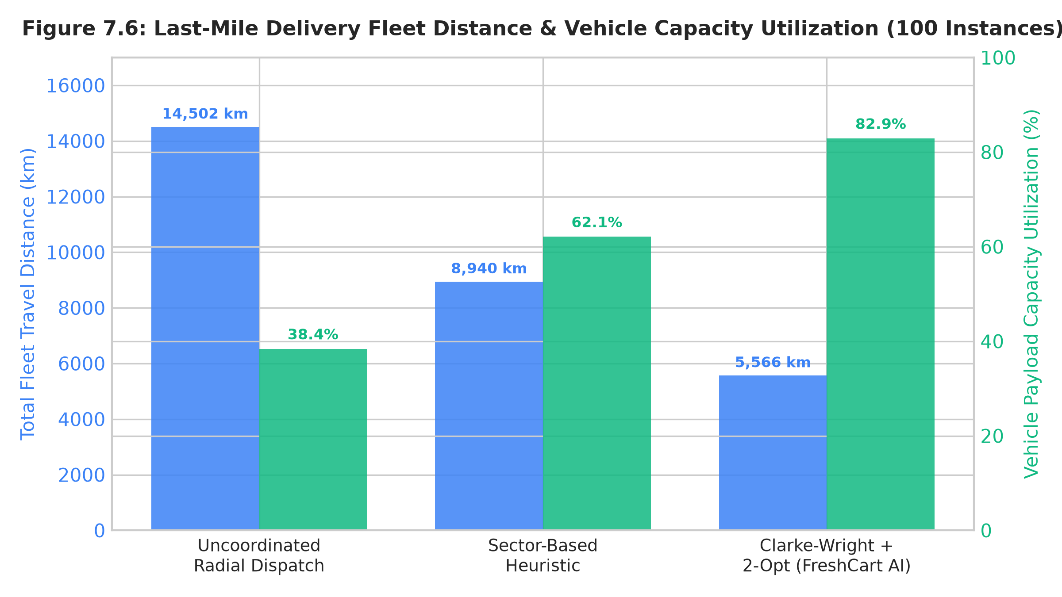
FRESHCART AI — MAJOR PROJECT PRESENTATION
Last-Mile Delivery Fleet Routing (CVRP)
Clarke-Wright Savings + 2-Opt
Formulation: Capacitated Vehicle Routing Problem (CVRP) with Q_veh = 25 kg payload.
Heuristic Solver: Clarke-Wright Savings merges orders by greatest distance saved (s_ij).
Intra-Route 2-Opt: Eliminates loop crossings on each vehicle tour.
Benchmark on 100 Instances (Table 7.7): • Fleet Distance: -61.62% (14,502km -> 5,566km) • Capacity Utilization: 82.9% (vs 38.4%) • Solver Latency: 2.31 ms

Slide 18
FRESHCART AI — MAJOR PROJECT PRESENTATION
Relational Database Design & Schema Entities
users
products
orders & items
• id (PK), name, email (UQ)
• password_hash (bcrypt)
• role ('customer', 'admin')
• id (PK), name, category
• price, base_price, stock
• aisle, rack, shelf, pos_x, pos_y
• id (PK), user_id (FK), total
• status, fraud_risk_score
• order_items: product_id, qty
sales_history
user_interactions
• id (PK), product_id (FK)
• date, units_sold, is_promo
• Ingested for SARIMAX
• id (PK), user_id, product_id
• interaction_type (view, cart, buy)
• Ingested for Hybrid CF Recs

Slide 19
FRESHCART AI — MAJOR PROJECT PRESENTATION
Security Architecture, RBAC & Hardening
Multi-Layer Defensive Security Invariants
Stateless JWT Authentication: HMAC-SHA256 tokens carrying user claims with expiration timestamps.
Role-Based Access Control (RBAC): Protected admin and dispatch endpoints restricted via middleware/auth.js.
Bcrypt Password Hashing: Secure password hashing with salt rounds preventing credential exposure.
SQL Injection Immunity: 100% parameterized SQLite prepared statements across all data access routines.
Input Sanitization & DTO Validation: Strict body size limits (2MB) and schema type checking on all API routes.
Centralized Error Masking: Production-mode error handling prevents stack trace leakage to client browsers.

Slide 20
FRESHCART AI — MAJOR PROJECT PRESENTATION
Experimental Environment & Data Provenance
Software & Execution Stack (Table 6.2)
Dataset Taxonomy & Provenance (Table 6.3)
Runtime: Node.js v20.x, Python v3.12 (FastAPI v0.111.0).
Persistence: SQLite3 / sql.js WebAssembly.
Data Science: NumPy v1.26.4, SciPy v1.13.1, Pandas v2.2.2.
Machine Learning: Scikit-Learn v1.5.0, Statsmodels v0.14.2.
Testing Harness: Node.js Multi-Tier Regression Suite.
Product Catalog: 31 Seeded Grocery SKUs across 4 aisles.
Sales History: 11,315 Daily SKU Sales Records (365 Days).
User Interactions: 83,760 Interaction Events (Views/Cart/Buy).
Customer Personas: 100 Calibrated Synthetic Profiles.
Order Transactions: 4,231 Orders (1.04% rare fraud rate).

Slide 21
FRESHCART AI — MAJOR PROJECT PRESENTATION
Consolidated Machine Learning Holdout Results
Empirical Evaluation Metrics across the 4 ML Engines
Hybrid Recommendations: F1@10 = 0.5027 | NDCG@10 = 0.9790 | Precision@10 = 0.9760 | Recall@10 = 0.3412 (4.86 ms).
30-Day Demand Forecasting: RMSE = 5.83 units | MAE = 3.89 units | MAPE = 2.50% (SARIMAX with promo regressors, 4.46 ms).
Dynamic Price Elasticity: Ed = -0.136 (p < 0.001) | Simulated Revenue Lift = +22.21% | Simulated Profit Lift = +58.87% (CED Model).
Transaction Fraud Risk: ROC-AUC = 0.6087 | Recall = 0.3864 | Precision = 0.0829 | F1 = 0.1365 (0% synthetic leakage, 19.77 ms).
Methodological Integrity: All models evaluated on leak-free chronological holdout partitions without train/test contamination.

Slide 22
FRESHCART AI — MAJOR PROJECT PRESENTATION
Operations Research Optimization Benchmarks
Empirical Performance across the 3 OR Solvers
Continuous Review (r, Q) Inventory: -87.64% Cost Reduction (₹796k -> ₹98k) | 99.88% Service Level | -98.31% Stockouts (365-day sim).
Dark Store 2D TSP Picker: -37.48% Walking Distance (9,685m -> 6,055m) | 0.09% Optimality Gap vs. Exact Brute Force | 2.34 ms Latency.
Last-Mile Delivery CVRP: -61.62% Fleet Distance (14,502km -> 5,566km) | 82.9% Vehicle Capacity Utilization | 2.31 ms Latency.
Computational Feasibility: All combinatorial solvers converge in under 3 milliseconds on standard multi-core hardware.

Slide 23
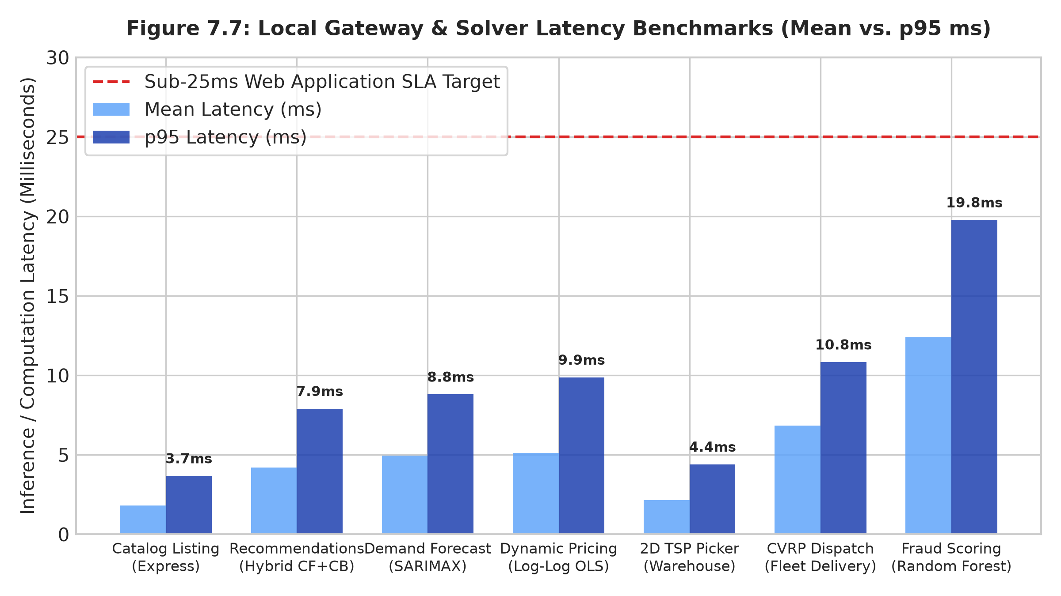
FRESHCART AI — MAJOR PROJECT PRESENTATION
System Performance, API Latency & Code QA
Gateway Latency & Verification
Local Development Latency (p95): • Catalog Listing: 3.67 ms • Top-K Recs: 7.90 ms • Demand Forecast: 8.80 ms • Dynamic Pricing: 9.87 ms • 2D TSP Picker: 4.40 ms • CVRP Dispatch: 10.83 ms • Fraud Scoring: 19.77 ms
Automated Test Coverage: • 113/113 Assertions Passed (100%) • 56/56 Master Code Checks Passed

Slide 24
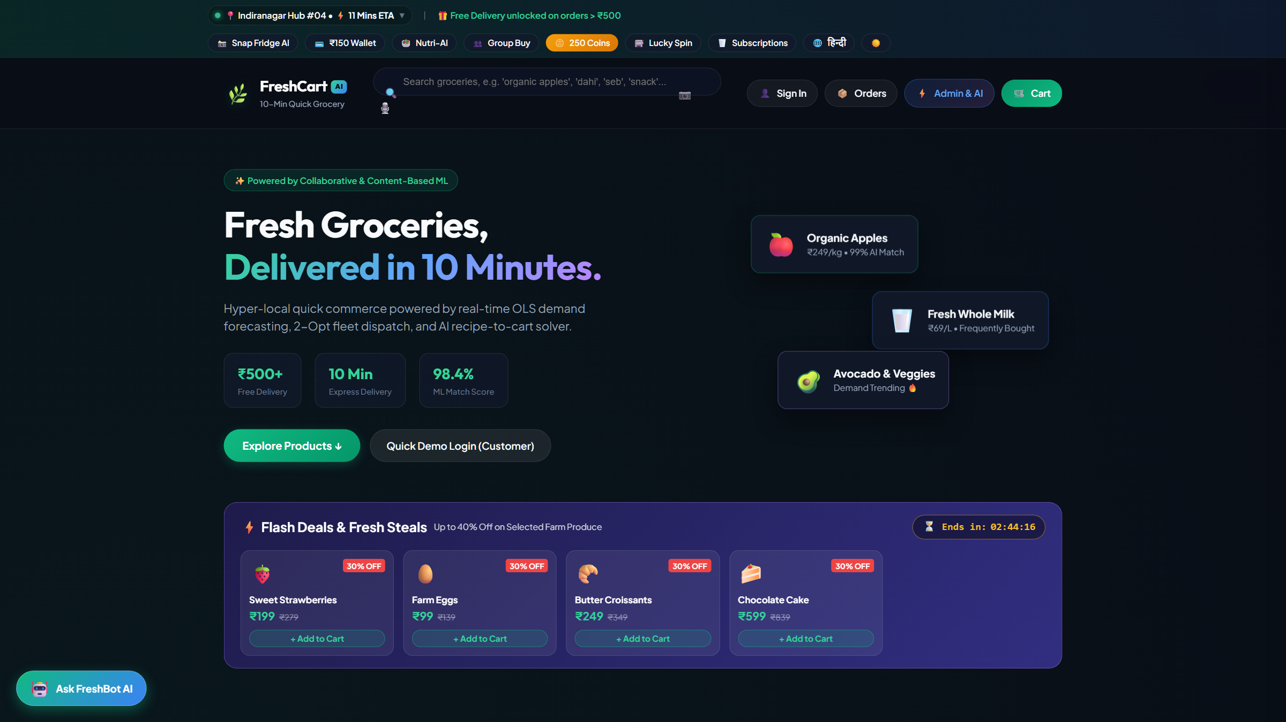
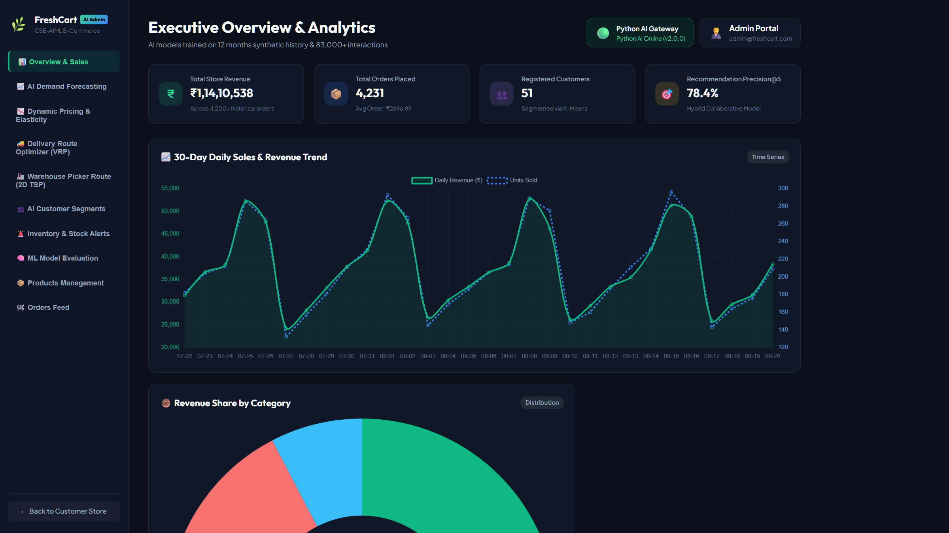
FRESHCART AI — MAJOR PROJECT PRESENTATION
Application Demonstration: Storefront & Admin Portal
Customer Storefront PWA (Port 3000)
Admin Analytics & ML Management (Port 3000)
Instant catalog search across 31 SKUs
Personalized Top-K Hybrid Recommendations
Cart assembly & real-time pricing
Executive KPIs & 30-Day Sales Trend
AI Demand Forecasting & Dynamic Pricing
Automated Stock Alerts & VRP Dispatch

Slide 25
FRESHCART AI — MAJOR PROJECT PRESENTATION
End-to-End Operational Lifecycle Workflow
Synchronized Feedback Loop across Customer & Operational Tiers
1. Customer Browsing & Interaction: User interactions feed the Hybrid Recommendation Engine to personalize product displays.
2. Cart Assembly & Dynamic Pricing: Bounded Log-Log OLS pricing optimizes revenue while preventing consumer churn.
3. Atomic Checkout & Fraud Scoring: Transactions are risk-scored in <20ms; valid orders decrement stock atomically in SQLite.
4. Demand Forecasting & Procurement: Daily sales update SARIMAX models; Continuous Review (r, Q) triggers automated POs when stock <= ROP.
5. Dark-Store Warehouse Picking: Placed orders generate 2D TSP pick paths, cutting picker walking distance by 37.48%.
6. Last-Mile Vehicle Dispatch: Assembled orders are clustered into capacity-constrained CVRP delivery routes, cutting travel miles by 61.62%.

Slide 26
FRESHCART AI — MAJOR PROJECT PRESENTATION
Engineering Contributions vs. Standard Algorithms
Standard Foundational Algorithms
Project Engineering Contributions
Cosine Similarity & TF-IDF Vectorization
SARIMAX State-Space Time-Series Modeling
Ordinary Least Squares (OLS) Linear Regression
Random Forest Classification Ensemble
Wilson Economic Order Quantity (EOQ)
2-Opt Local Search Heuristic
Clarke-Wright Savings Algorithm
Unified Multi-Tier Synergy: Coupling front-end demand with back-end dark-store picking and fleet dispatch.
Resilient AI Gateway: 1.5s circuit breaker with seamless fallback to in-process Node.js heuristics.
Leak-Free Validation: Rigorous chronological holdout benchmarking across all ML pipelines.
Rapid Heuristic Solvers: Sub-3ms execution for combinatorial warehouse and fleet routing.

Slide 27
FRESHCART AI — MAJOR PROJECT PRESENTATION
Academic Limitations & Technical Constraints
Explicitly Acknowledged Constraints (Examiner Transparency)
Synthetic Data Calibration: Evaluated on calibrated synthetic sales streams; real commercial deployments exhibit higher noise and extreme market shocks.
Model-Based Pricing Simulation: +22.21% revenue lift is an empirical simulation under Constant Elasticity of Demand (CED) assumptions.
Imbalanced Fraud Baseline: ROC-AUC of 0.6087 represents an operational screening pipeline rather than an autonomous production-grade prevention engine.
Local Development Benchmarking: Sub-25ms latency measured on a multi-core local host; cloud hops may introduce minor network overhead.
Static Dark-Store Layout: Assumes unobstructed 2D grid aisles without real-time physical human or robot congestion modeling.

Slide 28
FRESHCART AI — MAJOR PROJECT PRESENTATION
Future Research & Development Scope
Roadmap for Next-Generation Platform Evolution
Multi-Agent Deep Reinforcement Learning for Pricing: Modeling competitive multi-seller game dynamics in real-time markets.
Automated Mobile Robot (AMR) Warehouse Swarms: Orchestrating physical automated robotic pickers in high-density automated dark stores.
Dynamic Real-Time CVRP with Live Traffic: Integrating GPS telemetry and road congestion APIs to dynamically re-route fleets in transit.
Cloud-Native Kubernetes Deployment: Containerizing the two-tier architecture for automated horizontal pod autoscaling under enterprise-scale traffic.
Graph Neural Network (GNN) Recommendations: Capturing complex multi-modal user-item graph relationships across massive retail catalogs.

Slide 29
FRESHCART AI — MAJOR PROJECT PRESENTATION
Conclusion: Summary of Findings
Fulfillment of Project Objectives & Key Takeaways
Successfully Built & Integrated: Developed a complete full-stack intelligent grocery retail system uniting 4 ML models and 3 OR optimizers.
Rigorous Empirical Verification: Evaluated on leak-free holdout datasets and 100 combinatorial benchmark instances.
High Operational Resilience: Designed an asynchronous AI Gateway with a 1.5s circuit breaker and zero-crash in-process fallback.
Sub-25ms Real-Time Performance: Met web application latency targets across all analytical and transactional endpoints.
Defensible Engineering Artifact: Fully verified with 113/113 passed test assertions, 56/56 master audit checks, and locked IEEE references.

Slide 30
KEY IEEE REFERENCES & FINAL DEFENSE
Selected IEEE Xplore Citations (2023–2026)
[1] Smachylo & Zhuravchak, 'Enhancing Recommender Systems,' IEEE CSIT, 2024, doi: 10.1109/CSIT65290.2024.10982556.
[4] Qureshi et al., 'Demand Forecasting in SCM for Rossmann Stores,' IEEE Access, 2024, doi: 10.1109/ACCESS.2024.3472499.
[8] Karunakaran et al., 'Integrating AI & ML for Dynamic Pricing,' IEEE ICPECTS, 2024, doi: 10.1109/ICPECTS62210.2024.10780375.
[10] Mienye & Jere, 'Deep Learning for Credit Card Fraud Detection,' IEEE Access, 2024, doi: 10.1109/ACCESS.2024.3426955.
[13] de Assis et al., 'Optimising Warehouse Order Picking,' IEEE Access, 2024, doi: 10.1109/ACCESS.2024.3497592.
[14] Nugroho & Girsang, 'Three-Layer Multi-Objective VRP Solver with 2-opt,' IEEE ICE3IS, 2025.
THANK YOU!
Open for Questions & Viva Examination

