Slide 1
Skin Disease Prediction Course Code: CAP5001
TEAM MEMBERS:
20MIS7066 : Challa Jayanthi
20MIS7024 : Shashi Kiran Reddy
20MIS7042 : P. Sridhar Babu
GUIDED BY:
Prof.Arindam Dey

Slide 2


List of Content
AIM AND OBJECTIVES
ABSTRACT
INTRODUCTION
COMPONENTS
WORKFLOW OF METHOD

Slide 3
AIM AND OBJECTIVES
AIM:
To minimize human effort in skin disease prediction using computer vision approach such as image processing.
OBJECTIVE:
Our main objective is to develop an intelligent system which will use computer vision approaches for the prediction of skin disease using Deep Learning Approach.

Slide 4
Abstract
Skin diseases are one of the most common types of health illnesses faced by the people for ages. The identification of skin disease mostly relies on the expertise of the doctors and skin biopsy results, which is a time-consuming process.
An automated computer-based system for skin disease identification and classification through images is needed to improve the diagnostic accuracy as well as to handle the scarcity of human experts.
Classification of skin disease from an image is a crucial task and highly depends on the features of the diseases considered in order to classify it correctly. Many skin diseases have highly similar visual characteristics, which add more challenges to the selection of useful features from the image.
The accurate analysis of such diseases from the image would improve the diagnosis, accelerates the diagnostic time and leads to better and cost-effective treatment for patients.

Slide 5
Cont..
We utilized a Xception model pretrained on approximately 1,000,000 images and finetuned on 10015 dermoscopy images of HAM10000 dataset employing transfer learning.
Xception is a convolutional neural network that is 71 layers deep. You can load a pretrained version of the network trained on more than a million images from the ImageNet database. The pretrained network can classify images into 1000 object categories.
The model used in this project achieved an overall accuracy of 85.1% for seven classes in the dataset, whereas top2 and top3 accuracy of 91.02% and 95.82%, This method has the potential to assist dermatology specialists in decision making at critical stages.

Slide 6
Introduction
Skin diseases are characterized as disorders that often begin inside the body or start from the skin, and outwardly show on the skin. Some of them are extremely uncommon, however, others are commonly occurring.
They bring the person itch, and pain, as well as emotional and social impacts because of its visibility. All things considered, dermatologists guaranteed that a large portion of the skin diseases are manageable with legitimate medications, if they are decisively diagnosed .
Thus, an effective automatic skin disease detection design which can be used by the dermatologist to reduce their workload is highly anticipated.

Slide 7
Cont..
In today’s real time scenario of daily life, computer vision methodology has attracted researchers due to its nature of providing efficient information for better visual and experimental analysis.
In computer vision approach, image classification is also a promising technique which is used for various applications such as pattern recognition, remote sensing application, medical image processing etc.
It is a process of pixel sorting from image and accumulating into individual classes.
The Dermatology remains the most uncertain and complicated branch of science because of it complicacy in the procedures involved in diagnosis of diseases related to hair, skin, nails.
Human skin is considered the most uncertain and troublesome terrains due to the existence of hair, its deviations in tone and other mitigating factors.

Slide 8
Cont..
The skin disease diagnosis includes series of pathological laboratory tests for the identification of the correct disease.
These Skin abnormalities are very infectious and need to be treated at earlier stages to avoid it from spreading.
We utilized a Xception model pretrained on approximately 1,000,000 images and finetuned on 10015 dermoscopy images of HAM10000 dataset employing transfer learning.

Slide 9
Requirements
Software required:
python
Algorithms Used:
Convolutional Neural Network (CNN) – Deep Learning Algorithm
Library used:
Keras
Numpy
Pandas
Sklearn
Matplotlib
cv2

Slide 10
Step by step process
The process starts with data acquisition. Input to the CNN can be dermoscopic or clinical image, which can be preprocessed if needed.
the next step is data augmentation. This results in enough training samples to train the model.
Finally the data is fed into the CNN which performs feature extraction and classification by its own.
A CNN typically consists of convolution layer in which numbers of filters perform convolution operation on the image and generates feature maps.
These feature maps are further down sampled by pooling layers. Finally, the fully connected layer has all the connection from previous layer and does the classification accordingly.

Slide 11
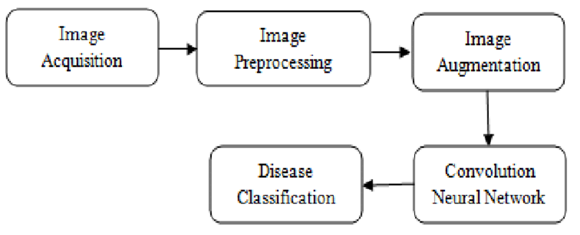
Cont..

Slide 12
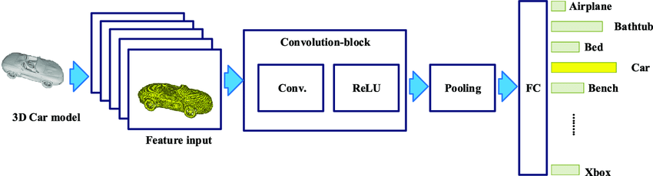
Cont …

Slide 13
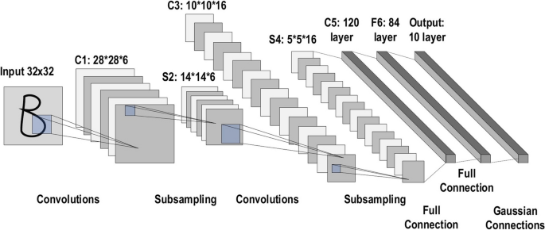
Cont..

Slide 14
THANK YOU

