Slide 1
Machine Learning: What, Why & Types
UNIT -1
INTRODUCTION
Your Name | Date

Slide 2
Learning Objectives
• Define what Machine Learning (ML) is
• Understand the need and importance of ML
• Explore types of ML with examples
Notes:
Introduce the session goals. Clarify that ML is foundational to modern AI applications.

Slide 3
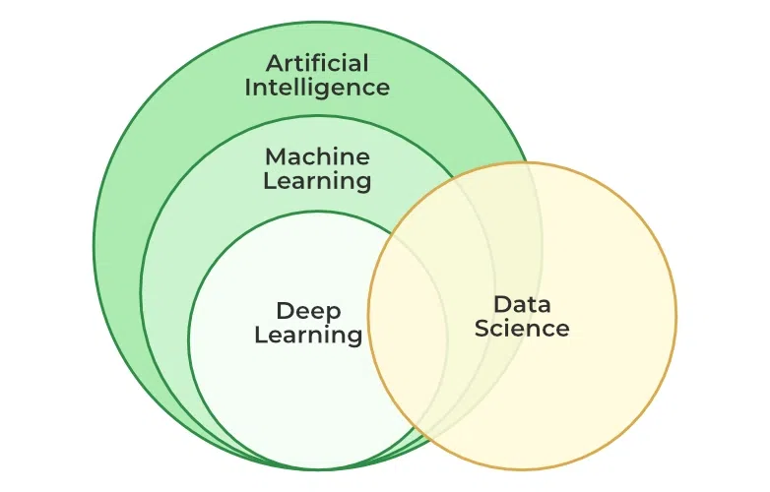
What is Machine Learning?
• Subfield of Artificial Intelligence (AI)
• Enables machines to learn from data
• No explicit programming needed
Notes:
ML allows computers to learn from data. It mimics how humans learn from experience.

Slide 4
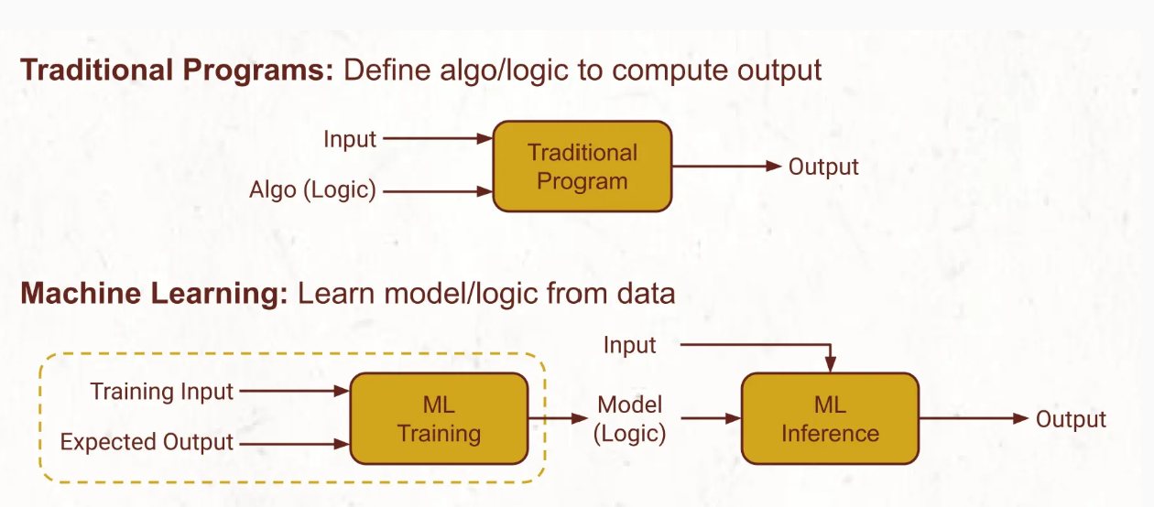
Traditional vs Machine Learning
Notes:
Highlight the shift in paradigm: ML focuses on learning rules from data.

Slide 5
EXAMPLE
In Traditional Programming Solution, a programmer will analyze how a human will determine whether an email is spam, and enumerate an exhaustive list of rules and patterns. For example:
the word FREE occurs several times
there are phrases like Weight Loss,
messages claiming you have won a lottery
messages originating from specific countries or IP addresses, and so on.
As spammers change tactics, the programmer needs to continuously update these rules to keep up with them. This is how Knowledge or Expert Systems were built in the past.
In Machine Learning Solutions, a programmer will:
Prepare data set: a large number of emails labeled by humans as spam or no-spam
Train, test, and tune models, and select the best.
During inference, this model is applied to determine whether to keep in an email in the inbox or the spam folder.
Statistical models are not 100% accurate. Spammers too keep coming up with new tactics. So sometimes spam classification is incorrect. Users will move such emails from the inbox to the spam folder (or vice versa).
Such user actions are tracked and are treated as new human-labeled data.
These examples are added to the data set, and a new model is trained to remain up-to-date with the spam trends.

Slide 6
Traditional vs Machine Learning
S.No | Traditional Software | Machine Learning
1 | In traditional software, the primary objective is to meet functional and non-functional requirements. | In machine learning models, the primary goal is to optimize the metric (accuracy, precision/recall, RMSE, etc) of the models. Every 0.1 % improvement in the model metrics could result in significant business value creation.
2 | The quality of the software primary depends on the quality of the code. | The quality of the model depends upon various parameters which are mainly related to the input data and hyperparameters tuning.
3 | Traditional software is created using one software stack such as MEAN, Java, etc. | Machine learning models could be created using different algorithms and associated libraries. Each of these algorithms could result in different performance.

Slide 7
Why Machine Learning?
• Automates decision-making processes
• Handles large, complex datasets
• Enables smart applications (e.g., AI assistants, recommender systems)
Notes:
Discuss real-world value: automation, scalability, and adaptability.

Slide 8
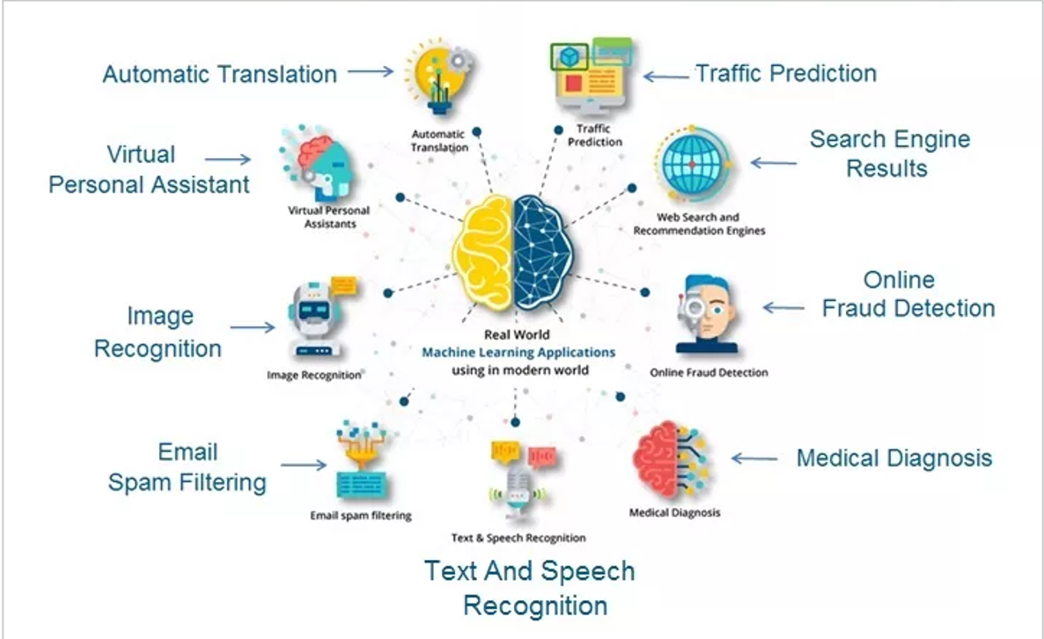
Real-Life Applications of ML
Notes:
Use visuals or examples to connect ML to daily life.

Slide 9
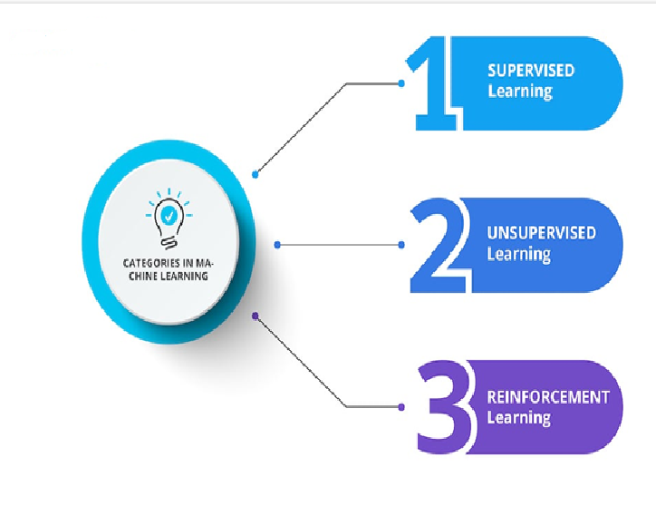
Types of Machine Learning
Notes:
Brief overview of the main types. Detailed discussion in upcoming slides.

Slide 10
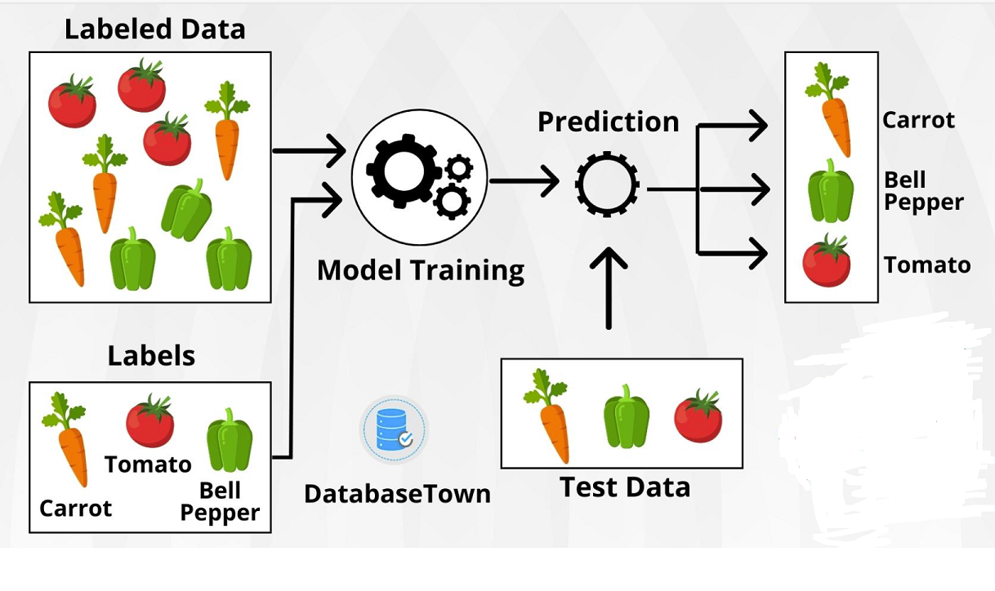
Supervised Learning
•Focuses on training models to make predictions or decision based on labeled training data.
• Output is known
Examples: Classification, Regression
• Use Case: Spam detection, house price prediction
Notes:
Explain how models learn mapping from input to output using labeled data.

Slide 11
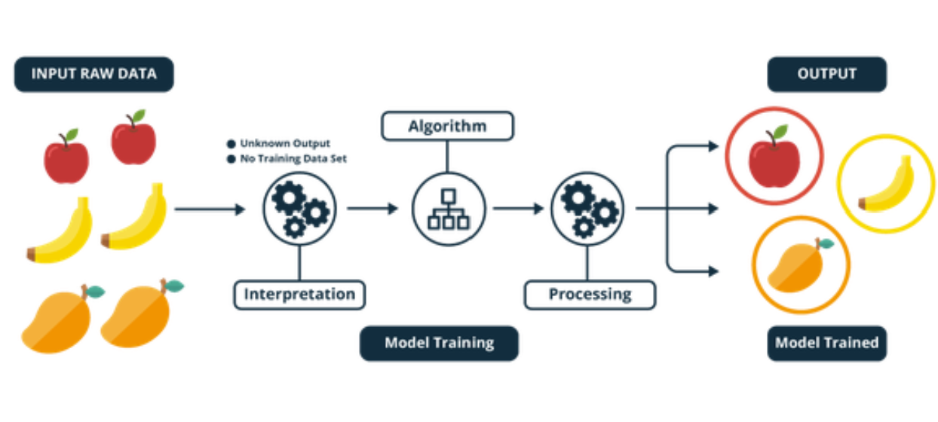
Unsupervised Learning
When a program automatically recognizes patterns or relationships in a given dataset. The algorithm is essentially on its own finding structure in its input, as it's not provided with classifications or labels ahead of time.
Learns from unlabeled data.
Finds hidden patterns
Examples: Clustering, Association
Use Case: Market basket analysis
Notes:
Show how it identifies structure in unstructured data.

Slide 12
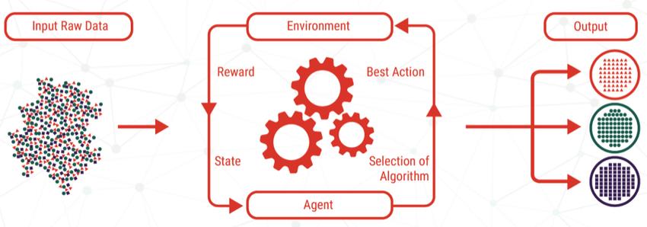
Reinforcement Learning
• Learns via rewards and penalties
• Agent interacts with environment
• Use Case: Robotics, game playing (e.g., AlphaGo)
Notes:
Use examples like AlphaGo to demonstrate learning through trial and error.

Slide 13
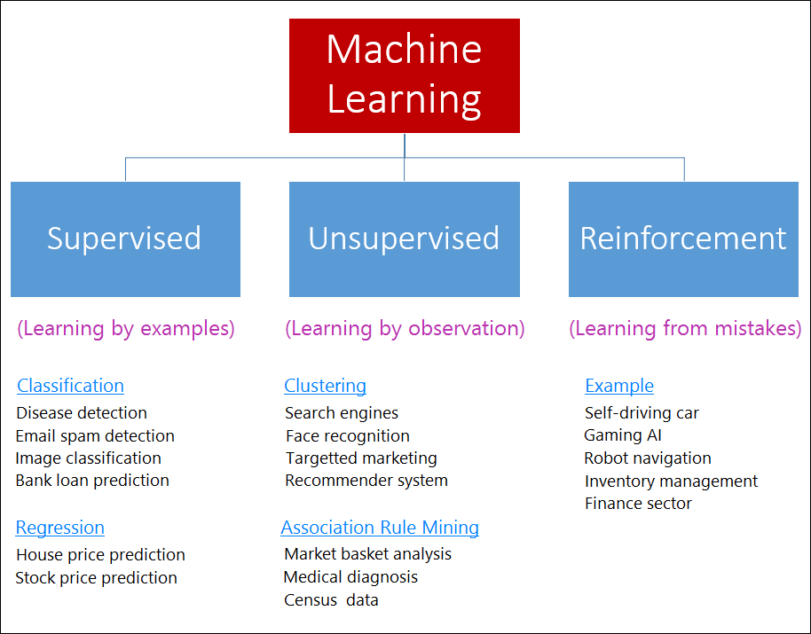
ML Types Comparison
Notes:
Summarize the differences to reinforce understanding.

Slide 14
Summary
• ML teaches computers to learn from data
• Applied in various domains
• Three main types: Supervised, Unsupervised, Reinforcement
Notes:
Recap key takeaways. Invite questions before moving to quiz.

Slide 15
Quiz Time
Q1: Which ML type requires labeled data?
Q2: What kind of learning is used in chess-playing bots?
Q3: Give an example of unsupervised learning.
Notes:
Use this quiz to check students' understanding.

Slide 16
Thank You!
• Questions & Answers
• Your Name / Email / Institution
Notes:
Wrap up the session and invite interaction.

