Slide 1
Supervised and unsupervised learning, Polynomial curve fitting
UNIT -1
INTRODUCTION

Slide 2
Learning Objectives
Supervised learning
Unsupervised learning
Polynomial curve fitting

Slide 3
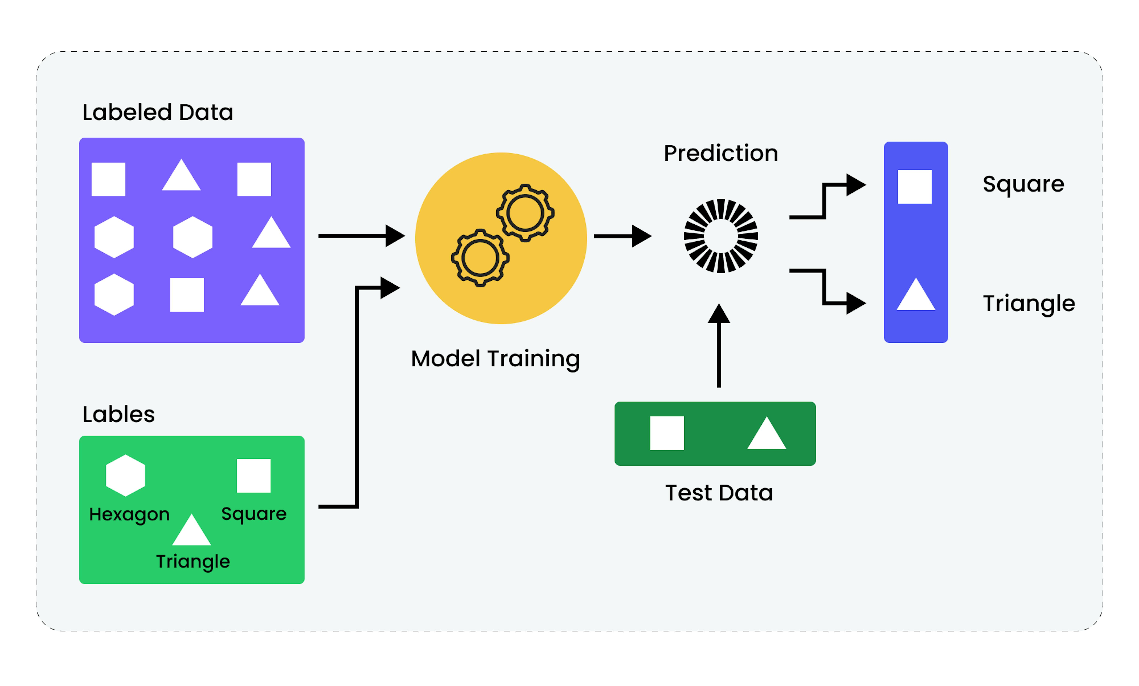
What is Supervised Learning?
- Supervised Learning is a type of machine learning where the model is trained using labeled data.
- Key Idea: Input → Algorithm → Output
- Types:
• Classification (Categorical output)
• Regression (Continuous output)

Slide 4
What is Classification?
- Classification assigns input data into predefined categories.
- Examples:
• Email spam detection
• Tumor diagnosis
• Animal image classification
- Output: Discrete / Categorical

Slide 5

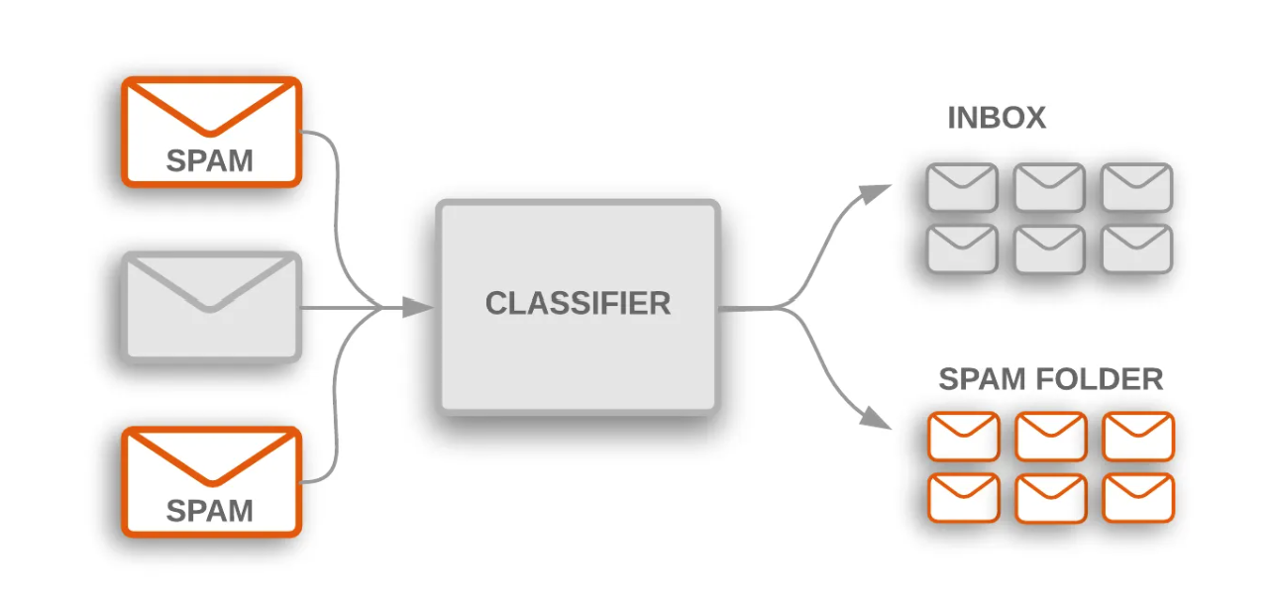
Example of Classification
Example: Email Spam Detection
Features:
Keywords (win, free, urgent)
Sender address
Email Structure
Model learns patterns from labeled emails.

Slide 6
Need for Probabilistic Predictions
- Real-world data is uncertain.
- Probabilistic outputs provide confidence levels.
Example:
- Email is spam: 90% confidence
- Not spam: 10%
Benefits:
- Better decision-making
- Thresholding possible

Slide 7
Real-World Applications
- Document Classification & Email Filtering
- Classifying Flowers (Iris Dataset)
- Image Classification & Handwriting Recognition
- Face Detection & Recognition
- Stock Price Prediction (Regression)

Slide 8
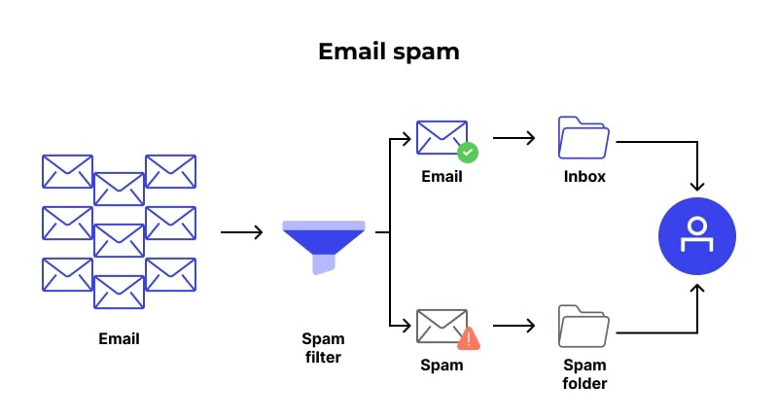
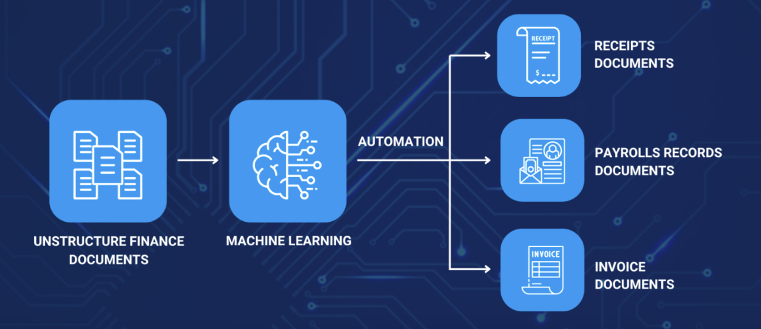
Document Classification & Spam Filtering
- Document Classification:
• News categorization, Language detection
Spam Filtering:
• Uses Naive Bayes, SVM
• Features: Word frequency, links

Slide 9
Classifying Flowers (Iris Dataset)
- Dataset: Setosa, Versicolor, Virginica
- Features: Petal & Sepal length/width
- Algorithms: Decision Tree, KNN, SVM

Slide 10
Image Classification & Handwriting Recognition
- Image Classification:
• Input: Pixels → Output: Object class
- Handwriting Recognition:
• Used in OCR (digits, letters)
- Datasets: MNIST, CIFAR-10

Slide 11
Face Detection and Recognition
- Face Detection: Finds faces in images
- Face Recognition: Matches faces to identities
- Techniques: CNNs, Haar Cascades, Deep Learning

Slide 12
What is Regression?
- Predicts continuous values using labeled data.
- Examples:
• House price prediction
• Temperature forecasting
• Income estimation
- Algorithms: Linear Regression, SVR

Slide 13
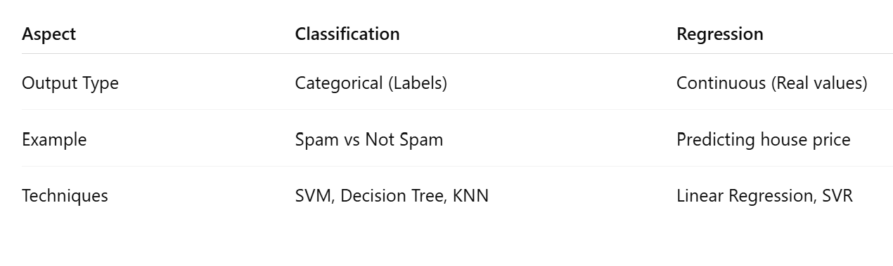
Classification vs Regression

Slide 14
Summary
- Supervised learning uses labeled data
- Classification: Discrete labels
- Regression: Continuous values
- Probabilistic outputs = confidence
- Applications: Text, image, face, numeric data

Slide 15
Unsupervised Learning

Slide 16
What is Unsupervised Learning?
- Unsupervised Learning is a type of machine learning where the model learns from unlabeled data.
- Goal: Discover hidden patterns, structures, or features in data.
- Key Techniques: Clustering, Dimensionality Reduction, Association Rule Mining

Slide 17
Discovering Clusters
- Clustering: Grouping similar data points based on features.
- Algorithms: K-Means, Hierarchical Clustering, DBSCAN
- Examples: Customer segmentation, Image compression, Social media communities

Slide 18
Example of Clustering
Use Case: Customer Segmentation
Input: Age, income, purchase frequency
Clusters:
- High-spenders
- Occasional buyers
- Budget customers
Benefit: Enables targeted marketing.

Slide 19
Discovering Latent Factors
- Latent Factors: Hidden variables explaining observed patterns.
- Example: Movie preferences → genre, mood, actor affinity
- Techniques: PCA, Non-negative Matrix Factorization (NMF)

Slide 20
Discovering Graph Structure
- Graph-Based Learning: Representing data as networks.
- Applications: Social network analysis, Fraud detection, Biology
- Goal: Identify communities, hubs, and bridges.

Slide 21
Matrix Completion – Image Inpainting
- Matrix Completion: Filling missing values in a matrix.
- Image Inpainting: Predict missing pixels in damaged images.
- Techniques: Low-rank approximation, Autoencoders

Slide 22
Collaborative Filtering
- Recommends items based on similar users.
- Types: User-based and Item-based filtering
- Example: Netflix recommending movies
- Built on: Matrix Factorization, Similarity Measures

Slide 23
Market Basket Analysis
- Finds associations between products bought together.
- Techniques: Apriori Algorithm, FP-Growth
- Example: Bread → Butter
- Applications: Cross-selling, Store product layout

Slide 24
Summary
- Unsupervised learning uses unlabeled data.
- Discovers clusters, latent factors, graph structures, associations.
- Applications: Marketing, recommendations, social networks, image repair

Slide 25
Polynomial Curve Fitting

Slide 26
What is Polynomial Curve Fitting?
- A supervised learning approach used to model the relationship between input x and target t
- Assumes the function can be approximated by a polynomial:
y(x, w) = w0 + w1x + w2x^2 + ... + wMx^M

Slide 27
The Polynomial Model
- The goal is to determine the coefficients w = {w0, w1, ..., wM}
- Model is trained using a set of N input-output pairs {(xₙ, tₙ)}
- We minimize the sum-of-squares error:
E(w) = 1/2 ∑(y(xₙ, w) - tₙ)²

Slide 28
Overfitting and Underfitting
- Underfitting: Model is too simple (e.g., low M)
- Overfitting: Model is too complex (e.g., high M)
- A good model balances bias and variance

Slide 29
Example: Fitting a Sinusoidal Function
- True function: t = sin(2πx) + noise
- Polynomial models of varying degrees M are fit to the data
- Overfitting observed for high M when data is limited

Slide 30
Controlling Overfitting: Regularization
- Add a penalty term to the error function:
E(w) = 1/2 ∑(y(xₙ, w) - tₙ)² + λ/2 ∑w_j²
- λ is a regularization parameter that controls complexity

Slide 31
Choosing Model Complexity
- Techniques:
• Cross-validation
• Bayesian inference
- Goal: Select M and λ to generalize well on unseen data

Slide 32
Key Takeaways
- Polynomial curve fitting illustrates the core challenges of machine learning:
• Overfitting vs underfitting
• Importance of model selection and regularization
- Fundamental to regression and function approximation tasks

Slide 33
References – curve fitting
Bishop, C. M. (2006). Pattern Recognition and Machine Learning. Springer-Chapter 1: Introduction

