Slide 1


|| Jai sri GURUDEV ||
ADICHUNCHANAGIRI UNIVERSITY
BGS INSTITUTE OF TECHNOLOGY
BG NAGARA - 571448
DEPARTMENT OF COMPUTER SCIENCE AND ENGINEERING
A Technical Seminar
On
“SMART MEDICAL MIRROR”
Under the guidance of
Co-Ordinator
Mrs. Namitha A R
Asst. Professor Dept. of CSE
BGSIT, BG Nagar
Guide
Mrs. Swetha S N
Asst. Professor Dept. of CSE
BGSIT, BG Nagar
Presented by
SURYA R
18CSE082

Slide 2
AGENDA
Abstract
Introduction
Literature Survey
Proposed System
System Requirements
System Design
Conclusion
Reference

Slide 3
ABSTRACT
A Smart Medical Mirror is another one of those smart devices which have been developed to improve our normal lives by making the things that we use on an everyday basis ‘SMART’.
It is a mirror with programmable functions and features adjoining a user personalized data feed and a mirror, hence, saving loads of time.
The Mirror built in the Proposed system is more focused on the Healthcare Perspective.
All that Smart Mirror does is make our life simpler by helping us to do multitasking and increasing our efficiency in the rush hours.

Slide 4
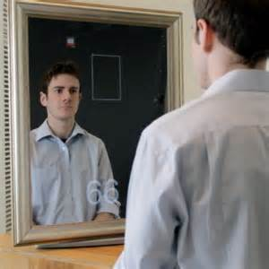
INTRODUCTION
The ability to monitor a patient's physiological signals by a remote, non-contact means is a tantalizing prospect that would enhance the delivery of primary healthcare.
Non-contact methods may not be able to provide details concerning cardiac electrical conduction that ECG offers.
Recent work has shown that pulse measurements can be acquired using digital camcorders/cameras with normal ambient light as the illumination source.

Slide 5
OBJECTIVE
The main objective of Medical Mirror is to build a device which measures the most commonly measured body parameters such as Height, Weight, Pulse-rate, Body Temperature, Blood Glucose Level and Blood Pressure.
To design a device which will be easy to use and have a compatible user interface to display the measured parameters on the mirror itself.
A user friendly mobile application that can record the reports of every visit. The report can be accessed whenever required.

Slide 6
LITERATURE SURVEY
Sl no | Author Name | Year | Title | Proposed Method
1 | M. Safa, K Meenakshi, G Saranya | 2021 | “Enhancing Smart Mirror with Human Health care Perspective towards Intelligence” | This Proposed system has good utilization of sensor with efficient programming using python.
2 | Shady Halaby | 2020 | “Novel Approach of a Smart Medical Mirror System for Medical Application” | The proposed system in this paper aims to detect the person’s body and get basic medical information such as body temperature and pulse rate.
3 | Mayur Wani, Prashant Ahire | 2019 | “Real time smart mirror system using internet of things” | In this paper, the smart mirror displays the basic information like weather, date, time. They had good Mirror architecture.

Slide 7
PROPOSED SYSTEM
Users can create their customized display by programming.
Some informational displays contain information aggregated from third party APIs, such as news feeds, and weather updates.
Displaying useful widgets like weather and calendar.
Switches to power saving mode when a user is not detected.
User-friendly UI with fully customization options.
Interact with smart mirror using hand gestures.
Lower cost than existing designs.

Slide 8
SYSTEM REQUIREMENT
HARDWARE REQUIREMENTS
Raspberry Pi 3.
Pi Camera.
LCD Monitor.
Reflection Film.
Ultrasonic Sensor.
HX711 Sensor.
Temperature Sensor.
Glucometer.
Power Supply.
SOFTWARE REQUIREMENTS
Raspbian OS.
Python IDE.
Magic Mirror Software.

Slide 9
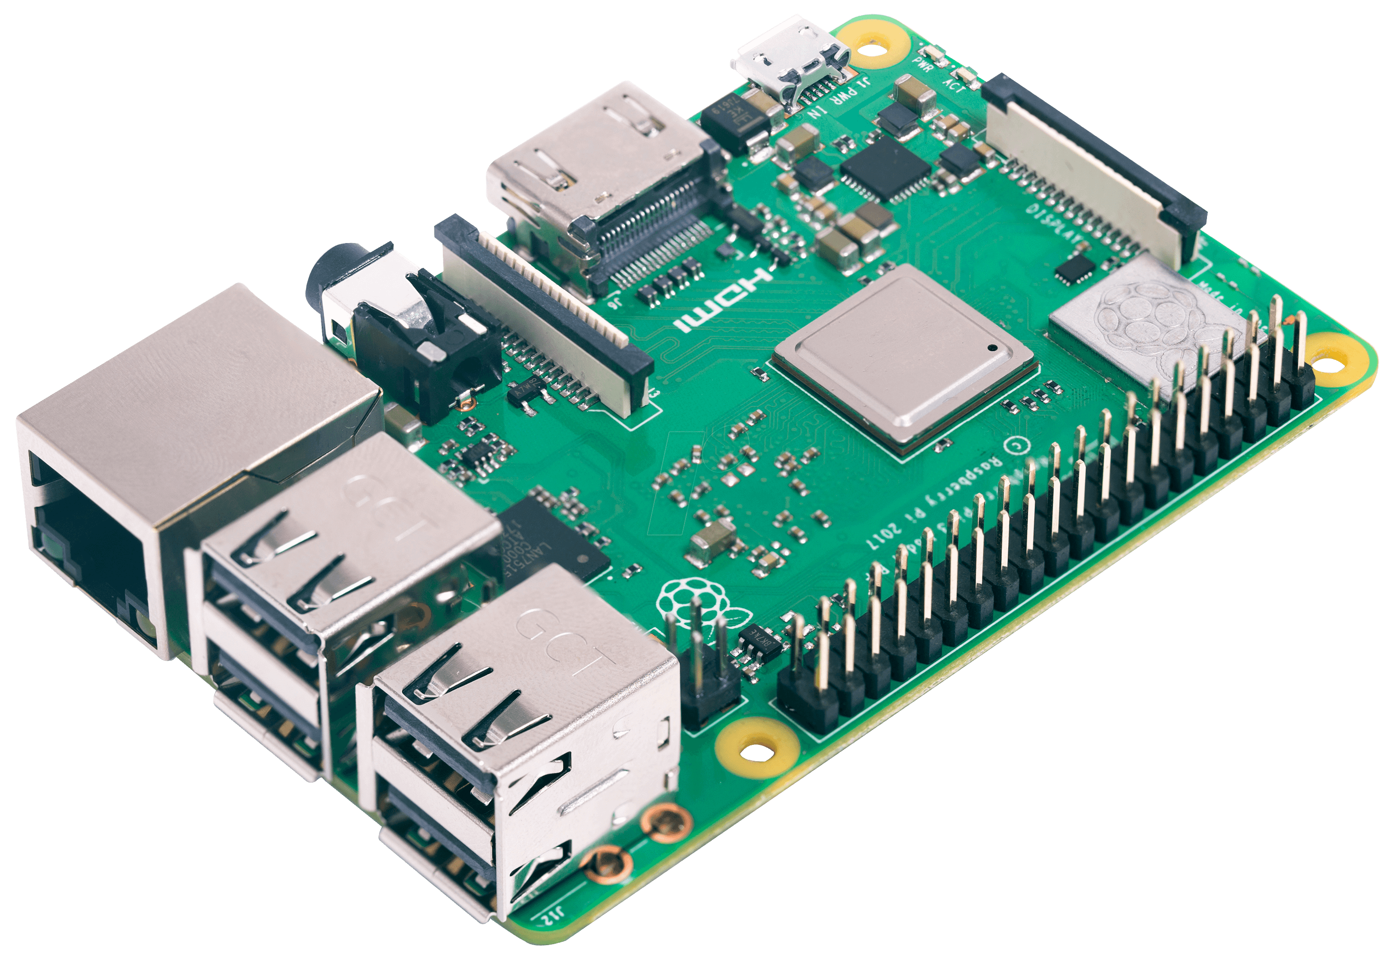
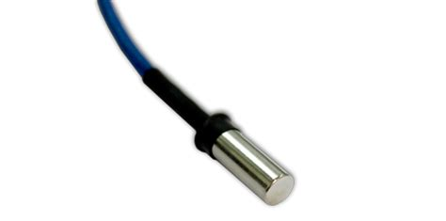
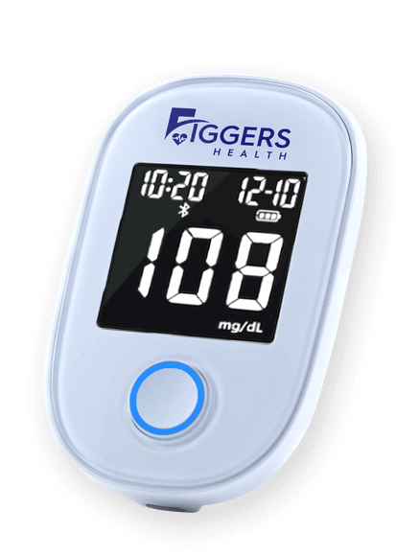
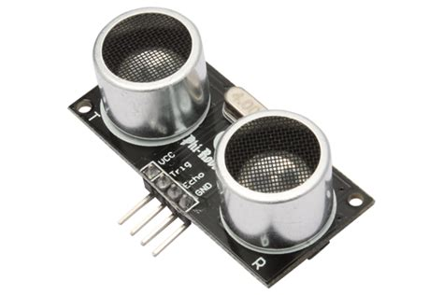
Fig. Temperature Sensor
Fig. Raspberry Pi 3
Fig. Glucometer
Fig. Ultrasonic Sensor

Slide 10
SYSTEM DESIGN
An automated face tracker detects the largest face within the video feed from the webcam and localizes the measurement region of interest (ROI) for each video frame.
It uses temperature sensor to measure the temperature from your body.
The raw RGB signals are decomposed into three independent components ( patterns) using independent component analysis.

Slide 11
SYSTEM DESIGN
A single user will be able to interact with the mirror at a time.
When looking into the mirror, the user will see a box appear around his/her face and a timer will be displayed on the top corner of the box.
Users will be asked to stay relatively still as the timer counts down to get accurate values.
User’s heart rate will be displayed on the mirror.
The heart rate measurement will be updated continuously until the user looks away.

Slide 12
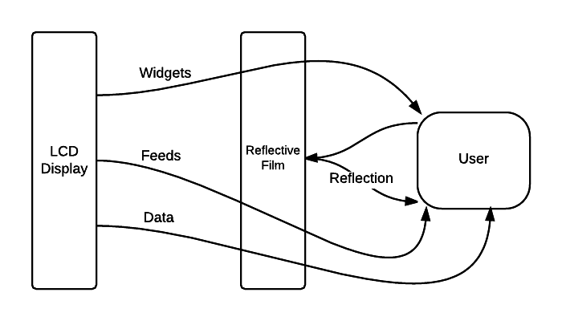
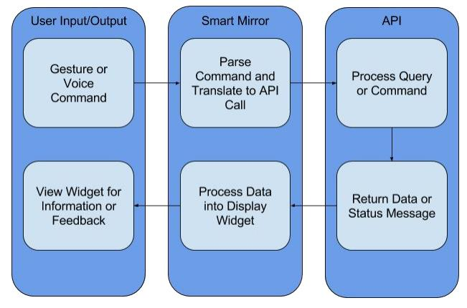
Fig. Smart Mirror setup
Fig. Program Flow

Slide 13
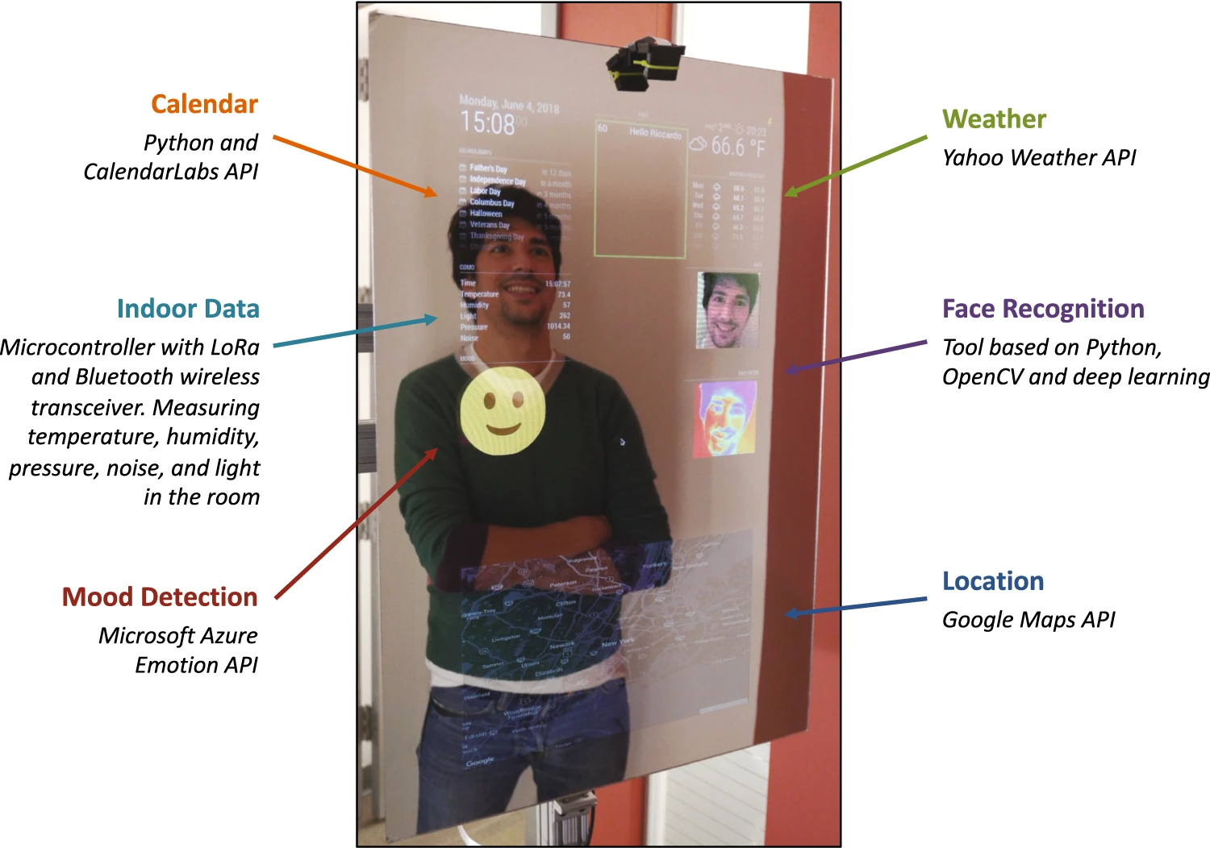
Fig. Smart Medical Mirror

Slide 14
ADVANTAGES AND APPLICATIONS
Advantages
i. The Medical Mirror fits seamlessly into the ambient home environment.
ii. Blending the data collection process into the course of our daily routines.
iii. The interface is intended to provide a convenient means for people to track their daily health with minimal effort.
iv. It is low cost compared with other methods.
v. An advanced approach to user’s health monitoring depends upon the state of the art technology.

Slide 15
Applications
It can be used as a domestic tool.
It can be placed in hospitals, clinics etc.
It can be used in military camps.

Slide 16
CONCLUSION
This project illustrates an innovative approach to pervasive health monitoring based on state of the art technology.
The Medical Mirror fits seamlessly into the ambient home environment, blending the data collection process into the course of our daily routines.
This interface is intended to provide a convenient means for people to track their daily health with minimal effort.

Slide 17
REFERENCE
[1]. Poh, M.-Z., mcduff, D.J. Picard, R.W. 2010. Non- contact, Automated Cardiac Pulse Measurements Using Video Imaging and Blind Source Separation. Optics Express, 18(10) 10762-10774.
[2]. Bhagyashree J. Bhoyar, Smita R. Londhe, 2014.Methodology for Medical Mirror. InternationalJournal of Scientific and Research Publications,4(1) 1-4.
[3]. M.Garbey, N.Sun, A.Merla., I. Pavlidis,2007.Contact-free measurement of cardiac pulsebased on the analysis of thermal imagery, IEEETrans. Biomed. Eng. 54(8), 1418–1426.

Slide 18
THANK YOU

