Slide 1


Document Upload Portal –
ARCHITECTURE & DESIGN
Sprint 1 – UPGRADE 2 ARCHITECT
June 2026
Shashi Shekhar · Technical Lead
1
© 2026 Cognizant | Confidential & Proprietary

Slide 2
Architecture
Problem · Requirements · Stack · HLD
2
© 2026 Cognizant | Confidential & Proprietary

Slide 3
AGENDA
Architecture
Design
Infrastructure
Operations
Section 01
Section 02
Section 03
Section 04
• Problem statement & requirements
• Technology stack
• High-level & application architecture
• Authentication & API design
• Database ER diagram
• Class & sequence diagrams
• Component diagram
• Deployment architecture
• CI/CD pipeline
• Security & compliance
• Monitoring & logging
• Performance, scalability & future-state
3
© 2026 Cognizant | Confidential & Proprietary

Slide 4
PROBLEM STATEMENT
Organizations require a secure and centralized platform to upload, store, and preview image documents while enforcing role-based access controls. Existing manual or shared-storage approaches lack proper authentication, ownership tracking, scalability, auditability, and secure document management. The Document Upload Portal addresses these challenges by providing a cloud-native solution built on Microsoft Azure for secure image upload, storage, retrieval, and governance.
Key challenges driving this initiative:
• Secure Authentication & Authorization – Ensure only authorized users can access and manage documents using Azure Entra ID and RBAC.
• Centralized Document Management – Provide a single platform for uploading, storing, and previewing image files.
• Ownership & Access Control – Restrict document access based on user roles and ownership.
• Scalability & Performance – Support growing document volumes and concurrent users without impacting performance.
• Secure Storage & Metadata Management – Store image files securely in Azure Blob Storage while maintaining metadata in Azure SQL Database.
• Compliance & Auditability – Enable logging, monitoring, and traceability of user activities.
• Operational Visibility – Provide real-time monitoring, telemetry, alerting, and health insights for proactive support.
• Cloud-Native Architecture – Leverage Azure managed services to improve reliability, security, maintainability, and cost efficiency.
4
© 2026 Cognizant | Confidential & Proprietary

Slide 5
REQUIREMENTS OVERVIEW
Functional
Features
Non-Functional
Quality
• User Authentication • Role-Based Access Control (Admin, Uploader, Viewer) • Secure Image Upload (JPG, PNG, GIF) • Image Preview and Retrieval • Image Metadata Management • Dashboard and Upload Status Tracking
• Centralized Document/Image Repository • Azure Blob Storage Integration • Metadata Storage in Azure SQL Database • JWT-Based Secure API Communication • Real-Time Monitoring and Alerting • Audit Logging and Activity Tracking
• High Availability and Reliability • Scalable Architecture for Future Growth • Enterprise-Grade Security and Compliance • Optimized Performance and Low Latency • Secure Data Storage and Encryption • Comprehensive Logging and Monitoring • Maintainable and Modular Design • Disaster Recovery and Backup Readiness
Secure Authentication & Authorization
Role-Based Access Control (RBAC)
Image Upload & Preview Management
Azure Blob Storage Integration
Azure SQL Metadata Management
Monitoring, Logging & Auditability
5
© 2026 Cognizant | Confidential & Proprietary

Slide 6
Document Upload Portal— TECHNOLOGY STACK
Frontend — .NET Core Web
• Creating Monolith, N-Tier Architecture Web Application using .NET Core Web .
• JWT interceptor attaches Bearer token;
Backend — .NET Web API
• Clean Architecture monolith
• Swagger at /swagger; health probe at /health; Serilog → App Insights → Log Analytics
Data & Cloud — Azure Managed Services
• Azure SQL Database — Manage Metadata
Azure BLOB Storage – Store Image
• Azure Key Vault — secrets via Managed Identity; Application Insights — APM & alerts
6
© 2026 Cognizant | Confidential & Proprietary

Slide 7
Design
Auth · API · ER · Class · Sequence
7
© 2026 Cognizant | Confidential & Proprietary

Slide 8
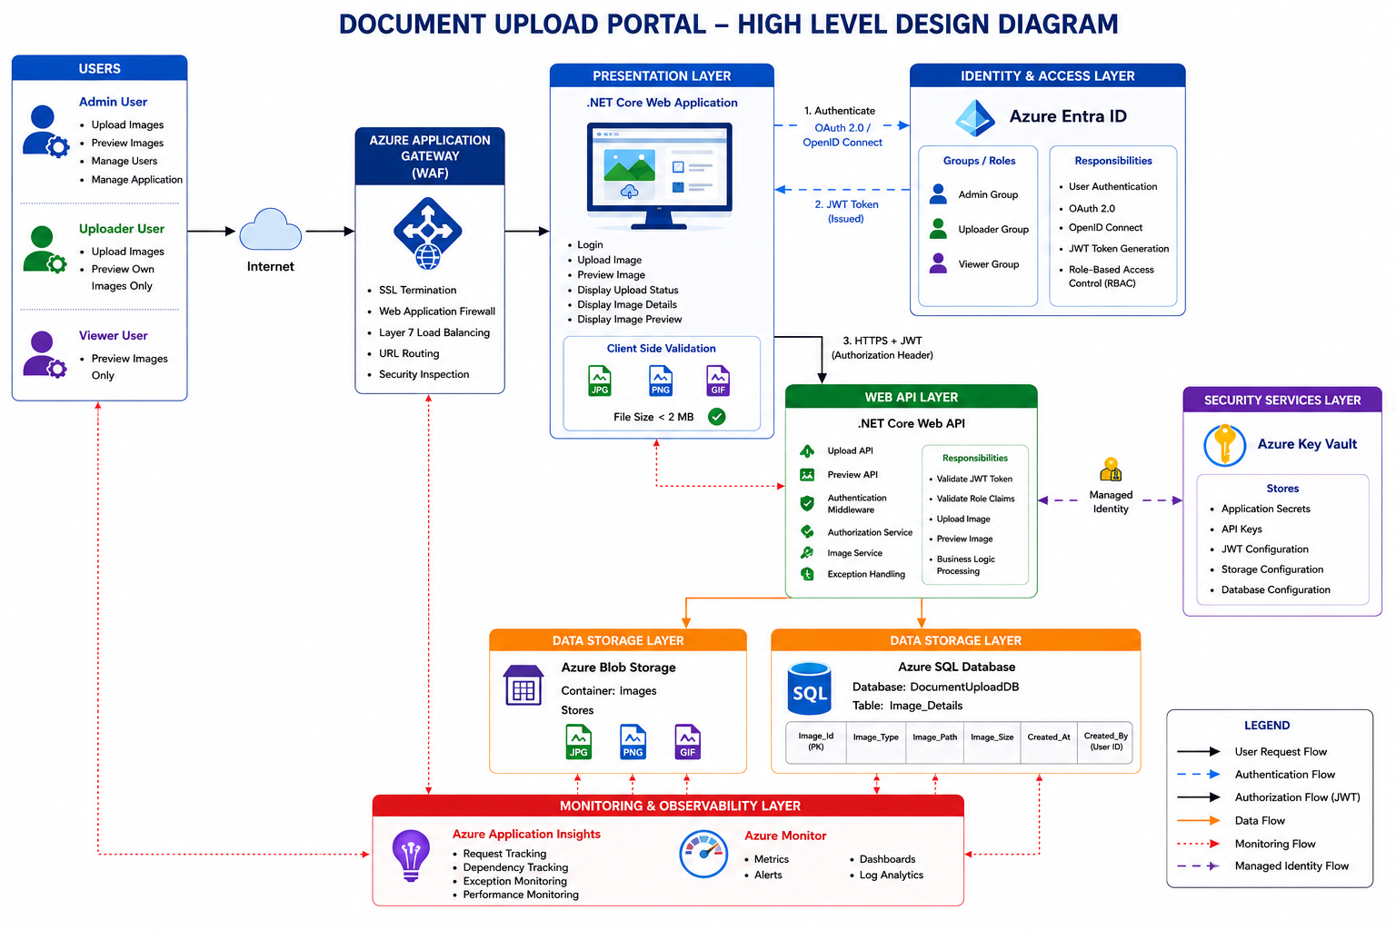
HIGH-LEVEL ARCHITECTURE
The Document Upload Portal follows a layered Azure-based architecture with a .NET Core Web Application as the presentation layer and a .NET Core Web API as the backend API layer.
Users upload and preview images through the Web UI. The API validates and handles JWT authentication and RBAC for Admin/Uploader Roles. Secrets such as SQL connection strings, JWT secrets are securely stored in Azure Key Vault.
Images are stored in Azure BLOB Storage, while metadata such as image ID, type, size, path, and uploaded user details are stored in Azure SQL Server.
The Document Upload Portal is designed as a secure, Azure-native solution that enables role-based image upload and preview capabilities. Azure Entra ID provides centralized authentication and authorization, while Azure Application Gateway secures inbound traffic. The application, hosted on Azure App Service, processes image upload and preview requests, stores image files in Azure Blob Storage, and maintains metadata in Azure SQL Database. Azure Key Vault secures application secrets, and Azure Monitor with Application Insights delivers centralized monitoring, logging, and operational visibility, ensuring a scalable, secure, and enterprise-ready platform.
8
© 2026 Cognizant | Confidential & Proprietary

Slide 9
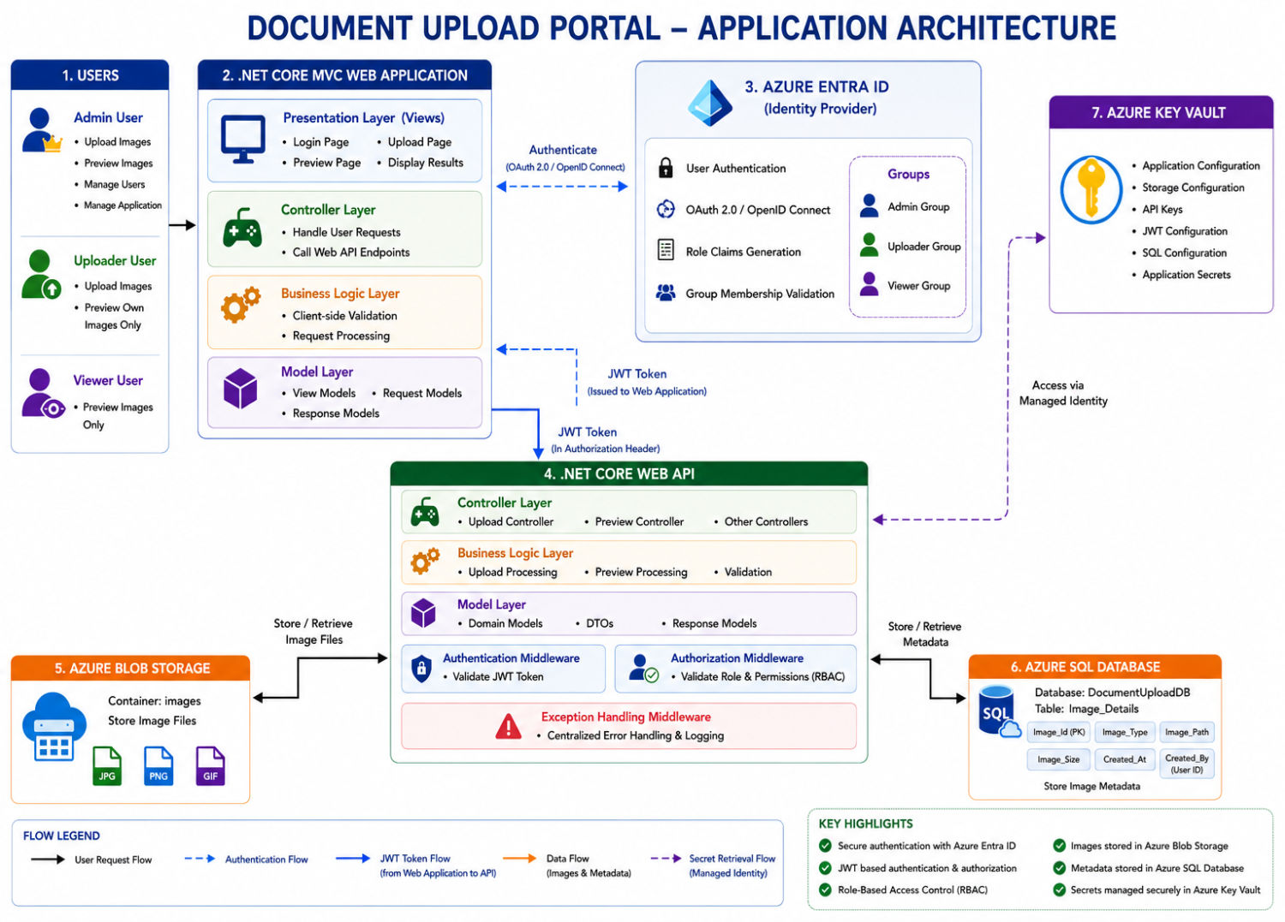
APPLICATION ARCHITECTURE DIAGRAM
The Document Upload Portal follows a secure layered architecture where users authenticate through Azure Entra ID and access the application based on role-based permissions (Admin, Uploader, and Viewer). The .NET Core Web Application consumes secured .NET Core APIs using JWT tokens, while the API layer enforces authentication, authorization, and business rules. Image files are stored in Azure Blob Storage, metadata is maintained in Azure SQL Database, Azure Key Vault secures application secrets, and Azure Monitor with Application Insights provides centralized monitoring and observability.
A secure and scalable Azure-based application architecture that enables authenticated users to upload and preview images through role-based access control, centralized identity management, secure API interactions, optimized storage services, and enterprise-grade monitoring capabilities.
8
© 2026 Cognizant | Confidential & Proprietary

Slide 10
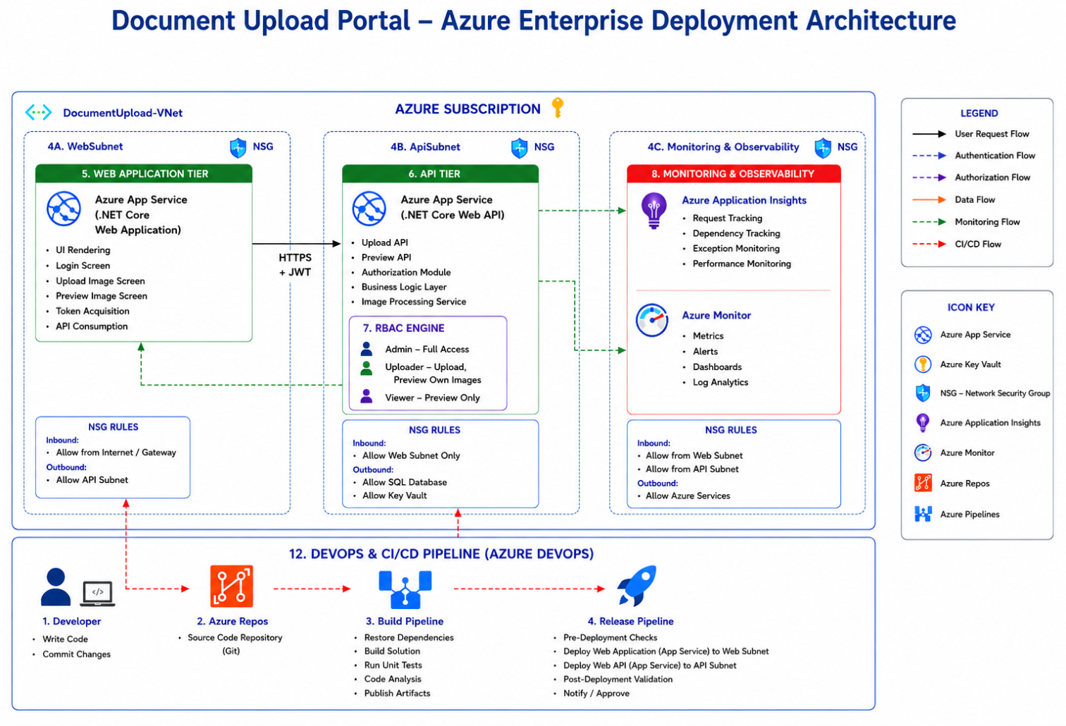
DEPLOYMENT DESIGN ARCHITECTURE
The Document Upload Portal follows a layered Azure-based architecture with a .NET Core Web Application as the presentation layer and a .NET Core Web API as the backend API layer.
Users upload and preview images through the Web UI. The API validates and handles JWT authentication and RBAC for Admin/Uploader Roles. Secrets such as SQL connection strings, JWT secrets are securely stored in Azure Key Vault.
Images are stored in Azure BLOB Storage, while metadata such as image ID, type, size, path, and uploaded user details are stored in Azure SQL Server.
The Document Upload Portal is designed as a secure, Azure-native solution that enables role-based image upload and preview capabilities. Azure Entra ID provides centralized authentication and authorization, while Azure Application Gateway secures inbound traffic. The application, hosted on Azure App Service, processes image upload and preview requests, stores image files in Azure Blob Storage, and maintains metadata in Azure SQL Database. Azure Key Vault secures application secrets, and Azure Monitor with Application Insights delivers centralized monitoring, logging, and operational visibility, ensuring a scalable, secure, and enterprise-ready platform.
8
© 2026 Cognizant | Confidential & Proprietary

Slide 11
API DESIGN OVERVIEW
Upload Image API
Endpoint : /images/upload
HTTP Method: POST Authentication : Azure Entra ID (JWT Token) Authorization : Admin, Uploader Security : HTTPS + JWT + RBAC Content-Type : application/json
Preview Image API
Endpoint : /images/{imageId}/preview
HTTP Method: GET Authentication : Azure Entra ID (JWT Token) Authorization : Admin, Uploader, Viewer Security : HTTPS + JWT + RBAC
11

Slide 12
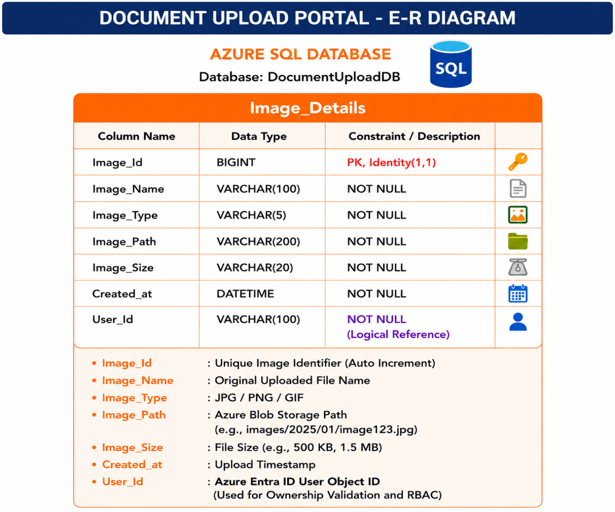
DATABASE – E-R DIAGRAM
The Entity Relationship Diagram (ERD) illustrates the database design for the Document Upload Portal, where Azure Entra ID manages user authentication, authorization, roles, and group memberships, while Azure SQL Database stores only image metadata. The core entity, Image_Details, captures information such as image name, type, storage path, size, upload timestamp, and the Azure Entra ID User_Id of the uploader. Physical image files are stored in Azure Blob Storage, and the Image_Path column provides the logical reference to the stored file. The User_Id serves as a logical ownership reference, enabling Role-Based Access Control (RBAC) and image-level authorization without storing user data in the database. This simplified, cloud-native design ensures scalability, security, minimal data redundancy, and seamless integration with Azure identity and storage services.
8
© 2026 Cognizant | Confidential & Proprietary

Slide 13
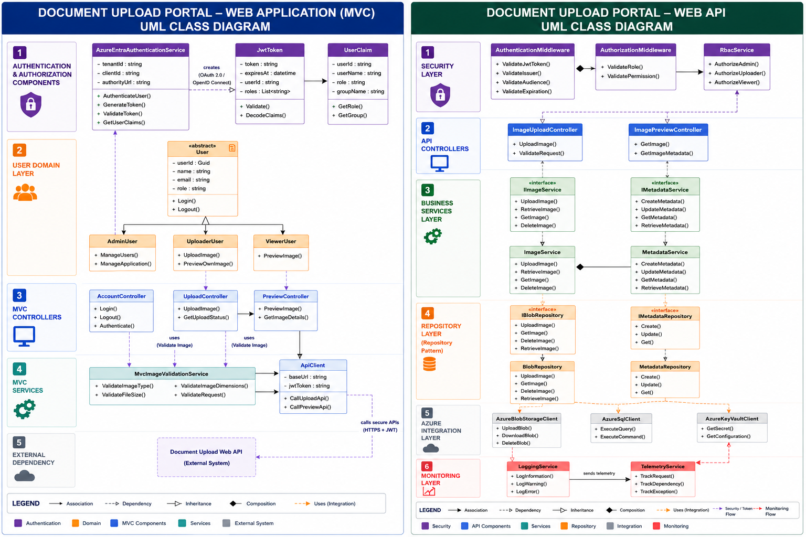
LOW-LEVEL DESIGN — CLASS DIAGRAM
8
© 2026 Cognizant | Confidential & Proprietary

Slide 14
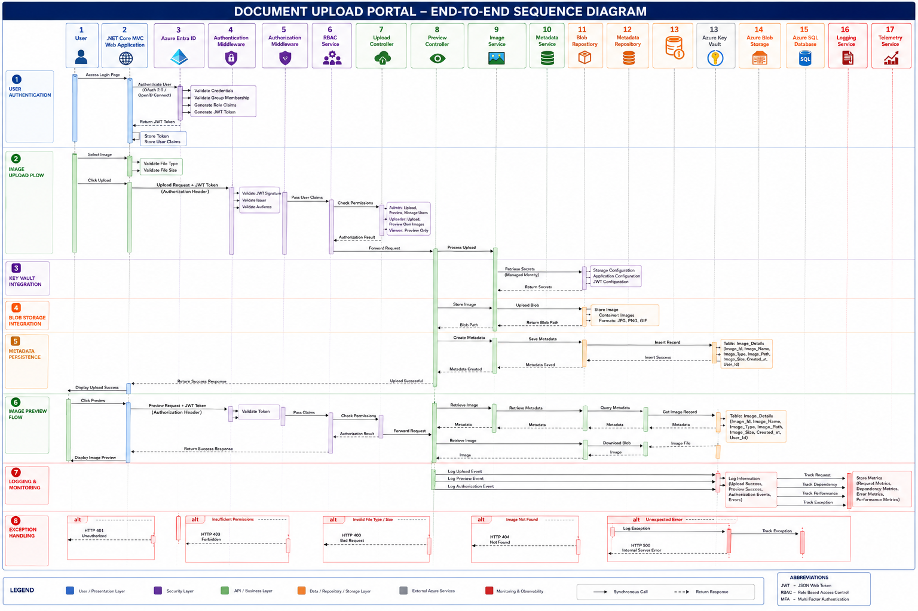
LOW-LEVEL DESIGN — SEQUENCE DIAGRAM
The Document Upload Portal Sequence Diagram illustrates the complete end-to-end interaction flow for secure image upload and preview operations within a cloud-native Azure environment. The process begins with user authentication through Azure Entra ID, where OAuth 2.0/OpenID Connect is used to validate credentials and generate a JWT token containing role-based claims. During image upload and preview requests, the JWT token is validated by the Authentication and Authorization middleware, and RBAC policies determine user access permissions. The application retrieves secure configurations from Azure Key Vault using Managed Identity, stores image files in Azure Blob Storage, and persists image metadata in Azure SQL Database using the Repository Pattern. The solution incorporates centralized logging, telemetry, monitoring, and exception handling to provide observability, security, reliability, and operational visibility. The sequence demonstrates a scalable, secure, and enterprise-grade architecture aligned with .NET Core, Azure Cloud Native, and SOLID design principles.
14
© 2026 Cognizant | Confidential & Proprietary

Slide 15
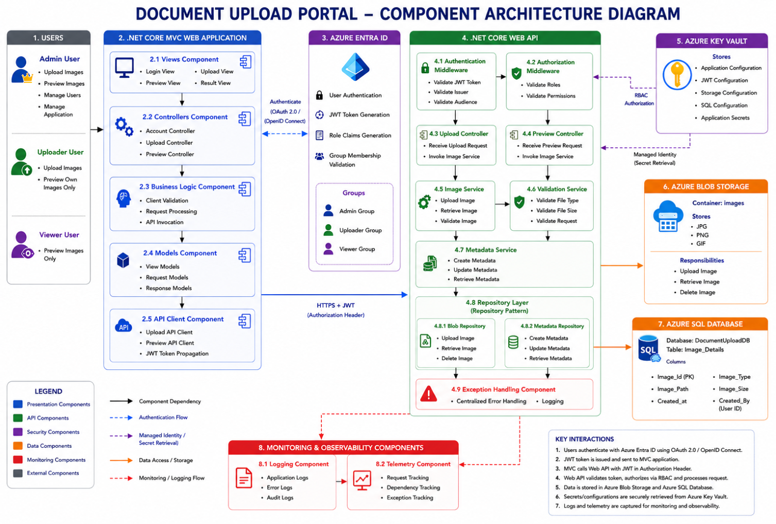
COMPONENT DIAGRAM — AS-BUILT
The Component Architecture Diagram illustrates the internal structure of the Document Upload Portal, highlighting the interaction between the .NET Core MVC Web Application, .NET Core Web API, security components, business services, repositories, and Azure platform services. The solution follows a layered monolithic architecture with clear separation of concerns, leveraging Azure Entra ID for authentication, RBAC for authorization, Repository Pattern for data access, Azure Blob Storage for image management, Azure SQL Database for metadata persistence, and Azure Key Vault for secure configuration management.
16
© 2026 Cognizant | Confidential & Proprietary

Slide 16
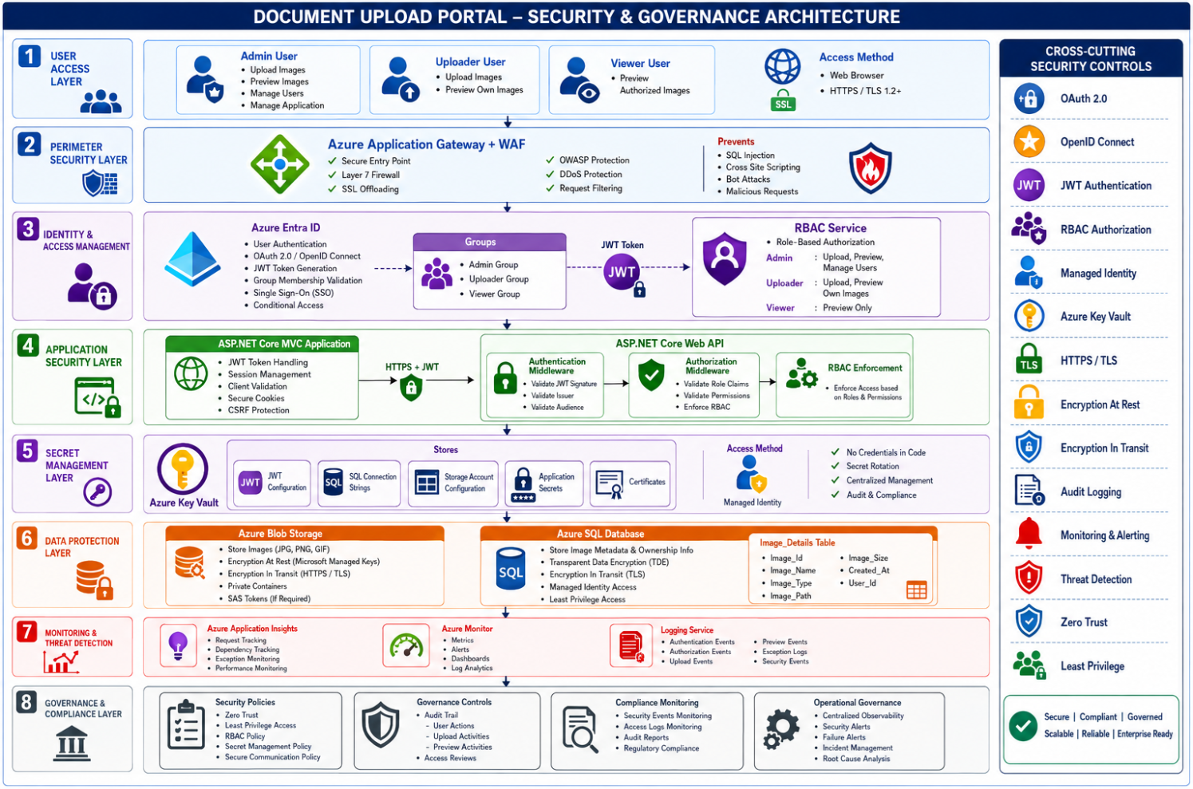
SECURITY & Governance
The Security & Governance Architecture ensures secure access, data protection, operational monitoring, and compliance across the Document Upload Portal. Azure Entra ID provides centralized authentication and RBAC-based authorization, while Azure Application Gateway and WAF protect external access. Azure Key Vault secures application secrets using Managed Identity, and Azure Blob Storage and Azure SQL Database provide encrypted storage for images and metadata. Azure Monitor and Application Insights deliver centralized observability, auditability, and threat monitoring, ensuring a secure, scalable, and enterprise-compliant platform.
18
© 2026 Cognizant | Confidential & Proprietary

Slide 17
MONITORING & LOGGING — STRATEGY
Telemetry sources
Collection
Aggregation
Alerting
Visualisation
• .Net Core (browser)
• Application Insights SDK (in-process)
• Application Insights (workspace-based)
• Azure Monitor metric & log alerts
• Azure Dashboards
• .NET 8 API (Serilog)
• Serilog → App Insights sink
• Log Analytics Workspace
• Action groups: Email today
• App Insights Workbooks
• Azure SQL diagnostics
• Diagnostic settings on Azure SQL & App Service
• Retention: 90 d AI, 12 m LAW
• Teams / Slack / ITSM → roadmap
• Availability tests on /health
• App Service platform logs
Correlation ID (X-Correlation-ID) propagated from SPA → API → Azure SQL; surfaced on every response and in every log line.
19
© 2026 Cognizant | Confidential & Proprietary

Slide 18
MONITORING & LOGGING — SUMMARY
Centralized Application Logging using Azure Application Insights to capture application events, API calls, exceptions, and user activities.
Real-Time Performance Monitoring to track API response times, image upload duration, request throughput, and application health.
Exception & Error Tracking for proactive identification of upload failures, database connectivity issues, and image processing errors.
Infrastructure Monitoring using Azure Monitor to track App Service, Azure SQL Database, and Azure Storage performance metrics.
Security Audit Logging to record user authentication, authorization failures, RBAC access events, and suspicious activities for compliance and forensic analysis.
Alerting & Notifications configured for critical events such as high error rates, application downtime, storage threshold breaches, and failed authentication attempts.
Distributed Request Tracing to track end-to-end transaction flow across UI, APIs, Azure Blob Storage, and Azure SQL Database for faster root cause analysis.
Log Analytics & Dashboarding using Azure Monitor Workbooks and Log Analytics for operational insights, trend analysis, and capacity planning.
20
© 2026 Cognizant | Confidential & Proprietary

Slide 19
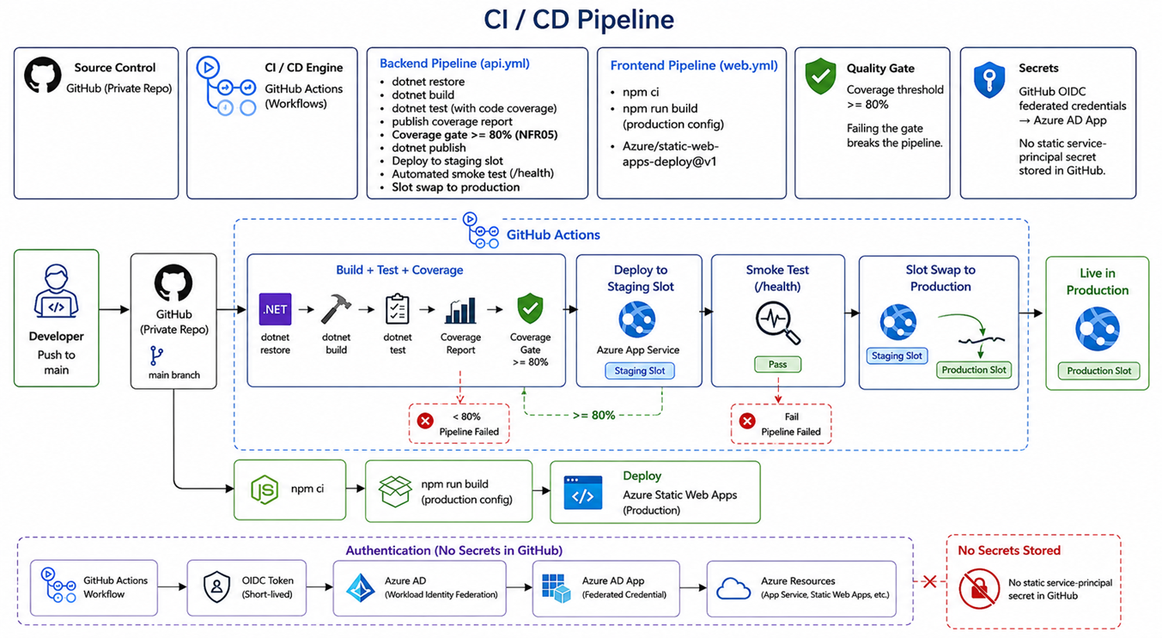
DEVOPS & CI/CD PIPELINE — AS-BUILT
Source Control & Engine
• GitHub private repo; main branch triggers GitHub Actions workflows on every push
• OIDC federated credentials to Azure AD App — no static secret stored in GitHub
Backend Pipeline (api.yml)
• dotnet restore, build, test with coverage report; coverage gate >= 80% (NFR05)
• dotnet publish → deploy to App Service staging slot → smoke test /health → slot swap
• Coverage < 80% or /health fail → pipeline blocked, no production deployment
Frontend Pipeline (web.yml)
• npm ci → npm run build (production config) → deploy to Azure Static Web Apps
Quality Gates & Security
• Coverage threshold >= 80%; Dependabot (NuGet + npm) + CodeQL scan on every PR
• Auth via OIDC Workload Identity Federation — no static service-principal secret
Environments
• Dev: Basic B1 + Free SWA + Basic SQL UAT: S1 + Standard SWA + S2 SQL
• Prod: P1v3 x2 + staging slot + Std SWA + GP_Gen5_2 ZR + KV + App Insights
21
© 2026 Cognizant | Confidential & Proprietary

Slide 20
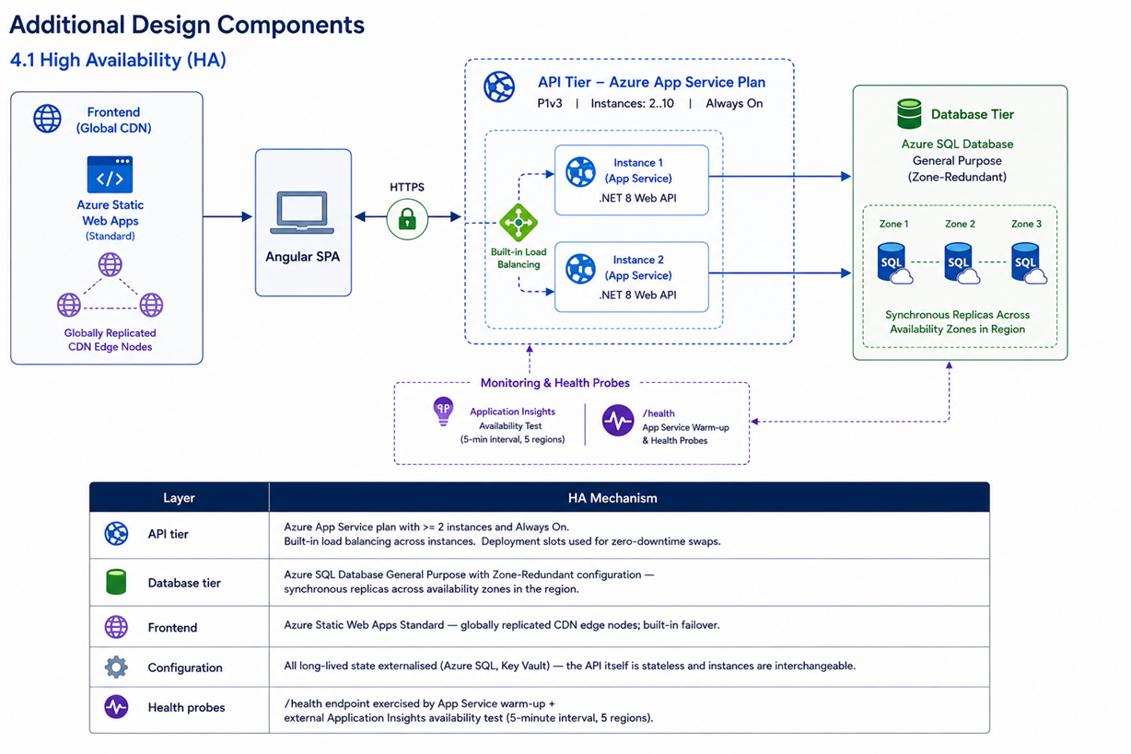
PERFORMANCE & SCALABILITY — AS-BUILT
High Availability Architecture
• API tier on Azure App Service Plan (P1v3); 2-10 instances with built-in load balancing
• Deployment slots enable zero-downtime swap; Always-On keeps instances warm
• Azure SQL Database (General Purpose, Zone-Redundant) — synchronous replicas across 3 availability zones
Scalability
• App Service auto-scales out on CPU > 70%; vertical scaling to Gen5_8 SQL without downtime
• Azure Static Web Apps (Standard) on globally replicated CDN edge — reduces API backend load
• All reads use AsNoTracking(); paged endpoints (max 100/page); streaming CSV export
Health & Monitoring
• Application Insights availability tests probe /health every 5 min from 5 Azure regions
• App Service warm-up probe on /health ensures instances are ready before receiving traffic
• Metric alerts on failed-request rate, p95 latency, DTU and CPU via Azure Monitor
NFR Targets
• Response <= 30 s end-to-end (case-study) p95 <= 500 ms on GET endpoints under load
• 99.9% API availability + 99.99% Azure SQL Zone-Redundant availability SLA
Future: Redis read-cache, HPA on AKS, geo-routing via Front Door — see slide 24
22
© 2026 Cognizant | Confidential & Proprietary

Slide 21
FUTURE-STATE ROADMAP — PHASED MIGRATION
Phase
Move
Description
0
Today
Monolithic Clean Architecture · App Service · Azure SQL
1
Containerize
Dockerfile · App Service for Containers (same image)
2
Stand up AKS
Run container at <10% traffic via Front Door rule
3
Add APIM
Move JWT validation + rate limit + caching to APIM
4
Notification Service
Service Bus topics · async events · email/SMS
5
Auth Service
OAuth 2.0 + Entra External ID · MFA · refresh tokens
6
Split services
Customers + Sales as deploy units · Redis read-cache
7
Analytics + CQRS
Read model · Blob staging for large exports
8
Hardening
Private Endpoints · Defender · geo-replication
Each phase is gated by an explicit trigger (team size, traffic, SLO, regulatory) — not a calendar date.
23
© 2026 Cognizant | Confidential & Proprietary

Slide 22
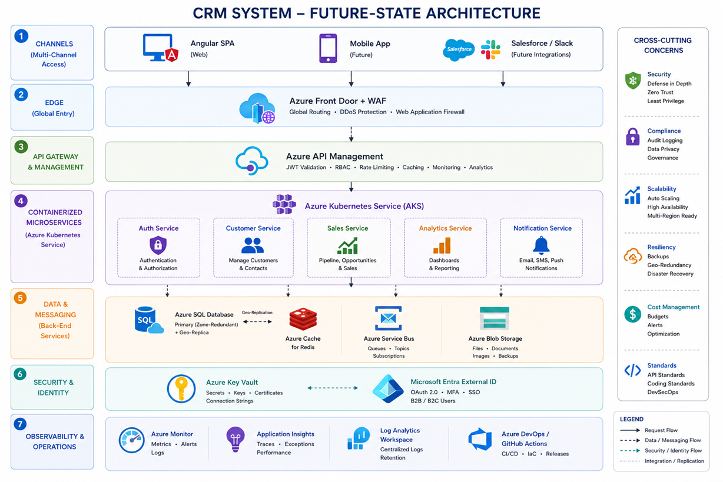
FUTURE-STATE ARCHITECTURE — TARGET
Multi-Channel Edge
• Channels: Web (Angular SPA), Mobile App (future), Salesforce / Slack integrations
• Azure Front Door + WAF — global routing, DDoS protection, Web Application Firewall
API Gateway & Microservices (AKS)
• Azure API Management — JWT validation, RBAC, rate limiting, caching, analytics
• AKS with HPA: Auth Service, Customer Service, Sales Service, Analytics, Notification Service
Data & Messaging
• Azure SQL (geo-replicated, Zone-Redundant) + Azure Cache for Redis (read-cache layer)
• Azure Service Bus — async event queues/topics for notifications and decoupled processing
• Azure Blob Storage — documents, images, large export staging
Security & Identity
• Azure Key Vault for secrets/keys/certificates; Microsoft Entra External ID for OAuth 2.0 + MFA
• B2B and B2C users; SSO; Zero-Trust, Least Privilege, Defence-in-Depth model
Observability & Operations
• Azure Monitor, App Insights, Log Analytics Workspace; Azure DevOps / GitHub Actions CI/CD
24
© 2026 Cognizant | Confidential & Proprietary

Slide 23
CONCLUSION
Production-ready CRM today,
evolution-ready architecture for tomorrow.
• Lean, modular .NET 8 monolith following Clean Architecture — easy to operate, easy to evolve.
• Enterprise-grade controls: BCrypt-12, RBAC, lockout, rate limiting, audit trail, RowVersion concurrency.
• All secrets in Azure Key Vault; passwordless access to SQL & KV via Managed Identity.
• Observable end-to-end: Serilog → App Insights → Log Analytics with correlation IDs.
• Future-state path is open — phased migration to AKS · APIM · Service Bus · Redis · B2C documented (slides 23–24).
Companion documents
• VEV_CRM_HLD.docx · VEV_CRM_LLD.docx · VEV_CRM_API_Specification.docx
25
© 2026 Cognizant | Confidential & Proprietary

Slide 24
Thank you
Venkateswaramma Vasapilli · Technical Lead
venkateswaramma.vasapilli@cognizant.com(2371857)
26
© 2026 Cognizant | Confidential & Proprietary

