Slide 1

De-Raining of Images
Ganesh 210001037
Shashivardhan 210001032
Abhichand 210001039

Slide 2

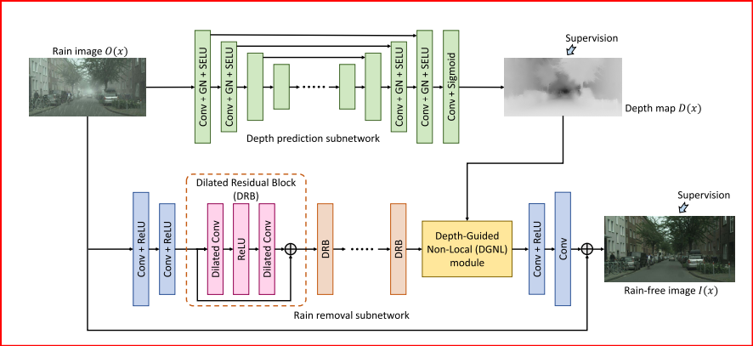
The Core: Model V1
The De-raining model consists of TWO essential components:
Rain Removal Network: This subnetwork is responsible for predicting a rain-free image from the input rain image by using the predicted depth map as guidance.
Depth Prediction Network: This subnetwork is responsible for obtaining the depth map of a given input image.

Slide 3
Sneak Peak: Depth Prediction
4 Downsample layers. Each consists of:
Conv2d
GroupNorm
SELU
3 Feature extraction layers. Each consists of:
Conv2d
GroupNorm
SELU
4 Upsample layers. Each consists of:
Conv2d, GroupNorm, SELU
Followed by :
ConvTranspose2d, GroupNorm,
SELU, Conv2d, SELU, Conv2d, Sigmoid

Slide 4
Sneak Peak: Rain Removal
11 DRB.
DRB:
Appearance Map
Theta, phi, g
ConvTranspose2d
ReLU
Conv2d
Conv2d
ReLU
Conv2d
ReLU
DilConv2d>ReLU>DilConv2d
X + Features(X)
Interpolate(sigmoid)
Depth Relation Map
Softmax
Softmax on D and D^{T}
S = Softmax(R_{a}, R_{d})
BMM(S, g)

Slide 5
So what did we do?
ViT: Vision Transformer
Our analysis on the model made one thing evident
AVOID PLAYING WITH MATH-BACKED MODULES.
FOCUS ON THE DEPTH PREDICTION NETWORK.
SOTA models capable of replacing the standard CNNs.
Model V2

Slide 6
Why not CNNs?
ViT has achieved state-of-the-art performance on image classification tasks.
ViT can be trained end-to-end without pre-training or fine-tuning, saving time and resources compared to traditional CNN-based approaches.
ViT is more flexible than CNNs, as it can be trained on small datasets with few examples and still achieve good performance.
ViT can handle input images of arbitrary size and aspect ratio, allowing it to be used for a wider range of applications.
ViT is more interpretable than traditional CNNs, making it easier to understand how the network is making its decisions in applications such as medical imaging.

Slide 7

Understanding Our Approach
Now we know we can use ViT instead of CNNs for the same purpose but how? Since ViT originally was modelled for classification on RGB we need to make changes.
We modified ViT architecture at pre-end stages by changing the classification head to a FC layer which maps the output feature map into dim(X) while keeping the normalization in mind.
The next issue which was dealt was the preservation of the dimensionality of input image since in the UNet architecture the dimensions of X (b h w c) keeps changing.
X = Input Image
b : batch
h : height
w: width
c : channels

Slide 8
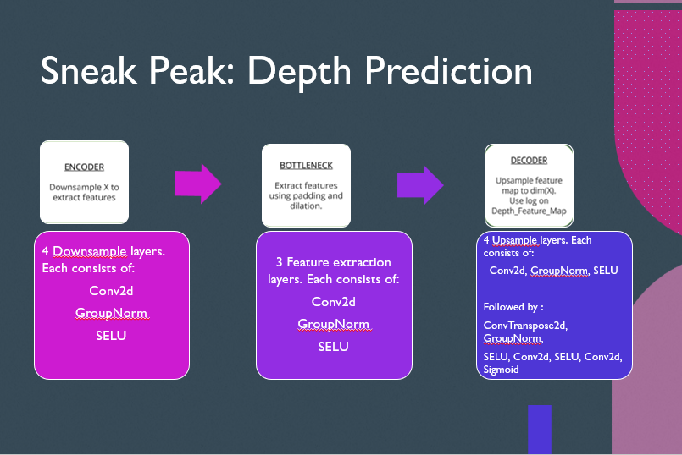
We could either change the encoder and decoder layers or the bottleneck layer or both by replacing CNNs with our modified ViT.
Upon study from different papers and websites, the best methodology is to replace CNNs only in the bottleneck.
We even experimented with other two possibilities and did infact find the above approach the best.

Slide 9
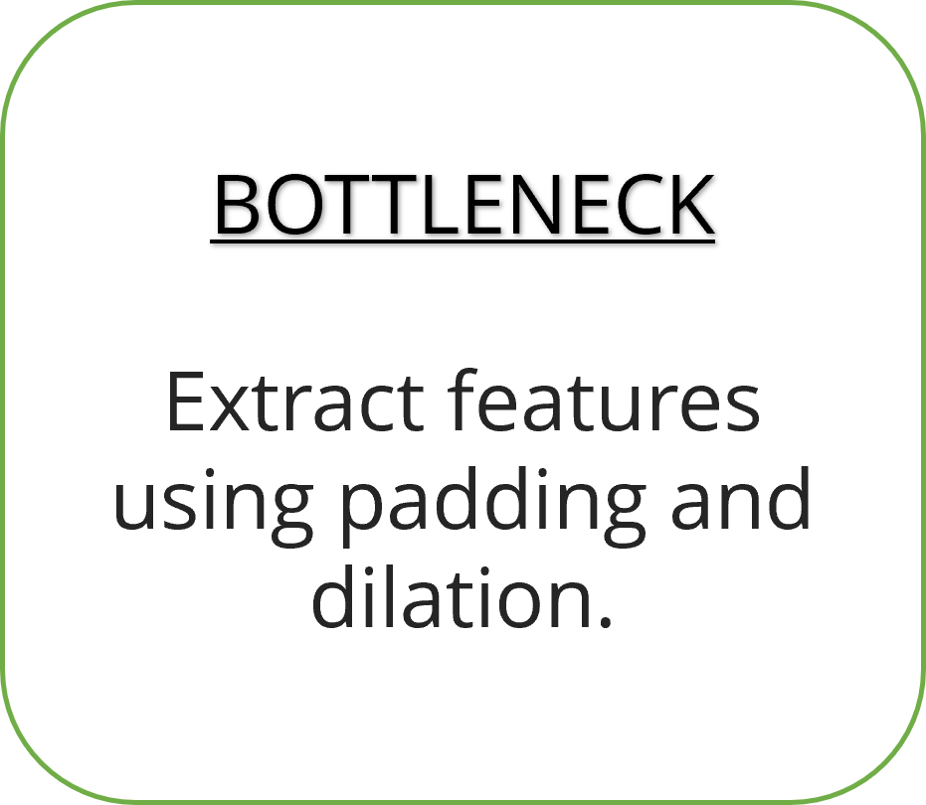
Redefined Core: Model V2
ViT comprises of:
Patch Embedding
Transformer:
QKV Attention
FeedForward
Linear Head
VIT
ViT

Slide 10
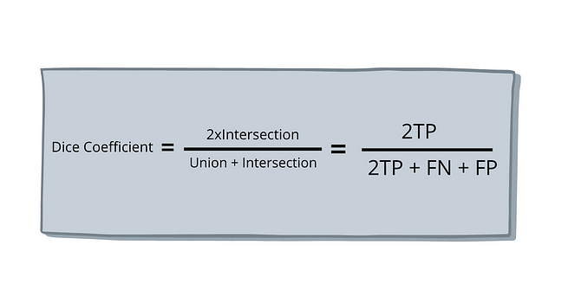
The Loss
DICE LOSS: It is well-suited for evaluating the overlap between two sets of segmentation masks.
It evaluates the similarity between predicted and ground truth segmentation at a global level. Spatial relationship is considered.
It produces a score of 1 for perfect overlap between predicted and ground truth segments.

