Slide 1
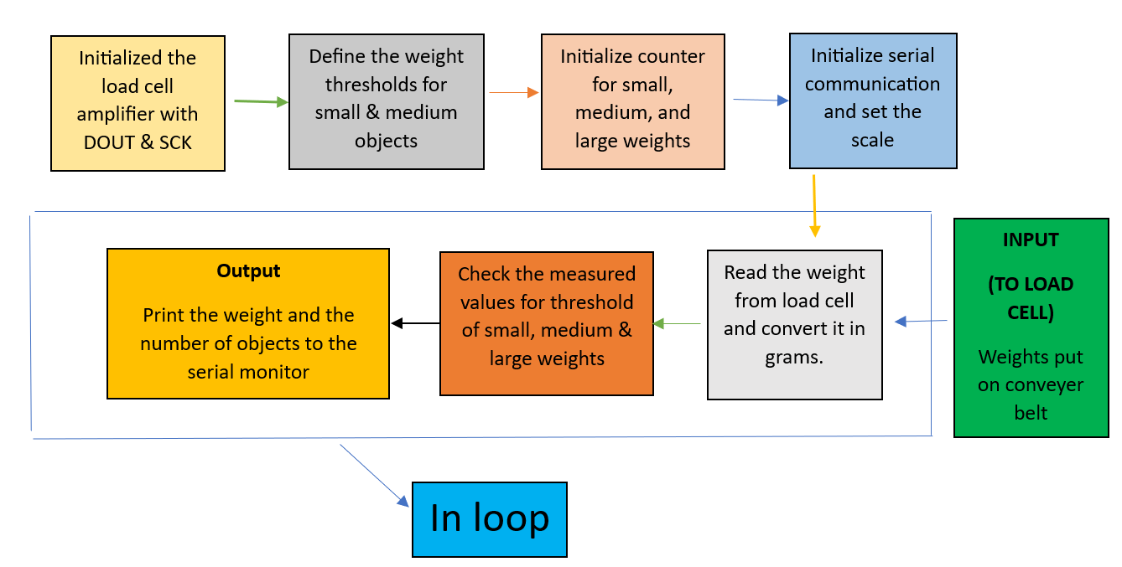
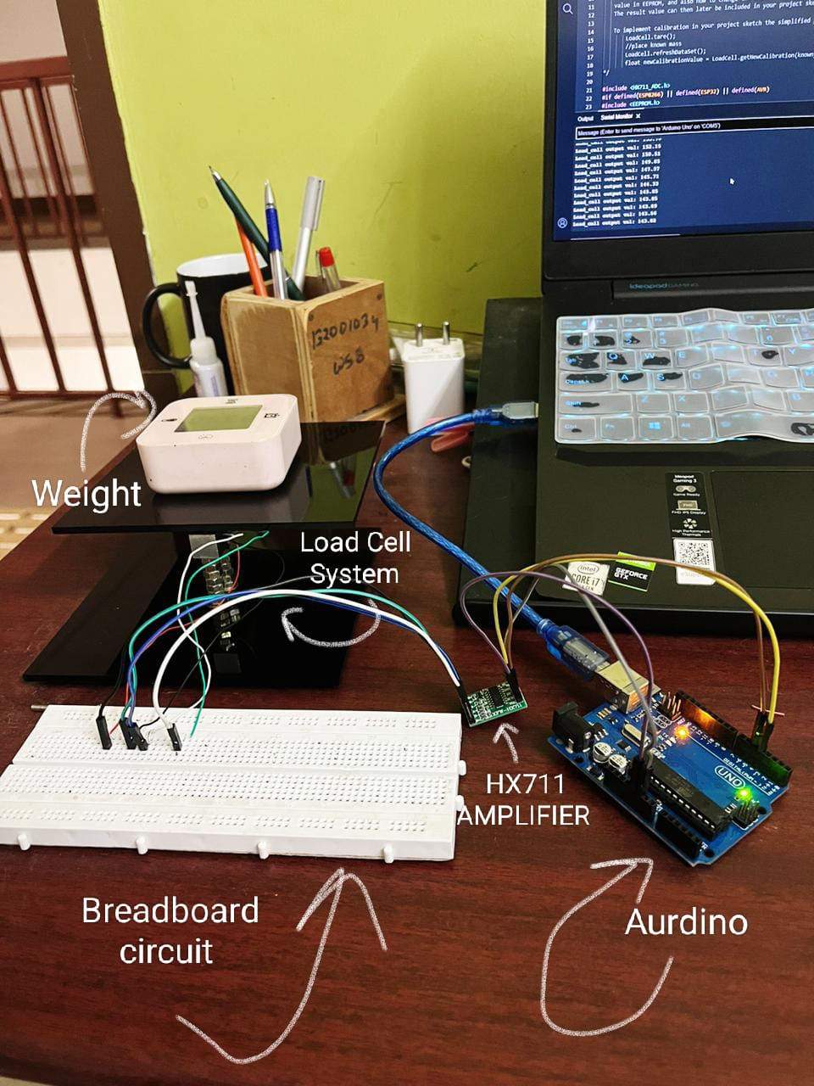
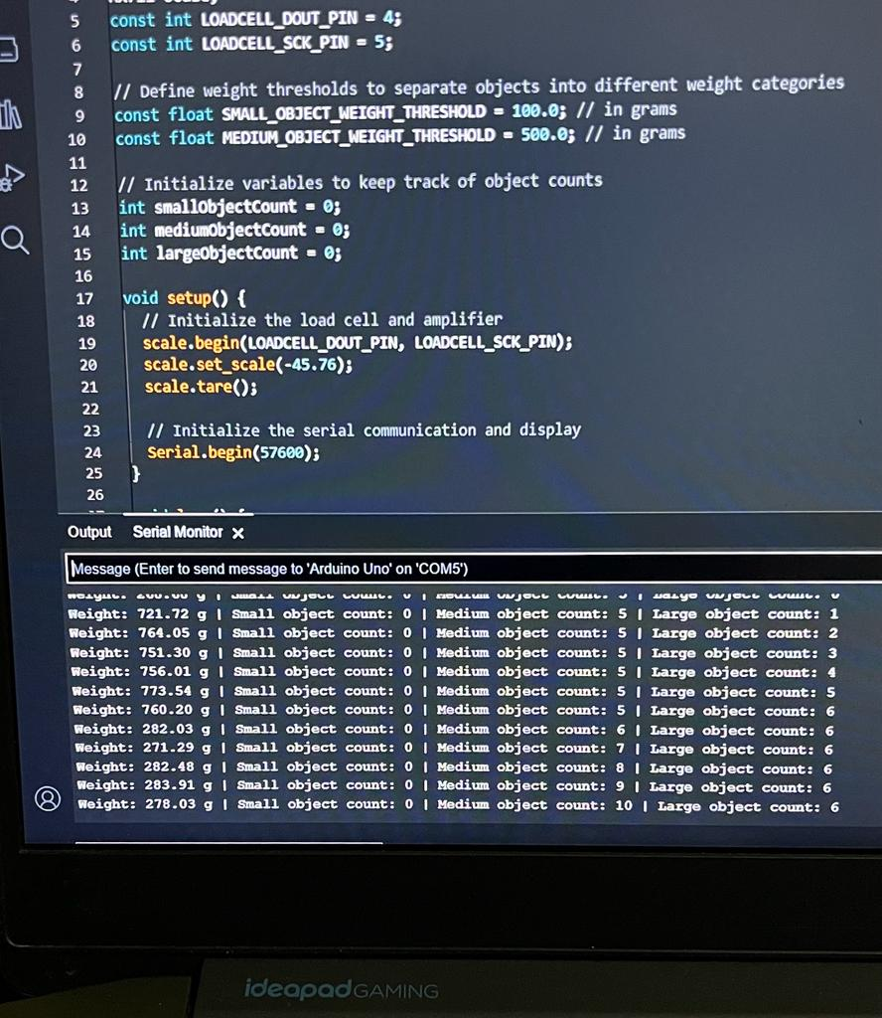
Object Weight Measurement Kept over a conveyer belt
Objectives
Design and implement a system that measure the weight of objects over a conveyer belt and count the objects of different weights separately.
Proposed System
Prototype & Results
Observations:
1. Weigh accurately for >50g
2. For weights <100g, every 10 seconds count of small is increased, and for weight in range 100-500g, medium count is increased, and above 500g count of large is increased
Errors:
1. Percentage error in measuring the weights : 3.69 %
Group No: 12
Members : Shashwat Singh, Saiful Hasan, Vaibhav Mishra, Shyam Nair

