Slide 1

Chapter 12
File Management
Operating Systems:
Internals and Design Principles, 6/E
William Stallings
Patricia Roy
Manatee Community College, Venice, FL
©2008, Prentice Hall
Notes:
‹#›

Slide 2
File Management
File management system consists of system utility programs that run as privileged applications
Concerned with secondary storage
Notes:
‹#›

Slide 3
File System Properties
Long-term existence
Sharable between processes
Structure
Notes:
‹#›

Slide 4
File Operations
Create
Delete
Open
Close
Read
Write
Notes:
‹#›

Slide 5
File Terms
Field
  Basic element of data
  Contains a single value
  Characterized by its length and data type
Record
  Collection of related fields
  Treated as a unit
Notes:
‹#›

Slide 6
File Terms
File
  Collection of similar records
  Treated as a single entity
  Have file names
  May restrict access
Database
  Collection of related data
  Relationships exist among elements
Notes:
‹#›

Slide 7
Typical Operations
Retrieve_All
Retrieve_One
Retrieve_Next
Retrieve_Previous
Notes:
‹#›

Slide 8
Typical Operations
Insert_One
Delete_One
Update_One
Retrieve_Few
Notes:
‹#›

Slide 9
File Management Systems
The way a user or application may access files
Programmer does not need to develop file management software
Notes:
‹#›

Slide 10
Objectives for a File Management System
Meet the data management needs and requirements of the user
Guarantee that the data in the file are valid
Optimize performance
Provide I/O support for a variety of storage device types
Notes:
‹#›

Slide 11
Objectives for a File Management System
Minimize or eliminate the potential for lost or destroyed data
Provide a standardized set of I/O interface routines
Provide I/O support for multiple users
Notes:
‹#›

Slide 12
Minimal Set of Requirements
Each user should be able to create, delete, read, write and modify files
Each user may have controlled access to other users’ files
Each user may control what type of accesses are allowed to the users’ files
Each user should be able to restructure the user’s files in a form appropriate to the problem
Notes:
‹#›

Slide 13
Minimal Set of Requirements
Each user should be able to move data between files
Each user should be able to back up and recover the user’s files in case of damage
Each user should be able to access the user’s files by using symbolic names
Notes:
‹#›

Slide 14
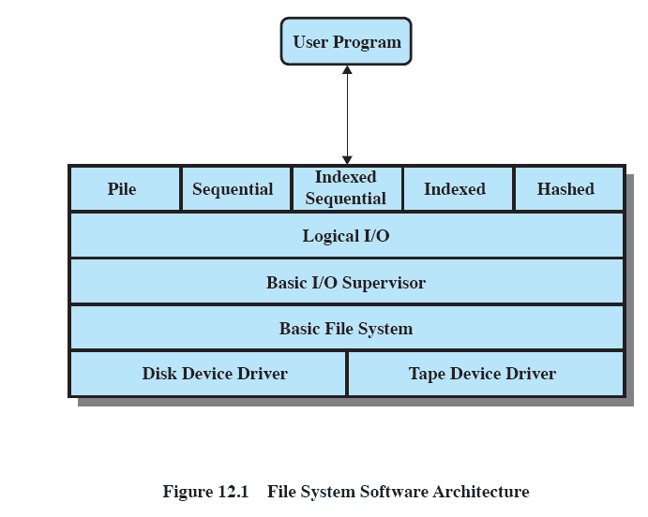
Files System Software Architecture
Notes:
‹#›

Slide 15
Device Drivers
Lowest level
Communicates directly with peripheral devices
Responsible for starting I/O operations on a device
Processes the completion of an I/O request
Notes:
‹#›

Slide 16
Basic File System
Physical I/O
Deals with exchanging blocks of data
Concerned with the placement of blocks
Concerned with buffering blocks in main memory
Notes:
‹#›

Slide 17
Logical I/O
Enables users and applications to access records
Provides general-purpose record I/O capability
Maintains basic data about file
Notes:
‹#›

Slide 18
Access Method
Reflect different file structures
Different ways to access and process data
Notes:
‹#›

Slide 19
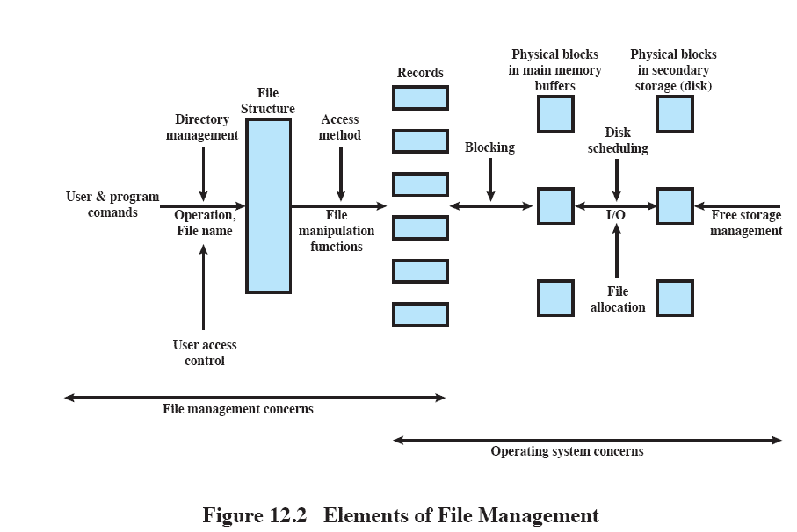
Elements of File Management
Notes:
‹#›

Slide 20
File Management Functions
Identify and locate a selected file
Use a directory to describe the location of all files plus their attributes
On a shared system, describe user access control
Notes:
‹#›

Slide 21
Criteria for File Organization
Short access time
  Needed when accessing a single record
Ease of update
  File on CD-ROM will not be updated, so this is not a concern
Notes:
‹#›

Slide 22
Criteria for File Organization
Economy of storage
  Should be minimum redundancy in the data
  Redundancy can be used to speed access such as an index
Simple maintenance
Reliability
Notes:
‹#›

Slide 23
File Organization
The Pile
  Data are collected in the order they arrive
  Purpose is to accumulate a mass of data and save it
  Records may have different fields
  No structure
  Record access is by exhaustive search
Notes:
‹#›

Slide 24
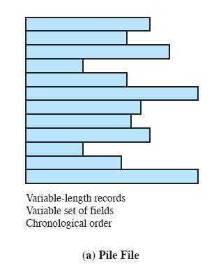
The Pile
Notes:
‹#›

Slide 25
File Organization
The Sequential File
  Fixed format used for records
  Records are the same length
  All fields the same (order and length)
  Field names and lengths are attributes of the file
Notes:
‹#›

Slide 26
File Organization
The Sequential File
  One field is the key filed
    Uniquely identifies the record
    Records are stored in key sequence
Notes:
‹#›

Slide 27
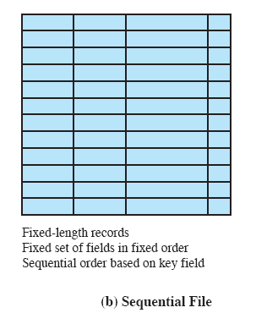
The Sequential File
Notes:
‹#›

Slide 28
File Organization
Indexed Sequential File
  Index provides a lookup capability to quickly reach the vicinity of the desired record
    Contains key field and a pointer to the main file
    Indexed is searched to find highest key value that is equal to or precedes the desired key value
    Search continues in the main file at the location indicated by the pointer
Notes:
‹#›

Slide 29
File Organization
Comparison of sequential and indexed sequential
  Example: a file contains 1 million records
  On average 500,00 accesses are required to find a record in a sequential file
  If an index contains 1000 entries, it will take on average 500 accesses to find the key, followed by 500 accesses in the main file. Now on average it is 1000 accesses
Notes:
‹#›

Slide 30
File Organization
Indexed Sequential File
  New records are added to an overflow file
  Record in main file that precedes it is updated to contain a pointer to the new record
  The overflow is merged with the main file during a batch update
  Multiple indexes for the same key field can be set up to increase efficiency
Notes:
‹#›

Slide 31
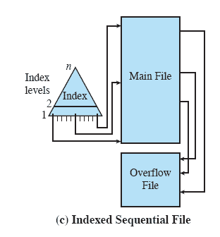
Indexed Sequential File
Notes:
‹#›

Slide 32
File Organization
Indexed File
  Uses multiple indexes for different key fields
  May contain an exhaustive index that contains one entry for every record in the main file
  May contain a partial index
Notes:
‹#›

Slide 33
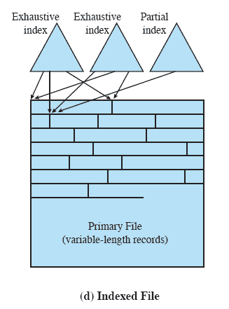
Indexed File
Notes:
‹#›

Slide 34
File Organization
The Direct or Hashed File
  Directly access a block at a known address
  Key field required for each record
Notes:
‹#›

Slide 35
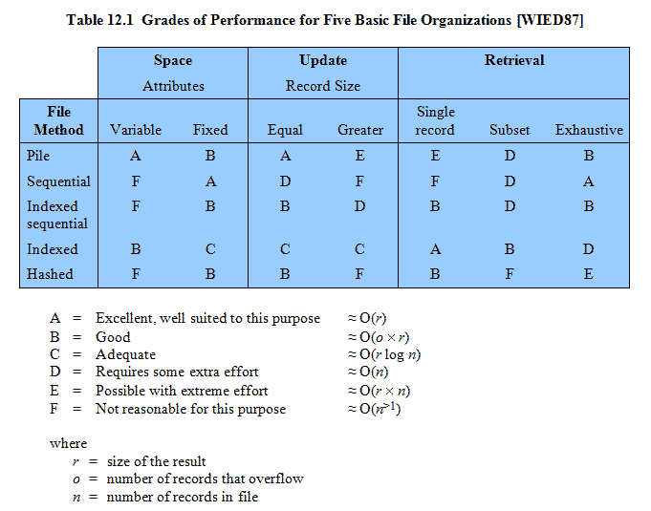
Performance
Notes:
‹#›

Slide 36
File Directories
Contains information about files
  Attributes
  Location
  Ownership
Directory itself is a file owned by the operating system
Provides mapping between file names and the files themselves
Notes:
‹#›

Slide 37
Simple Structure for a Directory
List of entries, one for each file
Sequential file with the name of the file serving as the key
Provides no help in organizing the files
Forces user to be careful not to use the same name for two different files
Notes:
‹#›

Slide 38
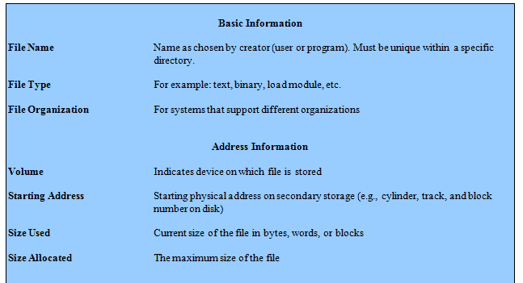
Information Elements of a File Directory
Notes:
‹#›

Slide 39
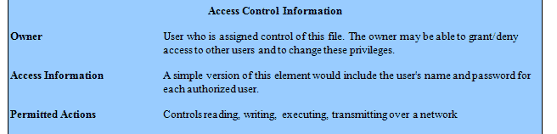
Information Elements of a File Directory
Notes:
‹#›

Slide 40
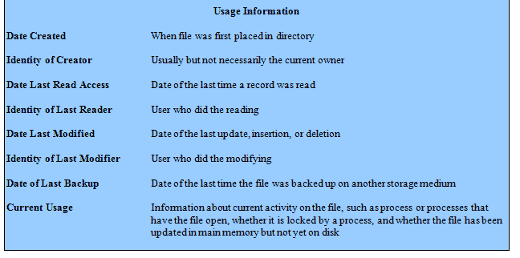
Information Elements of a File Directory
Notes:
‹#›

Slide 41
Two-Level Scheme for a Directory
One directory for each user and a master directory
Master directory contains entry for each user
  Provides address and access control information
Notes:
‹#›

Slide 42
Two-Level Scheme for a Directory
Each user directory is a simple list of files for that user
Still provides no help in structuring collections of files
Notes:
‹#›

Slide 43
Hierarchical, or Tree-Structured Directory
Master directory with user directories underneath it
Each user directory may have subdirectories and files as entries
Notes:
‹#›

Slide 44
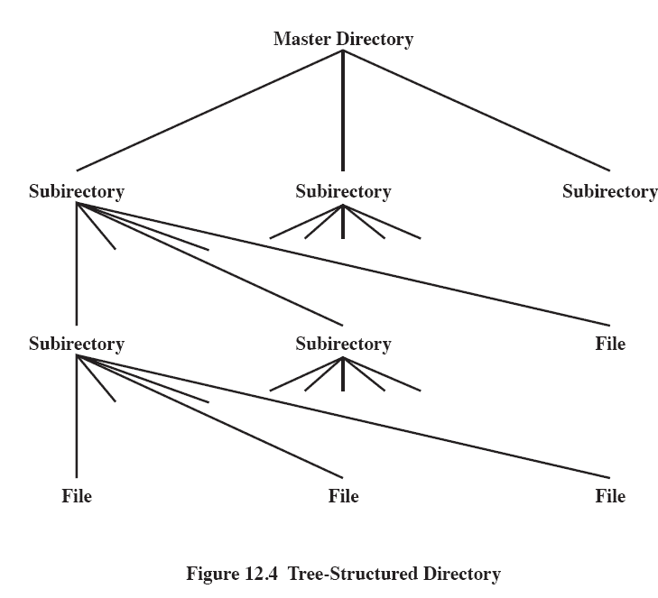
Tree-Structured Directory
Notes:
‹#›

Slide 45
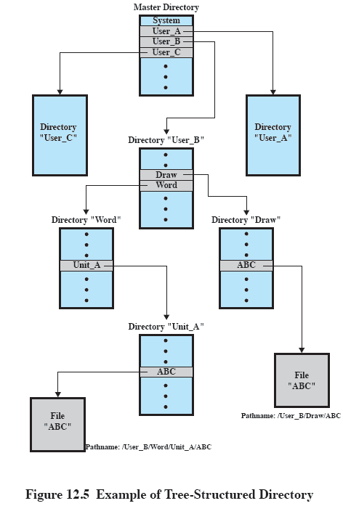
Example of Tree-Structured Directory
Notes:
‹#›

Slide 46
Hierarchical, or Tree-Structured Directory
Files can be located by following a path from the root, or master, directory down various branches
  This is the pathname for the file
Can have several files with the same file name as long as they have unique path names
Notes:
‹#›

Slide 47
Hierarchical, or Tree-Structured Directory
Current directory is the working directory
Files are referenced relative to the working directory
Notes:
‹#›

Slide 48
File Sharing
In multiuser system, allow files to be shared among users
Two issues
  Access rights
  Management of simultaneous access
Notes:
‹#›

Slide 49
Access Rights
None
  User may not know of the existence of the file
  User is not allowed to read the user directory that includes the file
Knowledge
  User can only determine that the file exists and who its owner is
Notes:
‹#›

Slide 50
Access Rights
Execution
  The user can load and execute a program but cannot copy it
Reading
  The user can read the file for any purpose, including copying and execution
Appending
  The user can add data to the file but cannot modify or delete any of the file’s contents
Notes:
‹#›

Slide 51
Access Rights
Updating
  The user can modify, deleted, and add to the file’s data. This includes creating the file, rewriting it, and removing all or part of the data
Changing protection
  User can change access rights granted to other users
Deletion
  User can delete the file
Notes:
‹#›

Slide 52
Access Rights
Owners
  Has all rights previously listed
  May grant rights to others using the following classes of users
    Specific user
    User groups
    All for public files
Notes:
‹#›

Slide 53
Simultaneous Access
User may lock entire file when it is to be updated
User may lock the individual records during the update
Mutual exclusion and deadlock are issues for shared access
Notes:
‹#›

Slide 54
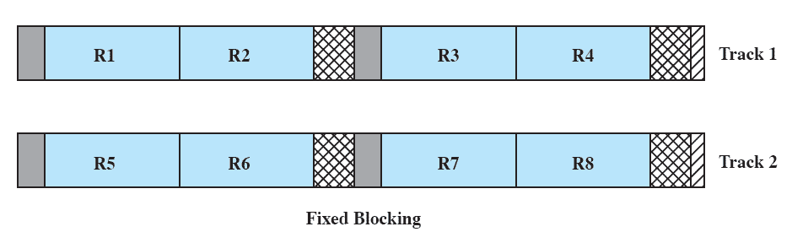
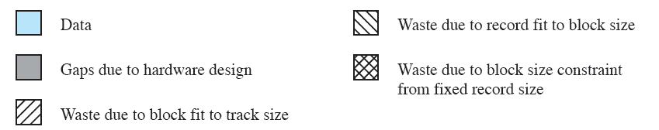
Fixed Blocking
Notes:
‹#›

Slide 55
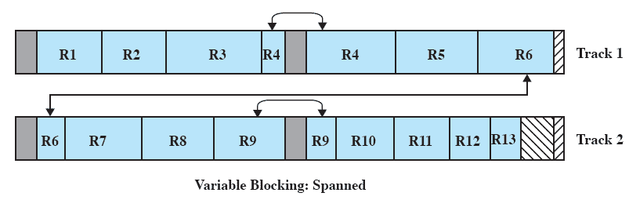
Variable Blocking: Spanned
Notes:
‹#›

Slide 56
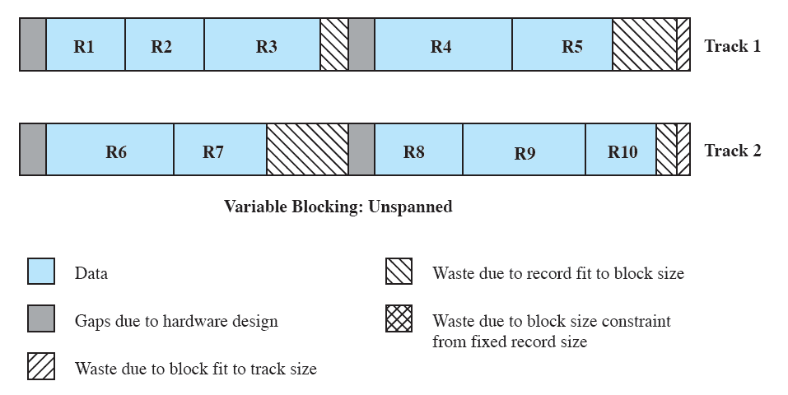
Variable Blocking: Unspanned
Notes:
‹#›

Slide 57
Secondary Storage Management
Space must be allocated to files
Must keep track of the space available for allocation
Notes:
‹#›

Slide 58
Preallocation
Need the maximum size for the file at the time of creation
Difficult to reliably estimate the maximum potential size of the file
Tend to overestimate file size so as not to run out of space
Notes:
‹#›

Slide 59
Contiguous Allocation
Single set of blocks is allocated to a file at the time of creation
Only a single entry in the file allocation table
  Starting block and length of the file
External fragmentation will occur
  Need to perform compaction
Notes:
‹#›

Slide 60
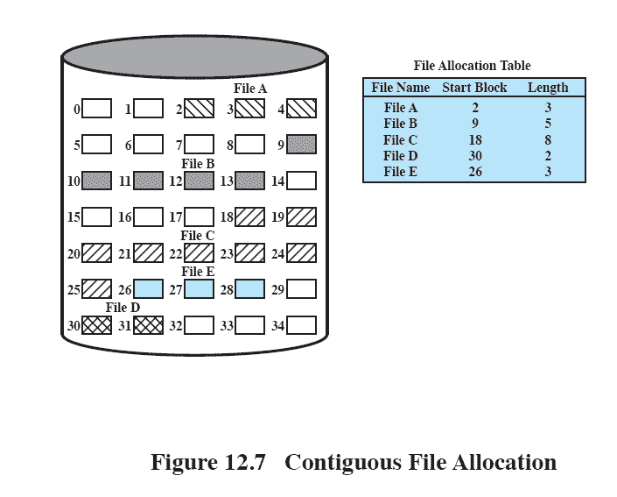
Contiguous File Allocation
Notes:
‹#›

Slide 61
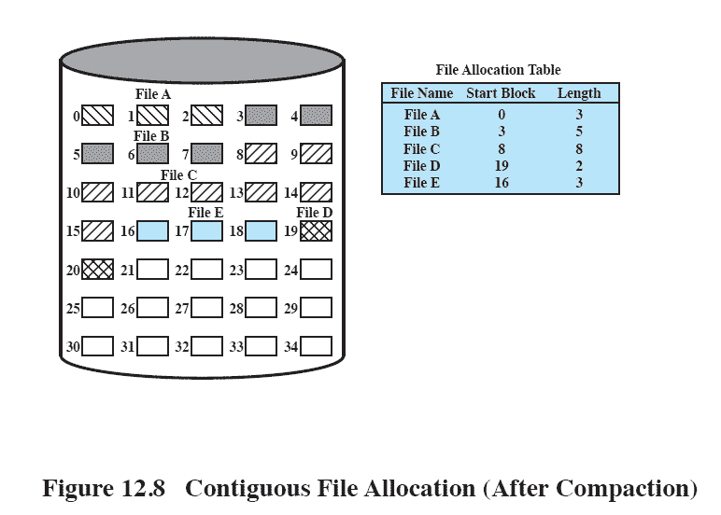
Contiguous File Allocation
Notes:
‹#›

Slide 62
Chained Allocation
Allocation on basis of individual block
Each block contains a pointer to the next block in the chain
Only single entry in the file allocation table
  Starting block and length of file
Notes:
‹#›

Slide 63
Chained Allocation
No external fragmentation
Best for sequential files
No accommodation of the principle of locality
Notes:
‹#›

Slide 64
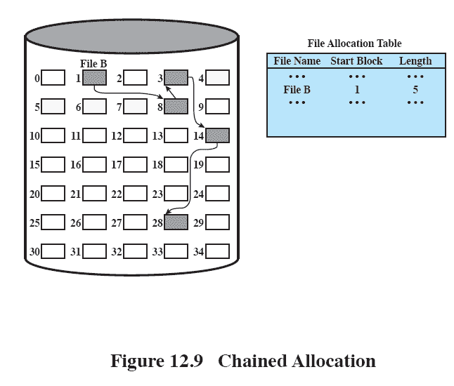
Chained Allocation
Notes:
‹#›

Slide 65
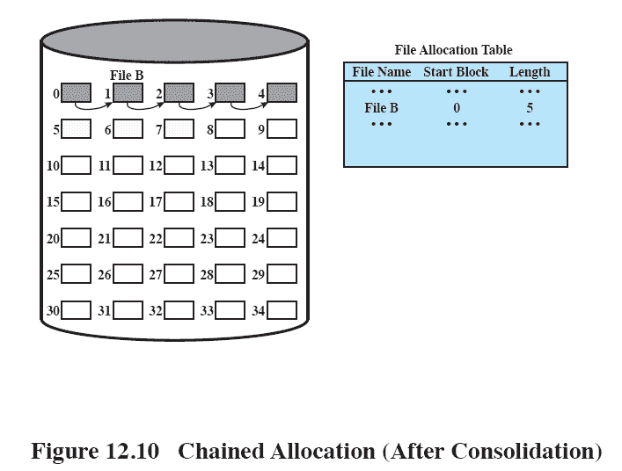
Chained Allocation
Notes:
‹#›

Slide 66
Indexed Allocation
File allocation table contains a separate one-level index for each file
The index has one entry for each portion allocated to the file
The file allocation table contains block number for the index
Notes:
‹#›

Slide 67
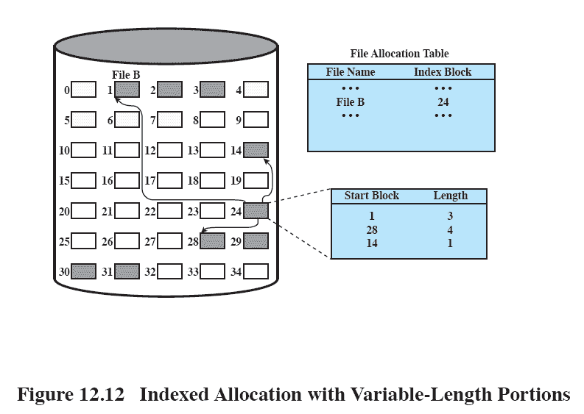
Indexed Allocation
Notes:
‹#›

Slide 68
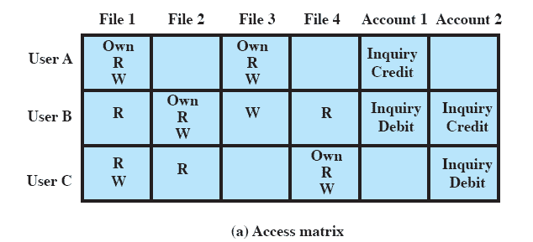
Access Matrix
Notes:
‹#›

Slide 69
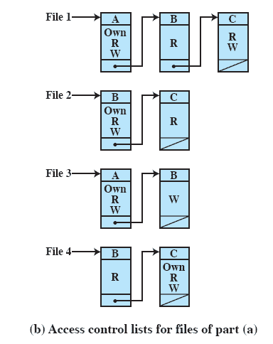
Access Control List
Notes:
‹#›

Slide 70
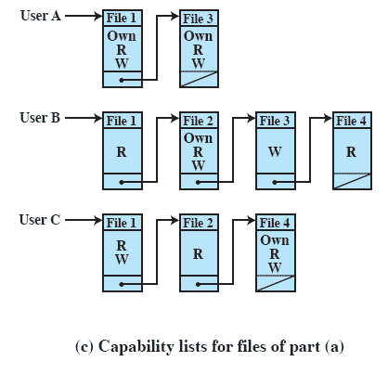
Capability Lists
Notes:
‹#›

