Slide 1
Module-2
IoT Network Architecture and
Design

Slide 2
This chapter explores the following areas
Drivers Behind New Network Architectures
Comparing IoT Architectures
A Simplified IoT Architecture
The Core IoT Functional Stack
IoT Data Management and Compute Stack

Slide 3
Drivers Behind New Network Architectures
To implement any networking concepts designing and understanding the network architecture is of utmost importance.
The difference between IT and IoT networks is much like the difference between residential architecture and stadium architecture.

Slide 4
The key difference between IT and IoT is the data.
While IT systems are mostly concerned with reliable and continuous support of business applications such as email, web, databases and so on.
IoT is all about the data generated by sensors and how that data is used.
The essence of IoT architectures thus involves how the data is transported, collected, analyzed, and ultimately acted upon.

Slide 5
IOT ARCHITECTURAL DRIVERS
Scale
Security
Constrained Devices and Networks
Data
Legacy Device Support

Slide 6
i. Scale
The scale of a typical IT network is on the order of several thousand devices—typically printers, mobile wireless devices, laptops, servers, and so on.
But when a scale of a network goes from a few thousand endpoints to a few millions the IT engineers lack a required skills to design a network that is intended to support millions of routable IP endpoints.

Slide 7
ii. Security
The frequency and impact of cyber attacks in recent years has increased dramatically. Protecting corporate data from intrusion and theft is one of the main functions of the IT department.
IoT systems require consistent mechanisms of authentication, encryption, and intrusion prevention techniques that understand the behaviour of industrial protocols and can respond to attacks on critical infrastructure

Slide 8
ii. Security
For optimum security, IoT systems must:
Be able to identify and authenticate all entities involved in the IoT service(i.e., gateways, endpoint devices, home networks, roaming networks, service platforms)
Ensure that all endpoint device encrypted
user data shared between the and
back-end applications is

Slide 9
Constrained Devices and Networks
Most IoT sensors are designed for a single job, and they are typically small and inexpensive. This means they often have limited power, CPU, and memory, and they transmit only when there is something important.
If an IT network has performance constraints, the solution is simple: Upgrade to a faster network.
If too many devices are on one VLAN and are impacting performance, we can simply carve out a new VLAN and continue to scale as much as we need.

Slide 10
iv. Data
IoT devices generate a mountain of data. In general, most IT shops don’t really care much about the unstructured chatty data generated by devices on the network.
However, in IoT the data is like gold, as it is what enables businesses to deliver new IoT services that enhance the customer experience, reduce cost, and deliver new revenue opportunities

Slide 11
iv. Data
Although most IoT-generated data is unstructured, the insights it provides through analytics can revolutionize processes and create new business models.
For ex :
Imagine a smart city with a few hundred thousand smart streetlights, all connected through an IoT network.
However, when all this data is combined, it can become difficult to manage and analyze effectively.

Slide 12
v. Legacy Device Support
Supporting legacy devices in an IT organization is not usually a big problem. If someone’s computer or operating system is outdated, she simply upgrades. If someone is using a mobile device with an outdated Wi-Fi standard, such as 802.11b or 802.11g, we can simply deny him access to the wireless network, and he will be forced to upgrade.
In OT systems, end devices are likely to be on the network for a very long time—sometimes decades.
As IoT networks are deployed, they need to support the older devices already present on the network, as well as devices with new capabilities.

Slide 13
In many cases, legacy devices are so old that they don’t even support IP.
For ex :
A factory may replace machines only once every 20 years—or
perhaps even longer!
It does not want to upgrade multi-million-dollar machines just so it can connect them to a network for better visibility and control.
However, many of these legacy machines might support older protocols, such as serial interfaces, and use RS-232.
In this case, the IoT network must either be capable of some type of protocol translation or use a gateway device to connect these legacy endpoints to the IoT network

Slide 14
Comparing IoT Architectures
In the past several years, architectural frameworks have emerged to address the challenge of designing massive-scale IoT networks
The foundational concept in all these architectures is supporting data, process, and the functions that endpoint devices perform.
Two of the best-known architectures
oneM2M
IoT World Forum (IoTWF)

Slide 15
The oneM2M IoT Standardized Architecture
European Telecommunications Standards Institute (ETSI) created the M2M Technical Committee in 2008.
The goal of this committee was to
create a common architecture that would help accelerate the adoption of M2M applications and devices.

Slide 16
In 2012 launched oneM2M as a global initiative designed to promote efficient M2M communication systems and IoT.
create a readily
common services layer, which can be embedded in field devices to
allow
communication with application servers.
One of the greatest challenges in designing an IoT architecture is dealing with the heterogeneity of devices, software, and access methods.

Slide 17
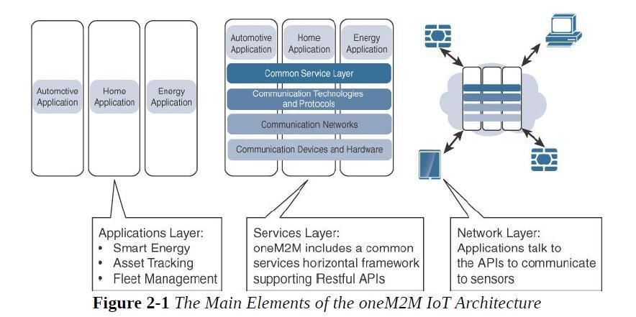

Slide 18
The oneM2M architecture divides IoT functions into three major domains: the application layer, the services layer, and the network layer.
Let’s examine each of these domains in turn:
Applications layer
The oneM2M architecture gives major attention to connectivity between devices and their applications.
This domain includes the
application-layer standardize API with business
protocols and attempts to
definitions for interaction
intelligence (BI) systems.

Slide 19
Services layer
This layer is shown as a horizontal framework across the vertical industry applications.
At this layer, horizontal modules include the physical network that the IoT applications run on, the underlying management protocols, and the hardware.

Slide 20
iii. Network Layer
This is the communication domain for the IoT devices and endpoints.
It includes the devices themselves and the communications network that links them.
the communications infrastructure include wireless mesh technologies, such as IEEE 802.15.4, and wireless point-to-multipoint systems, such as IEEE 801.11
Also included are wired device connections, such as IEEE 1901 power line communications.

Slide 21
The IoT World Forum (IoTWF) Standardized Architecture
In 2014 the IoTWF architectural committee (led by Cisco, IBM, Rockwell Automation, and others) published a seven- layer IoT architectural reference model.
visualizing IoT from a technical perspective.
Each of the seven layers is broken down into specific functions, and security encompasses the entire model.
Figure 2.2 details the IoT reference model published by the IoTWF

Slide 22
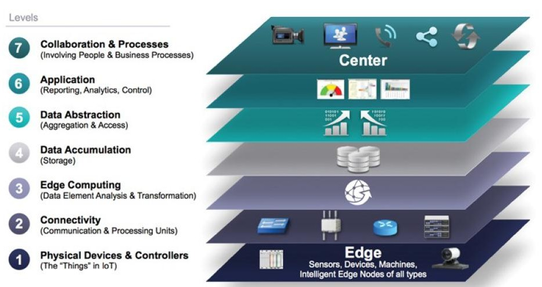
Figure 2.2 : IoT Reference Model Published by the IoT World Forum

Slide 23
Using this reference model, we are able to achieve the following:
Decompose the IoT problem into smaller parts
Identify different technologies at each layer and how they relate to one another
Define a system in which different parts can be provided by different vendors
Have a process of defining interfaces that leads to interoperability
Define a tiered security model that is enforced at the transition points between levels

Slide 24
Layer 1: Physical Devices and Controllers Layer
This layer is home to the “things” in the Internet of Things
including the various endpoint devices and sensors that send and receive information.
The size of these “things” can range from almost
microscopic sensors to giant machines in a factory.
Their primary function is generating data and being capable of being queried and/or controlled over a network.

Slide 25
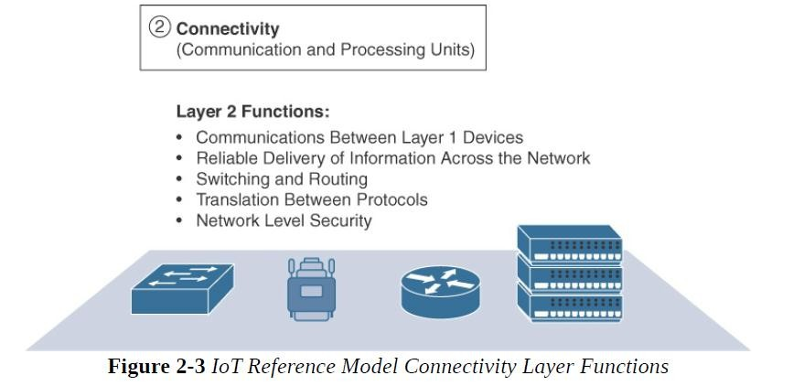
Layer 2: Connectivity Layer
the focus is on connectivity.
The most important function of this IoT layer is the
reliable and timely transmission of data.

Slide 26
Layer 3: Edge Computing
Edge computing is often referred to as the “fog” layer
At this layer, the emphasis is on data reduction and converting network data flows into information that is ready for storage and processing by higher layers.
One of the basic principles of this reference model is that information processing is initiated as early and as close to the edge of the network as possible

Slide 27
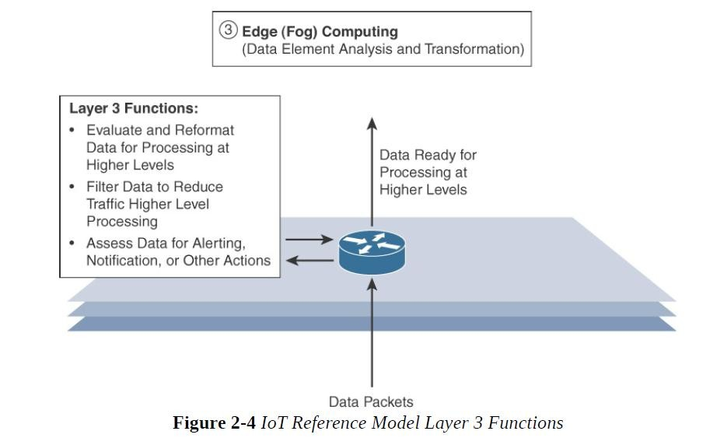

Slide 28
Upper Layers: Layers 4–7
The upper layers deal with handling and processing the IoT
data generated by the bottom layer.
IoT Reference Model Layer
Functions
Layer 4 : Data Accumulation Layer
Captures data and stores it so it usable by applications when necessary. Converts event-based data to query based processing.
Layer 5: Data Abstraction Layer
Reconciles multiple data formats and ensures consistent semantics from various sources. Confirms that the data set is complete and consolidates data into one place or multiple data stores using visualization.
Layer 6: Applications Layer
Interprets data using software applications. Applications may monitor, control and provide reports based on the analysis of the data.
Layer 7: Collaboration and
processes layer
Consumes and shares the application information.
Collaboration on and communicating IoT information often requires multiple steps and it is what makes IoT useful. This layer can change business processes and delivers benefits of IoT

Slide 29
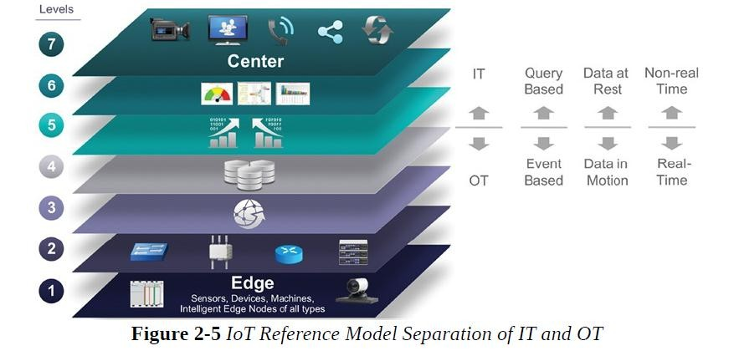
IT and OT Responsibilities in the IoT Reference Model

Slide 30
The bottom of the stack is generally in the domain of OT.
For an industry like oil and gas, this includes sensors and devices connected to pipelines, oil rigs, refinery machinery, and so on.
The top of the stack is in the IT area and includes things like the servers, databases, and applications, all of which run on a part of the network controlled by IT.

Slide 31
At the bottom, in the OT layers, the devices generate real-time data at their own rate
data has to be buffered or stored at certain points within the IoT stack.
Layering data management in this way throughout the stack helps the top four layers handle data at their own speed.

Slide 32
the real-time “data in motion” close to the edge has to be organized and stored so that it becomes “data at rest” for the applications in the IT tiers.
The IT and OT organizations need to work together for overall data management.

Slide 33
Additional IoT Reference Models
Purdue model for control Hierarchy
Industrial Internet Reference Architecture(IIRA) by Industrial Internet Consortium(IIC)
Internet of Things-Architecture(IoT-A)

Slide 34
A Simplified IoT Architecture
we can describe an IoT framework that highlights the fundamental building blocks that are common to most IoT systems and which is intended to help you in designing an IoT network.
This framework is presented as two parallel stacks:
The IoT Data Management and Compute Stack
The Core IoT Functional Stack

Slide 35
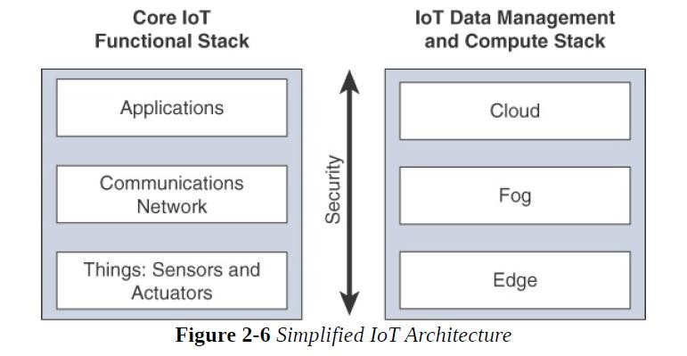
A Simplified IoT Architecture

Slide 36
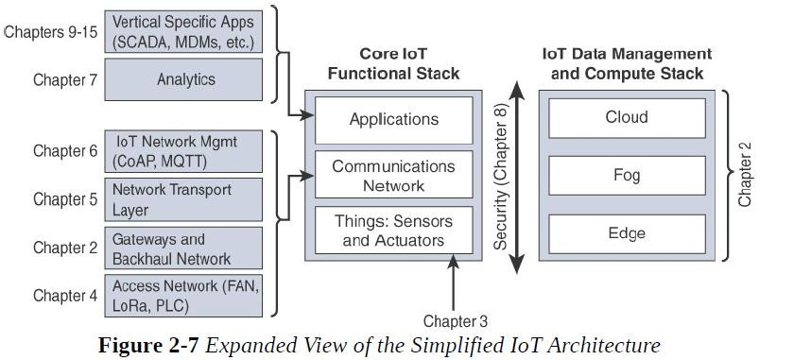

Slide 37
The Core IoT Functional Stack
IoT networks are built around the concept of “things,” or smart objects performing functions and delivering new connected services.
These objects are “smart” because they use a combination of contextual information and configured goals to perform actions.
“thing” interacts with an external system to report information that the smart object collects, to exchange with other objects, or to interact with a management platform.

Slide 38
From an architectural standpoint, several components have to work together for an IoT Network to be operational
“Things” layer
Communications network layer
Access network sublayer
Gateways and backhaul network sublayer
Network transport sublayer
IoT network management sublayer
Application and analytics layer

Slide 39
Layer 1: Things: Sensors and
Actuators Layer
Most IoT networks start from the object, or “thing,” that needs to be connected.
From an architectural standpoint, the variety of smart object types, shapes, and needs drive the variety of IoT protocols and architectures.

Slide 40
Battery-powered or power-connected
Mobile or static
Low or high reporting frequency
Simple or rich data
Report range
Object density per cell

Slide 41
Battery-powered or power-connected
This classification is based on whether the object carries its own energy supply or receives continuous power from an external power source.
Battery-powered things can be moved more easily than line- powered objects.
Batteries limit the lifetime and amount of energy that the object is allowed to consume, thus driving transmission range and frequency

Slide 42
Mobile or static:
This classification is based on whether the “thing”
should move or always stay at the same location.
A sensor may be mobile because it is moved from one object to another or because it is attached to a moving object
The frequency of the movement may also vary, from
occasional to permanent.

Slide 43
Low or high reporting frequency
This classification is based on how often the object
should report monitored parameters.
A rust sensor may report values once a month.
A motion sensor may report acceleration hundred times per second.
several
Higher frequencies drive higher energy consumption

Slide 44
Simple or rich data
This classification is based on the quantity of data exchanged
at each report cycle.
A humidity sensor in a field may report a simple daily index and while an engine
sensor may report hundreds of parameters, from temperature
to pressure, gas velocity etc.
Richer data typically drives higher power consumption.

Slide 45
Report range
This classification is based on the distance at which the
gateway is located.
Object density per cell
This classification is based on the number of smart objects over a given area, connected to the same gateway

Slide 46
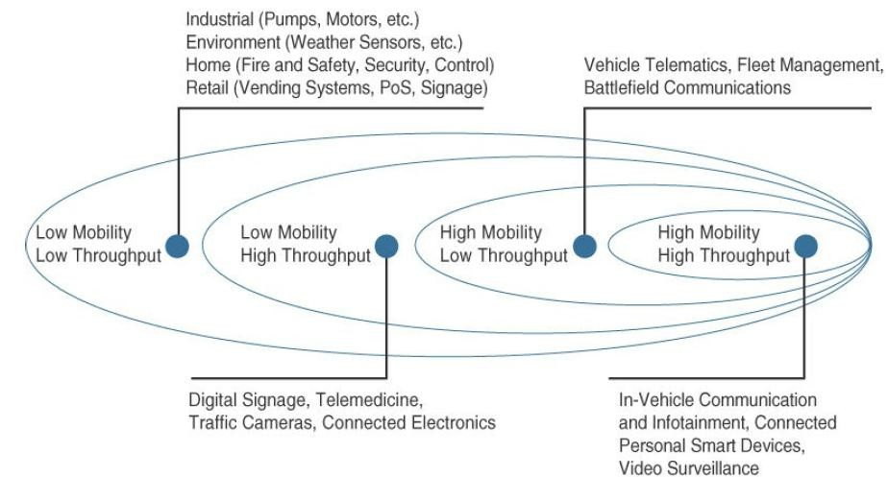
Figure 2.8: Example of Sensor Applications Based on Mobility and Throughput

Slide 47
Layer 2: Communications Network Layer
When smart objects are not self contained, they need to communicate with an external system. In many cases, this communication uses a wireless technology. This layer has four sublayers:
Access Network Sublayer
Gateways and backhaul network sublayer
Network transport sublayer
IoT network management sublayer

Slide 48
i. Access Network Sublayer
There is a direct relationship between the IoT network technology we choose and the type of connectivity topology this technology allows
Each technology was designed with a certain number of
use cases in mind
what to connect, where to connect, how much data to transport at
what interval and over what distance.

Slide 49
As IoT continues to grow exponentially, we will encounter a wide variety of applications and special use cases.
For each of them, an access technology will be required. IoT sometimes reuses existing access technologies whose characteristics match more or less closely the IoT use case requirements.
One key parameter determining the choice of access technology is the range between the smart object and the information collector.

Slide 50
Figure 2.9 lists some access technologies we may encounter in the IoT world and the expected transmission distances.
Range estimates are grouped by category names that illustrate the environment or the vertical where data collection over that range is expected.
Common groups are as follows:
PAN (personal area network): Scale of a few meters. This is the personal space around a person. A common wireless technology for this scale is Bluetooth.
HAN (home area network): Scale of a few tens of meters. At this scale, common wireless technologies for IoT include ZigBee and Bluetooth Low Energy

Slide 51
NAN (neighbourhood area network): Scale of a few hundreds of meters. The term NAN is often used to refer to a group of house units from which data is collected.
FAN (field area network): Scale of several tens of meters to several hundred meters. FAN typically refers to an outdoor area larger than a single group of house units.
LAN (local area network): Scale of up to 100 m. This term is very common in networking, and it is therefore also commonly used in the IoT space when standard networking technologies (such as Ethernet or IEEE 802.11) are used.

Slide 52
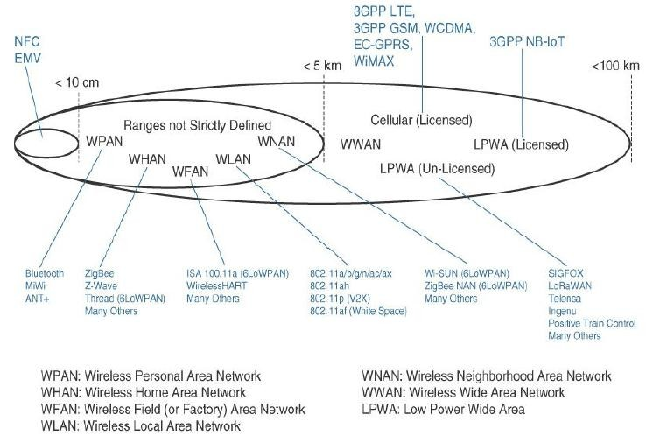
Figure 2.9 : Access Technologies and Distances

Slide 53
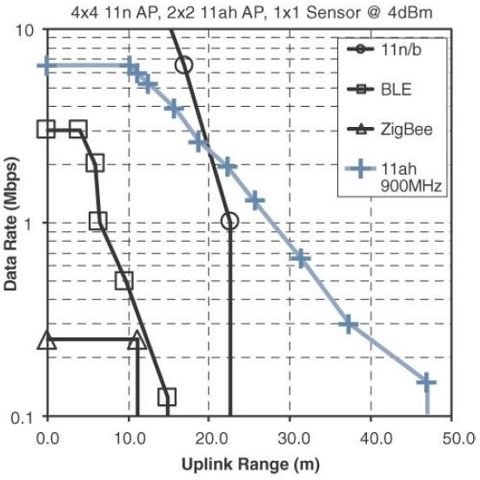
Figure 2.10 demonstrates four technologies representing WHAN to WLAN ranges and compares the throughput and range that can be achieved in each case.
Figure 2.10 : Range Versus Throughput for Four WHAN to WLAN Technologies

Slide 54
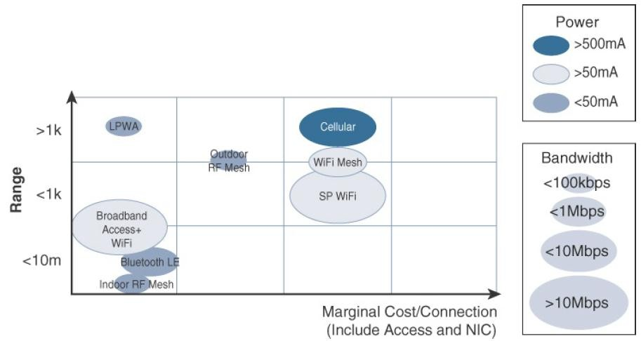
Figure 2.11 combines cost, range, power consumption, and typical available bandwidth for common IoT access technologies.
Figure 2.11 : Comparison Between Common Last-Mile Technologies in Terms of
Range Versus Cost, Power, and Bandwidth

Slide 55
Communication topologies:
Some technologies offer flexible connectivity structure to extend communication possibilities
Point-to-point topologies:
These topologies allow one point to communicate with another point.
several technologies are referred to as “point-to-point” when each object establishes an individual session with the gateway

Slide 56
Point-to-multipoint topologies:
These topologies allow one point to communicate with more than one other point.
Most IoT technologies where one or more than one gateways communicate with multiple smart objects are in this category

Slide 57
To form a network, a device needs to connect with another device.
When both devices fully implement the protocol stack functions,
they can form a peer-to peer network.
The sensor which can implement a subset of protocol functions to perform just a specialized part (communication with the coordinator). Such a device is called a reduced-function device (RFD).

Slide 58
An RFD cannot be a coordinator. An RFD also cannot implement direct communications to another RFD.
The coordinator that implements the full network functions is called, by contrast, a full-function device (FFD).

Slide 59
An FFD can communicate directly with another FFD or with more than one FFD, forming multiple peer-to-peer connections.
Topologies where each FFD has a unique path to another FFD are called cluster tree topologies. FFDs in the cluster tree may have RFDs, resulting in a cluster star topology.
Figure 2.12 illustrates these topologies
Other point-to-multipoint technologies allow a node to have more than one path to another node, forming a mesh topology.

Slide 60
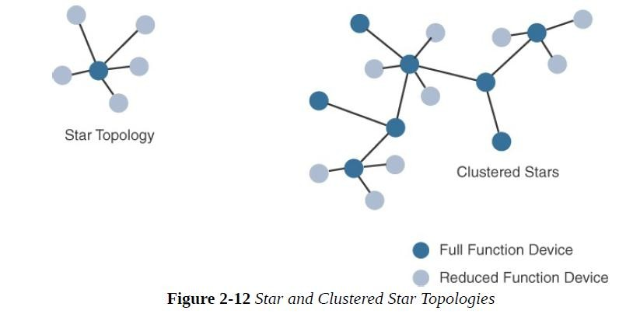

Slide 61
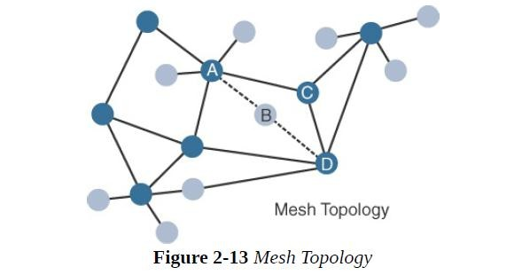
Figure 2.13 shows a mesh topology.
Nodes A and D are too far apart to communicate directly. In this case, communication can be relayed through nodes B or C. Node B may be used as the primary relay

Slide 62
Gateways and Backhaul Sublayer
Data collected from a smart object may need to be forwarded
to a central station where data is processed.
As this station is often in a different location from the smart object, data directly received from the sensor through an access technology needs to be forwarded to another medium (the backhaul) and transported to the central station.
Ex: A dedicated short-range communication (DSRC) allows vehicle-to-vehicle and vehicle-to-infrastructure communication.

Slide 63
is in charge of this inter-medium
The gateway
communication.
In most cases, the smart objects are static or mobile within a limited area.
The gateway is often static. However, some IoT technologies
do not apply this model.
When the smart object’s operation is controlled from a local site, and when the environment is stable (for example, factory or oil and gas field), Ethernet can be used as a backhaul.
WiMAX (802.16) is an example of a longer-range technology. WiMAX can achieve ranges of up to 50 kilometers with rates of up to 70 Mbps

Slide 64
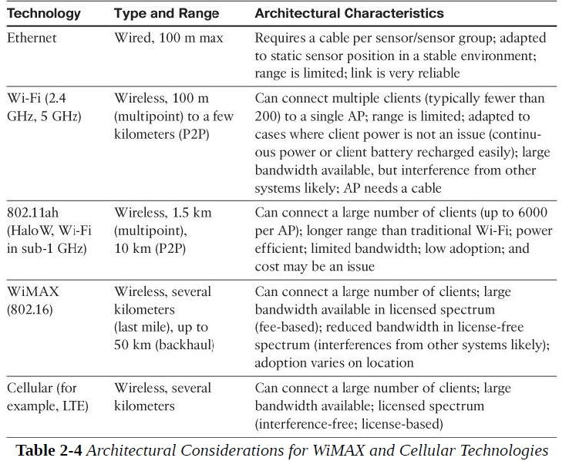

Slide 65
Network Transport Sublayer
We know that a hierarchical communication architecture in which a series of smart objects report to a gateway that conveys the reported data over another medium and up to a central station.
However, practical implementations are often flexible, with
multiple transversal communication paths

Slide 66
communication structure involve
peer-to-peer
point-to-point
point-to-multipoint (gateway or head-end)
unicast and multicast communications update to one or multiple systems)
(software

Slide 67
communication occurs over multiple media
For ex: power lines inside our house or a short- range wireless system like indoor Wi-Fi and/or ZigBee
a longer-range wireless system to the gateway, and yet another wireless or wired medium for backhaul transmission.
To allow for such communication structure, a network protocol with specific characteristics needs to be implemented.

Slide 68
The protocol needs to be open and standard-based to
accommodate multiple industries and multiple media.
Scalability (to accommodate thousands or millions of sensors in a single network) and security are also common requirements.
IP is a protocol that matches all these requirements.
The flexibility of IP allows this protocol to be embedded in objects of very different natures, exchanging information over very different media, including low-power, lossy, and low-bandwidth networks.

Slide 69
Finally, the transport layer protocols built above IP (UDP
and TCP) can easily be leveraged to decide whether the network should control the data packet delivery (with TCP) or whether the control task should be left to the application (UDP).

Slide 70
IoT Network Management Sublayer
IP, TCP, and UDP bring connectivity to IoT networks.
Upper-layer protocols need to take care of data transmission between the smart objects and other systems.
Multiple protocols have been created to solve IoT data communication problems.
Some networks depends on a push model and some other networks depends on a pull model

Slide 71
some IoT implementers have suggested HTTP
which has a client and server component.
But HTTP is something of a fat protocol and was not designed to operate in constrained environments with low memory, low power, low bandwidth, and a high rate of packet failure.

Slide 72
Despite these limitations, other web- derived protocols have been suggested for the IoT space.
One example is WebSocket.
WebSocket is part of the HTML5 specification, and provides a simple bidirectional connection over a single connection

Slide 73
WebSocket is often combined with other protocols, such as MQTT to handle the IoT-specific part of the communication.
With the same logic of reusing well-known methods, Extensible Messaging and Presence Protocol (XMPP) was created.
XMPP is based on instant messaging and presence.
It allows the exchange of data between two or more systems and supports presence and contact list maintenance

Slide 74
To respond to the limits of web-based protocols, another
protocol was
created by the IETF
(CoRE) working
Constrained Restful
Environments
group: Constrained
Application Protocol (CoAP).
CoAP uses some methods similar to those of HTTP (such as Get, Post, Put, and Delete) but implements a shorter list, thus limiting the size of the header.
CoAP also runs on UDP (whereas HTTP typically uses TCP). CoAP also adds a feature that is lacking in HTTP and very useful for IoT.
Another common IoT protocol utilized in these middle to upper layers is Message Queue Telemetry Transport (MQTT).

Slide 75
MQTT uses a broker-based architecture.
The sensor can be set to be an MQTT publisher (publishes a piece of information),
the application that needs to receive the information can be set as the MQTT subscriber, and
any intermediary system can be set as a broker to relay the information between the publisher and the subscriber(s).
MQTT runs over TCP. A consequence of the reliance on TCP is that an MQTT client typically holds a connection open to the broker at all times.

Slide 76
Layer 3: Applications and Analytics Layer
Once connected to a network, our smart objects exchange information with other systems.
As soon as our IoT network spans more than a few sensors, the power of the Internet of Things appears in the applications that make use of the information exchanged with the smart objects
From an architectural standpoint, basic classification can be as follows:
Analytics Versus Control Applications
Data Versus Network Analytics

Slide 77
Analytics Versus Control Applications
Multiple applications can help increase the efficiency of an IoT network.
Each application collects data and provides a range of functions based on analysing the collected data.
Analytics Application
Control Application

Slide 78
Analytics Application
This type of application collects data from multiple smart objects, processes the collected data, and displays information resulting from the data that was processed.
The display can be about any aspect of the IoT network, from historical reports, statistics, or trends to individual system states.
Control Application
This type of application controls the behaviour of the smart object or the behaviour of an object related to the smart object.
For ex : a pressure sensor may be connected to a pump

Slide 79
An example of control system architecture is SCADA.
SCADA was developed as a universal method to
access remote systems and send instructions.
One example where SCADA is widely used is in the control and monitoring of remote terminal units (RTUs) on the electrical distribution grid.

Slide 80
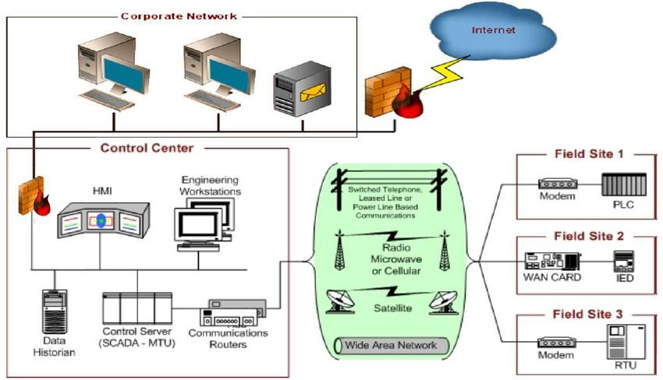
SUPERVISORY CONTROL AND DATA ACQUISITION (SCADA)

Slide 81
Data Versus Network Analytics
Data analytics:
This type of analytics processes the data collected by smart objects and combines it to provide an intelligent view related to the IoT system.
Network analytics:
Most IoT systems are built around smart objects connected to the network
A loss or degradation in connectivity is likely to affect the efficiency of the system. Such a loss can have dramatic effects.

Slide 82
IoT Data Management and Compute Stack
The massive scale of IoT networks is fundamentally driving new architectures. As per the projections by Cisco nearly 50 billion devices will be connected to the IoT networks by the year 2020.
In fact, the data generated by IoT sensors is one of the single biggest challenges in building an IoT system.

Slide 83
In the case of modern IT networks, the data sourced by a computer or server is typically generated by the client/server communications model, and it serves the needs of the application.
In sensor networks, the vast majority of data generated is unstructured and of very little use on its own.

Slide 84
In most cases, the processing location is outside the smart object. A natural location for this processing activity is the cloud.
Smart objects need to connect to the cloud, and data processing is centralized.
One advantage of this model is simplicity. Objects just need to
connect to a central cloud application.
This model also has some limitations.
The data volume increases with more number of smart objects being connected to the network which in turn creates a new requirements.

Slide 85
These new requirements include the following
Minimizing latency
Conserving network bandwidth
Increasing local efficiency

Slide 86
Data management in traditional IT systems is very simple.
The endpoints (laptops, printers, IP phones, and so on) communicate over an IP core network to servers in the data center or cloud.
Data is generally stored in the data center, and the physical links from access to core are typically high bandwidth, meaning access to IT data is quick.

Slide 87
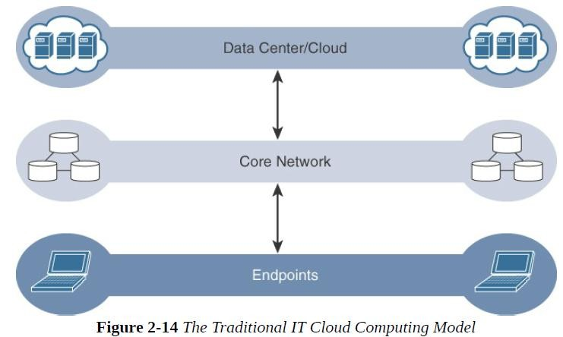

Slide 88
IoT systems function differently. Several data-related problems need to be addressed:
Bandwidth in last-mile IoT networks is very limited.
Latency can be very high.
Network backhaul from the gateway can be unreliable and often depends on 3G/LTE or even satellite links
The volume of data transmitted over the backhaul can be high, and much of the data may not really be that interesting(such as simple polling messages).
Big data is getting bigger. The concept of storing and analyzing all sensor data in the cloud is impractical.

Slide 89
Fog Computing
The solution to the challenges encountered in data management is to distribute data management throughout the IoT system, as close to the edge of the IP network as possible.
The best-known embodiment of edge services in IoT is fog computing.
Any device with computing, storage, and network connectivity can be a fog node.
Examples include industrial controllers, switches, routers,
embedded servers, and IoT gateways

Slide 90
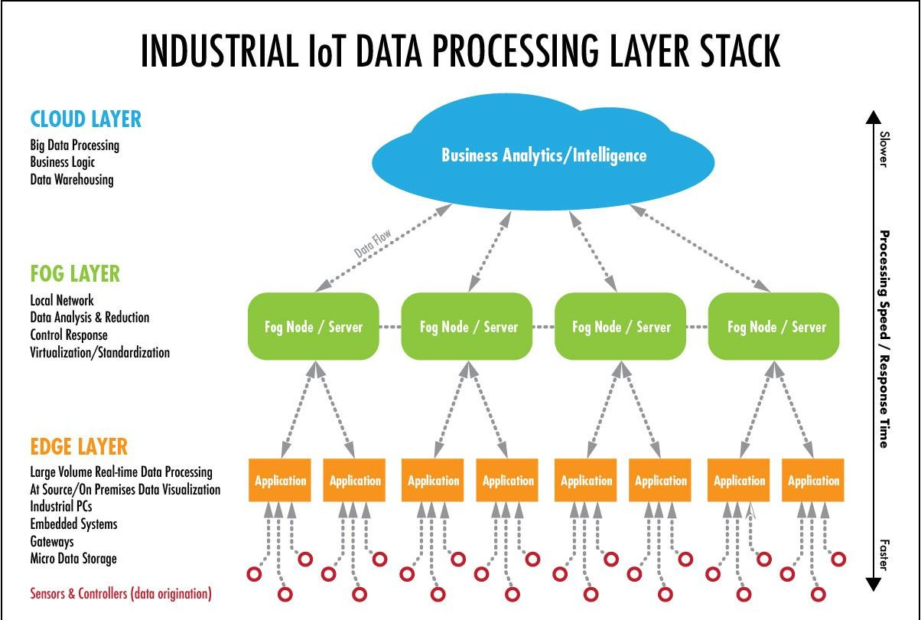

Slide 91
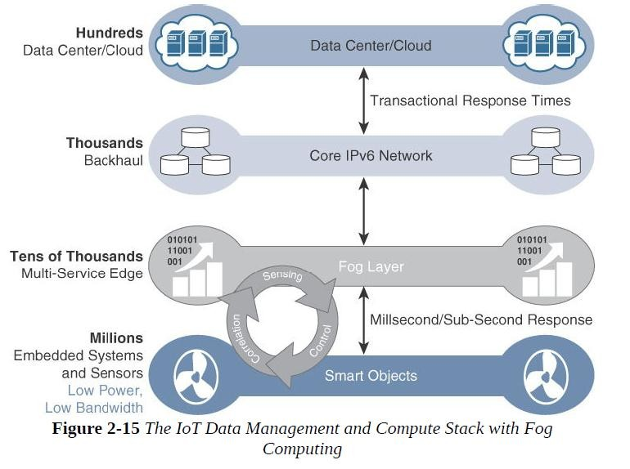

Slide 92
The
characteristic of fog computing are as
follows:
1. Contextual latency
location awareness and low
Geographic distribution
Deployment near IoT endpoints
Wireless communication between and the IoT endpoint
Use for real-time interactions
the fog

Slide 93
Contextual location awareness and low latency:
The fog node sits as close to the IoT endpoint as possible to deliver distributed computing.
Geographic distribution:
In sharp contrast to
the
more
centralized
cloud, the
services and applications targeted by
the fog nodes
demand widely distributed deployments.
Deployment near IoT endpoints:
Fog nodes are typically deployed in the presence of a large number of IoT endpoints.

Slide 94
Wireless communication between the fog and the IoT endpoint:
Although it is possible to connect wired nodes, the advantages of fog are greatest when dealing with a large number of endpoints, and wireless access is the easiest way to achieve such scale.
Use for real-time interactions:
Important fog applications involve real-time interactions rather than batch processing.
Pre-processing of data in the fog nodes allows upper-layer applications to perform batch processing on a subset of the data.

Slide 95
Edge Computing
Edge
distributed
computing computing
as topology
“a part of a in which information
processing is located close to the edge – where things and people produce or consume that information.”
Edge compute–capable meters are able to communicate
with each other to share information on small subsets.
Edge computing is also sometimes called “mist”
computing.

Slide 96
The Hierarchy of Edge, Fog, and Cloud
This model suggests a hierarchical organization of network, compute, and data storage resources.
At each stage, data is collected, analyzed, and responded to when necessary, according to the capabilities of the resources at each layer.
advantage of hierarchy
response to events from resources close to the end
device is fast and can result in immediate benefits
resources available in the cloud when necessary.

Slide 97
Figure 2.16 illustrates the hierarchical nature of edge, fog, and cloud computing across an IoT system.
From an architectural standpoint, fog nodes closest to the network edge receive the data from IoT devices.
The fog IoT application then directs different types of data to the optimal place for analysis:

Slide 98
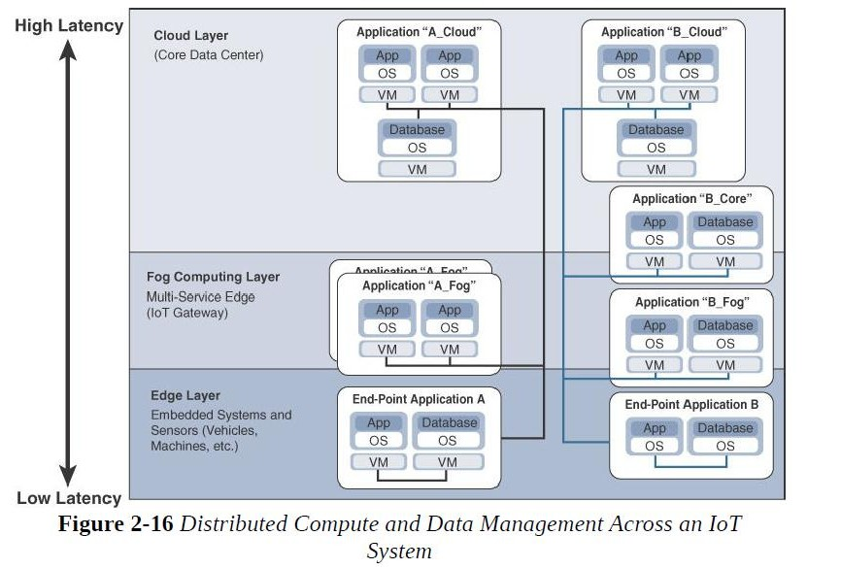

Slide 99
The fog IoT application directs different types of data for analysis:
The most time-sensitive data is analyzed on the edge or fog node closest to the things generating the data.
Data that can wait seconds or minutes for action is passed along to an aggregation node for analysis and action.
Data that is less time sensitive is sent to the cloud for historical analysis, big data analytics, and long-term storage.

