Slide 1
E-Commerce Introduction

Slide 2
What is e-commerce?
Refers to business that is carried out online using applications that work using internet
These applications may be e-mail,instant messaging,website and mobile applications

Slide 3
Ecommerce Ecosystem
Online travel ticketing : Ticketing for air,rail,bus,movies,events
Online : Retail products sold through online route
Online market place : Platform where sellers and buyers transact online
Online deals : Deals purchased online, redemption may or may not happen online
Online portal classified : Includes car,job,property and matrimonial portals

Slide 4
Features of E-commerce
Ubiquity – refers to quality of being available everywhere. Cosumers can connect to Internet anytime and anywhere including homes,offices,mobilephone devices
Global connect – Ecommerce goes beyond traditional,cultural and national boundaries. Websites are available in multiple languages.
Universal standards – Technical standard of internet and conducting ecommerce are shared by all of nations in the world.
Interactivity – Ecommerce facilitate 2 way communication between merchant and consumer.Consumer can interact with companies using chat,sms,e-mail and voice over internet

Slide 5
Features of E-commerce
Personalization/customization : Allow merchants to target their marketing msg to people based on their interest and past history. Allow merchant to change the product or services to match it with purchasing behavior and preferences of consumer.
Social Networking : Ecommerce players have partnered with social media n/w sites to allow users to share content and to deploy to companys emarketing systems.

Slide 6
Ecommerce Advatages
Operates 24/7 (browsing , buying,selling)
No need for setting up physical outlet
No geographic limitations
Low operational cost due to low overheads
Wide range of product and services
Wide choice of payment options(cash,credit card,debit card,vouchers)
Low operational costs allowing company to earn on higher margins
Helps consumers compare different products

Slide 7
Ecommerce disadvantages
Lacks tangibility
Scope of offering customer services while purchasing is low
Susceptible to cyber attacks
Low customer loyalty
Highly competitive
Low barriers to entry
Customer data susceptible to risk of theft
Highly dependent on technology and needs to be continuously updated with latest web and CRM tools

Slide 8
What is e-commerce?
Electronic commerce or e-commerce refers to a wide range of online business activities for products and services.
It also pertains to “any form of business transaction in which the parties interact electronically rather than by physical exchanges or direct physical contact.”
E-commerce is usually associated with buying and selling over the Internet, or conducting any transaction involving the transfer of ownership or rights to use goods or services through a computer-mediated network.
E-commerce is the use of electronic communications and digital information processing technology in business transactions to create, transform, and redefine relationships for value creation between or among organizations, and between organizations and individuals

Slide 9
What is e-commerce?
Includes:
Online business to business transactions
Online business to consumer transactions
Digital delivery of products and services
Online merchandising
Automated telephone transactions eg phone banking
EFTPOS and other automated transfer systems

Slide 10
What is E-Commerce?
E-Commerce can be defined as …
The conduct of selling, buying, logistics, or other organization-management issues via the WEB.
OR
Technology mediated exchanges between parties (individuals and/or organizations) as well as the electronically based intra- or interorganizational activities that facilitate such exchanges.

Slide 11
EC Advantages/Disadvantages
EC Advantages
Ability to reach new markets
Reduces costs (for some businesses)
Increased purchasing opportunities
More efficient (electronic payments, telecommuting, etc.)

Slide 12
EC Advantages/Disadvantages
EC Disadvantages
Incompatibility for certain industries
Limitations of the medium
Costs!!!
Skills required
Cultural and legal issues

Slide 13
E-Commerce - Advantages
E-Commerce advantages can be broadly classified in three major categories −
Advantages to Organizations
Advantages to Consumers
Advantages to Society

Slide 14
Advantages to Organizations
Using e-commerce, organizations can expand their market to national and international markets with minimum capital investment. An organization can easily locate more customers, best suppliers, and suitable business partners across the globe.
E-commerce helps organizations to reduce the cost to create process, distribute, retrieve and manage the paper based information by digitizing the information.
E-commerce improves the brand image of the company.
E-commerce helps organization to provide better customer services.
E-commerce helps to simplify the business processes and makes them faster and efficient.
E-commerce reduces the paper work.
E-commerce increases the productivity of organizations. It supports "pull" type supply management. In "pull" type supply management, a business process starts when a request comes from a customer and it uses just-in-time manufacturing way.

Slide 15
Advantages to Customers
It provides 24x7 support. Customers can enquire about a product or service and place orders anytime, anywhere from any location.
E-commerce application provides users with more options and quicker delivery of products.
E-commerce application provides users with more options to compare and select the cheaper and better options.
A customer can put review comments about a product and can see what others are buying, or see the review comments of other customers before making a final purchase.
E-commerce provides options of virtual auctions.
It provides readily available information. A customer can see the relevant detailed information within seconds, rather than waiting for days or weeks.
E-Commerce increases the competition among organizations and as a result, organizations provides substantial discounts to customers.

Slide 16
Advantages to Society
Customers need not travel to shop a product, thus less traffic on road and low air pollution.
E-commerce helps in reducing the cost of products, so less affluent people can also afford the products.
E-commerce has enabled rural areas to access services and products, which are otherwise not available to them.
E-commerce helps the government to deliver public services such as healthcare, education, social services at a reduced cost and in an improved manner.

Slide 17
E-Commerce - Disadvantages
The disadvantages of e-commerce can be broadly classified into two major categories −
Technical disadvantages
Non-Technical disadvantages

Slide 18
Technical Disadvantages
There can be lack of system security, reliability or standards owing to poor implementation of e-commerce.
The software development industry is still evolving and keeps changing rapidly.
In many countries, network bandwidth might cause an issue.
Special types of web servers or other software might be required by the vendor, setting the e-commerce environment apart from network servers.
Sometimes, it becomes difficult to integrate an e-commerce software or website with existing applications or databases.
There could be software/hardware compatibility issues, as some e-commerce software may be incompatible with some operating system or any other component.

Slide 19
Non-Technical Disadvantages
Initial Cost - The cost of creating/building an e-commerce application in-house may be very high. There could be delays in launching an e-Commerce application due to mistakes, and lack of experience.
User resistance − Users may not trust the site being an unknown faceless seller. Such mistrust makes it difficult to convince traditional users to switch from physical stores to online/virtual stores.
Security/ Privacy − It is difficult to ensure the security or privacy on online transactions.
Lack of touch or feel of products during online shopping is a drawback.
E-commerce applications are still evolving and changing rapidly.
Internet access is still not cheaper and is inconvenient to use for many potential customers, for example, those living in remote villages

Slide 20
E-commerce vs. E-business
E-commerce involves
Digitally enabled commercial transactions between organizations and individuals.
Digitally enabled transactions include all transactions mediated by digital technology
Commercial transactions involve the exchange of value across organizational or individual boundaries in return for products or services

Slide 21
E-commerce vs. E-business
E-business involves
Digital enablement of transactions and processes within a firm, involving information systems under the control of the firm
E-business does not involve commercial transactions across organizational boundaries where value is exchanged

Slide 22
Is e-commerce the same as e-business?
In e-commerce, information and communications technology (ICT) is used in inter-business or inter-organizational transactions (transactions between and among firms/organizations) and in business-to-consumer transactions (transactions between firms/organizations and individuals).
In e-business, on the other hand, ICT is used to enhance one’s business. It includes any process that a business organization (either a for-profit, governmental or non-profit entity) conducts over a computer-mediated network.
e-business is:“The transformation of an organization’s processes to deliver additional customer value through the application of technologies, philosophies and computing paradigm of the new economy

Slide 23
Is e-commerce the same as e-business?
e-commerce is outward-facing and involves customer or client interaction – usually buying and selling.
E-business is digital machinations of making a company run smoothly and all business conducted online. It can involve e-commerce.
E-commerce is often confused with e-business, although they have nothing to do with one another.
E-commerce only refers to the goods and services transaction between a seller and a consumer, whereas e-business refers to the complete process necessary to manage an online business.

Slide 24
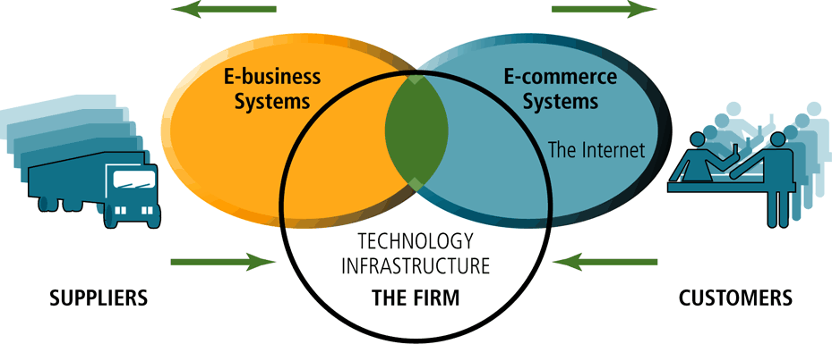
The Difference Between E-commerce and E-Business

Slide 25
E-Commerce - Business Models
Business - to - Business (B2B)
Business - to - Consumer (B2C)
Consumer - to - Consumer (C2C)
Consumer - to - Business (C2B)
Business - to - Government (B2G)
Government - to - Business (G2B)
Government - to - Citizen (G2C)

Slide 26
Business - to - Business
A website following the B2B business model sells its products to an intermediate buyer who then sells the product to the final customer. As an example, a wholesaler places an order from a company's website and after receiving the consignment, sells the endproduct to the final customer who comes to buy the product at one of its retail outlets.

Slide 27
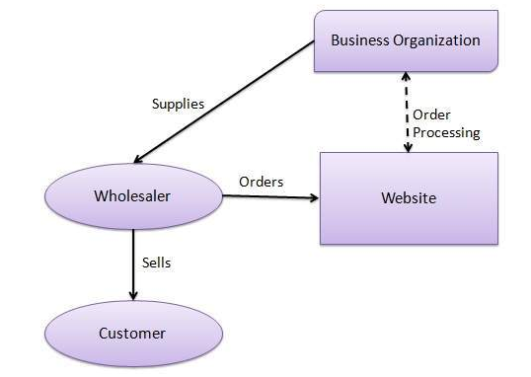

Slide 28
Business - to - Consumer
A website following the B2C business model sells its products directly to a customer. A customer can view the products shown on the website. The customer can choose a product and order the same. The website will then send a notification to the business organization via email and the organization will dispatch the product/goods to the customer.

Slide 29
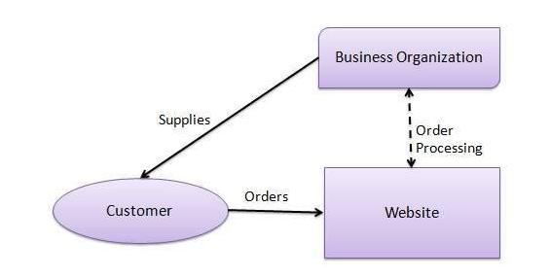
Business - to - Consumer

Slide 30
Consumer - to - Consumer
A website following the C2C business model helps consumers to sell their assets like residential property, cars, motorcycles, etc., or rent a room by publishing their information on the website. Website may or may not charge the consumer for its services. Another consumer may opt to buy the product of the first customer by viewing the post/advertisement on the website.

Slide 31
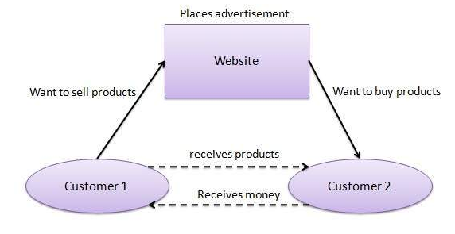
Consumer - to - Consumer

Slide 32
Consumer - to - Business
In this model, a consumer approaches a website showing multiple business organizations for a particular service. The consumer places an estimate of amount he/she wants to spend for a particular service. For example, the comparison of interest rates of personal loan/car loan provided by various banks via websites. A business organization who fulfills the consumer's requirement within the specified budget, approaches the customer and provides its services.

Slide 33
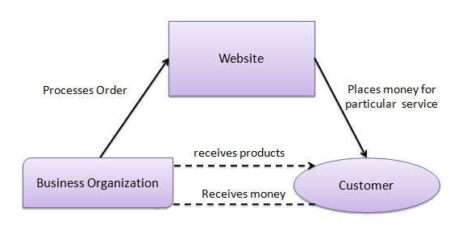

Slide 34
Business - to - Government
B2G model is a variant of B2B model. Such websites are used by governments to trade and exchange information with various business organizations. Such websites are accredited by the government and provide a medium to businesses to submit application forms to the government.

Slide 35

Business - to - Government

Slide 36
Government - to - Business
Governments use B2G model websites to approach business organizations. Such websites support auctions, tenders, and application submission functionalities.

Slide 37

Government - to - Business

Slide 38
Government - to - Citizen
Governments use G2C model websites to approach citizen in general. Such websites support auctions of vehicles, machinery, or any other material. Such website also provides services like registration for birth, marriage or death certificates. The main objective of G2C websites is to reduce the average time for fulfilling citizen’s requests for various government services.

Slide 39

Government - to - Citizen

Slide 40
Examples of G2B/B2G services
Government procurement
Electronic procurement marketplaces
Electronic auctions
E-learning
Electronic incorporation forms
Updating corporate information
Sending filledout electronic forms(eg tax forms,social insurance forms)
Sending electronic payments
Sending/receiving answers electronically
On line meeting
Project management cooperation

Slide 41
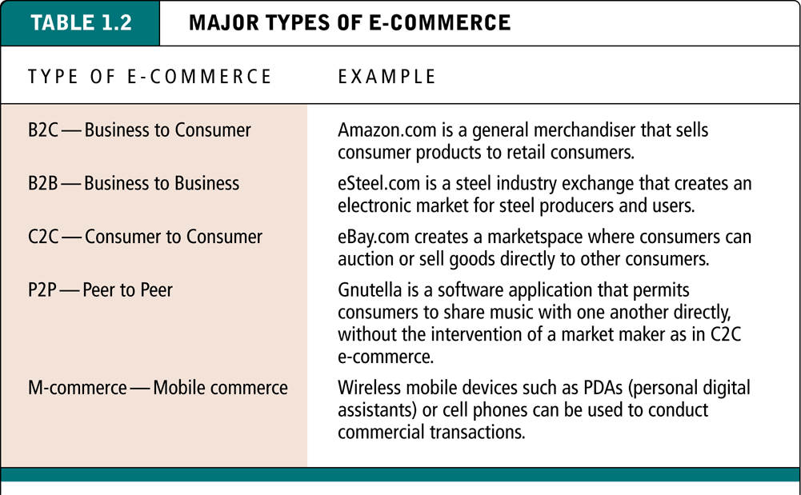
Major Types of E-Commerce

Slide 42
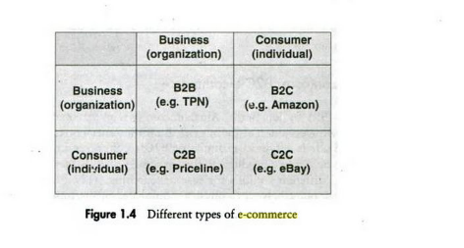

Slide 43
Major Types of E-Commerce
Market relationships
Business-to-Consumers (B2C)
Business-to-Business (B2B)
Consumer-to-Consumer (C2C)
Technology-based
Peer-to-Peer (P2P)
Mobile Commerce (M-commerce)
Notes:
We can group these five types in two kind of themes…..

Slide 44
Business-to-Consumer E-commerce
Most commonly discussed type
Online businesses attempt to reach individual consumers

Slide 45
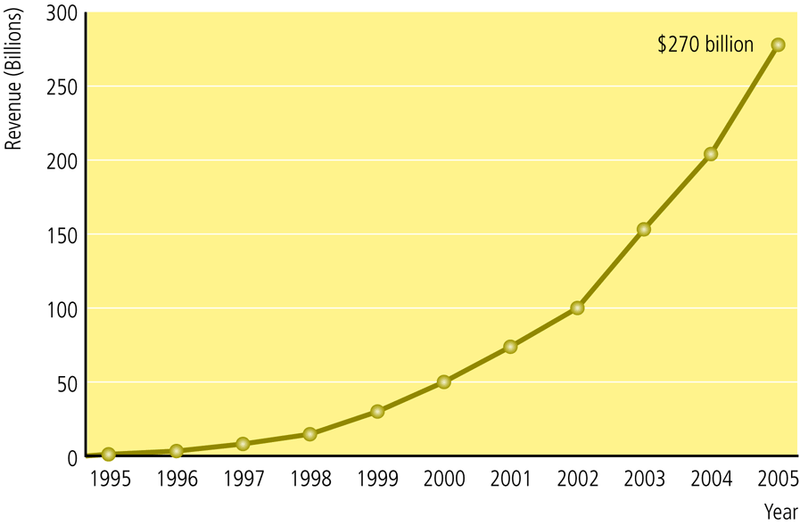
The Growth of B2C E-Commerce
Europe is expected
to reach €263M
by 2011
(Forrester
report, 2006)

Slide 46
Business-to-Business E-commerce
Businesses focus on sell to other businesses
Largest form of e-commerce
Primarily involved inter-business exchanges at first
Other models have developed
e-distributors
infomediaries
B2B service providers

Slide 47
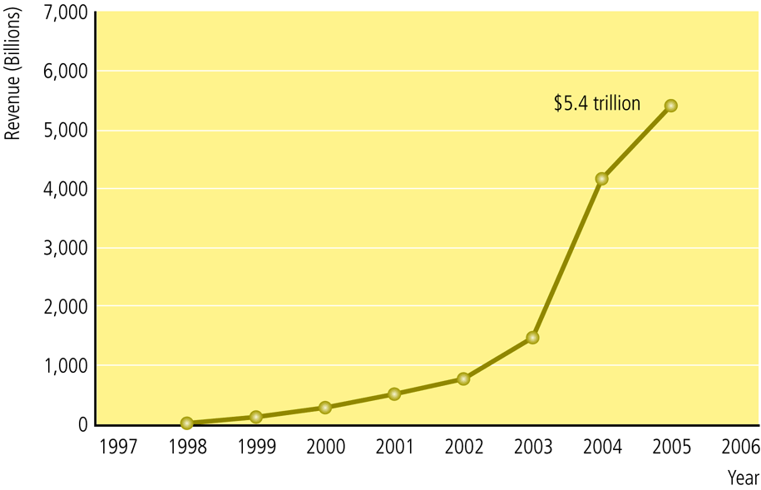
The Growth of B2B E-Commerce

Slide 48
Consumer-to-Consumer E-commerce
Provide a way for consumers to sell to each other
Estimated $5 billion market
Consumer:
prepares the product for market
places the product for auction or sale
relies on market maker to provide catalog, search engine, and transaction clearing capabilities

Slide 49
Peer-to-Peer E-commerce
Enables Internet users to share files and computer resources
Napster (early example)
Skype (more modern and successful example)

Slide 50
Mobile E-commerce
Wireless digital devices enable transactions on the Web
Uses personal digital assistants (PDAs) to connect
Used most widely in Japan and Europe

Slide 51
Difference Between Traditional Commerce and e-Commerce
BASIS FOR COMPARISON | TRADITIONAL COMMERCE | E-COMMERCE
Meaning | Traditional commerce is a branch of business which focuses on the exchange of products and services, and includes all those activities which encourages exchange, in some way or the other. | e-Commerce means carryng out commercial transactions or exchange of information, electronically on the internet.
Processing of Transactions | Manual | Automatic
Accessibility | Limited Time | 24×7×365
Physical inspection | Goods can be inspected physically before purchase. | Goods cannot be inspected physically before purchase.

Slide 52
Difference Between Traditional Commerce and e-Commerce
BASIS FOR COMPARISON | TRADITIONAL COMMERCE | E-COMMERCE
Customer interaction | Face-to-face | Screen-to-face
Scope of business | Limited to particular area. | Worldwide reach
Information exchange | No uniform platform for exchange of information. | Provides a uniform platform for information exchange.
Resource focus | Supply side | Demand side

Slide 53
Difference Between Traditional Commerce and e-Commerce
BASIS FOR COMPARISON | TRADITIONAL COMMERCE | E-COMMERCE
Business Relationship | Linear | End-to-end
Marketing | One way marketing | One-to-one marketing
Payment | Cash, cheque, credit card, etc. | Credit card, fund transfer etc.
Delivery of goods | Instantly | Takes time

Slide 54
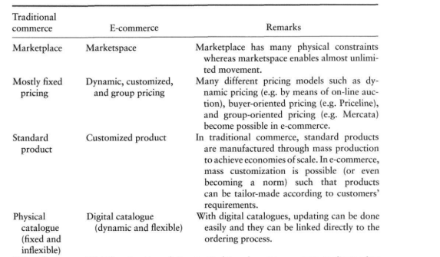

Slide 55
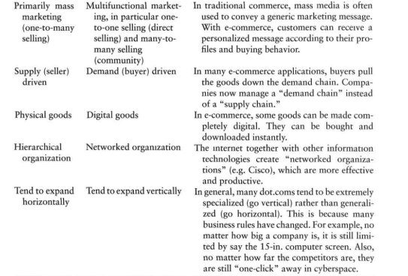

Slide 56
ADVANTAGES AND DISADVANTAGES OF ECOMMERCE
Faster buying/selling procedure, as well as easy to find products.
Buying/selling 24/7.
More reach to customers, there is no theoretical geographic limitations.
Low operational costs and better quality of services.
No need of physical company set-ups.
Easy to start and manage a business.
Customers can easily select products from different providers without moving around physically.

Slide 57
Advantages and disadvantages of starting up an e-commerce shop
Advantages
More clients. There is no local store or company with sufficient offices in different cities that compares with e-commerce’s reach. The possibility of selling and buying from any part of the world expands the target public and allows the company to gain more clients.
No schedule: E-commerce does not run on schedules, whereas it is nearly impossible to find a traditional store that is open 24/7. Websites are open all day long and clients can buy whatever they want whenever they want it.
Less costs: not needing a physical store reduces the costs of running a traditional business. In addition, when e-commerce brings suppliers together with consumers there are not even production costs.

Slide 58
Advantages
Bigger profit margin: cost reduction and market extension mean that, even with lower prices, a bigger profit margin can be obtained than with a traditional store. More products are sold and more money is made.
Scalability: This means that you can sell to either one or to a thousand people at the same time. In a physical store there is always a limit to the number of clients that you can assist at the same time. On the other hand, with e-commerce, the only limit is your ability to attract clients. Well, that and your server. ;)

Slide 59
DISADVANTAGES OF ECOMMERCE
Any one, good or bad, can easily start a business. And there are many bad sites which eat up customers’ money.
There is no guarantee of product quality.
Mechanical failures can cause unpredictable effects on the total processes.
As there is minimum chance of direct customer to company interactions, customer loyalty is always on a check.
There are many hackers who look for opportunities, and thus an ecommerce site, service, payment gateways, all are always prone to attack

Slide 60
Types of e-commerce
B2B (Business-to-Business): businesses whose clients are also businesses or organizations. For example, we could think about a construction materials company selling its products to architects and interior designers.
B2C (Business-to-Consumer): businesses that sell their products or services directly to the consumer. This is the usual type and there are thousands of examples of clothes, shoes or electronics stores.
C2B (Consumer-to-Business): sites in which consumers offer products or services and businesses bid on them. We are talking about the traditional websites for freelancers such as Freelancer, Twago, Nubelo or Adtriboo.
C2C (Consumer-to-Consumer): businesses that facilitate the selling of products amongst consumers. The clearest example is eBay or any other second hand website.
In addition to these types of electronic commerce, there are other popular types such as G2C (Goverment-to-Consumer), C2G (Consumer-to-Goverment) or B2E (Business-to-Employer).

Slide 61
e commerce trade cycle
Trade cycle is more or less categorised into four areas.
First is the identification of a supplier by a consumer, and the agreement of terms for supply.
The second stage is selecting the goods and taking delivery.
The traditional third stage, payment and invoicing, is usually executed along with the selection of goods, in e-commerce.
The final stage is after-sales, in which complaints are addressed, support given, and any further involvement of the supplier with the product as specified in the terms of supply is engaged.

Slide 62
e commerce trade cycle
As an example of the trade cycle, a consumer will go to Amazon to find a specific product. This is the identification of a supplier. Once the product is added to the shopping basket, the consumer will check out using Amazon’s specific e-commerce software, and pay for it while specifying an address at which to take delivery, combining the second and third phases. Once the product arrives, and if it is unsatisfactory, the customer returns it to Amazon, who then will provide a refund, a replacement or another service, thereby fulfilling the fourth phase of the e-commerce trade cycle as agreed through that country’s laws and Amazon’s own terms and conditions. More complex products are subject to altered trade cycles, as are e-commerce systems for less consumer-focussed areas, such as consultancy or bespoke manufacturing work. All will, however, follow the same basic cycle at the heart of their operation.

Slide 63
The e-Commerce Trade Cycle:
A trade cycle is the series of exchanges, between a customer and supplier, that take place when a commercial exchange is executed. A general trade cycle consists of:
Pre-Sales: Finding a supplier and agreeing the terms.
Execution: Selecting goods and taking delivery.
Settlement: Invoice (if any) and payment.
After-Sales: Following up complaints or providing maintenance.

Slide 64
The e-Commerce Trade Cycle
For business-to-business transactions the trade cycle typically involves the provision of credit with execution preceding settlement whereas in consumer-to-business these two steps are typically co-incident. The nature of the trade cycle can indicate the e-Commerce technology most suited to the exchange.
Commercial transactions that are repeated on a regular basis, such as supermarkets replenishing their shelves, is one category of trade cycle.

Slide 65
Trade cycle varies depending on:
The nature of the parties to the transaction
Frequency of trade exchanges
The nature of the goods or services being exchanged

Slide 66
Three generic trade cycles can be identified
Regular, repeat transactions between commercial trading partners(Repeat)
Irregular transactions between commercial trading partners(Credit)
Irregular transactions in one-off trading relationships (commercial or retail)(Cash)

Slide 67
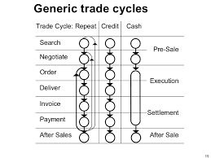

Slide 68
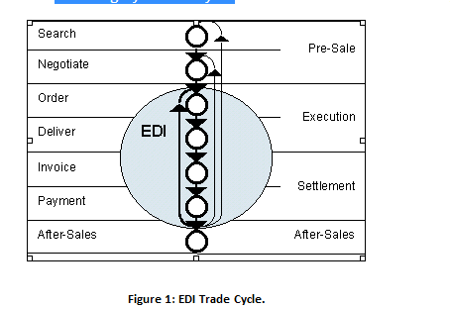

Slide 69
E-COMMERCE EXAMPLES
An individual purchases a book on the Internet.
A government employee reserves a hotel room over the Internet.
A business calls a toll free number and orders a computer using the seller's interactive telephone system.
A business buys office supplies on-line or through an electronic auction.
A retailer orders merchandise using an EDI network or a supplier's extranet.
A manufacturing plant orders electronic components from another plant within the company using the company's intranet.
An individual withdraws funds from an automatic teller machine (ATM).

