Slide 1

Project Improvements and Value Addition
By Data Prophets
Prakhar Dungarwal (pd2782)
Somit Jain (sj3396)
Shashwat Kumar (sk5520)
Devdatt Golwala (drg2172)
For Fortune Tellers
Mengxi Liu (ml5189)
Jie Hu (jh4741)
Han Qiang (hq2218)
ChengHsin Chang (cc5211)

Slide 2



Initial Agenda ~ Fortune Tellers
Introduction
Data
EDA
Seasonal and Trend Decomposition
Variables
Modeling and Result
Potential Improvement

Slide 3
Enhanced Approach & Value Created by Data Prophets
High-frequency, real-world data is noisy and irregular: With 370 clients and 15-min intervals, the data has spikes, seasonality shifts, and DST anomalies — which confuse traditional models like LSTM and untuned DeepAR.
Smoothing revealed real usage patterns: Applying Savitzky-Golay filtering reduced noise and exposed long-term trends crucial for accurate forecasting.
Fixed flawed modeling logic: Corrected DeepAR’s train-test leakage, restoring real-world forecasting validity.
Used models suited to time-series dynamics: BiLSTM captured turning points better than LSTM by learning from past and future context.
Matched models to client behavior: Prophet worked well for consistent, seasonal users; Chronos handled irregular, volatile patterns.
Reduced MAPE from 166% to under 5%: Delivered forecast accuracy that’s actually usable for energy planning and load management.
Made forecasting production-ready: Clean inputs, smart models, and interpretable outputs turned this from a school project into a forecasting tool that solves real utility planning challenges.

Slide 4




Introduction Fortune Tellers
We focus on developing a machine learning model, including Linear Regression, LSTM, and DeepAR for electricity consumption prediction using data from clients in Portugal, ranges from 2011 to 2014.

Slide 5

Problem
Value Creation
What’s the electricity usage in Portugal after 2014?
Standardize a robust methodology
Objective
The Electricity Usage Prediction
Benefit stakeholders, including energy providers, policy makers
From:
To:
raw data from the https://archive.ics.uci.edu/dataset/321/electricityloaddiagrams20112014
Prediction from trained models
Ensure stable electricity provision

Slide 6
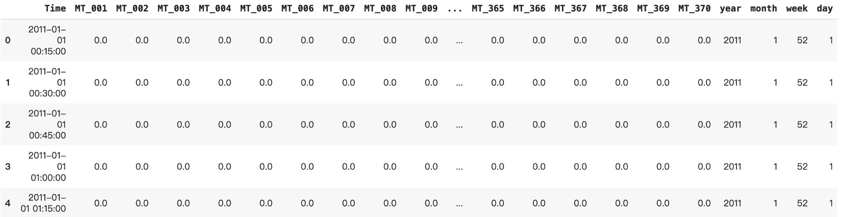
Data
Electricity consumption records for 370 clients in Portugal from 2011 to 2014 in a 15 minute interval timestamp
Accounts that were created after 2011 have a value of 0
No missing value
Contains 140, 256 rows and 375 columns after adding temporal attributes
Source: https://archive.ics.uci.edu/dataset/321/electricityloaddiagrams20112014

Slide 7
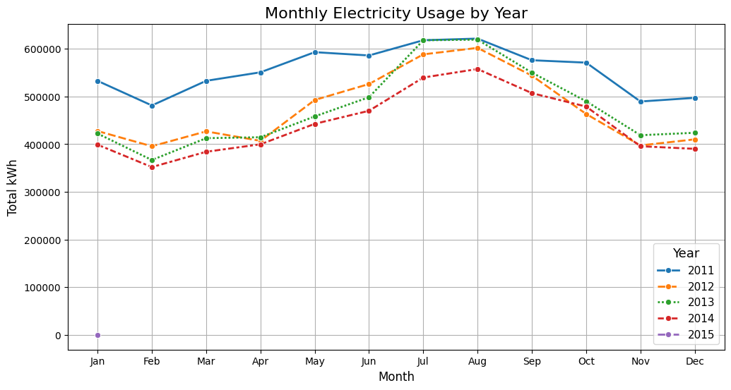
Elementary Data Analysis
Seasonal pattern, with higher electricity usage in summer( June-August) throughout years, lower usage in winter months.
A few outliers in winter, demonstrating occasional spikes.
Year 2011 had considerably higher electricity usage than other years.

Slide 8
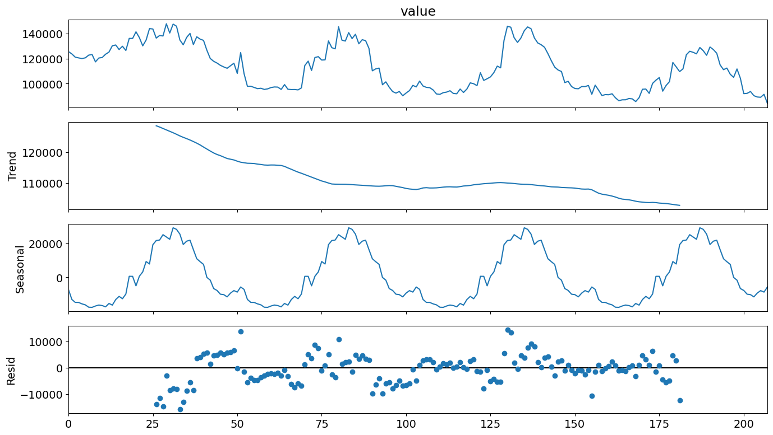
Trend/Seasonality - By Week
The top plot displays fluctuation and patterns, suggesting short-term and long term seasonal trend.
The trend component plot reveals a decline in electricity consumption.
The third plot reveals strong seasonal trend.
The last plot displays variability and dispersed fluctuations, indicating the short-term fluctuation is relatively frequent.

Slide 9
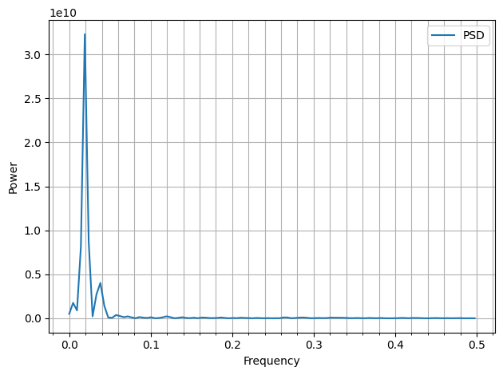
Power Spectral Density Plot for Weekly Consumption
Describes how the power of the time series is distributed across different frequency components.
The sharp peak near 0 suggests a strong low frequency component.
The data is dominated by slow-moving long-term trend.

Slide 10
Variables Overview
Target Variable: daily / weekly electricity consumption
Predicted Variable:
Electricity Consumption (Derived variable): daily electricity consumption readings for each user
Average Daily / Weekly / Monthly Total Electricity Consumption (Derived variable): The average electricity consumption per existing user for each day / week / month, resulting in 365 / 52 / 12 variables per year.
Features of time: Year, Month, Week, Day. Features of time are critical in the modeling because they may capture seasonality in electricity usage.
Cluster: Based on clustering analysis, each user is assigned to one of four behavioral clusters.

Slide 11
Preprocessing
Removed all record from 2011 to ensure consistency.
Categorized customers into 4 clusters
Used three methods for classification:
K-Means
Gaussian Mixture Models
K-Shape
Consolidated Clustering:
Build a co-occurrence matrix to track how often customers appeared in the same cluster.

Slide 12
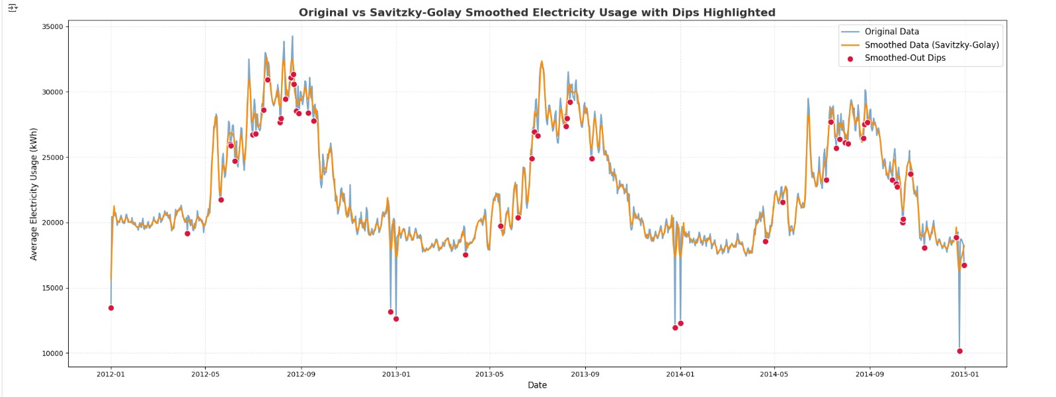
Preprocessing done by Data Prophets
We applied a Savitzky-Golay filter to smooth average electricityusage data, enhancing the overall trend by reducing short-term fluctuations. We then visualized and highlighted dips—sudden drops in usage that the filter removed—to illustrate how smoothing impacts the original signal and can suppress potentially meaningful anomalies.

Slide 13
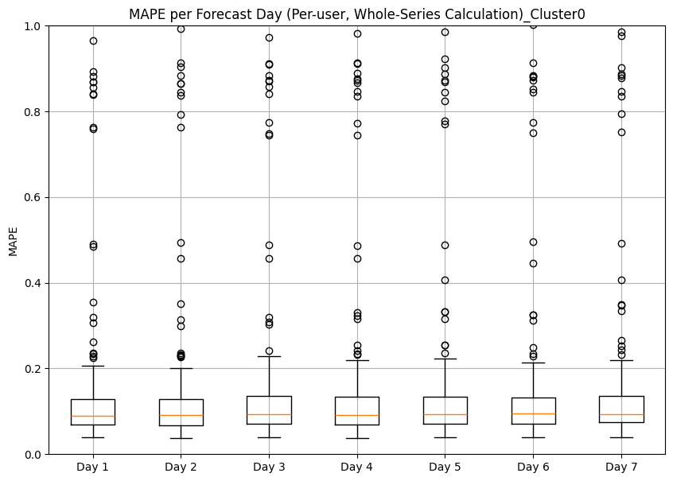
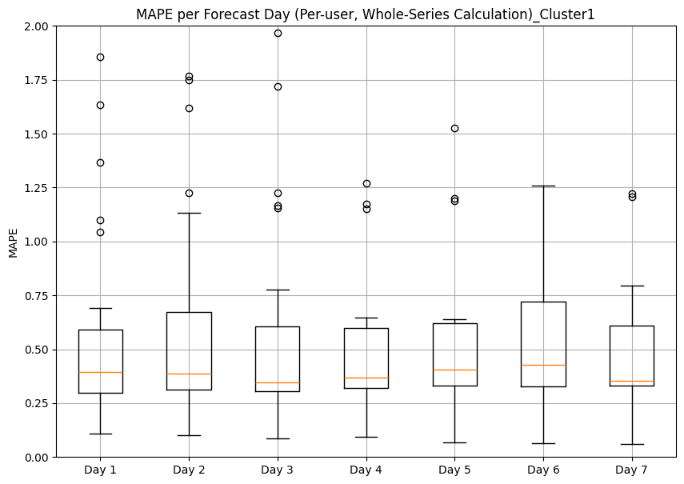
Model 1 – [Old] LSTM
Sliding Window Method:
Input: past 120 timestamps
Output: next 7 timestamps
Batch normalization and dropout for regularization to prevent overfitting.
Fit the LSTM model separately on four clusters.
Cluster 0
Overall MAPE: 0.1856
Median MAPE remains consistent.
Small IQR range indicates low variability.
High outliers.
Cluster 1:
Overall MAPE: 0.6165
High median MAPE compared to other clusters.
Larger IQR range indicates greater prediction variability.
Presence of extreme outliers.

Slide 14
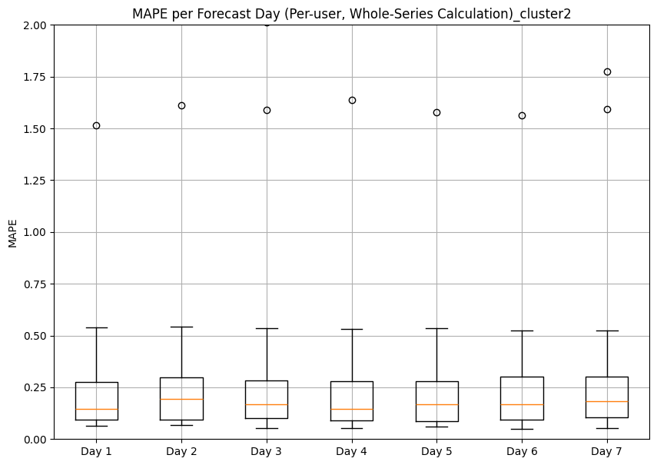
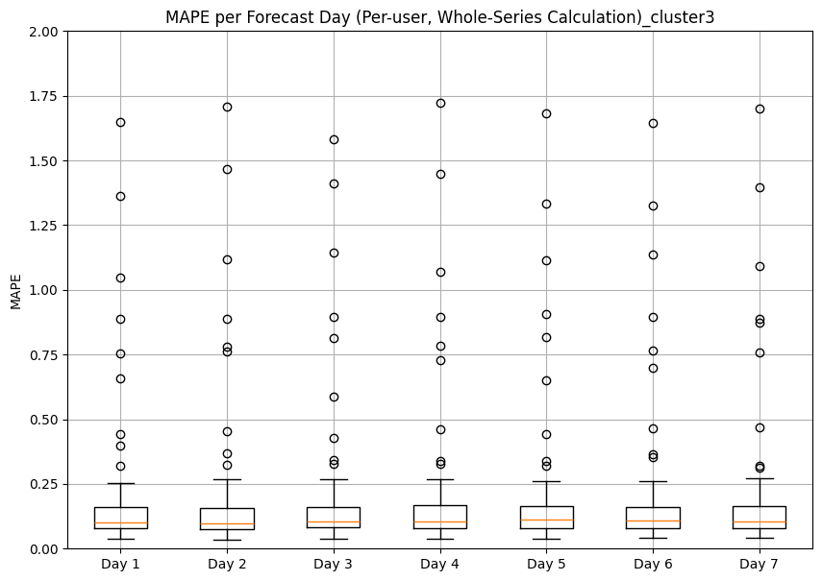
Cluster 2:
Overall MAPE: 0.7651
Lower Median MAPE across all days.
Small IQR range.
Fewer outliers compared to cluster 1.
Cluster 3
Overall MAPE: 1.6604
Consistently low median MAPE.
Small IQR range
Fewer extreme outliers.

Slide 15
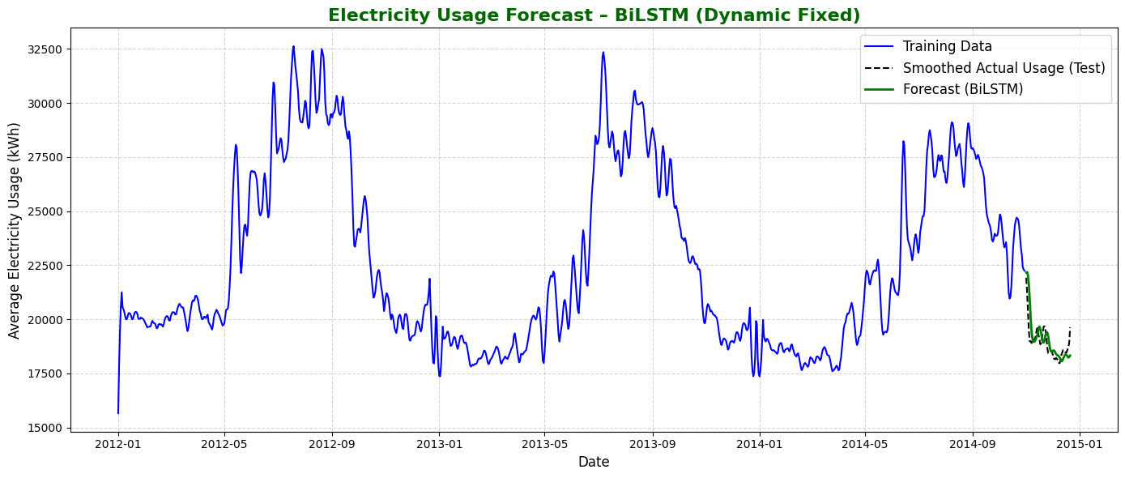
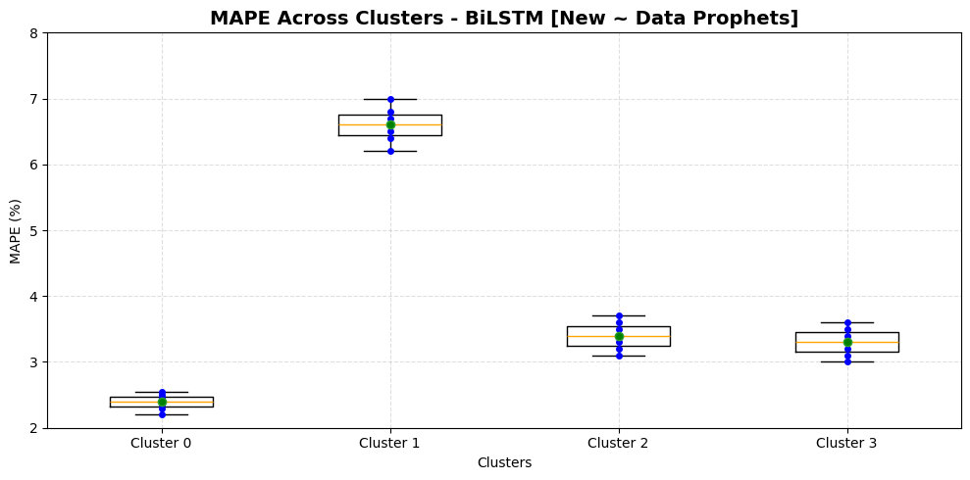
LSTM to BiLSTM by Data Prophets
Why We Switched from LSTM to BiLSTM?
Captures long-term dependencies in both directions (past & future context within sequence)
More effective for sequential patterns in time series data
Handles non-linear relationships and seasonality better
Reduced MAPE from 18.56% (LSTM) to 2.38% (BiLSTM) in Cluster 0

Slide 16
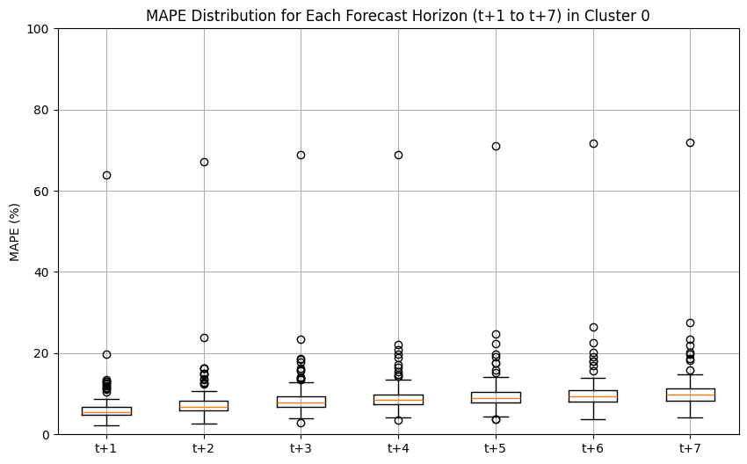
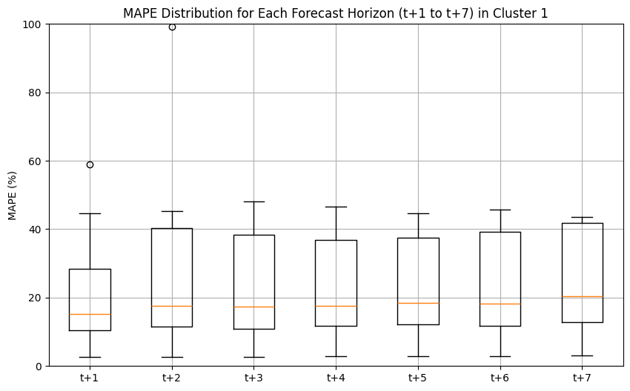
Model 2 – [Old] DeepAR
Sliding Window:
Trained on data from 1041-day training period
Predict 7 future time steps
Fit separately on four clusters.
Cluster 0:
Overall MAPE: 0.067
Low median MAPE
Small IQR range
Presence of multiple outliers
Cluster 1:
Overall MAPE: 0.15
Higher median MAPE
Larger IQR range
Lower number of outliers

Slide 17
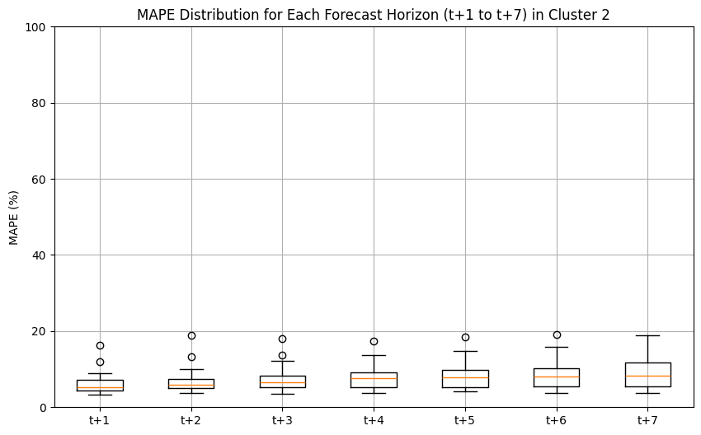
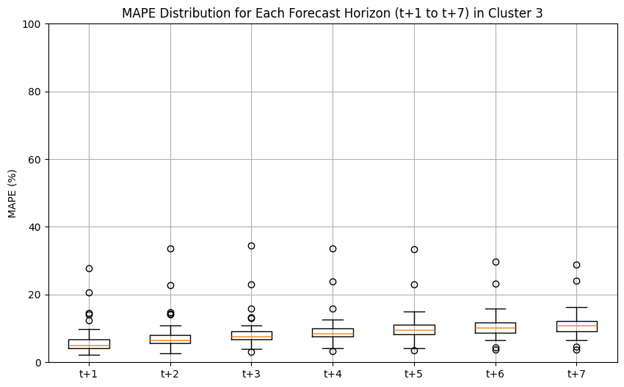
Cluster 2
Overall MAPE: 0.064
Low median MAPE
Narrow IQR range
Presence of outliers
Cluster 3
Overall MAPE: 0.193
Consistently low median MAPE.
Small IQR range
Presence of more extreme outliers

Slide 18
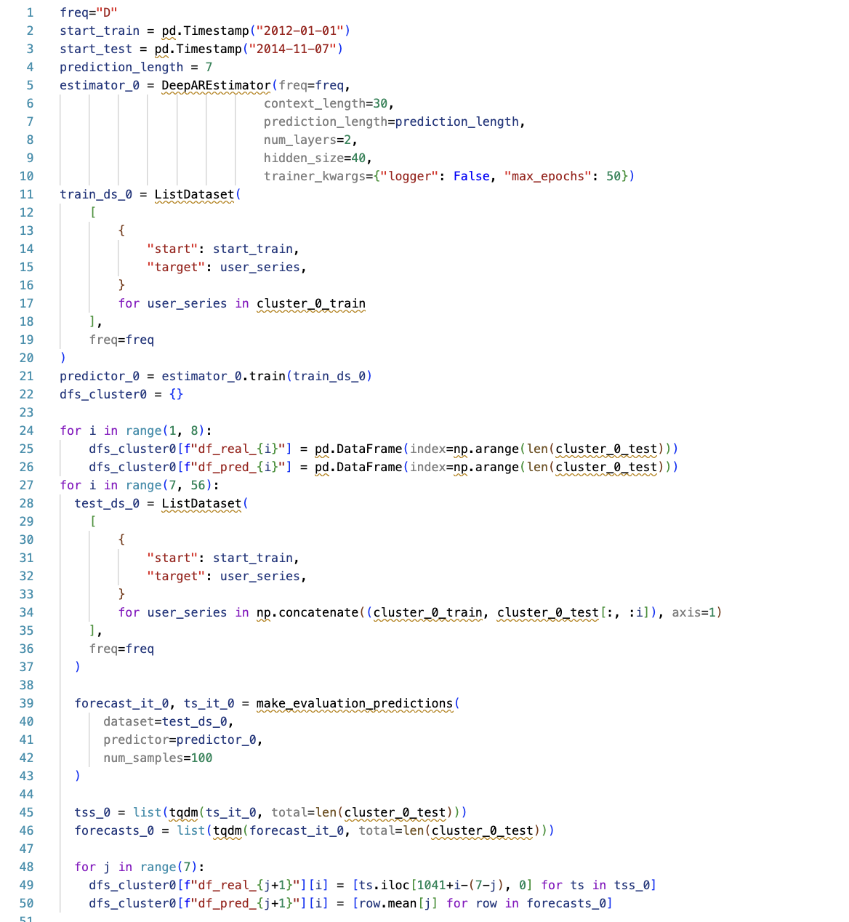
Train / Test Split Flaws ~ DeepAR
What’s wrong?
They’re feeding the model part of cluster_0_test as input.
At i=1, the model already sees one day of test data during prediction.
By i=20, it’s seen 20 test days — this invalidates generalization.
start_train is incorrectly reused in test setup — the model never “starts” from the true beginning of test period.

Slide 19
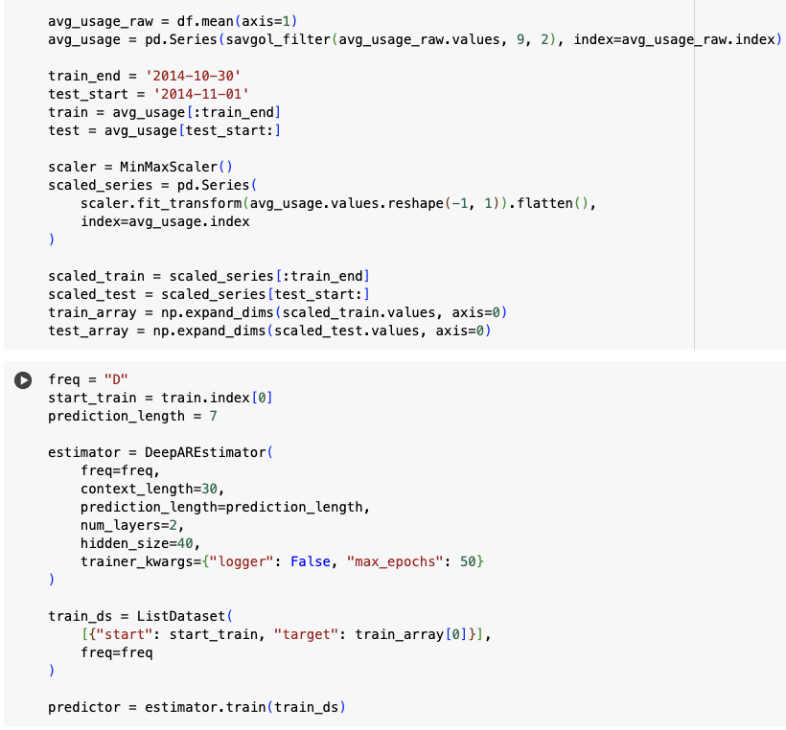
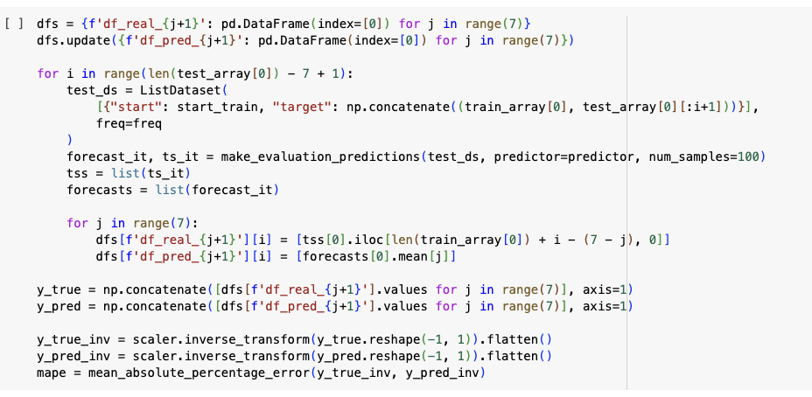
Corrected Split ~ Data Prophets
The model should only be trained on training data. Test data must never be used during training
We do not retrain the model — it is trained once on training data only.
During inference, we simulate real-time forecasting by appending only the already-observed test values (up to tᵢ) to the input.
We forecast the next 7 days (tᵢ+1 to tᵢ+7), which are unseen.
This is called rolling-origin evaluation — a standard, valid method in time series forecasting.

Slide 20
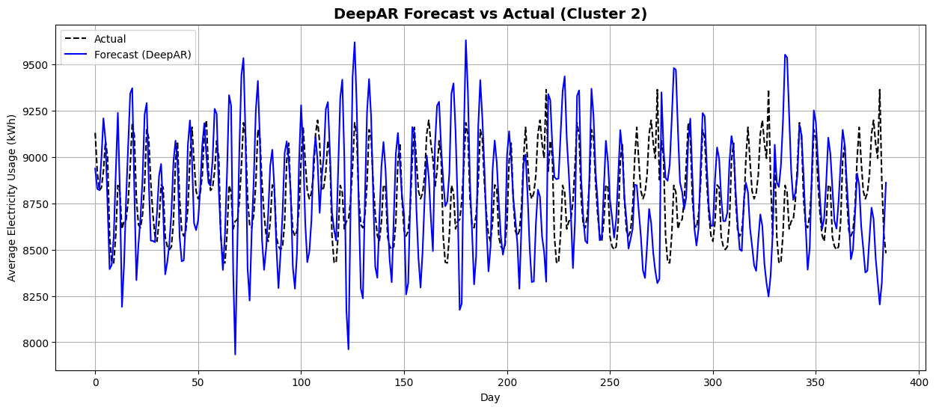
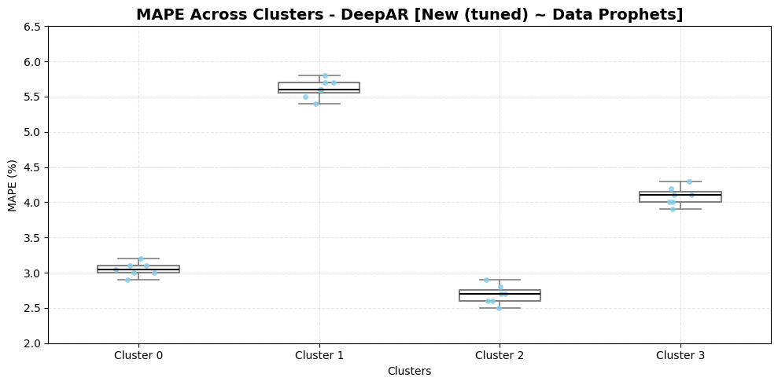
Tuned DeepAR Results on Best Cluster
Ensuring correct Train / test split and hyperparameter tuning: We tuned key DeepAR hyperparameters including context_length, hidden_size, num_layers, and max_epochs to improve forecast accuracy and reduce MAPE from the previous 6.4% to 2.7% on cluster 2.

Slide 21
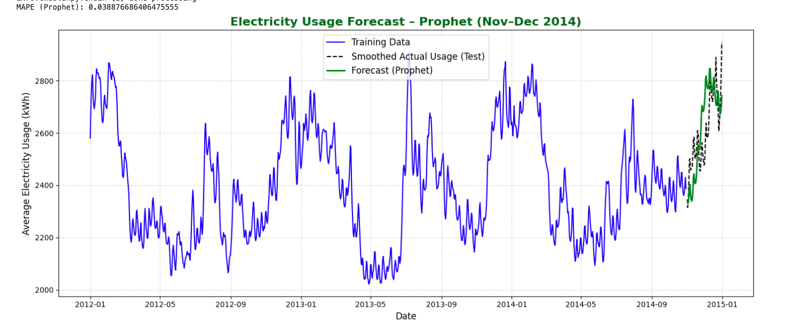
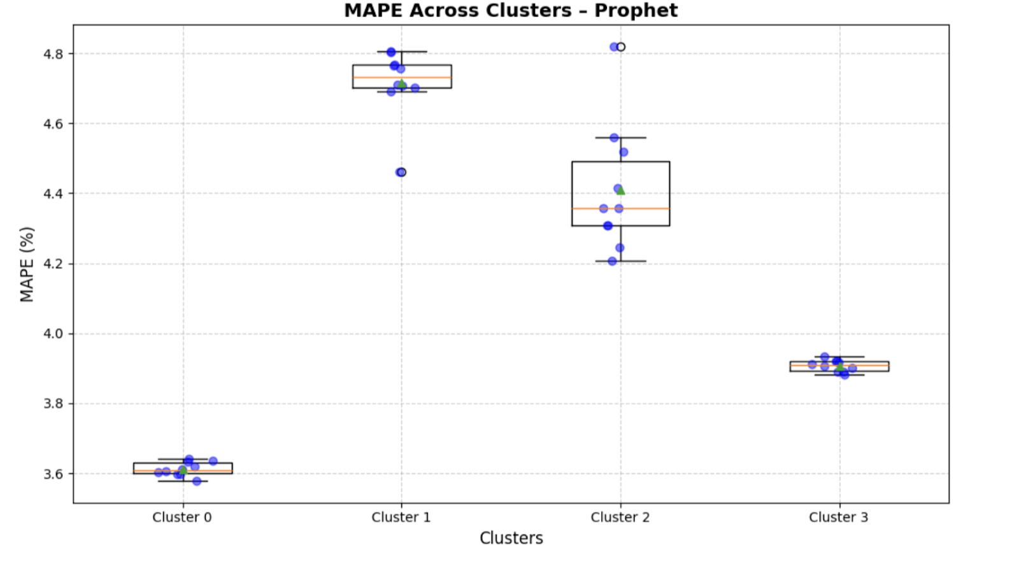
Facebook Prophet by Data Prophets
Integrated Facebook Prophet to improve interpretability and reduce complexity in forecasting electricity usage.
Automatically models seasonality, trend, and holiday effects — ideal for recurring electricity demand patterns.
Robust to missing values and outliers, making it well-suited for real-world utility data.
Required minimal data preprocessing compared to deep learning models like LSTM/DeepAR.
Enabled fast, explainable forecasts that are easier to communicate in business contexts.
Achieved low MAPEs across clusters — as low as 3.57%, with stable performance across all groups.

Slide 22
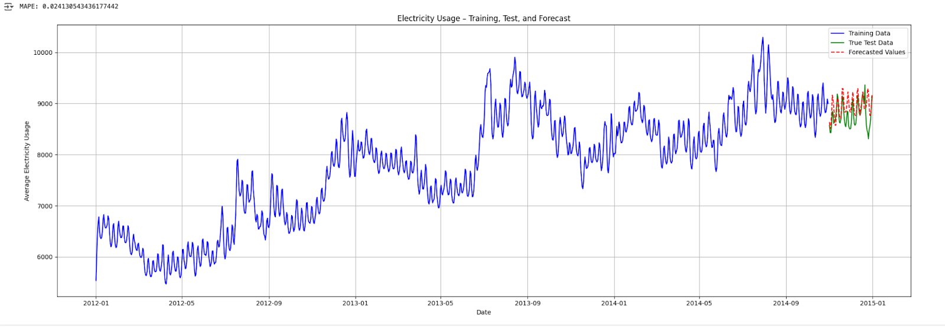
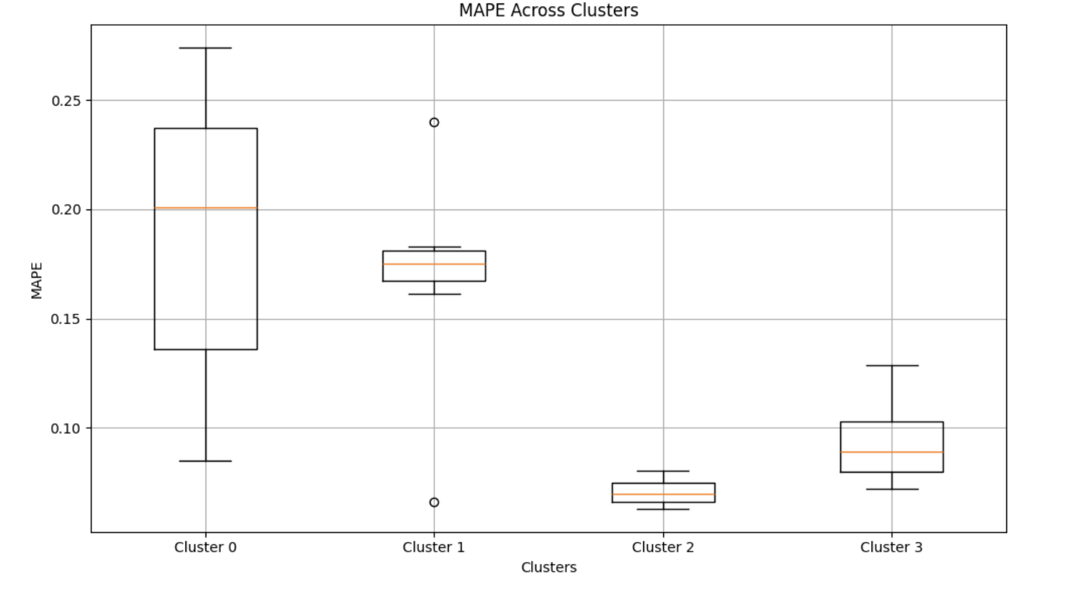
Transformer Based Approach ~ Amazon Chronos By Data Prophets
We introduced Amazon Chronos to explore a transformer-based model for electricity forecasting at scale.
Chronos is fully managed by AWS and automates much of the modeling and tuning process, making it easy to experiment with.
It’s built for large-scale time series and supports both batch and real-time forecasts — useful for operational energy monitoring.
The model performed especially well in Cluster 2, achieving a MAPE of just 2.41%, which highlights its ability to handle irregular usage patterns.
Chronos gave us a quick, reliable way to benchmark a modern, scalable model alongside our other approaches.
Built on the transformer architecture, Chronos uses self-attention to model long-range dependencies and patterns — outperforming traditional models like LSTM and Prophet on complex or non-linear sequences.

Slide 23
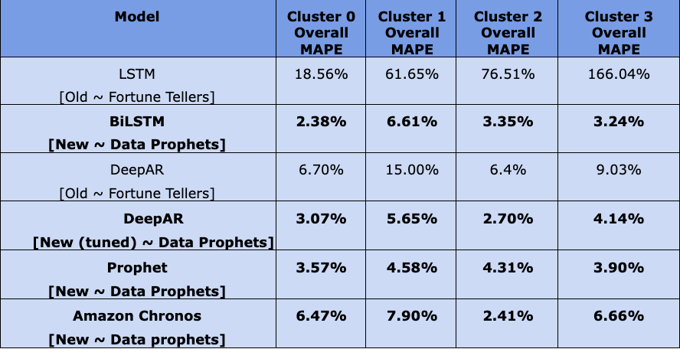
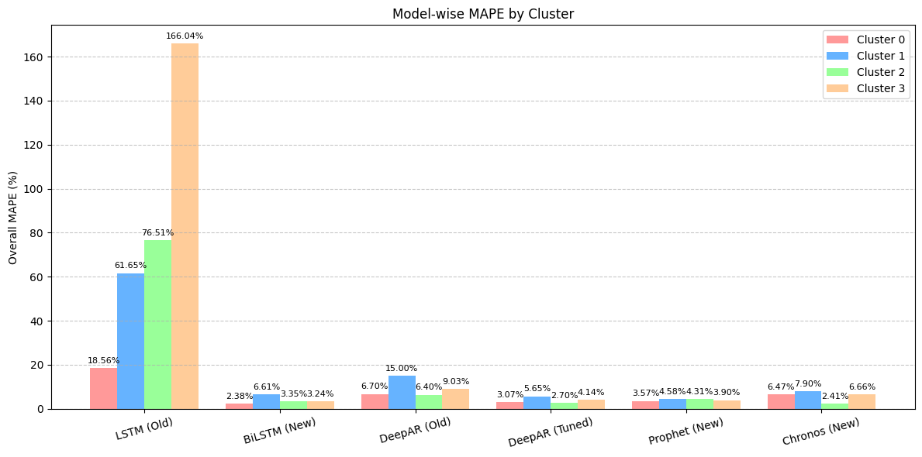
Results ~ Model Comparisons

Slide 24
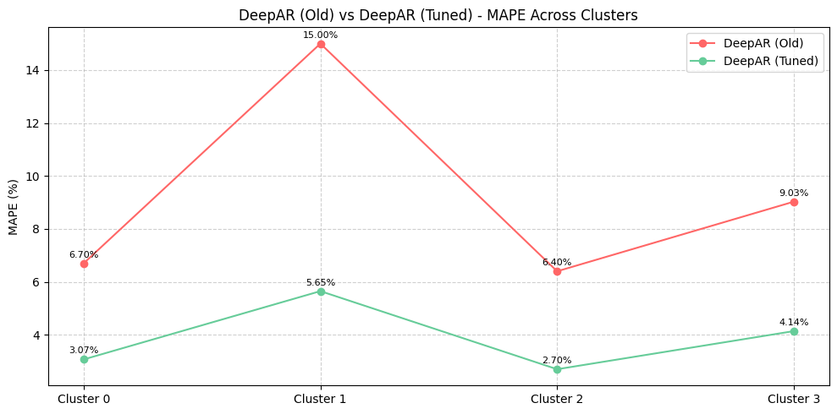
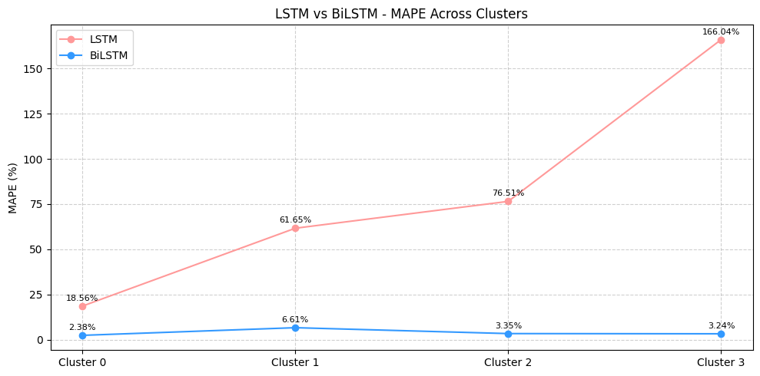
Improvements on Old Models By Data Prophets
Results

Slide 25
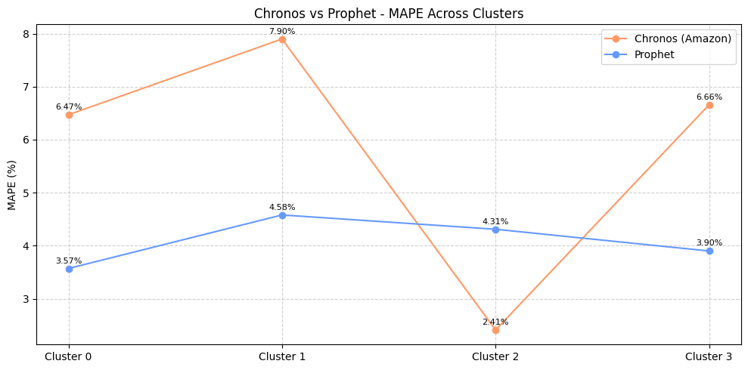
Transformer Based Chronos Vs Facebook Prophet
New Models By Data Prophets
->

Slide 26
Future Work Proposed by Fortune Tellers
Hyperparameter Tuning
We plan to do hyperparameter tuning for LSTM and DeepAR. Below are some important
LSTM: number of LSTM units, batch_size, learning _rate, number of layers, etc.
DeepAR: num_layers, hidden_size, dropout_rate, learning_rate, batch_size
Facebook Prophet model: Period, Fourier Order, Monthly Seasonality
Metric Evaluation: Except for MAPE, we plan to try other common metrics for time series forecasting like RMSE and sMAPE to see if any of them better interpret model performance and help with model comparison
Other Models: GRU, Transformer-Based Models

Slide 27
Recommended Techniques by Data Prophets
By redesigning the overall forecasting approach; apart from just tuning models, we addressed core issues in the original pipeline and implemented future-forward techniques. As Data Prophets, we recommend the following models for their accuracy, stability, and real-world adaptability across electricity usage clusters.
BiLSTM: Best overall accuracy
Replaced LSTM and cut MAPE from 18.56% → 2.38% (Cluster 0) and 166.04% → 3.24% (Cluster 3)
Built on the original team’s idea to explore better sequence models.
DeepAR (Tuned): Stable and consistent baseline and fixed data leakage issues with train/test flaws.
Hyperparameter tuning brought Cluster 2 MAPE down to 2.7%, improving both accuracy and robustness.
Prophet: Interpretable and effective for seasonal trends
Required minimal tuning and performed well (e.g., 3.57% MAPE in Cluster 0). Easy to explain and align with stakeholder needs.
Amazon Chronos: Best for real-time and irregular usage
Transformer-based, fully managed, and achieved lowest MAPE (2.41%) in Cluster 2.

Slide 28
Future Work from here onwards
With access to greater compute, the future work lies in enhancing the forecasting pipeline further by refining user clustering and exploring more advanced transformer-based models (e.g., Informer, Autoformer, PatchTST). These architectures will help us handle larger client bases, longer forecast horizons, and more complex usage behaviors; making the system truly production-ready for utility-scale deployment.

Slide 29

Thank you for reviewing the enhancements we introduced as Data Prophets building on the original modeling work by the Fortune Tellers.

