Slide 1

CAPSTONE PROJECT MoodMate: An AI-Powered Sentiment Companion
Presented By
Student Name: Shashwat SRIVASTAVA
College Name: SRM University
Department: computer application
Email ID: ss6545@srmist.edu.in
AICTE Student ID: STU64cb314ca60b11691038028

Slide 2
OUTLINE
Problem Statement
Proposed System/Solution
System Development Approach
Algorithm & Deployment
Result
Conclusion
Future Scope
References

Slide 3
Problem Statement
In today's fast-paced digital world, people often express their thoughts and emotions through text on social media, messaging platforms, and many online forums.
However, identifying them and replying to them appropriately in text is a challenge—especially in automated systems that lack empathy. There is a need for an intelligent system that can not only detect the emotional tone of a user's input but also provide supportive and improve their mood.

Slide 4
Proposed Solution
To address the need for emotionally intelligent interaction, I propose MoodMate, an AI-powered sentiment analysis chatbot that not only detects the sentiment of user input but also provides some motivational statements to boost moods of people and support them.
Using a pre-trained transformer model from the Hugging Face transformers library, the system analyzes the emotional tone (positive or negative) of user messages. Based on the detected sentiment, it selects a relevant response from a custom made dataset CSV file. The chatbot is deployed via a simple and interactive web interface using Gradio on huggingface, allowing users to type in their thoughts and receive both an accurate sentiment classification and a corresponding motivational message. This system serves as a lightweight emotional support tool, helping users feel acknowledged and encouraged in real-time.

Slide 5
System Approach
System Requirements
Operating System: Windows/Linux/MacOS
Python version: 3.8 or above
Web Browser: Any modern browser (Chrome, Firefox, Edge)
RAM: Minimum 4GB (8GB recommended)
Libraries Required to Build the Model
transformers – for sentiment analysis using pre-trained NLP models
gradio – for building and deploying the user-friendly web interface
csv – for reading mood-boosting suggestions from a custom file
random – to select suggestions dynamically
collections – specifically defaultdict for organized sentiment mapping

Slide 6
Algorithm & Deployment
Algorithm Selection:
The project utilizes a pre-trained transformer-based model for sentiment analysis, specifically using Hugging Face's pipeline("sentiment-analysis"). This model is chosen due to its strong performance on general-purpose sentiment classification tasks and its ability to understand emotional nuance in text.
Data Input:
The primary input to the system is free-form text entered by the user. This text is analyzed to determine the emotional sentiment (e.g., Positive or Negative). Based on this sentiment, the system selects a relevant mood booster from the CSV file.
Training Process:
The system uses a pre-trained model. The model operates as a zero-shot classifier.
Prediction Process:
When a user inputs a message, the model predicts its sentiment label and confidence score. The chatbot then selects a corresponding motivational message from a predefined list based on the predicted sentiment and returns it to the user via a web interface.

Slide 7
Result
The performance of the sentiment analysis chatbot is evaluated based on its ability to correctly identify user sentiment and provide relevant, uplifting suggestions. The chatbot classifies text inputs as either positive or neutral or negative using the pre-trained transformer model.
While no formal accuracy metric was computed (since the model is pre-trained), the system consistently returns predictions (typically >90% confidence scores) for most inputs. Screenshots and example use are shown in next slide.

Slide 8
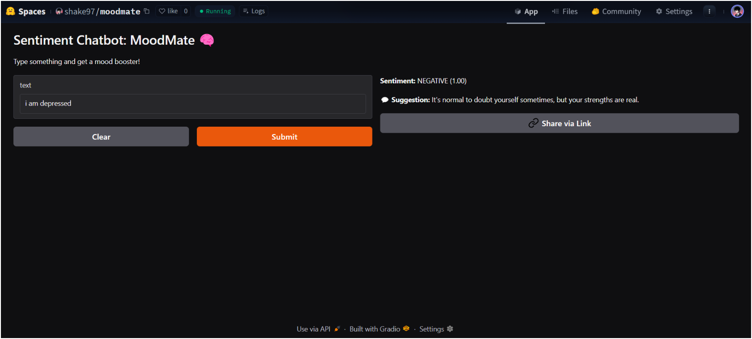
Result

Slide 9
Conclusion
The MoodMate chatbot successfully demonstrates the capability of leveraging pre-trained transformer models for real-time sentiment analysis and emotional support. The integration of sentiment detection with dynamic mood boosters provides users with an interactive and uplifting experience. During implementation, challenges included ensuring meaningful suggestions for all sentiment types and maintaining accurate sentiment classification for varied input expressions.
Future improvements can involve customizing the sentiment model with user-specific data or expanding the booster database to cover a wider range of emotional contexts.
Overall, this project highlights the practical application of NLP in enhancing user well-being and showcases how AI can be used creatively for emotional intelligence in digital interactions.

Slide 10
Future scope
There is significant potential to enhance and expand the MoodMate sentiment chatbot. Future improvements may include incorporating more diverse data sources and training the model with custom datasets to increase the accuracy and cultural sensitivity of sentiment detection. The chatbot can be enhanced to engage in more natural, human-like conversations by integrating advanced dialogue management systems and fine-tuning with conversational datasets .
Additionally, expanding language support, adding voice interaction, and integrating with wearable or mobile platforms could make the chatbot more accessible. Leveraging advanced machine learning techniques such as reinforcement learning or edge-based deployment can further optimize performance. Ultimately, the goal is to make MoodMate more emotionally intelligent and capable of smooth, meaningful interactions that truly support users in real-time.

Slide 11
References
A Deep Learning Approach to Sentiment Analysis for Chatbots. Procedia Computer Science
Deep Learning for Natural Language Processing. Machine Learning Mastery.
GitHub Link:

Slide 12
Thank you

