Slide 1
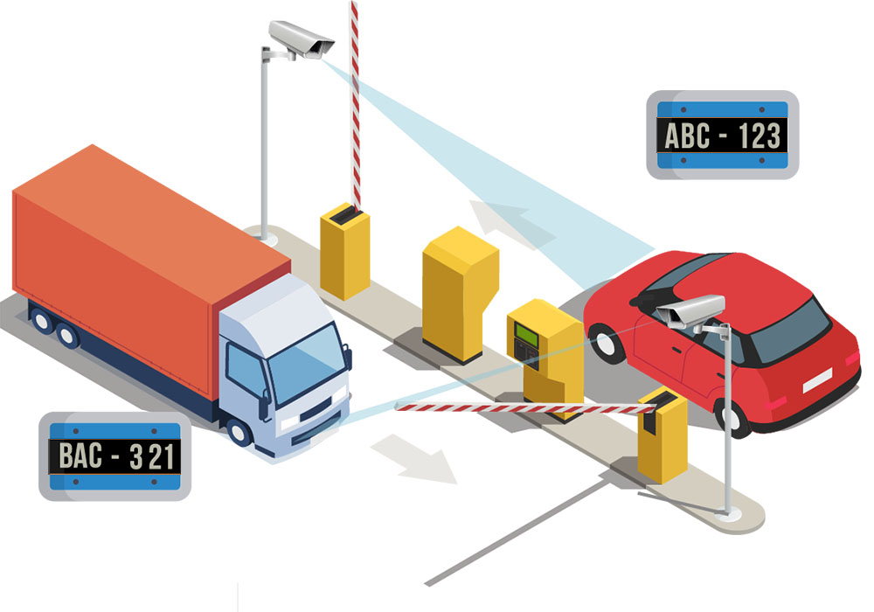
Vehicle Number Plate Detection and Recognition
UNDER THE MENTORSHIP OF :
Miss. Meenakshi Maindola
(Assistant Professor)
SUBMITTED BY:
Name: Shashwat Bansal University Roll no. : 2019487 Course: B. Tech AI & ML

Slide 2

INTRODUCTION
Vehicle Number Plate Detection and Recognition using OpenCV and EasyOCR
AN Automatic Number Plate Recognition(ANPR) specified dataset, preferably with plates from various countries and in different conditions, is essential for training robust license plate recogniton ssytem.
In this project, I have utilized OpenCV, a powerful computer vision library, and the pre-trained easyOCR model to build an efficient number plate detection system.
I have also used imutils to classify basic image processing functions such as translation, rotation, resizing and displaying matplotlib images easier with OpenCV

Slide 3
PROBLEM STATEMENT
License plates exhibit significant variability in terms of fonts, colors, and layouts across different regions and countries
The system should be capable of handling a wide range of lighting scenarios to ensure consistent performance.
In real-world scenarios, vehicles move at varying speeds and may approach the camera at different angles.The system must be capable of accurately detecting and recognizing number plates under these dynamic conditions.
The system must adhere to privacy regulations and ethical considerations. It should be designed to process and store data responsibly,

Slide 4
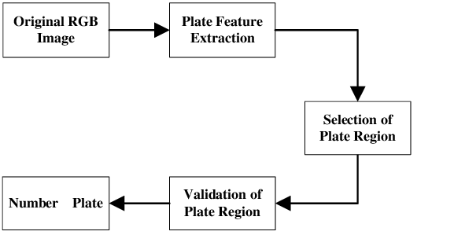
METHODOLOGY
Language used:
Python
Tool used:
Jupyter Notebook
Framework of Project

Slide 5

MODEL EVALUATION AND DEPLOYMENT
Objective: The goal is to develop a robust and scalable ANPR system that addresses the challenges mentioned above. The system should leverage state-of-the-art computer vision techniques, machine learning algorithms.
Data Collection: Gather a diverse dataset of vehicle images with annotated number plates for training and testing the ANPR model.
Fine-Tuning: Iteratively fine-tune the model based on evaluation results to enhance its performance, particularly in challenging scenarios such as varied lighting conditions and plate formats.

Slide 6
RESULT AND DISCUSSIONS
Our ANPR model was evaluated on a separate test dataset to assess its performance. We used the following metrics:
Accuracy: The overall accuracy of number Plate classification.
Precision: The ability to correctly identify true correct number.
Recall: The ability to correctly detect all actual Vehicle Number.
F1-score: The harmonic mean of precision and recall, providing a balanced performance measure.

Slide 7
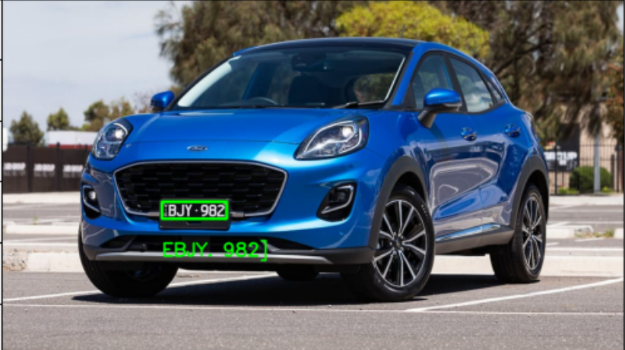
MODEL EVALUATION
The model demonstrates promising performance, accurately recognizing number plate in vehicles. Further fine-tuning and data augmentation could potentially improve the model's overall accuracy.

Slide 8
CONCLUSIONS AND FUTURE WORK
In conclusion, our vehicle number plate recognition project using easyOCR and OpenCV has demonstrated promising results in recognizing no. plate from vehicles.
Continued Model Optimization: Future efforts will focus on refining the ANPR model further, addressing any identified limitations or areas for improvement.
User-Friendly Integration: The ANPR system has been seamlessly integrated into existing systems, and a user-friendly interface allows for easy adoption. The system's interoperability ensures compatibility with diverse hardware setups.
Advanced Machine Learning Techniques: Exploring advanced machine learning and deep learning techniques to further enhance the system's intelligence and adaptability.

Slide 9

THANKYOU

