Slide 1
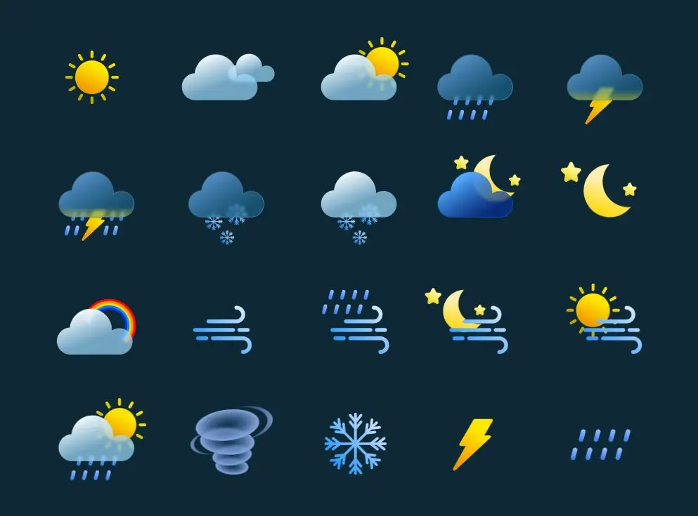
WEATHER APP USING REATCTJS
Name :SHASHWAT BANSAL
Roll No. : 2019487
Section :AI-ML
Under The Mentorship of :
Ms. Tanusha Mittal

Slide 2
INTRODUCTION
Our Weather App, developed using ReactJS, provides real-time weather updates with a user-friendly interface. The app allows users to search for weather conditions in any city, displaying current temperature, humidity, weather description. It uses the OpenWeatherMap API to fetch accurate weather data, ensuring users have up-to-date information at their fingertips. The app also features intuitive design , making it accessible on various devices.

Slide 3
WHY REACTJS ?
React.js is a powerful and versatile JavaScript library that enables efficient and scalable user interface development.
Key Features :
Virtual DOM for fast and efficient rendering
Component-based architecture for modular design
Seamless integration with third-party libraries and APIs
Benefits:
The use of React.js ensures a smooth and responsive user experience, fast development cycles, and maintainable codebase.

Slide 4
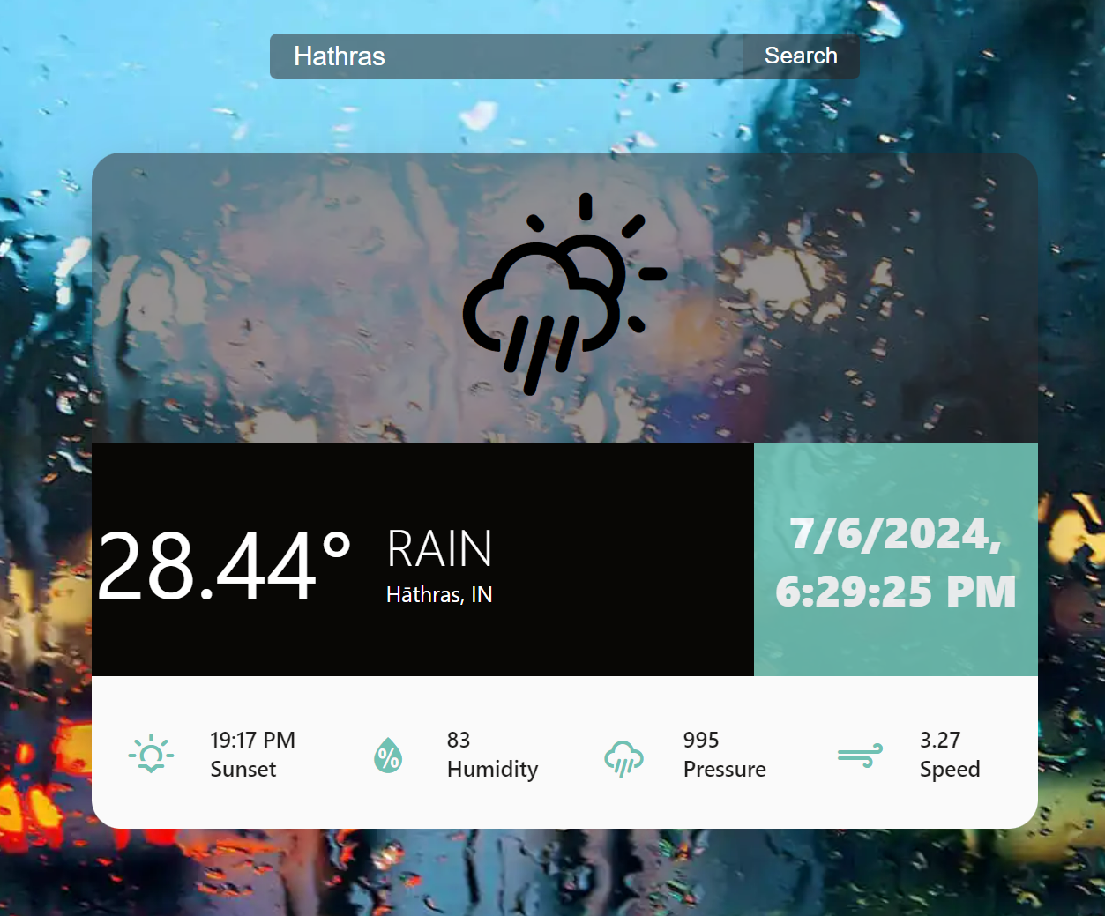
FEATURES
Real Time Weather Updates
Receive accurate, up-to-the-minute weather information for your location or any city of your choice.
Weather Forecasting
Plan your day with confidence by accessing detailed weather forecasts for the next few days.
Intuitive Interface
Enjoy a clean, visually appealing design that makes weather information easy to understand and navigate.

Slide 5
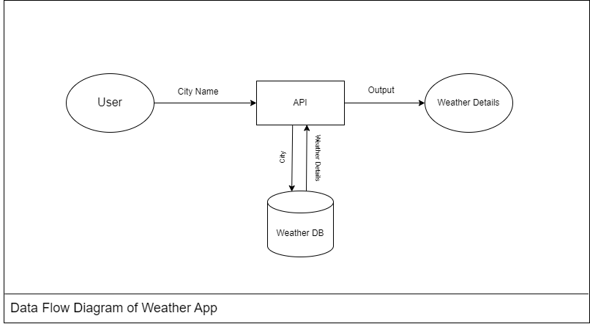



DATA FETCHING AND API INTEGRATION
Data Collection
Gather weather data from reliable third-party APIs, ensuring accuracy and timeliness.
API Integration
Seamlessly integrate the weather API into the React.js
application for a smooth data flow
Data Parsing
Extract and format the relevant weather data for efficient
display and processing

Slide 6
UI DESIGN
Weather Icons
Clear and intuitive weather icons to represent different weather conditions.
Temperature Display
Precise and easy-to-read temperature information for the current and forecasted weather.
Precipitation Indicators
Visual cues to highlight the likelihood and intensity of precipitation.

Slide 7

STATE MANAGEMENT
State Initialization
Set up the initial state of the weather app, including user location, current weather, and forecast data.
State Updates
Efficiently manage state changes, such as user location updates, API responses, and user preferences.
State Synchronization
Ensure smooth synchronization between the user interface and the underlying state, providing a seamless user experience.
1
2
3

Slide 8

FUTURE WORK
Personalization
Allow users to customize the app's appearance, preferences, and notification settings for a more personalized experience.
Advanced Forecasting
Integrate more comprehensive weather data, such as hourly forecasts, weather alerts, and historical trends, to provide users with deeper insights.
Voice Commands
Implement voice control functionality, enabling users to interact with the app hands-free and providing a more intuitive user experience.

Slide 9

CONCLUSION
The weather app leverages the power of React.js to deliver a seamless, user-friendly, and feature-rich experience. From real-time weather updates to personalized forecasts, this app aims to become an indispensable tool in your daily life, helping you stay informed and prepared.

Slide 10
THANK YOU

