Slide 1
VOL
Team member: Shashwat, Pujith, Yatharth, Justin
TA: Haoyang He
External Collaborator: Professor Wenshan Wang, Airlab
Improving Visual-Odometry using Lidar-Camera Fusion
Notes:
Main title: 40 pt. Arial
Presenter Name: 16 pt. Arial
Presenters Title: 16 pt. Arial Italic

Slide 2
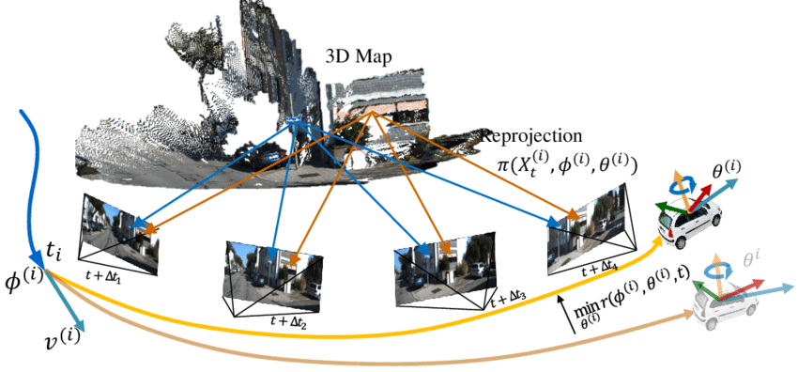
Definition for Visual Odometry (VO)
Visual odometry (VO) is crucial for autonomous systems and is a key component of visual SLAM.
Given RGB (+LiDAR) frames, we estimate the relative rotation and translation between sequential frames.
Notes:
ref: https://www.researchgate.net/figure/The-illustration-of-our-visual-odometry-framework-The-initial-state-vti-of-current_fig2_332103736
Presenter Name: 16 pt. Arial
Presenters Title: 16 pt. Arial Italic

Slide 3
Visual odometry (VO) is crucial for autonomous systems and is a key component of visual SLAM.
Geometry-based methods are unreliable in challenging environments, such as around dynamics obstacles and rapid movements.
Learning-based monocular VO(TartanVO) has shown impressive real-world performance even when solely trained on simulated dataset.
But, monocular images have scale ambiguity, meaning they lack the inherent depth information.
Lidar lacks sufficient salient information to compute detailed semantics or establish correspondences between frames effectively
Motivation
Notes:
Main title: 40 pt. Arial
Presenter Name: 16 pt. Arial
Presenters Title: 16 pt. Arial Italic

Slide 4
We propose a multimodal approach to Visual Odometry, combining the rich contextual features of monocular RGB images with the precise 3D structure from LiDAR data. This fusion enhances both depth perception and semantic understanding for improved motion estimation.
Project Proposal
Dataset
TartanAir v2
Size: 40TB
Environments: 100 diverse environments containing indoor and outdoor scenes
Modalities: RGB, LiDAR, Depth, Poses, Trajectories
Notes:
Main title: 40 pt. Arial
Presenter Name: 16 pt. Arial
Presenters Title: 16 pt. Arial Italic

Slide 5
Baselines
Unimodal Baselines
RGB:
Classical: ORB-SLAM, LSD-SLAM
Learning: TartanVO, DytanVO, DPVO
LiDAR:
Classical: ICP-SLAM, LOAM
Learning: LO-NET
Multimodal Baselines
Classical: V-LOAM
Learning: DV-LOAM, H-VLO, DVLO (RGB+LiDAR)

Slide 6
Approaches
Train image encoder with strong 3D-centric features by distilling LiDAR data
RGB to LiDAR masked autoencoder
Align image feature with LiDAR features? Contrastive training?
Joint Embedding Prediction with RGB and LiDAR
Early Fusion
Use 2D and 3D convs to patch/encode images and LiDAR, respectively, and cross-attend
Intermediate Fusion
Use RGB image for auxiliary task (computing flow) and fuse this with LiDAR
Late Fusion
Have two transformers, one for images and one for LiDAR, concatenate outputs and have a linear layer at the end
Notes:
Think about scenarios of RDB modality confusion like b.w: pothole or a shadow
There should not be information leak such that Lidar gets preference
RGB modality having a reasoning of whether all the objects in the scene have their shadows projected similarly and this might be a rock shadow or not can be considered.

Slide 7
Some Queries
Is there a requirement on number of unimodal / multimodal baselines?

