Slide 1
CSE518 : Artificial Intelligence
Project Presentation
Feni Vithani - AU2340119
Shashwat Gohel - AU2340235

Slide 2
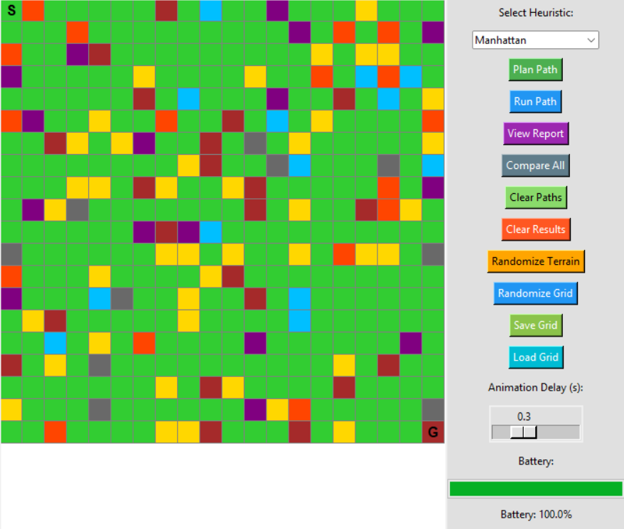
A Reflex Rover Agent
Battery-Aware Path Planning in Dynamic Terrain

Slide 3
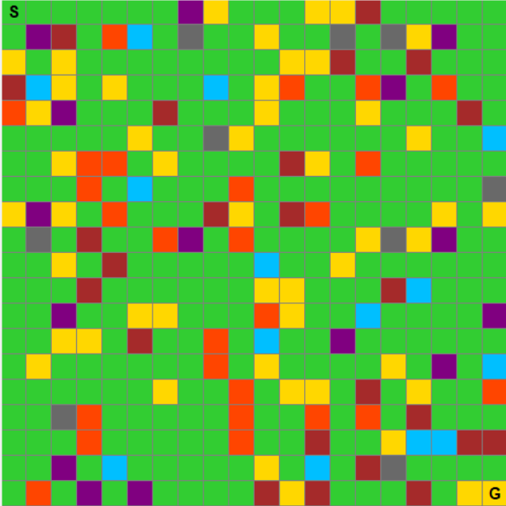
The Grid and the Terrain
7 types of Terrains :
Sandy (Yellow) - Cost:10
Rock (Brown) - Blocked
Recharge (Blue) - Cost: 5 + Full Charge
Hazardous (Orange) - Cost: 15
Trap (Purple) - Cost: 20
Cliff (Gray) - Blocked
Flat (Green) : Cost = 5

Slide 4
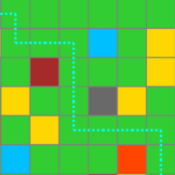
Rover Movement
Movement :
4 - directional movement.
Cost = Terrain Cost * 1.0
A* Algorithm :
f(n) = g(n) + h(n).
g(n) = Actual Cost from the Start
f(n) = Heuristics Guess
Completely Skips the Rocks, Cliff blocks

Slide 5
4 - Heuristics
Manhattan :
Movement Like the blocks in the city ( Left, Right, Up and Down) .
Euclidian :
The straight line Distance between 2 points - just like measuring distance with ruler.
Terrain Penalized :
Adds a penalty proportionals to local terrain cost .
Path of Least Regret:
Prevents the rover from moving into a area of varying terrain

Slide 6
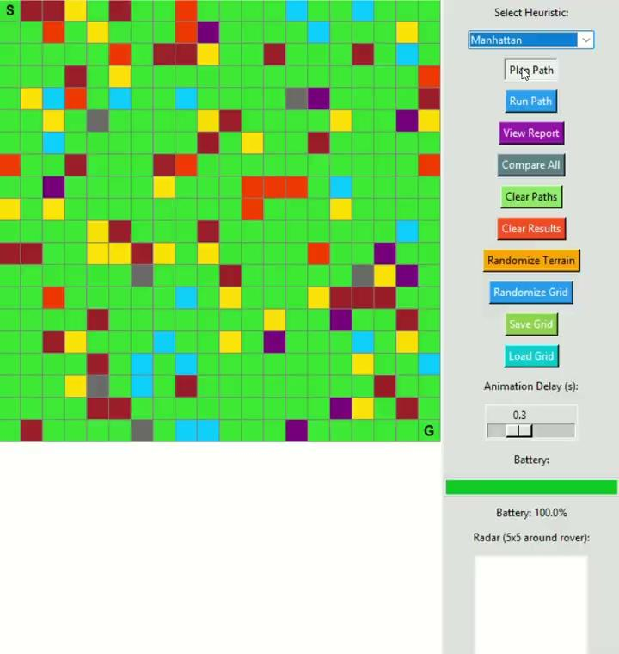
Manhattan Heuristics
Measures distance by counting only horizontal and vertical steps.
Best for grid maps without diagonal movement.
Produces staircase-like paths.

Slide 7
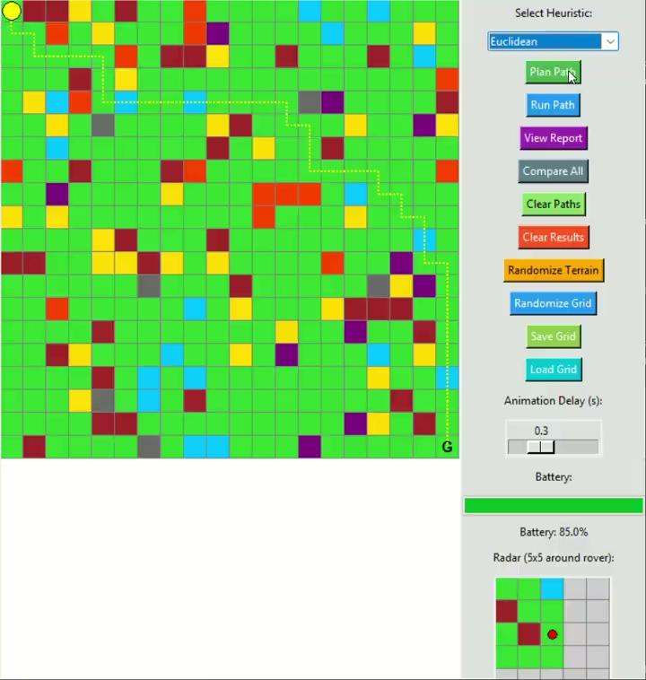
Euclidian Heuristics
Measures the straight-line distance between two points.
Best when diagonal or free-direction movement is allowed.
Produces smoother, more direct paths.

Slide 8
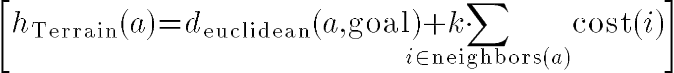
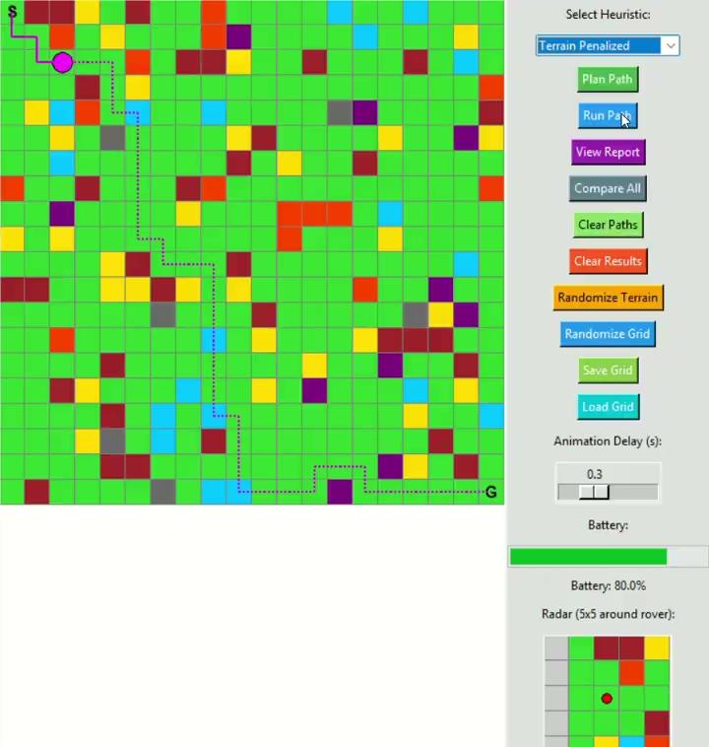
Terrain Penalized Heuristics
Adds extra cost for moving through difficult terrain (rocks, sand, steep areas).
Helps avoid high-cost or unsafe regions, even if the path is longer.
Not admissible because penalties may exceed optimal cost

Slide 9
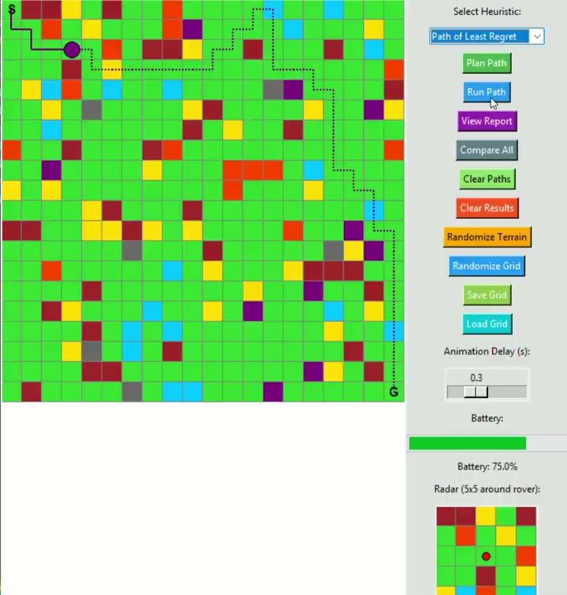
Path of Least Regret Heuristics
Penalizes areas with high variance in terrain cost (unstable or unpredictable ground).
Favors consistent, low-risk regions over risky ones.
Useful in noisy or uncertain environments.

Slide 10
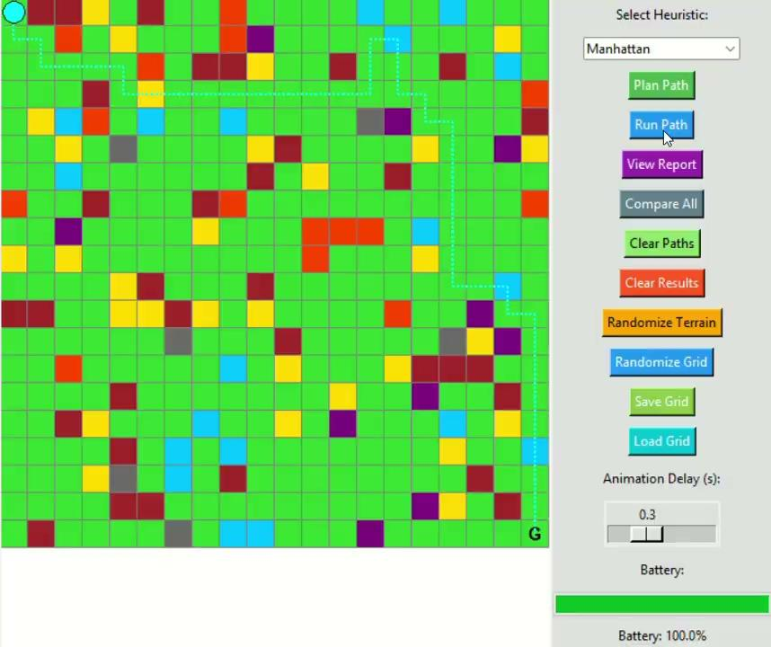
Battery System & Recharge Logic
Battery starts at 100%.
Battery decreases by a fixed amount at each step.
If battery falls below 20%, the system switches to emergency mode.
If the direct path requires more than 100% battery, recharge stops must be added.
The route can contain up to a maximum of eight segments.
A recharge station will always be available within two cells of any position.

Slide 11
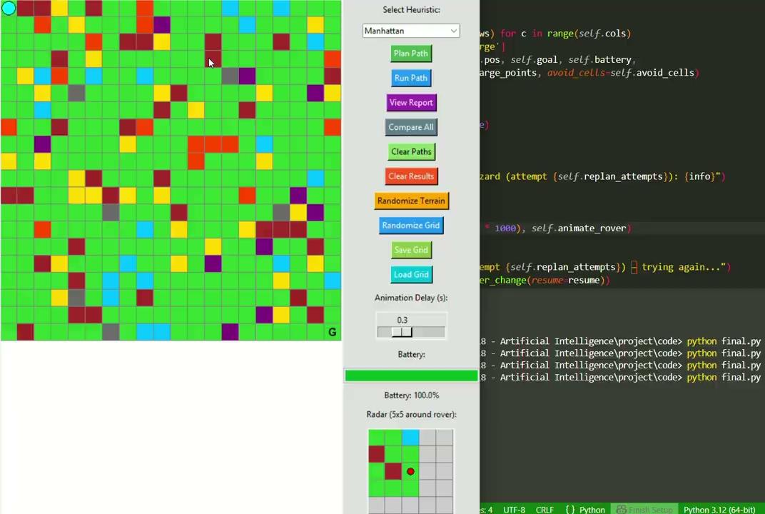
Reflex Agent: React to Danger
On encountering hazardous terrain, the rover adds the cell to its avoid list.
It immediately backtracks 2–3 steps to a safe position.
On stepping into a trap, the rover converts the cell into a permanent rock and triggers a red flash alert.
With low battery, the rover reroutes to the nearest recharge point.
Upon entering either hazardous or trap terrain, the rover instantly backtracks 2–3 steps, stores the cell in its avoidance memory, and initiates a fresh path replanning cycle.

Slide 12
Comparison of the Heuristics
Heuristic | How It Works | Strength | Limitation
Manhattan | Counts horizontal & vertical steps only | Simple, fast, perfect for grid movement | Paths can look blocky/staircase-like
Euclidean | Straight-line distance between points | Smooth, direct routes | Less accurate on strict grid movement
Terrain-Penalized | Adds cost based on terrain difficulty | Avoids unsafe or high-cost regions | Inadmissible; may give longer paths
Path of Least Regret | Penalizes areas with unstable terrain values | Favors stable, predictable ground | Can avoid areas unnecessarily

Slide 13
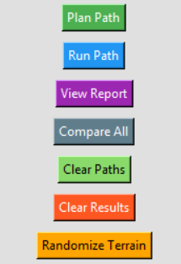
Unique Features
World Changes:
3% random per step
2 scheduled changes (user)
Re-planning:
Max 3 attempts
Fail 3x→ Rover dies (Red Flash)

Slide 14
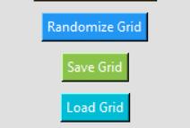
Unique Features
Novel Features:
Save/Load Grid (.json) — reuse maps
Radar System — 5×5 sensor view
Randomize Terrain — 2 surprise changes during the run
Compare All — view 4 paths at once
Clear Trails/Results — clean UI
Real World Use:
Drones, Self-driving Cars, Mars Rover

Slide 15
THANK YOU

