Slide 1

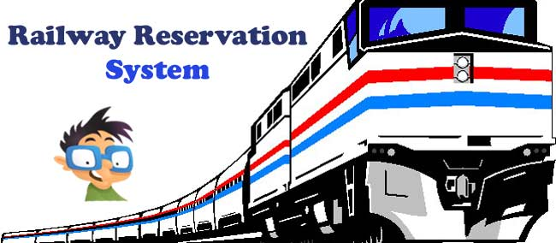
OBJECT ORIENTED PROGRAMMING IN JAVA :PROJECT(cs1304)
RAILWAY RESERVATION SYSTM
Presented by: SHASHWAT MALHOTRA Registration number: 189202122
CSe-D

Slide 2
INTRODUCTION
This project introduces railway reservation system . It explains how reservation is being done in Indian Railways . The step by step procedure is explained . This project is developed in java language . All most all the header files have been used in this project .Proper comments have been given at desired locations to make the project user friendly . Various functions and structures are used to make a complete use of this language .This project is well versed with the programming . Railway reservation can easily accompanied with the help of this.
Today one cannot afford to rely on the fallible human beings of be really wants to stand against today’s merciless competition where not to wise saying “to err is human” no longer valid, it’s outdated to rationalize your mistake. So, to keep pace with time, to bring about the best result without malfunctioning and greater efficiency so to replace the unending heaps of flies with a much sophisticated hard disk of the computer. One has to use the data management software . Software has been an ascent in atomization various organizations. Many software products working are now in markets, which have helped in making the organizations work easier and efficiently. Data management initially had to maintain a lot of ledgers and a lot of paperwork has to be done but now software production this organization has made their work faster and easier. Now only this software has to be loaded on the computer and work can be done . This prevents a lot of time and money. The work becomes fully automated and any information regarding the organization can be obtained by clicking the button. Moreover, now it’s an age of computers of and automating such an organization gives the better look.

Slide 3
CURRENT WORK – WHAT HAVE WE DONE TILL NOW?
Inheritance
Static Keyword
This keyword
Method overriding
Interface
Array of Objects
String class
File handling
Try-catch block
Exception Handling
User defined exceptions
Throw keyword
Threads in Java
Runnable
Serializable
File Handling
Input/Output File Stream
Input/Output Object Stream

Slide 4
SOFTWARE REQUIREMENTS
TECHNOLOGIES: CORE JAVA
PLATFORM: JAVA RUNTIME ENVIRONMENT(JRE) 1.6 OR ABOVE
OPERATING SYSTEM: WINDOWS 10/8/7/XP, LINUX
OTHER TOOLS: TEXT EDITOR(NOTEPAD)

Slide 5
EXPLANATION
This project start by displaying the various options for the user to do the operations which he/she wants to perform.
They can perform the various operations like booking ticket , cancelling ticket ,searching for a passenger etc by pressing one arithmetic value bw 1-9 and perform the task.
BOOKING A TICKET- 1. First of all user is asked to tell in which class he\she wants the ticket to get booked.
2. Then program checks the availability of ticket in a particular class.
3. Then the programmer ask for passenger name , age , phone no.
4. After entering all the details it display that your ticket is booked and pls pay this much amount.
CANCELLING A TICKET- After booking a ticket each passenger gets a unique passenger no. by entering a passenger no.
if your passenger no. gets matched it will display pls collect the amount and finally it will display ticket is cancelled successfully.
RESERVATION CHART DISPLAY- This function display the no. of booked ticket in different class and display all the information of each and every passenger.
SEARCHING A PASSENGER- this function ask for the passenger no to get searched if passenger no. matches with the data present then all the information will get display otherwise it will display no such passenger found.

Slide 6
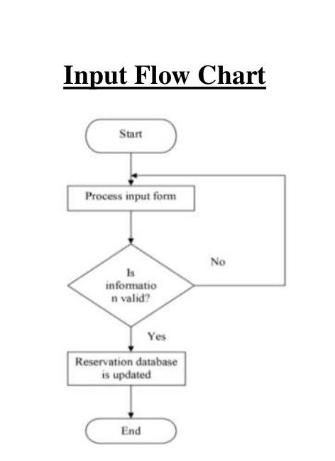
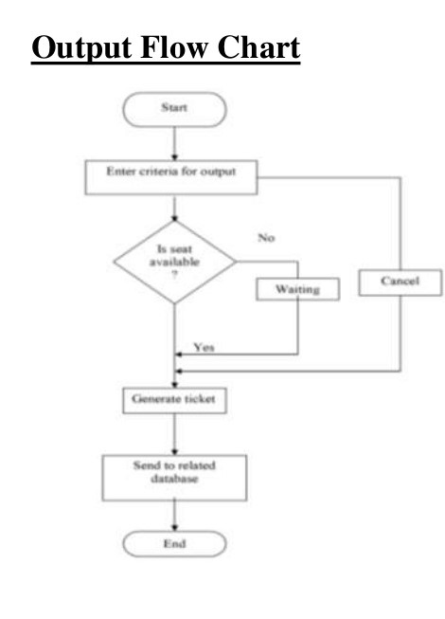
FLOW DIAGRAM AND METHODOLOGY

Slide 7
CODE(APPENDIX)
import java.io.*;
public class railreserve
{
InputStreamReader isr=new InputStreamReader (System.in);
BufferedReader br=new BufferedReader (isr);
//System.out.println("Please enter a word"
// );
//pno = pnr no.
int pno[]=new int[275];
String name[]=new String[275];
//phno = phone no.
String phno[]=new String[275];
int age[]=new int[275];
//cl == class
int cl[]=new int[275];
int pcount=0;
int pnum=1;
//max seat in Ac class
int max1=75;
int max2=125;
int max3=175;

Slide 8
public static void main(String args[])throws Exception
{
railreserve train1 = new railreserve();
train1.doMenu();
}
public void doMenu()throws Exception
{
int cho=0;
do
{
System.out.println("\f");
doHeading();
System.out.println("1.Book ticket");
System.out.println("2.Cancel ticket");
System.out.println("3.Search passenger");
System.out.println("4.Reservation chart");
System.out.println("5.Display unbooked tickets");
System.out.println("6.Exit");
System.out.println("Please enter your choice");
cho=Integer.parseInt(br.readLine());

Slide 9
switch(cho)
{
case 1:doBook();
break;
case 2:doCancel();
break;
case 3:doSearch();
break;
case 4:doDispList();
break;
case 5:doDispUnbooked();
break;
case 6:doExit();
break;
default :System.out.println("Invalid choice");
}
}while(cho!=6);
}

Slide 10
private void doHeading()throws Exception
{
System.out.println("#########################################################");
System.out.println("*********Railway Reservation For Kabul Express***********");
System.out.println("#########################################################");
}
private void doBook()throws Exception
{
System.out.println("Please enter the class of ticket");
System.out.println("1. AC\t 2. First\t 3. Sleeper\t");
//c is for storing class of train
int c =Integer.parseInt(br.readLine());
System.out.println("Please enter no. of tickets");
int t=Integer.parseInt(br.readLine());
int ticketAvailable = 0;

Slide 11
if(c==1 && max1>=t)
{
ticketAvailable=1;
}
if(c==2 && max2>=t)
{
ticketAvailable=1;
}
if(c==3 && max3>=t)
{
ticketAvailable=1;
}
if(ticketAvailable==1)
{
for(int i=0 ; i<t ; i++)
{
pno[pcount]=pnum;
System.out.println("Please enter your name");
name[pcount]=br.readLine();
System.out.println("Please enter your age");
age[pcount]=Integer.parseInt(br.readLine());
cl[pcount]=c;

Slide 12
System.out.println("Please enter your phno");
phno[pcount]=br.readLine();
pcount++;
pnum++;
System.out.println("Ticket successfully booked");
}
if(c==1)
{
max1 -= t;
System.out.println("Please pay Rs."+t*1500);
}
if(c==2)
{
max2 -= t;
System.out.println("Please pay Rs."+t*1200);
}
if(c==3)
{
max3 -= t;
System.out.println("Please pay Rs."+t*1000);
}
System.out.println("Paid successfully");
}

Slide 13
private void doCancel()throws Exception
{
int t_pno[]=new int[275];
String t_name[]=new String[275];
String t_phno[]=new String[275];
int t_age[]=new int[275];
int t_cl[]=new int[275];
int t_pcount=0;
int passengerFound=0;
System.out.println("Please enter your passenger no.");
int p=Integer.parseInt(br.readLine());

Slide 14
for(int i=0;i<pcount;i++)
{
if(pno[i]!=p)
{//transfer
t_pno[t_pcount]=pno[i];
t_name[t_pcount]=name[i];
t_phno[t_pcount]=phno[i];
t_age[t_pcount]=age[i];
t_cl[t_pcount]=cl[i];
t_pcount++;
}
else
{
passengerFound=1;
if(cl[i]==1)
{
max1++;
System.out.println("Please collect refund of Rs."+1800);
}

Slide 15
if(cl[i]==2)
{
max2++;
System.out.println("Please collect refund of Rs."+1500);
}
if(cl[i]==3)
{
max3++;
System.out.println("Please collect refund of Rs."+1000);
}//else
}//if
}
if(passengerFound==1)
{
pno=t_pno;
name=t_name;
age=t_age;
cl=t_cl;
phno=t_phno;
pcount=t_pcount;
System.out.println("ticket successfully cancelled");
}
}//method

Slide 16
private void doDispList()throws Exception
{
System.out.println("Passenger list in AC class");
System.out.println("pno \t name \t\t age \t phno");
for(int i=0;i<pcount;i++)
{
if(cl[i]==1)
{
System.out.println(pno[i]+"\t"+name[i]+"\t\t"+age[i]+"\t"+phno[i]);
}
}
System.out.println("Passenger list in First class");
System.out.println("pno \t name \t\t age \t phno");
for(int i=0;i<pcount;i++)
{
if(cl[i]==2)
{
System.out.println(pno[i]+"\t"+name[i]+"\t\t"+age[i]+"\t"+phno[i]);
}
}
System.out.println("Passenger list in Sleeper class");
System.out.println("pno \t name \t\t age \t phno");

Slide 17
for(int i=0;i<pcount;i++)
{
if(cl[i]==3)
{
System.out.println(pno[i]+"\t"+name[i]+"\t\t"+age[i]+"\t"+phno[i]);
}
}
}
private void doSearch()throws Exception
{
int passengerFound=0;
System.out.println("Please enter passenger no. to search");
int p=Integer.parseInt(br.readLine());

Slide 18
for(int i=0;i<pcount;i++)
{
if(pno[i]==p)
{
System.out.println("Detail found");
passengerFound=1;
System.out.println("passenger no.="+pno[i]);
System.out.println("name="+name[i]);
System.out.println("class="+cl[i]);
System.out.println("phno="+phno[i]);
System.out.println("age="+age[i]);
}
}//for
if(passengerFound==0)
System.out.println("No such passenger");
}//method
private void doDispUnbooked()throws Exception
{
System.out.println("No. of booked tickets status");
System.out.println("AC class"+max1);
System.out.println("First class"+max2);
System.out.println("Sleeper class"+max3);
}

Slide 19
private void doExit()
{
System.out.println("&&&&&&&&&&&&&&&&&&&&&&&&&&&&&&&&&&&&&&");
System.out.println("Name : Shashwat Malhotra , Branch : CSE, Section : D, Roll No. : 4, Registration no. : 189202122");
System.out.println("&&&&&&&&&&&&&&&&&&&&&&&&&&&&&&&&&&&&&&");
};
}

Slide 20
OUTPUT
D:\java>javac railreserve.java D:\java>java railreserve ######################################################### *********Railway Reservation For Kabul Express*********** ######################################################### 1.Book ticket 2.Cancel ticket 3.Search passenger 4.Reservation chart 5.Display unbooked tickets 6.Exit Please enter your choice 1 Please enter the class of ticket 1. AC 2. First 3. Sleeper 1 Please enter no. of tickets 1 Please enter your name Shashwat Please enter your age 19 Please enter your phno 9928686955 Ticket successfully booked Please pay Rs.1500 Paid successfully

Slide 21
######################################################### *********Railway Reservation For Kabul Express*********** ######################################################### 1.Book ticket 2.Cancel ticket 3.Search passenger 4.Reservation chart 5.Display unbooked tickets 6.Exit Please enter your choice 4 Passenger list in AC class pno name age phno 1 Shashwat 19 9928686955 Passenger list in First class pno name age phno Passenger list in Sleeper class pno name age phno

Slide 22
######################################################### *********Railway Reservation For Kabul Express*********** ######################################################### 1.Book ticket 2.Cancel ticket 3.Search passenger 4.Reservation chart 5.Display unbooked tickets 6.Exit Please enter your choice 3 Please enter passenger no. to search 1 Detail found passenger no.=1 name=Shashwat class=1 phno=9928686955 age=19

Slide 23
######################################################### *********Railway Reservation For Kabul Express*********** ######################################################### 1.Book ticket 2.Cancel ticket 3.Search passenger 4.Reservation chart 5.Display unbooked tickets 6.Exit Please enter your choice 5 No. of booked tickets status AC class74 First class125 Sleeper class175

Slide 24
######################################################### *********Railway Reservation For Kabul Express*********** ######################################################### 1.Book ticket 2.Cancel ticket 3.Search passenger 4.Reservation chart 5.Display unbooked tickets 6.Exit Please enter your choice 2 Please enter your passenger no. 1 Please collect refund of Rs.1800 ticket successfully cancelled

Slide 25
######################################################### *********Railway Reservation For Kabul Express*********** ######################################################### 1.Book ticket 2.Cancel ticket 3.Search passenger 4.Reservation chart 5.Display unbooked tickets 6.Exit Please enter your choice 6 &&&&&&&&&&&&&&&&&&&&&&&&&&&&&&&&&&&&&& Name : Shashwat Malhotra , Branch : CSE, Section : D, Roll No. : 4, Registration no. : 189202122 &&&&&&&&&&&&&&&&&&&&&&&&&&&&&&&&&&&&&&

Slide 26
CONCLUSION
Rather than designing manually we have made use of computer as
once that data’s are input it performs accurate function. There is no
chance of fault or miscalculation if the data are feeded correctly. Use of
the computers has solved many problems, which are faced while manual
calculation.
This is not the end but beginning of the versatile, efficient and
outsourcing railway reservation system. This is the one which is
Railway Reservation System
compatible to all operating system. By making this we project we made a
small footstep towards the path of progress of platform independent
railway reservation system.
LIMITATION OF THE PROJECT:
1. The most significant limitation of over project is its dependency
over the server because of this when is fail then whole work is to be
stopped.
2. Response time of the system may vary because of variable
network speed.
3. Another limitation of our project is that in this software and
hardware requirement is high comparison of existing system.
4.This is for only one train Kabul express so we need database for all train to display their data.

