Slide 1
Loan Prediction
Group no: 8
Shashwath Kumar - PES2201800623
Manas V Shetty - PES2201800670
Yogadisha S - PES2201800037

Slide 2
Objectives
Cleaning the dataset
Analysing trend of Loan Amount drawn depending on Property
Analysing Loan Approval depending on Education
Analysing Loan Approval depending on Credit History
Normalizing data
Checking if data is normalized
Finding Correlation between variables
Plotting a Simple Linear Regression between Income and Loan
Hypothesis Testing
Notes:
Analysing Trend of Loan Amount drawn depending on Property Area

Slide 3
Dataset
Title : Loan Prediction
Source : https://datahack.analyticsvidhya.com/contest/practice-problem-loan-prediction-iii/
Description : Analysing Loan Data
No. of rows : 613
No. of variables : 6 Numerical, 6 Categorical

Slide 4
Variable Description
Gender - Male/Female 13 Null
Married – Yes/No 3 Null
Dependents – Number of people dependent on Applicant 15 Null
Education – Graduate/Non-Graduate 0 Null
Self-Employed- Yes/No 32 Null
Applicant Income 0 Null
Co applicant Income 0 Null
Loan Amount 22 Null
Loan Amount Term – Time to pay off loan 14 Null
Credit History – If they have paid previous loans 50 Null
Property Area – Urban/Semi-urban/rural 0 Null
Loan Status – Y/N 0 Null
No. of columns: 12

Slide 5
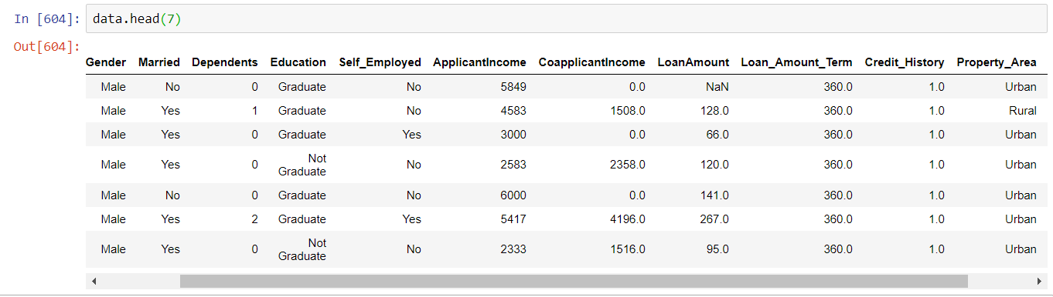

Slide 6
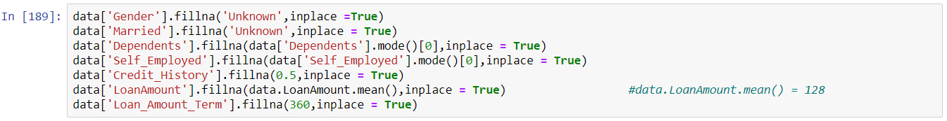
Data Cleaning
Gender, Married, Credit_History Null values are replaced with ‘Unknown’
Dependents, Self_Employed, Loan_Amount_Term null values are replaced with mode
Loan Amount null values replaced with mean
Remove column Loan_ID
Changing categorical data in Loan Status to 1s and 0s
Adding an additional variable – Total Income

Slide 7
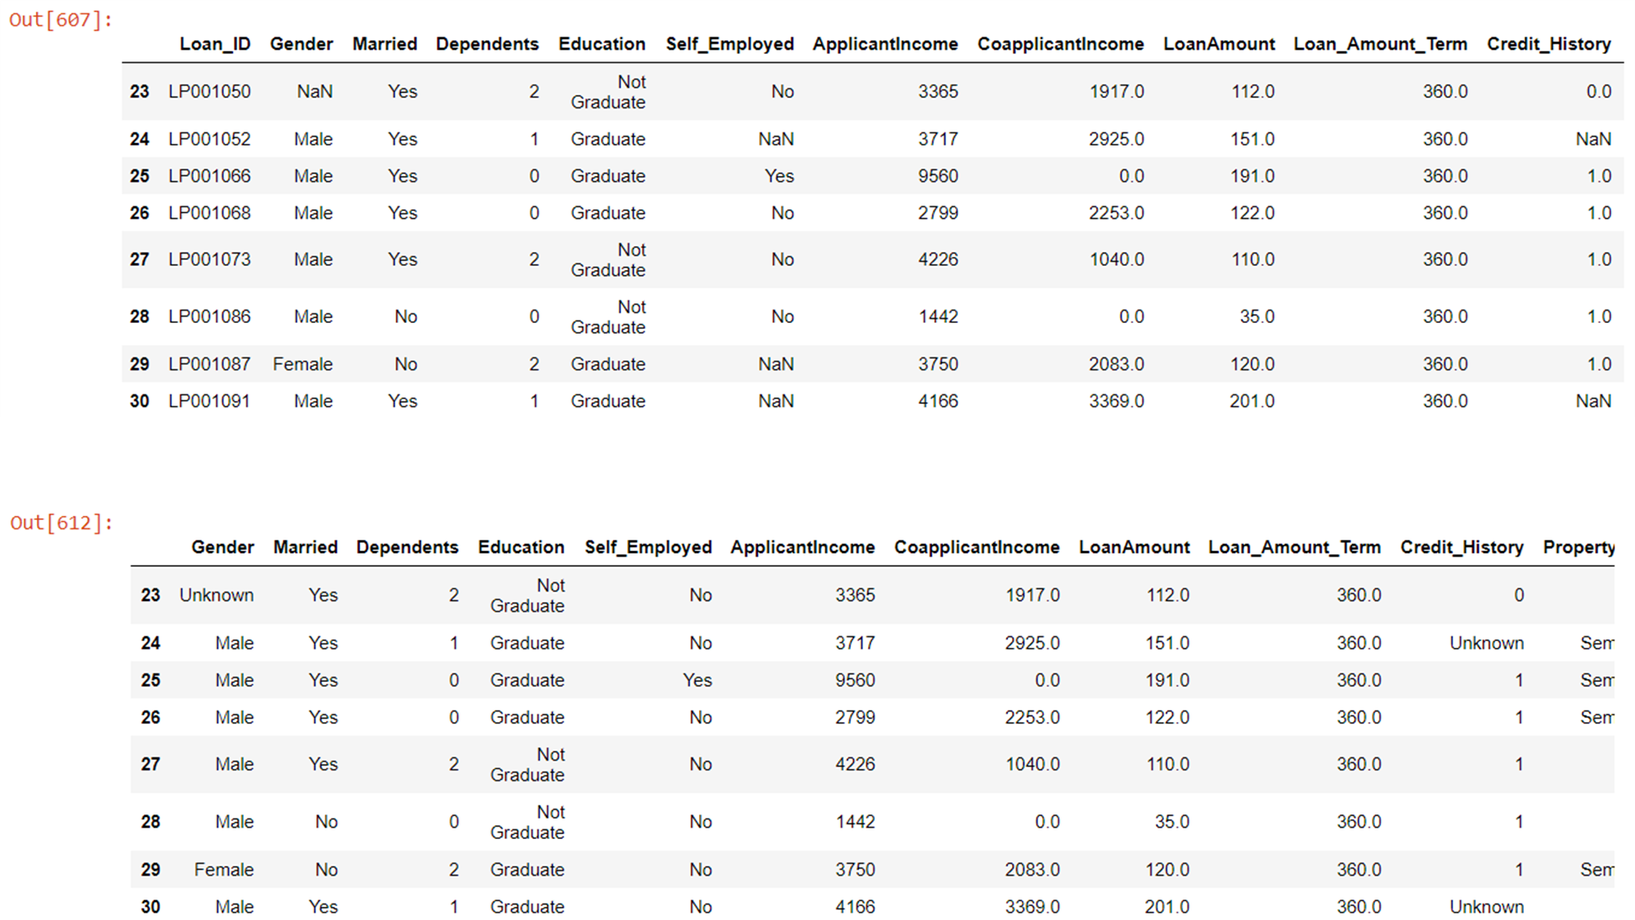
Comparison

Slide 8
Data Normalization and Standardization
Normalization is the process of organizing a database to reduce redundancy and improve data integrity.
The goal of normalization is to change the values of numeric columns in the dataset to a common scale, without distorting differences in the ranges of values.
Data standardization is this process of making sure that your data set can be compared to other data sets.
In our data set we normalize Loan Amount and Total Income so that they can be compared with each other

Slide 9
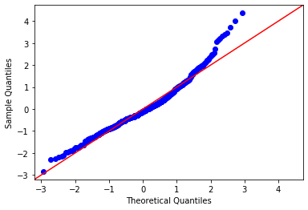
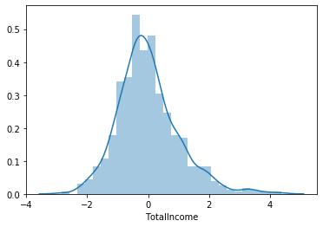
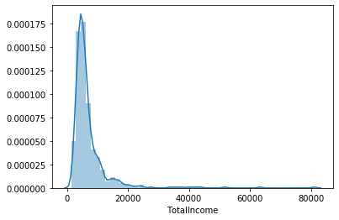
Checking with Q-Q plot
Log is applied to remove the right skewness of the graph

Slide 10

Data Visualization

Slide 11
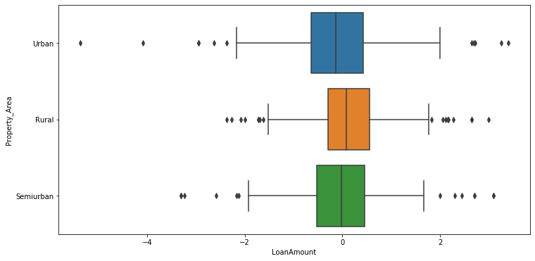
Trends between Area and Loan taken
sns.boxplot(x = 'Property_Area', y = 'LoanAmount', data = data, orient = 'v')

Slide 12
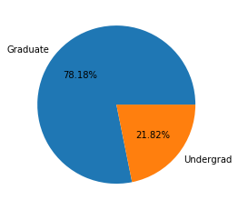
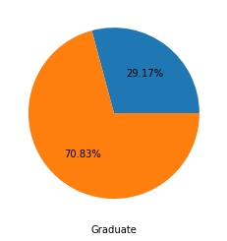
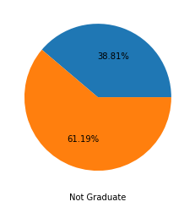
Education and Loan Approval
plt.pie(data.Education.value_counts(),labels=['Graduate','Undergrad'],autopct='%1.2f%%’)
gbs = data.groupby(by=["Education", "Loan_Status"]).size()
plt.figure(0)
plt.pie([gbs[0],gbs[1]],autopct='%1.2f%%')
plt.xlabel('Graduate')
plt.figure(1)
plt.pie([gbs[2],gbs[3]],autopct='%1.2f%%')
plt.xlabel('Not Graduate’)
Graduates have a higher rate of Loan Approval

Slide 13
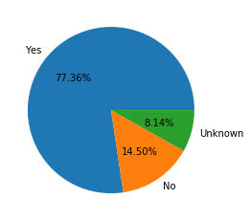
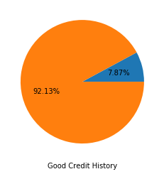
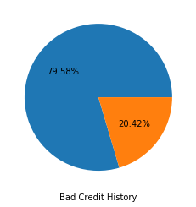
Credit History and Loan Approval
plt.pie(data.Credit_History.value_counts(),labels=['Yes','No','Unknown'],autopct='%1.2f%%’)
gbs = data.groupby(by=["Credit_History", "Loan_Status"]).tolist().size()
plt.figure(0)
plt.pie([gbs[1],gbs[0]],autopct='%1.2f%%')
plt.xlabel('Good Credit History')
plt.figure(1)
plt.pie([gbs[3],gbs[2]],autopct='%1.2f%%')
plt.xlabel('Bad Credit History’)
Loan Approved 92% of the time for people with Good credit history

Slide 14
Exploratory Analysis
All three property areas have similar means and interquartile ranges.
However, we can see that urban properties have a much wider range.
Graduates make up the vast majority of applicants for loans.
Graduates also have a higher loan approval rate compared to non graduates
Only 20% of applicants were given approval with a bad credit history
But, 92% of applicants were approved with a good credit history

Slide 15
Correlation and Regression

Slide 16
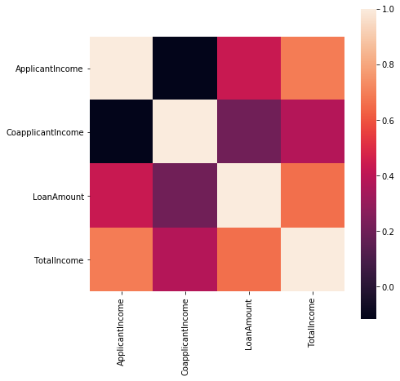
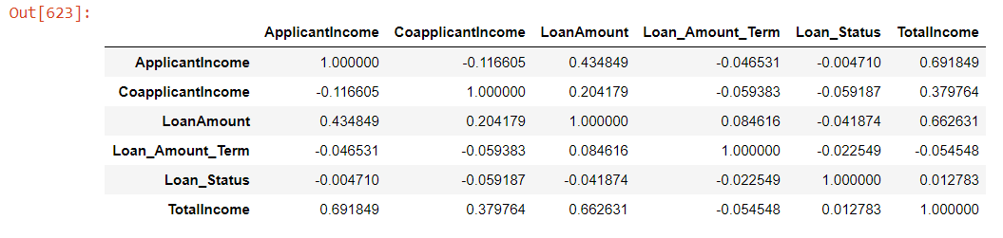
Correlation
statistical technique that can show whether and how strongly pairs of variables are related.
From the graph we can see that Loan Amount and Total Income are correlated with r=0.66

Slide 17
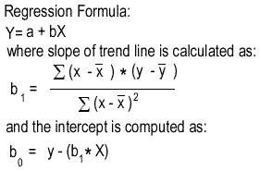
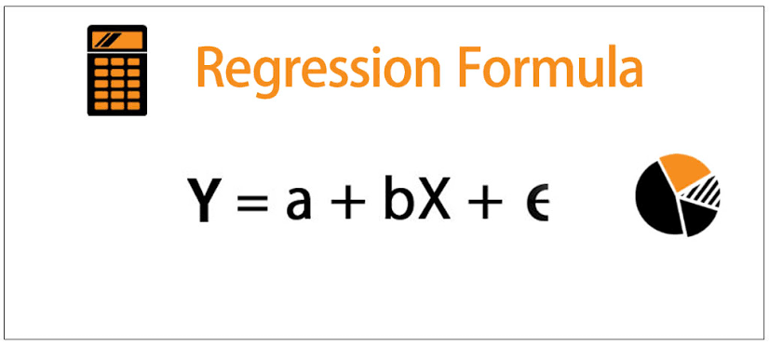

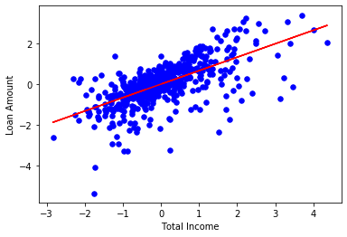
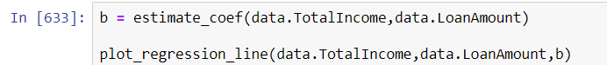
Regression
a statistical approach to find the relationship between variables
In our problem, we are going to use Simple Linear Regression.
Y=a + bx
Plotting the regression curve between Loan Amount and Total Income.
Applying the formula, we get the coefficients to be:
a = -7.591214173554817e-16
b = 0.6626313083498345

Slide 18
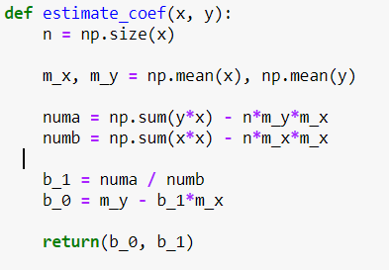
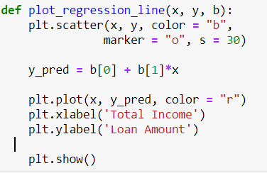

Slide 19
Hypothesis Testing

Slide 20
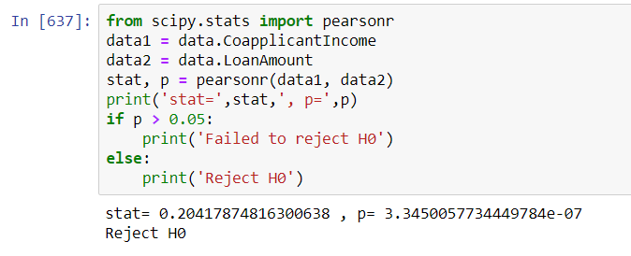
H0 : Loan Amount and Co applicant Income are Independent
Using Pearson's correlation test
We find that the p-value < 0.05, So we can reject the hypothesis.
Co applicant Income and Loan Amount are correlated

Slide 21
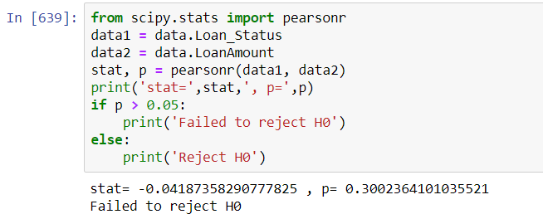
H0 : Loan Amount and Loan Status are Independent
Using Pearson's correlation test
We find that the p-value > 0.05, So we cannot reject the hypothesis.
Loan Status and Loan Amount are probably independent

Slide 22
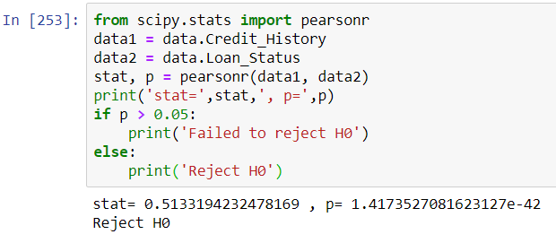
H0 : Credit History and Loan Status are Independent
Using Pearson's correlation test
We find that the p-value << 0.05, So we cannot reject the hypothesis.
Credit History and Loan Status are dependent.

Slide 23
Conclusion
Loan Amount and Total Income are linearly dependent. R=0.66
Applicant Income also forms a linear relationship with Loan Amount. R=0.43
Co applicant Income also forms a linear relationship with Loan Amount. R=0.20
Credit History affects Loan status.
Loan Status is independent of Loan Amount, so credibility does not correlate to loan taken.

Slide 24
THANK YOU

