Slide 1
Video Game Sales Analysis
Batch no: 18
Shashwath Kumar - PES2201800623
Keshav Shivkumar - PES2201800168

Slide 2
Objectives
Analyzing Genre trends by year
Analyzing Platform trends by year
Trend of PS platforms over the years
Trend of XBox platforms over the years
Competition between Microsoft and SONY
Sales in North America
Sales in Eurasia
Sales in Japan
Sales in Other countries
Deducing the factors that affect number of game sales
Predicting game sales using the different factors in every region

Slide 3
Dataset
Title : Video Game Sales
Source : https://www.kaggle.com/ashaheedq/video-games-sales-2019
Description : Analysis and prediction of Video game sales worldwide
No. of rows : 55,792
Variables involved : Name, Genre, ESRB Rating, Platform, Publisher, Developer, Critic Score, Global Sales, NA Sales, PAL Sales, JP Sales, Other Sales, Year

Slide 4
Variable Description
Name - Name of the game
Platform - Platform of the game (i.e. PC, PS4, XOne, etc.)
Genre - Genre of the game
ESRB Rating - ESRB Rating of the game
Publisher - Publisher of the game
Developer - Developer of the game
Critic Score - Critic score of the game from 10
Global Sales - Total worldwide sales (in millions)
NA Sales - Sales in North America (in millions)
PAL Sales - Sales in Europe (in millions)
JP Sales - Sales in Japan (in millions)
Other Sales - Sales in the rest of the world (in millions)
Year - Year of release of the game
No. of columns: 14

Slide 5
Approach
Data Preparation : Scraped from the website vgchartz.com. Removed columns which are unnecessary such as img_url, User score, vg chartz score. The year 2020 is also removed from the dataset.
Data Analysis : Analyzing Trend of Genre by year, Trends of platforms per Year, Trends of Playstation, Xbox and the competition between PlayStation and Microsoft. Pie Chart representation of Sales in different regions of the world.
Data Redundancy : None present

Slide 6
Literature Survey
Paper by Amar Aziz , Shuhaida Ismail , Muhammad Fakri Othman , Aida Mustapha
Empirical Analysis on Sales of Video Games - 2018
Source : https://www.researchgate.net/publication/326510277_Empirical_Analysis_on_Sales_of_Video_Games_A_Data_Mining_Approach

Slide 7
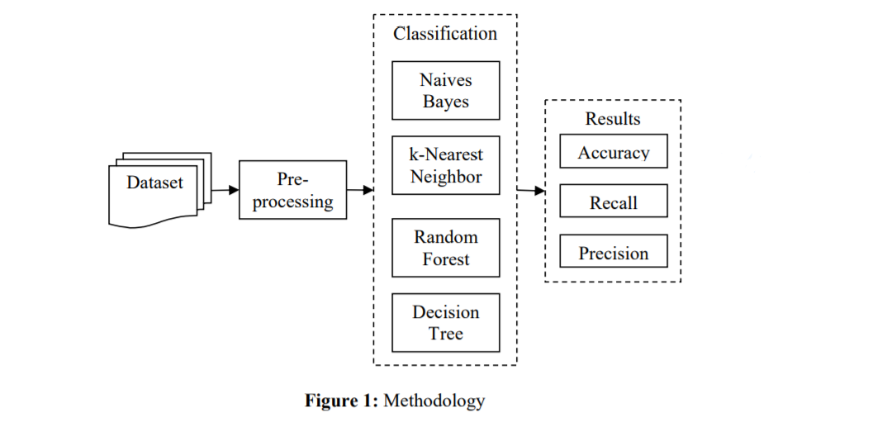
Methodology
Decision Tree is used to predict and to find the correlation between features and as before for pre-processing the dataset.
Data cleaning is performed in order to remove noise and to correct the inconsistencies existing in the data.
The next step is merging two different data sets by using data integration technique.
Classification is performed to analyse the statistical value between pair or two items.

Slide 8
Experiments
Data Pre-Processing : Data pre-processing technique that has been used in this experiment is normalization. Normalization technique is generally used to rescale the attribute values in the dataset.
Data Transformation : cross-validation technique is used to estimate the statistical performance of the learning operator and to estimate the accurate of model performance in training and testing phase.
Operators Parameters : suitable operators are chosen in order to produce the result and to fix error occurs during the experiment.
Assessment Criteria : Assessments criteria accuracy is calculated by taking the percentage of correct predictions over the total number of examples.

Slide 9
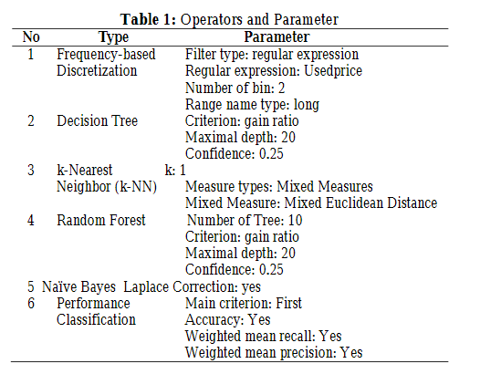
Operators and Parameters
Naïve Bayes: This technique is used to create a Bayesian model that predicts the value of a target attribute (often called class or label) based on several input attributes of the dataset.
k-Nearest Neighbor: By comparing a given test example with training examples that are similar
Random Forest: The Random Forest operator is used to generate a set of random trees.
Decision Tree: The technique used to create a classification model that predicts the value of a target attribute (often called class or label) based on several input attributes of the dataset.

Slide 10
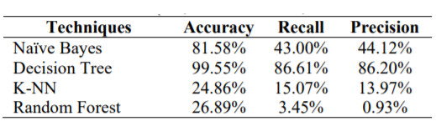
Results
The accuracy, recall and precision of the data were gathered by based on four machine learning algorithms :
Naïve Bayes
Decision Tree
k-NN
Random Forest.

Slide 11
Data Pre-processing
Removed rank, img url, vgchartz score, last update, basename from columns, user score.
If Sales have N/A remove the row.
Reduced to close to 5000 rows.

Slide 12

Data exploration

Slide 13
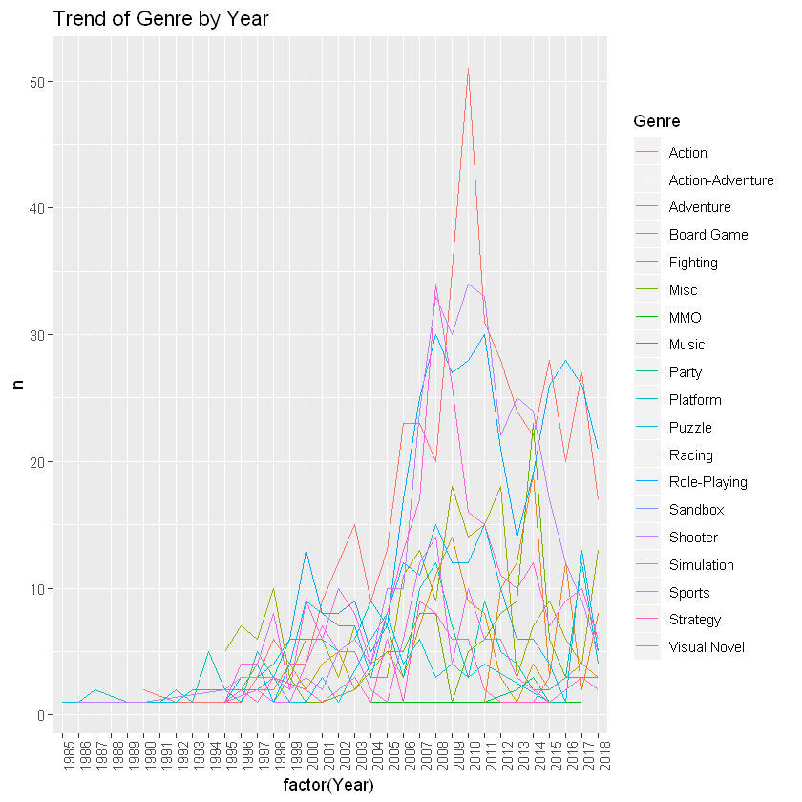
Trends of all Genres by Year
ggplot(q1, aes(x = factor(Year), y = n, colour=Genre, group=Genre)) + geom_line()+ggtitle("Trend of Genre by Year")+theme(axis.text.x = element_text(angle = 90,hjust = 1))

Slide 14
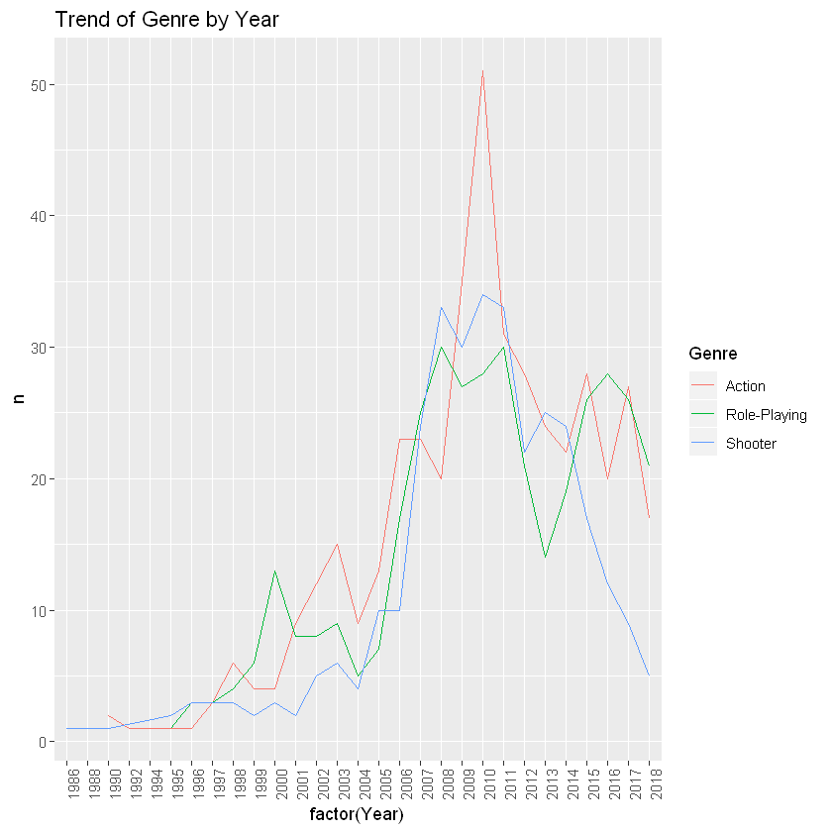
Trends of Top 3 Genres
ggplot(q1main, aes(x = factor(Year), y = n, colour=Genre, group=Genre)) + geom_line()+ggtitle("Trend of Genre by Year")+theme(axis.text.x = element_text(angle = 90,hjust = 1))

Slide 15
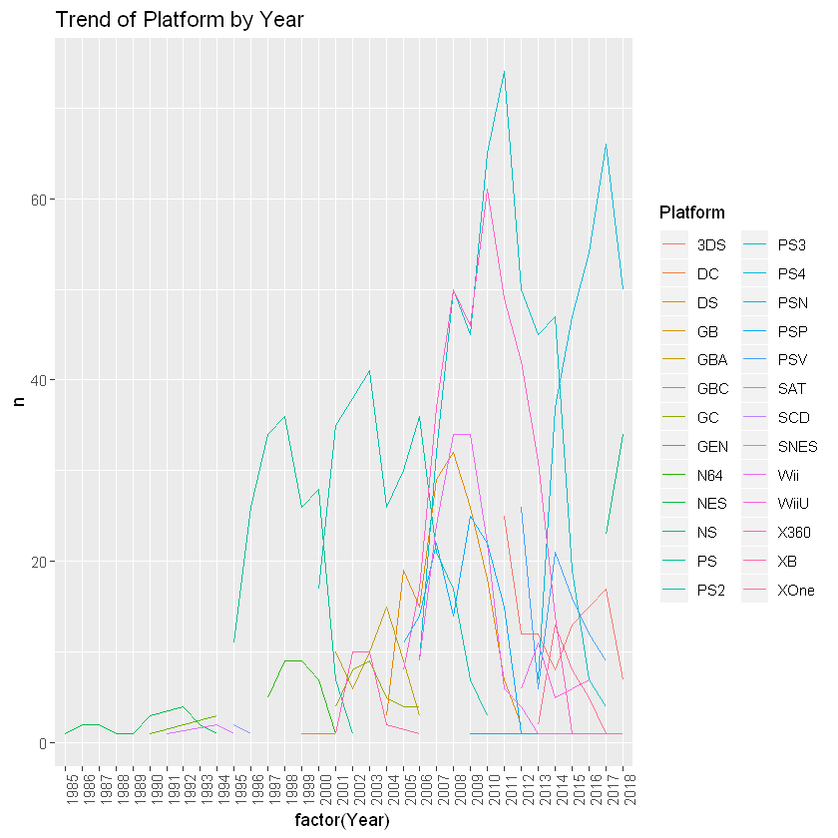
Trend of Platform by Year
ggplot(q2, aes(x = factor(Year), y = n, colour=Platform, group=Platform)) + geom_line()+ggtitle("Trend of Platform by Year")+theme(axis.text.x = element_text(angle = 90,hjust = 1))

Slide 16
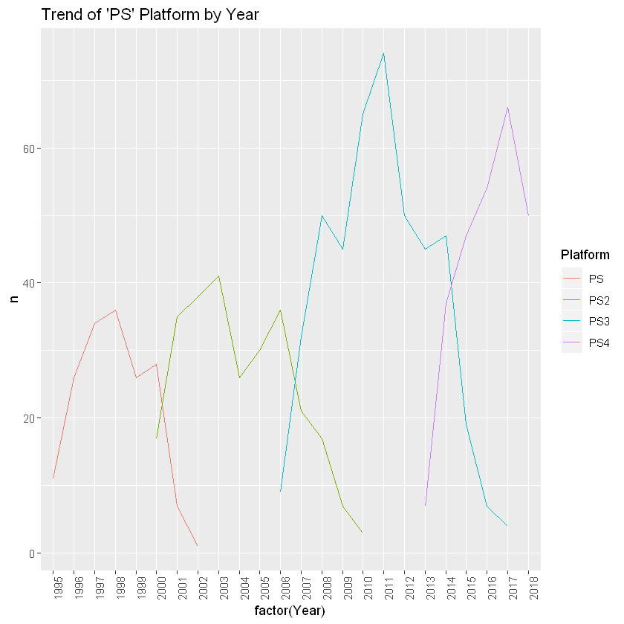
PlayStation platforms
q3_ps<-q2[q2$Platform=="PS" | q2$Platform=="PS2" | q2$Platform=="PS3"| q2$Platform=="PS4",]
ggplot(q3_ps, aes(x = factor(Year), y = n, colour=Platform, group=Platform)) + geom_line()+ggtitle("Trend of 'PS' Platform by Year")+theme(axis.text.x = element_text(angle = 90,hjust = 1))

Slide 17
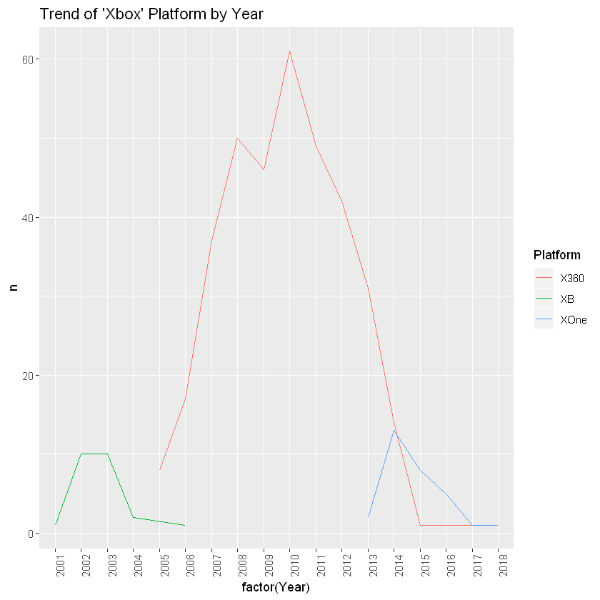
XBOX Platform
q4_xb<-q2[q2$Platform=="XB" | q2$Platform=="X360" | q2$Platform=="XOne",]
ggplot(q4_xb, aes(x = factor(Year), y = n, colour=Platform, group=Platform)) + geom_line()+ggtitle("Trend of 'Xbox' Platform by Year")+theme(axis.text.x = element_text(angle = 90,hjust = 1))

Slide 18
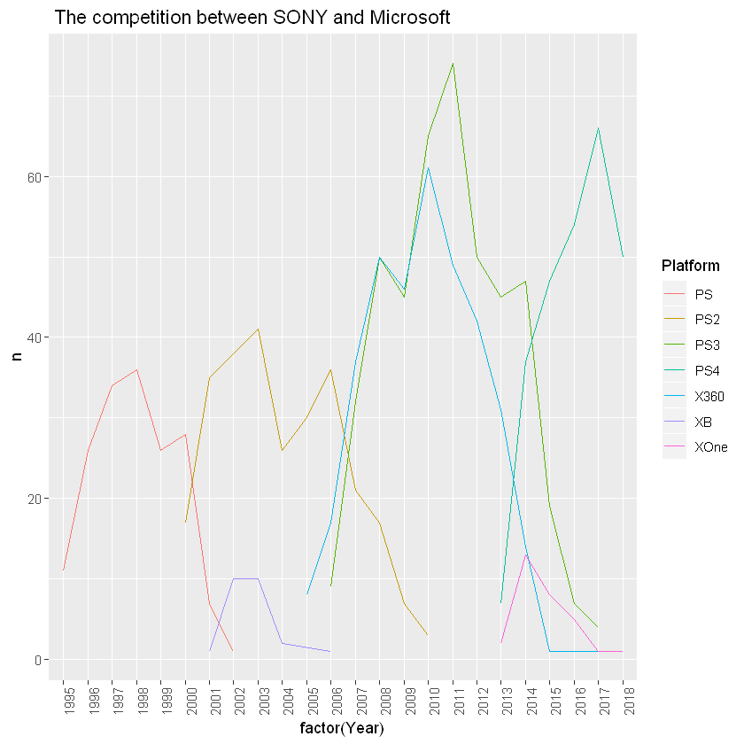
PlayStation vs XBox
q5_mix<-q2[q2$Platform=="XB" | q2$Platform=="X360"| q2$Platform=="XOne" | q2$Platform=="PS"|q2$Platform=="PS2" | q2$Platform=="PS3" | q2$Platform=="PS4" ,]
ggplot(q5_mix, aes(x = factor(Year), y = n, colour=Platform, group=Platform)) + geom_line()+ggtitle(" The competition between SONY and Microsoft")+theme(axis.text.x = element_text(angle = 90,hjust = 1))

Slide 19
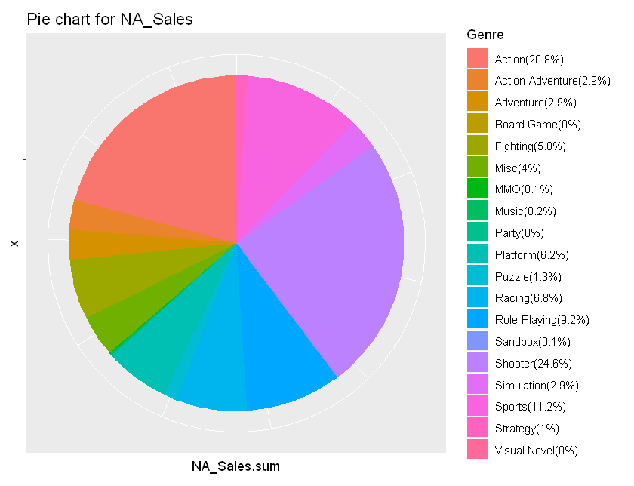
NA Sales by Genre
Action and Shooter are the most popular genres in NA
ggplot(data = sum_sale, mapping = aes(x = 'Content', y = NA_Sales.sum, fill = Genre )) + geom_bar(stat = 'identity', position = 'stack', width = 1)+ coord_polar(theta ="y") + ggtitle("Pie chart for NA_Sales")+ theme(axis.text = element_blank())+ scale_fill_discrete(labels =labelNA)

Slide 20
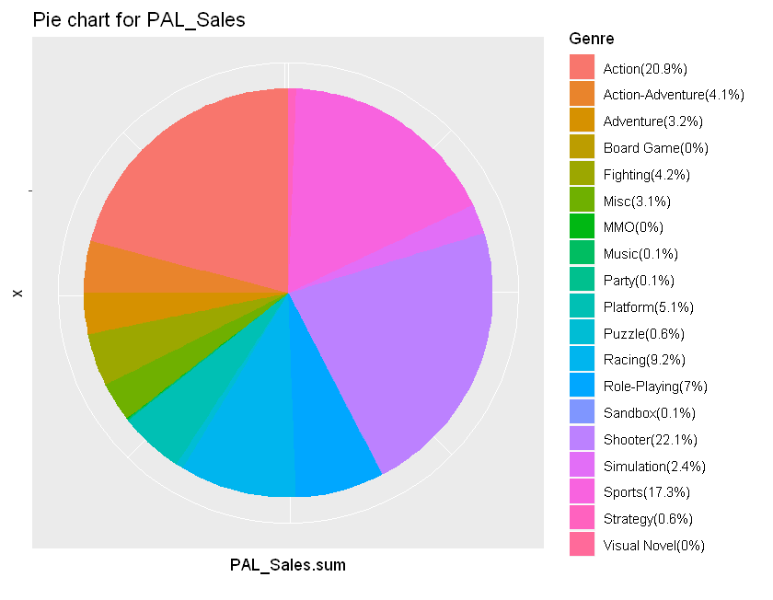
PAL Sales by Genre
Action and Shooters are the most popular genres in Eurasia
ggplot(data = sum_sale, mapping = aes(x = 'Content', y = PAL_Sales.sum, fill = Genre )) + geom_bar(stat = 'identity', position = 'stack', width = 1)+ coord_polar(theta ="y") + ggtitle("Pie chart for PAL_Sales")+ theme(axis.text = element_blank())+ scale_fill_discrete(labels =labelPAL)

Slide 21
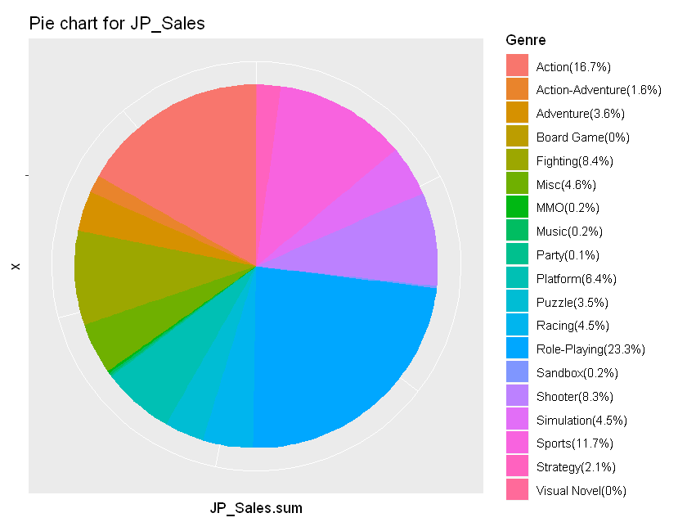
Japan Sales by Genre
Action and Role-Playing games are the most popular
ggplot(data = sum_sale, mapping = aes(x = 'Content', y = JP_Sales.sum, fill = Genre )) + geom_bar(stat = 'identity', position = 'stack', width = 1)+ coord_polar(theta ="y") + ggtitle("Pie chart for JP_Sales")+ theme(axis.text = element_blank())+ scale_fill_discrete(labels =labelJP)

Slide 22
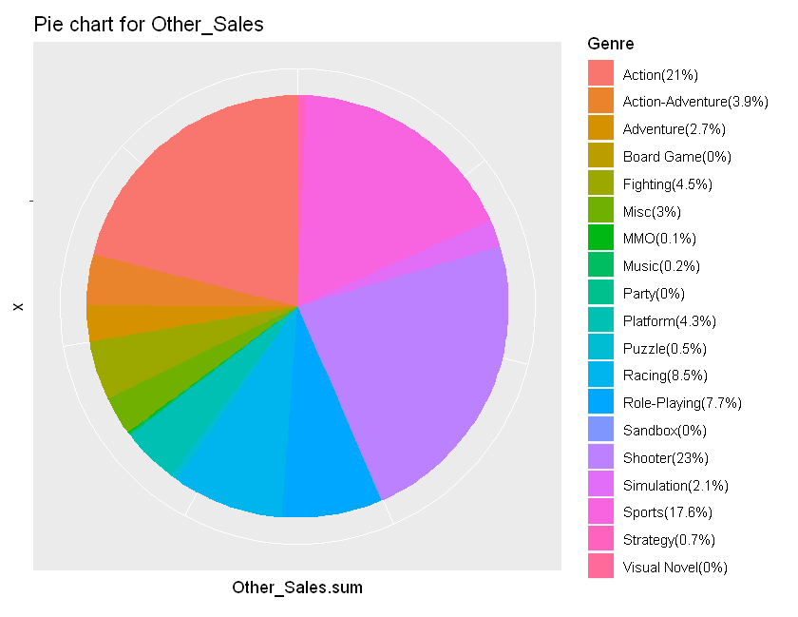
Other Sales
Action, Shooters and Sports games are the most popular
ggplot(data = sum_sale, mapping = aes(x = 'Content', y = Other_Sales.sum, fill = Genre )) + geom_bar(stat = 'identity', position = 'stack', width = 1)+ coord_polar(theta ="y") + ggtitle("Pie chart for Other_Sales")+ theme(axis.text = element_blank())+ scale_fill_discrete(labels =labelOTHER)

Slide 23
Exploratory Analysis
Action, Role-Playing and Shooter games are the most popular games Worldwide
PS3 had the most selling games for SONY
Xbox 360 had the most selling games for Microsoft
Xbox 360 was the best competitor to the same gen PS platforms
Action and Shooters are popular among the world. But, in Japan role-playing games are much more popular than action and shooter games.

Slide 24
Data Prediction and Regression

Slide 25
Linear Regression model
The majority of video games were not selling well, and their data fits the linear regression model very well.
The data of best-selling games(Super Mario, Call of Duty, etc.) doesn’t fit the model well.
When sales is big enough, sales variable itself is also an influential factor to regression model. Finally, we used square rooted sales as a transform of response Y thus eliminate the error due to butterfly effect.
The higher R-square presents a better fitting model.

Slide 26
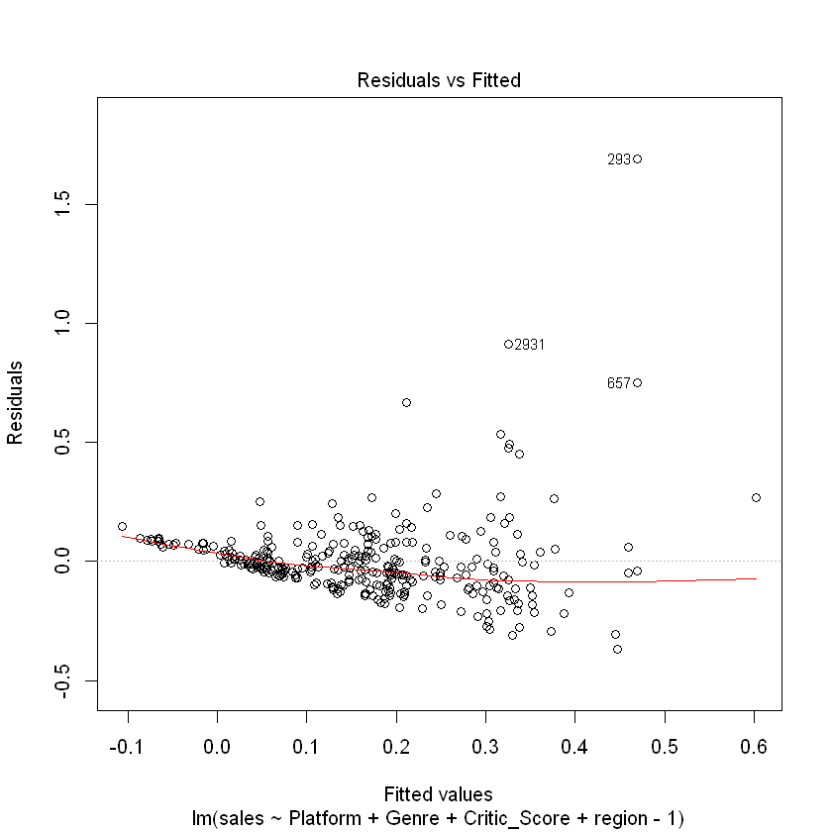
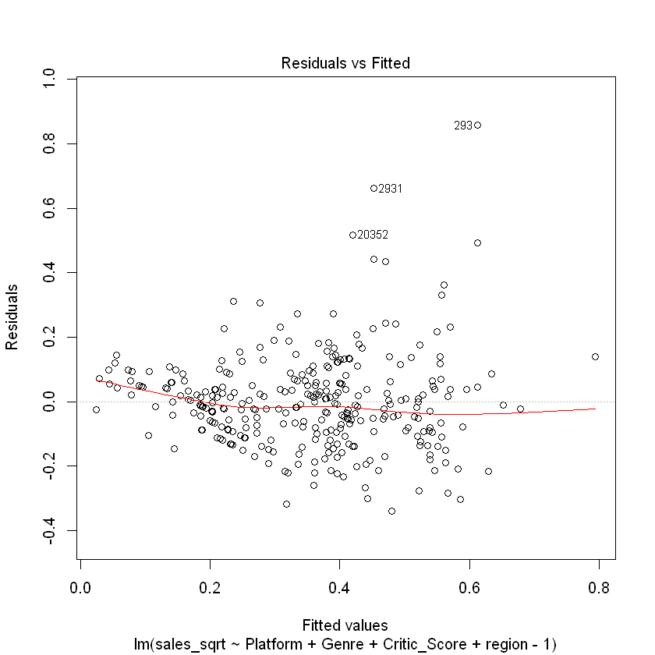
Residuals vs FITTED
A residual is the difference between the observed value of the dependent variable (y) and the predicted value (ŷ).
new_video_nintendo_training$sales_sqrt <- sqrt(new_video_nintendo_training$sales)
new_video_nintendo_test$sales_sqrt <- sqrt(new_video_nintendo_test$sales)
lm1 <- lm(sales~Platform+Genre+Critic_Score+region-1,data=new_video_nintendo_training)
lm2 <- lm(sales_sqrt~Platform+Genre+Critic_Score+region-1,data=new_video_nintendo_training)

Slide 27
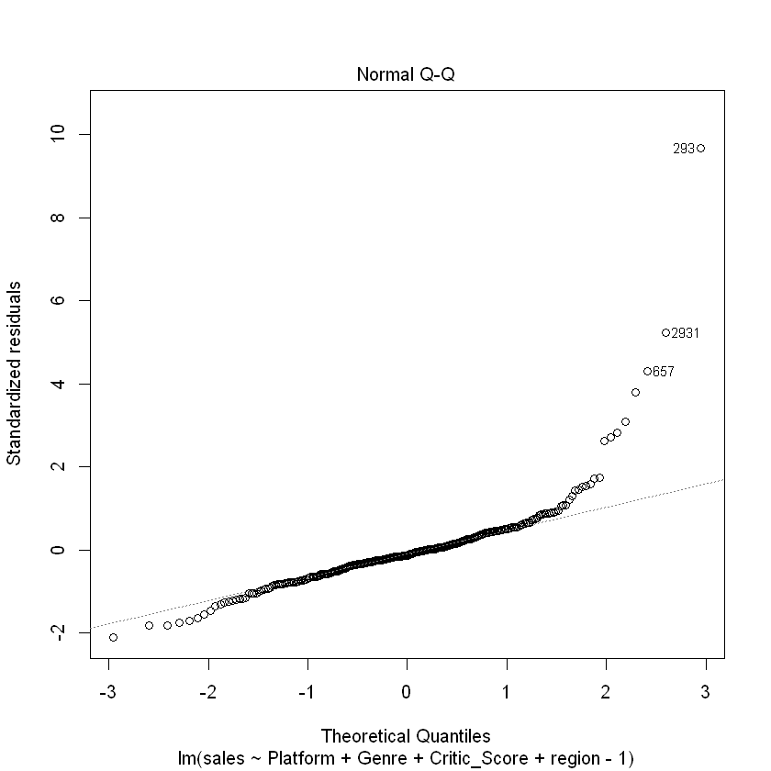
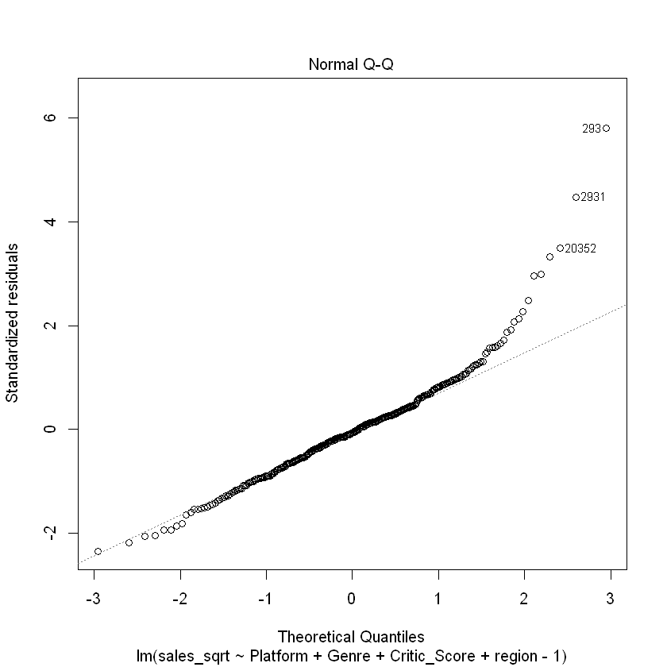
Q-Q Plot
A Q-Q plot is a scatterplot created by plotting two sets of quantiles against one another.

Slide 28
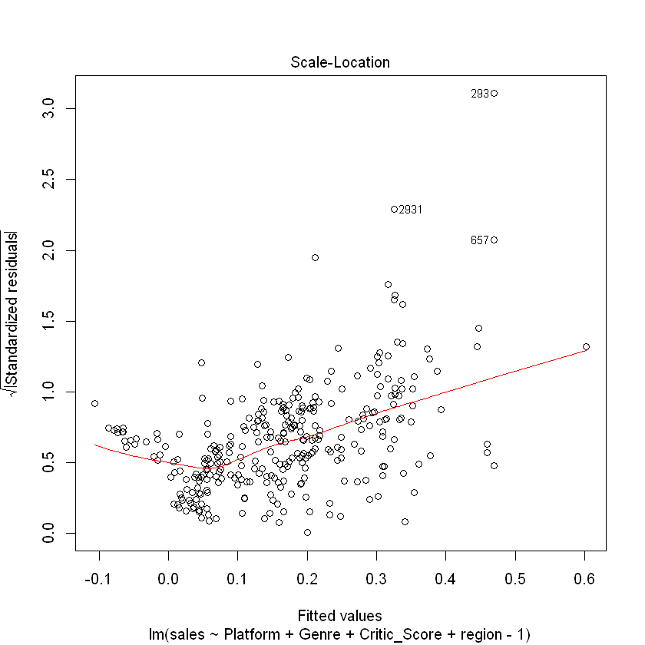
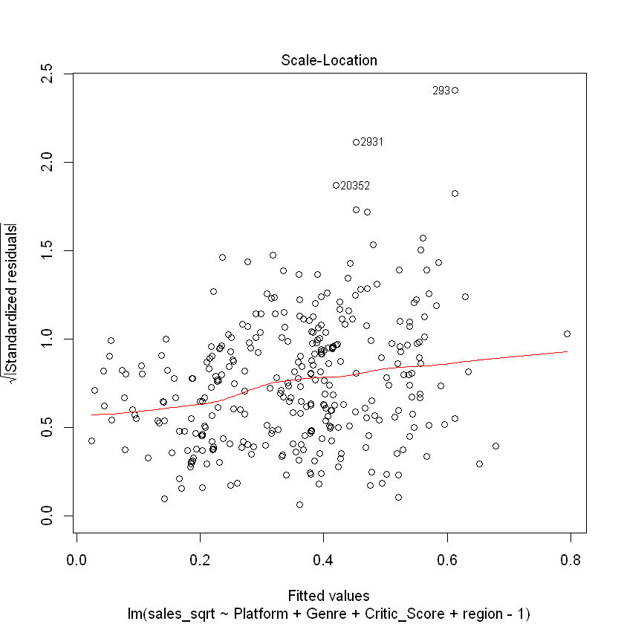
Scale Location
This plot shows if residuals are spread equally along the ranges of predictors

Slide 29
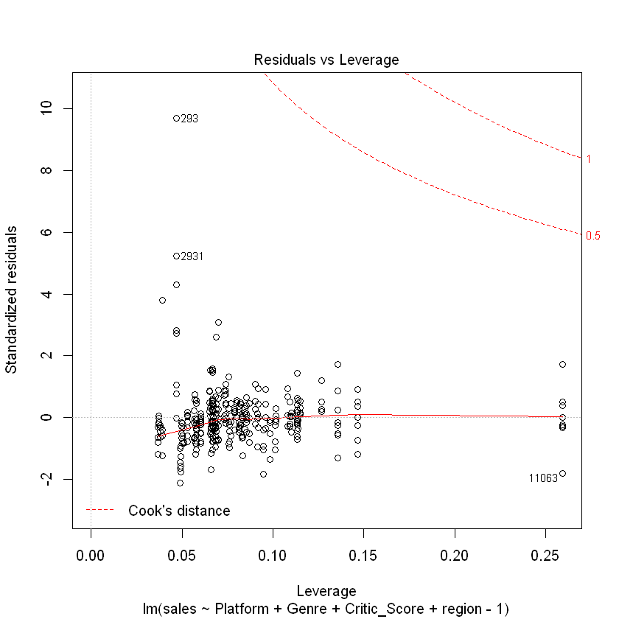
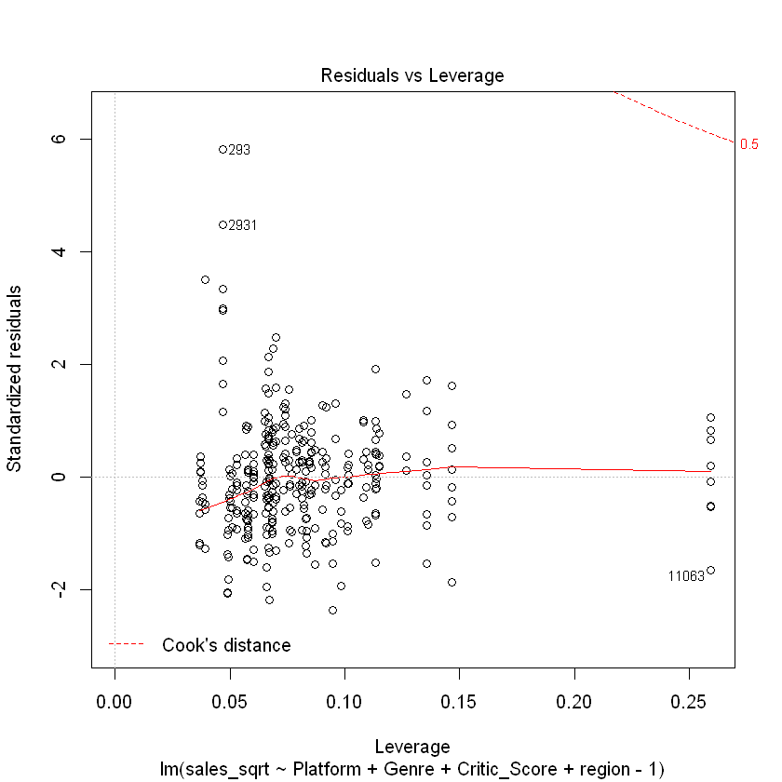
Residuals vs Leverage
The Residuals vs. Leverage plots helps you identify influential data points on your model

Slide 30
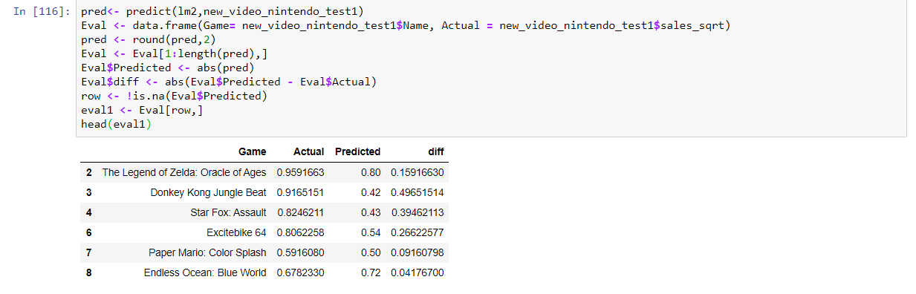

Prediction
We use lm2 to predict values and find the RMSE values, which predicts how far off the predicted values are to the observed values.
We get RMSE value to be 0.14

Slide 31
Hypothesis Testing

Slide 32

H0 : NA_sales does not depend on Genre
fit <- lm( NA_Sales ~ Genre , data = vgsales)
summary(fit)
We find that the p-value < 0.05, So we can reject the hypothesis.
North American sales depends on the genre of the game.

Slide 33

H0 : PAL_sales does not depend on Genre
fit <- lm( PAL_Sales ~ Genre , data = vgsales)
summary(fit)
We find that the p-value < 0.05, So we can reject the hypothesis.
European sales depends on the genre of the game.

Slide 34

H0 : JP_sales does not depend on Genre
fit <- lm(JP_Sales ~ Genre , data = vgsales)
summary(fit)
We find that the p-value < 0.05, So we can reject the hypothesis.
Japanian sales depends on the genre of the game.

Slide 35
Conclusion
The majority of video games were not selling well, and their data fits the linear regression model very well.
The data of best-selling games(Super Mario, Call of Duty, etc.) doesn’t fit the model well.
When sales is big enough, sales variable itself is also an influential factor to regression model.
Finally, we used square rooted sales as a transform of response Y thus eliminate the error due to butterfly effect. The higher R-square presents a better fitting model.
Lm2 has a R-Squared value of 0.8621 compared to lm1 with 0.5519

Slide 36
THANK YOU

